Slide 1

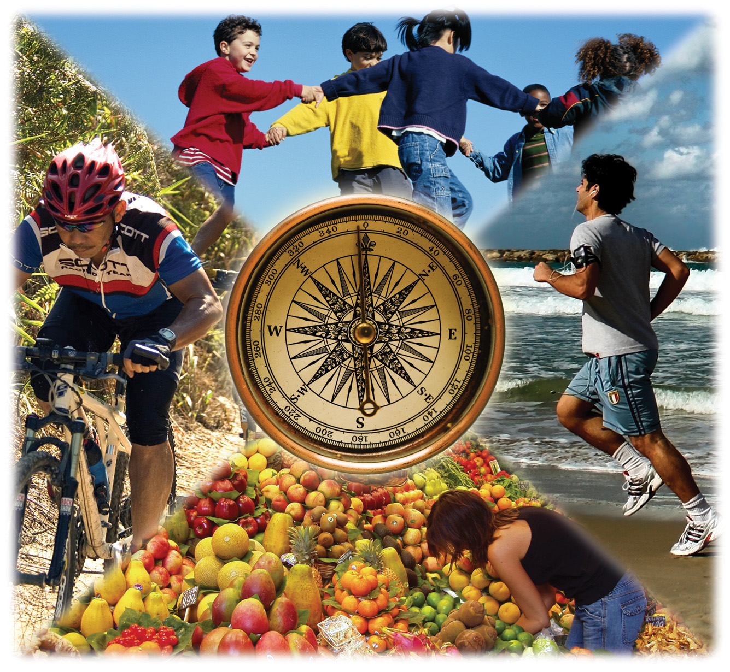
Welcome to the
Resident Leadership Academy!
ORIENTATION
SESSION ONE
Session objectives:
1. Introduce sessions for RLA.
2. Review trends in obesity and obesity-related chronic diseases in the US.
3. Examine our neighborhoods and identify possible health outcomes.
4. Discuss possible strategies.
1
Notes:
Welcome to the Resident Leadership Academy
The Resident Leadership Academy (RLA) is an effort initiated in San Diego County that is designed to engage and support community members like you in creating better, healthier neighborhoods. Congratulations on being part of the solution. The basic concept behind the RLA is to engage residents in activities and knowledge that can lead to healthier neighborhood environments. RLA participants will learn ways to involve local grassroots networks in community improvement projects.
Throughout this RLA program, you will gain knowledge and skills to address the following topics:
How to strengthen social networks within your neighborhoods
Ways in which social and environmental factors play a role in shaping lives
How neighborhood design and safety influence walking and other forms of activity
How healthy food systems can be created
Ways to plan and implement neighborhood projects that improve quality of life and support healthy living
Ways to interact with decision-makers and other key partners to achieve improvements in your neighborhood.
As you participate in the RLA, you will work with the whole group to create and implement one or more Community Improvement Projects (CIP). The CIP will enable you to gain experience in carrying out projects that result in positive neighborhood changes. This curriculum is designed to help support the group’s efforts as well as build leadership skills for future community improvement projects.
BENEFITS OF THE RESIDENT LEADERSHIP ACADEMY
Participants will increase their knowledge and skills, expand their social networks, and enjoy better neighborhood environments
Communities will experience positive changes in local environments that enhance quality of life for healthy and happy neighborhoods
Health outcomes will improve for San Diego residents and the overall costs of health care will be reduced.
Session Objectives:
1. Review RLA learning sessions for the Resident Leadership Academy including support for a Community Improvement Project.
2. Review trends in obesity and obesity-related chronic diseases in the US and understand how rates differ based on culture, income, and place.
3. Examine environment and health outcomes at the neighborhood scale and establish the case for environmental prevention strategies in high-need communities.

Slide 2
AGENDA
SESSION 1: WELCOME
INTRODUCTIONS
OBESITY AS PUBLIC HEALTH CRISIS
INTERACTIVE ACTIVITY
Community Photos: What’s Wrong With This Picture?
ADDRESSING CHRONIC DISEASE EFFECTIVELY
CONCLUSION
2
Notes:
Agenda
Welcome - Resident Leadership Academy Background
Introductions - Resident Leadership Academy Vision
Obesity as Public Health Crisis
- Building Better Health
- Trends of Obesity & Obesity-Related Disease
- Addressing Obesity and Supporting All Individuals
Interactive Activity - What’s Wrong With This Picture? (Instructions located in Facilitator’s Manual only)
Addressing Chronic Disease Effectively
Conclusion

Slide 3
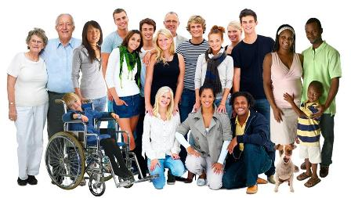
LIVE WELL SAN DIEGO
County of San Diego
3
Notes:
In 2010, the Board of Supervisors adopted a comprehensive initiative called Live Well San Diego. This long-term plan to advance the health, safety and overall well-being of the region is being built with community involvement in three parts.
The first component – Building Better Health – was adopted on July 13, 2010. Building Better Health calls for improving the health of all residents and supporting healthy choices
The second component – Living Safely – was adopted on October 9, 2012. Living Safely calls for ensuring residents are protected from crime and abuse, neighborhoods are safe and communities are resilient to disasters and emergencies
Because living well goes beyond health and safety, a third phase – Thriving –currently under development, calls for promoting a region in which residents can enjoy the highest quality of life

Slide 4
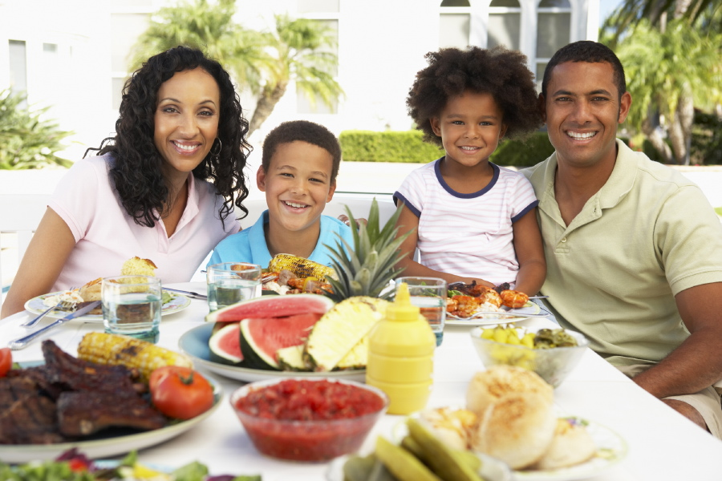
“BUILDING BETTER HEALTH”
Key Themes:
Build a Better System
Support Healthy Choices
Pursue Policy Changes for a Healthy Environment
Change the Culture from Within
4
Notes:
Live Well San Diego is San Diego County’s long-term initiative to achieve the vision of healthy, safe and thriving communities. Live Well San Diego involves everyone. Only through a collective effort—in which all of us work together toward a shared purpose—can meaningful change be achieved in a region as large and diverse as San Diego County.
The County has adopted four approaches for realizing the Live Well San Diego vision:
Building a Better Service Delivery System - Improve the quality and efficiency of County government and its partners in the delivery of services to residents, contributing to better outcomes for clients and results for communities.
Supporting Healthy Choices - Provide information and resources to inspire county residents to take action and responsibility for their health, safety and well-being.
Pursuing Pursue Policy and Environmental Changes - Create environments and adopt policies that make it easier for everyone to live well, and encourage all individuals to get involved in improving their communities.
Changing Change the culture from within - Increase understanding among County employees and providers about what it means to Live Well and the role that all employees play in helping county residents Live Well

Slide 5
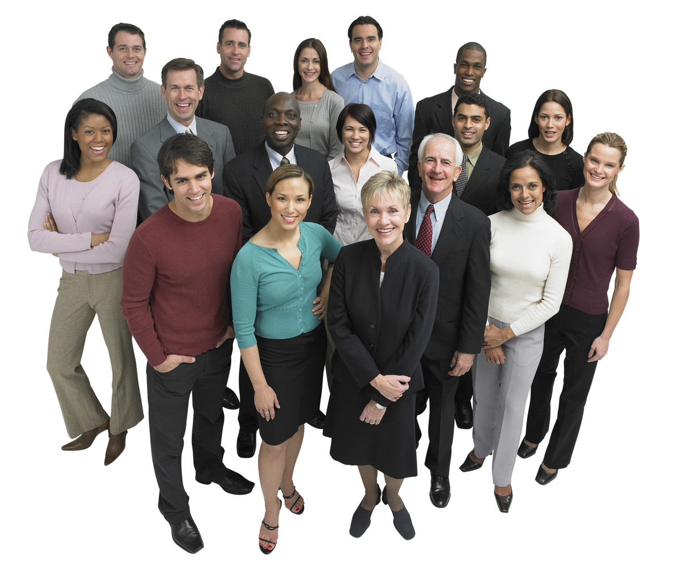
INTRODUCTION
We’ve met:
Facilitators
Community Health Promotion Staff
Now Let’s Meet Each Other…
5
Notes:
See next slide for instructions.
5

Slide 6

INTRODUCTIONS
Share your name.
How long have you:
  Lived
  Worked or
  Been connected
  to this community?
One thing you like about your neighborhood and one thing you’d like to improve.
6
Notes:
Facilitator can take notes of “One thing you like” and “One thing you’d like to improve” on white board, which can lead to future Community Improvement Projects.
This can be structured as an ice-breaker.
Additional feedback on expectations of facilitators and participants can be given.

Slide 7

RLA TRAINING MODULES
SESSION 1: ORIENTATION
SESSION 2: COMMUNITY BUILDING PRINCIPLES
SESSION 3: SOCIAL DETERMINANTS OF HEALTH
SESSION 4: SAFE, WALKABLE COMMUNITIES
SESSION 5: HEALTHY FOOD SYSTEMS
SESSION 6: LAND USE & COMMUNITY PLANNING
SESSION 7: LEADERSHIP, ADVOCACY & POLICY DEVELOPMENT
SESSION 8: COMMUNITY IMPROVEMENT PROJECT (CIP) NEEDS & ASSESSMENT
SESSION 9: CIP PLANNING & IMPLEMENTATION
SESSION 10: CIP IMPLEMENTATION, EVALUATION & CELEBRATION
7
Notes:
Review Sessions 1-7. Explain that last three sessions are to develop the CIP plan for their community.

Slide 8
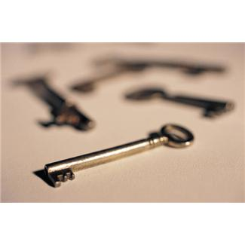
What do we need to build an effective team?
OPEN DISCUSSION
What key things do each of us need in order to build working relationships that are UNITED and based on TRUST?
8
Notes:
Ask group for ideas on how to work best together.
Some possible ideas to add to the conversation:
Reach out to outside entities
Agree to disagree sometimes
Work collaboratively to get projects completed – Teamwork
Speak respectfully to one another
Listen to each other’s perspective
Focus on team results rather than individual accolades/honors
Avoid any public confrontation and/or ridicule
Speak positively and respectfully to all community members/leaders
Identify, appreciate, and acknowledge each other’s skills and strengths
Make room for everyone for everyone to contribute their thoughts and questions.

Slide 9
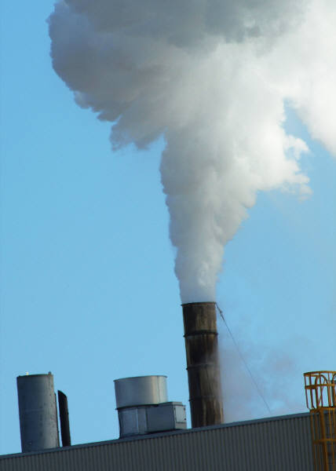
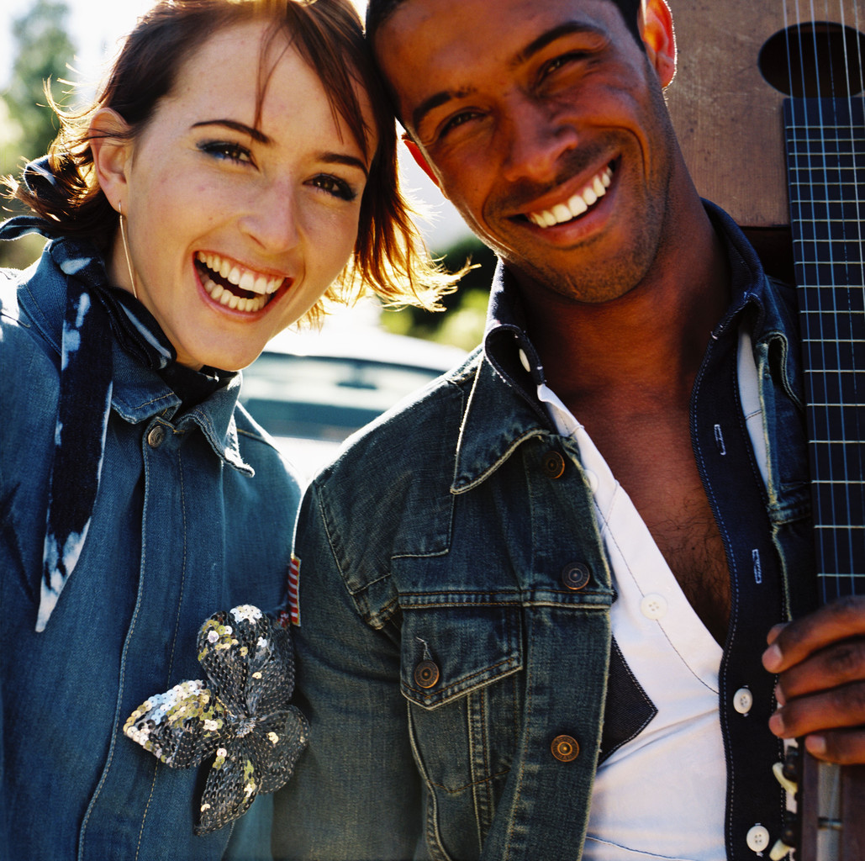
HOW MUCH Is poor health caused by individual choices or by the environment around us?
OPEN DISCUSSION
Individual choice or Environment
1 2 3 4 5 6 7 8 9 10
9
Notes:
How much does our individual lifestyle affect our health compared to our neighborhood environment?
Pick a whole number on the scale that represents what you think.

Slide 10
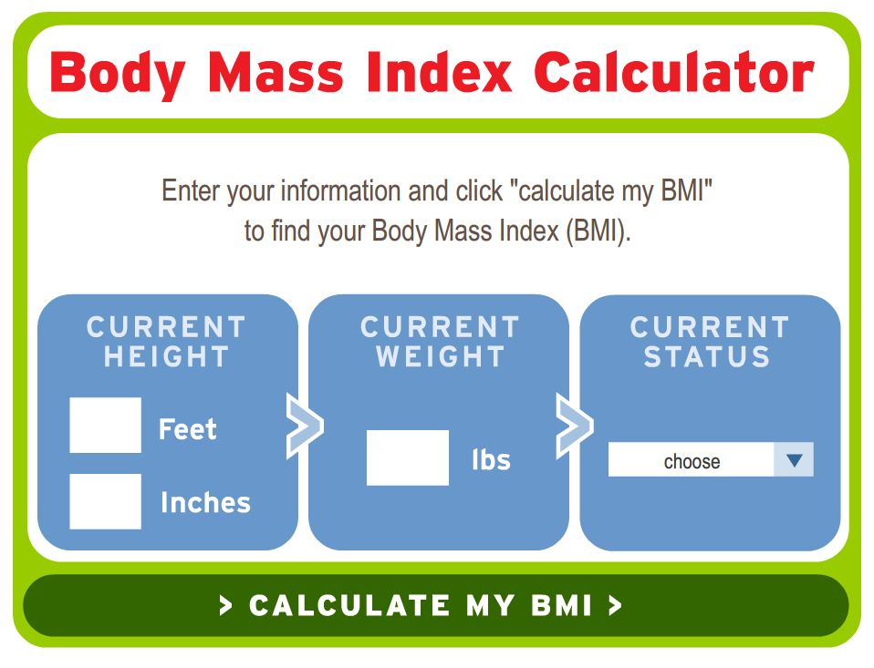
BODY MASS INDEX
Notes:
Obesity has become a Public Health Crisis in this Country –
Definitions:
Obesity: Body Mass Index (BMI) of 30 or higher
Body Mass Index (BMI): A measure of an adult’s weight in relation to his or her height, specifically the adult’s weight divided by the square of his or her height.
In the past 30 years, the obesity rates in this country have grown for children, teens and adults. More than 33% of kids and almost 70% of adults in the U.S. are overweight or obese. The alarming rate of growth in obesity rates over the past 30 years has raised concern due to the impact this has on healthcare costs, workplace productivity, and quality of life.
Source for calculator:
http://www.heart.org/HEARTORG/GettingHealthy/WeightManagement/BodyMassIndex/Body-Mass-Index-In-Adults-BMI-Calculator-for-Adults_UCM_307849_Article.jsp

Slide 11
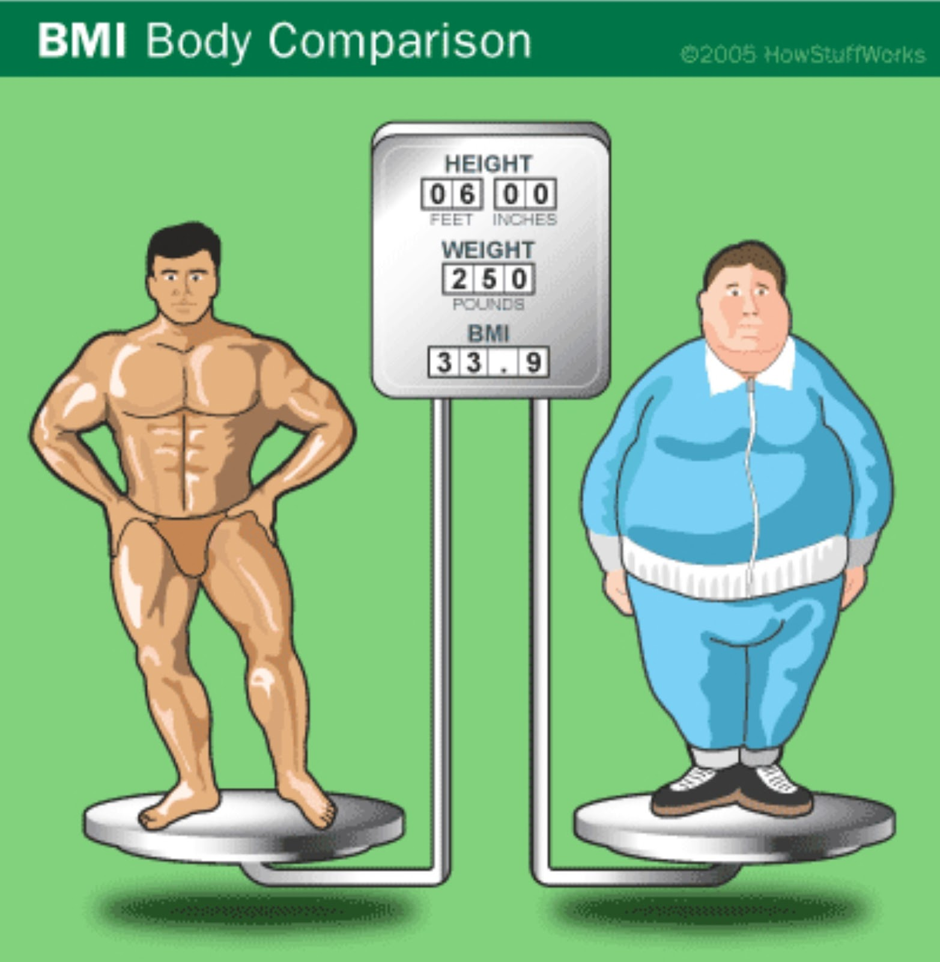
IS BMI AN ACCURATE MEASURE OF OBESITY?
11
Notes:
Is BMI an Accurate Measure of Obesity?
It's important to note that although Body Mass Index (BMI) is accurate most of the time, it may overestimate or underestimate body fat. For example, BMI doesn't distinguish between body fat and muscle mass, which weighs more than fat.
Many NFL players have been labeled "obese" because of their high BMI, when they actually have a low percentage of body fat.
The BMI is not always accurate in elderly adults, who have often lost muscle and bone mass. Although their BMI might be within a normal range, they could still be overweight. BMI may also relate differently to various ethnic groups. For example, Asians may be at risk for health problems at a lower BMI than Caucasians.
Because of the possibility for error, BMI should be just one of many gauges used to assess a person's weight status and health. The National Institutes of Health (NIH) recommends that doctors assess whether their patients are overweight based on three factors:
* Body Mass Index (BMI)
* Waist circumference - a measurement of abdominal fat
* Risk factors for diseases associated with obesity, such as high blood pressure, high LDL ("bad") cholesterol, low HDL ("good") cholesterol, high blood sugar, and smoking
Many health experts say that body fat percentage is a better indicator of weight status than BMI. But body fat isn't always as easy, or as inexpensive, to measure. Tests such as skin-fold measurements (in which a technician pinches a fold of skin on the patient's body to measure the subcutaneous fat layer just beneath the skin), dual energy X-ray absorptiometry (DEXA, which measures bone density), or bioelectrical impedance (which measures the opposition to a flow of electric current through the body -- impedance is low in lean tissue and high in fat tissue) are more precise, but they must be done by a trained medical professional.
Next, we'll learn about the history of BMI. http://health.howstuffworks.com/wellness/diet-fitness/weight-loss/bmi4.htm
Source: http://health.howstuffworks.com/wellness/diet-fitness/weight-loss/bmi3.htm

Slide 12
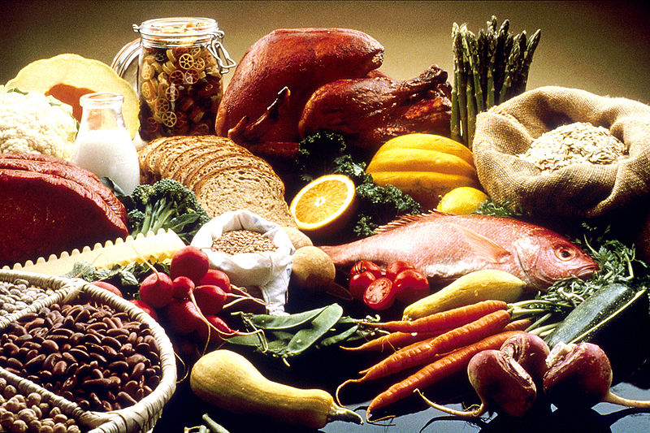
HOW TO TALK ABOUT WEIGHT
12
Notes:
In the next few slides, we are going to talk a lot about obesity, or unhealthy weight gain, and how it is a problem in the United States. We want to remind everyone, however, that many people struggle with weight gain, and the diseases associated with weight gain. Often times people who are overweight and obese are discriminated against. And research show that children who are teased about their weight by their parents are often driven to extreme dieting, taking laxatives, or purging. This sometimes leads to serious illness or death, and often times to even more unhealthy weight.
We talk about overweight and obesity because they are connected to serious health issues. But we want to be mindful that we do not want to single out any one person for being “fat” or “chubby” or tease them about their weight or what their body looks like. In the RLA, we are focused on how our neighborhoods and communities influence our health. But when we think about or interact with family or friends, please keep in mind that instead of talking about needing to lose weight, it’s more productive to talk about and support healthy behaviors.
For more information:
http://www.csmonitor.com/The-Culture/Family/Modern-Parenthood/2013/0625/How-to-talk-about-obesity-and-weight-loss-with-your-teen
http://www.startribune.com/lifestyle/health/212853321.html

Slide 13

13 states had obesity rates of <10%
8 states had obesity rates of <15%
OBESITY TRENDS AMONG U.S. ADULTS IN 1985
No Data <10% 10%–14%
Source: Behavioral Risk Factor Surveillance System, CDC.
13
Notes:
Even for those individuals in the audience who have seen these slides before, they present a compelling argument for the need to act.
The maps present the per cent of obese adults in all states – with darker blues representing higher rates of obesity.
25 years ago, there were only a few states in which greater than 10% of the adult population was obese.
Watch as the percent of obese adults increases in every state.
Higher obesity rates were initially clustered regionally in the Mid West and South – but the higher rates have quickly spread across the country.
In 1997, additional colors had to be added to the maps because of the continued increase in obesity.

Slide 14
10 states had obesity rates of <10% and
0 states had obesity rates ≥ 15%
OBESITY TRENDS AMONG U.S. ADULTS IN 1990
No Data <10% 10%–14%
Source: Behavioral Risk Factor Surveillance System, CDC.
10

Slide 15
OBESITY TRENDS AMONG U.S. ADULTS IN 1995
No Data <10% 10%–14% 15%–19%
Source: Behavioral Risk Factor Surveillance System, CDC.
15

Slide 16
0 states had obesity rates of <10%,
27 states had obesity rates between 15-19%, and
22 states had obesity rates ≥ 20%
OBESITY TRENDS AMONG U.S. ADULTS IN 2000
Source: Behavioral Risk Factor Surveillance System, CDC.
No Data <10% 10%–14% 15%–19% ≥20%
16

Slide 17
OBESITY TRENDS AMONG U.S. ADULTS IN 2005
Source: Behavioral Risk Factor Surveillance System, CDC.
No Data <10% 10%–14% 15%–19% 20%–24% 25%–29% ≥30%
17
Notes:
17

Slide 18
  Only 1 state (Colorado) had obesity rates of <20%.
  9 states had obesity rates ≥ 30%
OBESITY TRENDS AMONG U.S. ADULTS IN 2009
Source: Behavioral Risk Factor Surveillance System, CDC.
No Data <10% 10%–14% 15%–19% 20%–24% 25%–29% ≥30%
18
Notes:
18
In 2009, only a single state, Colorado, remained with the percent of obese adults under 20%.
This incredible increase in obesity represents more than individuals’ unhealthy choices – but rather shows the effect of environmental influences on our behavior.

Slide 19
OBESITY TRENDS
Why have Obesity Rates increased so dramatically in the past 20 years?
1990
1999
2009
No Data <10% 10%–14% 15%–19% 20%–24% 25%–29% ≥30%
19
Notes:
According to the CDC, “Rising rates of obesity seem to be a consequence of modern life, with access to large amounts of palatable, high calorie food and limited need for physical activity.”

Slide 20

FOOD, INC
Watch video clip from
Food, Inc.
20
Notes:
This video exposes how our nation’s food supply is now controlled by a handful of corporations that often put profits ahead of consumer health, the livelihood of the US farmer, and the safety of workers and the environment.
[Check instructor manual for video segment.]

Slide 21
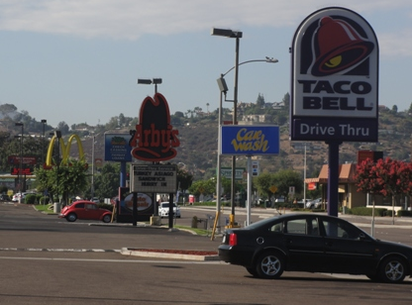
21
Notes:
Are there fast food chains like this in your neighborhood? Why do people like to eat at these places?
[These pictures are from El Cajon. Consider adding pictures from your community.]

Slide 22
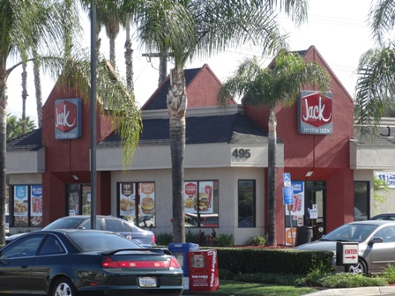
22
Notes:
Most fast food restaurants provide drive-thru options so a person does not even have expend any energy to get out of his/her car and walk into a restaurant to obtain calorie-laden food.

Slide 23
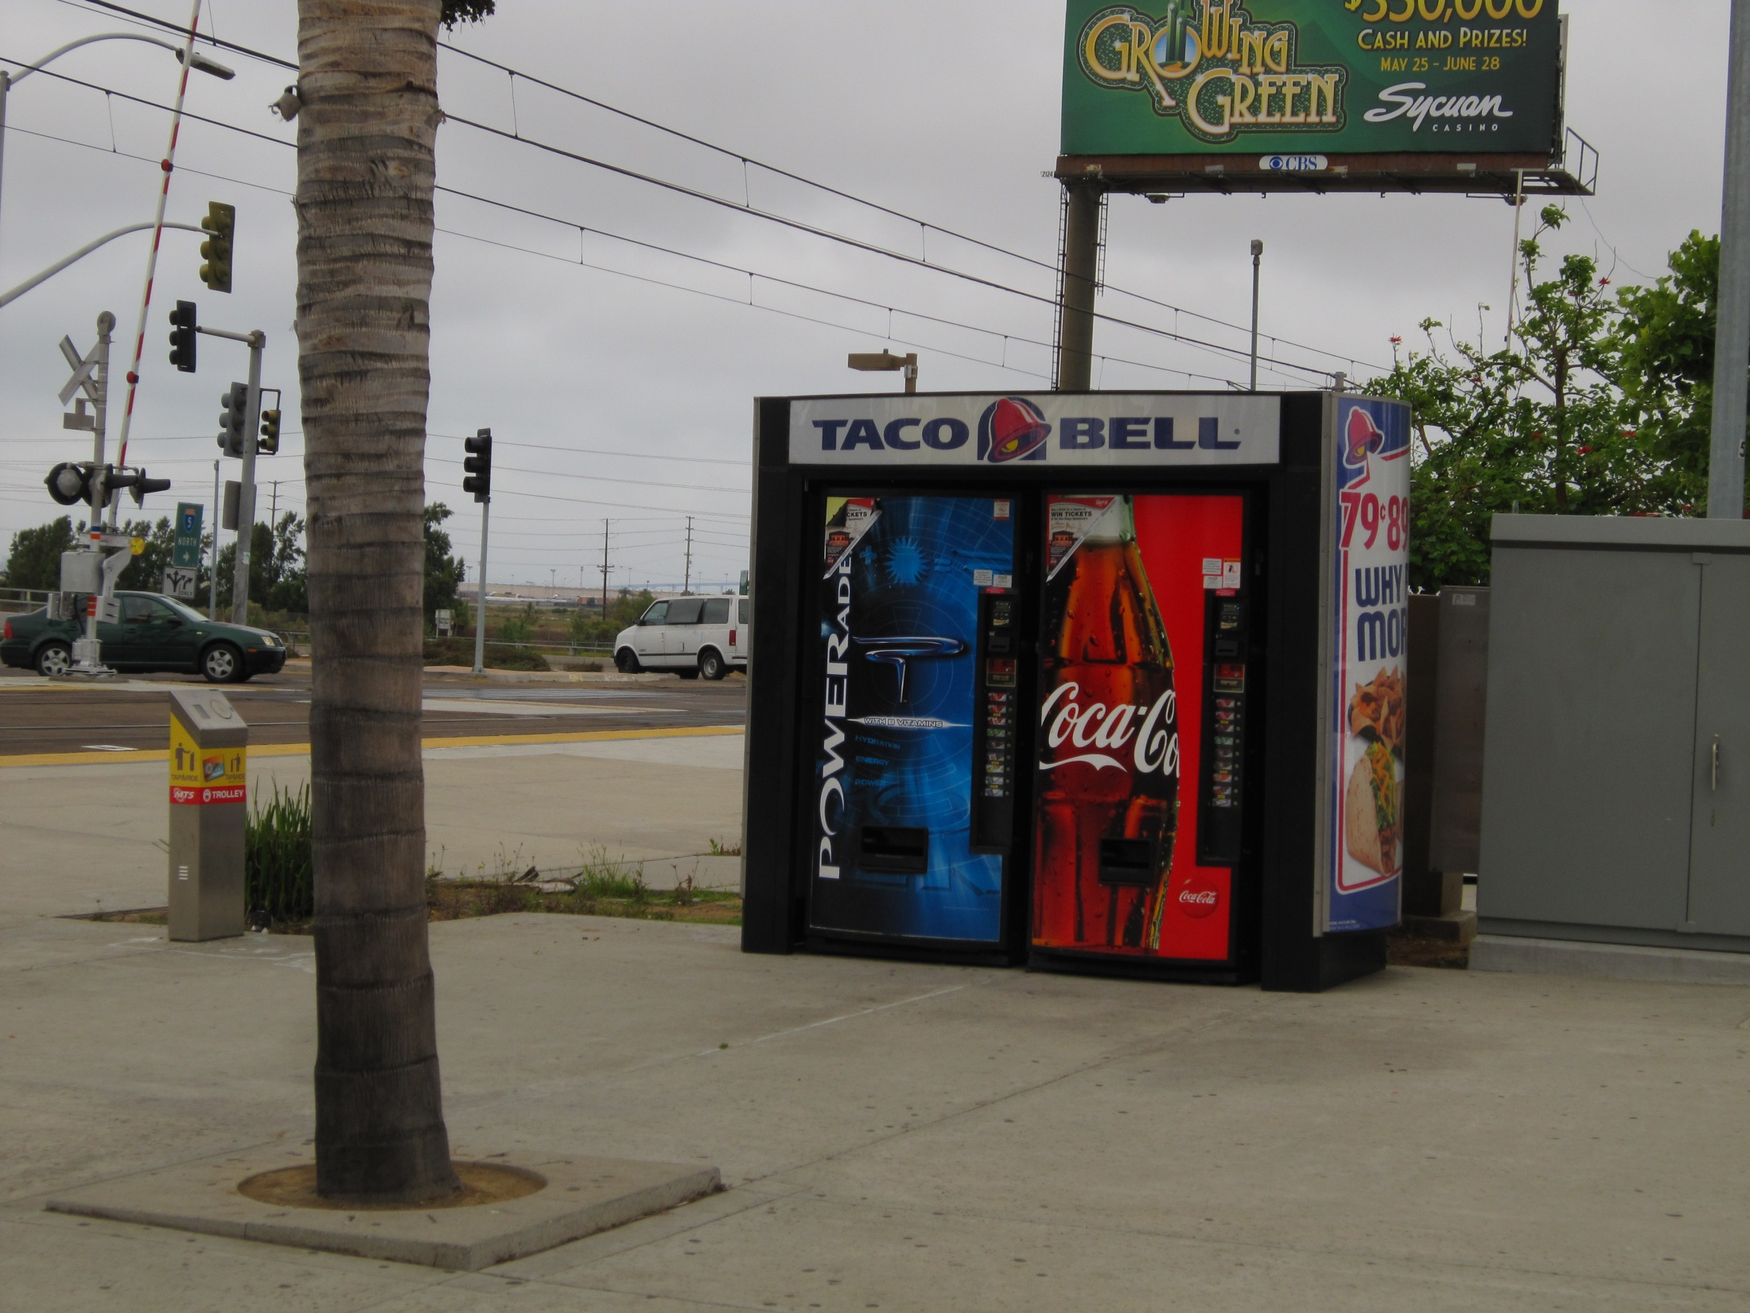
23
Notes:
Sugary sodas and other unhealthy soft drinks are readily available along walking routes when a water fountain would be a more healthy choice.

Slide 24
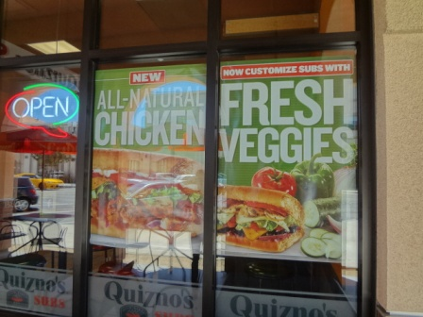
24
Notes:
Some fast food restaurants offer healthy alternatives with lean meats and fresh vegetables. Healthier choices are typically more expensive. The “Dollar Menu” does not usually have healthy choices.

Slide 25
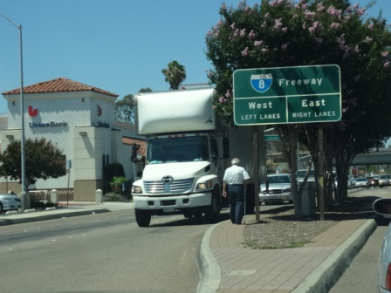
Notes:
Our car-based street system makes it difficult to cross the street for those who are walking.
[Add an example of poor walkability from your community or take pictures from Module 4.]

Slide 26
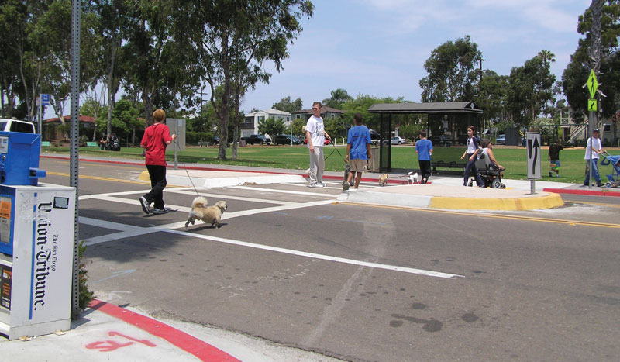
Notes:
A clearly marked crosswalk that is easy to see for cars and pedestrian makes it safer to cross the street.

Slide 27
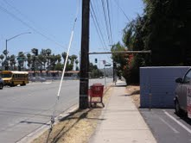
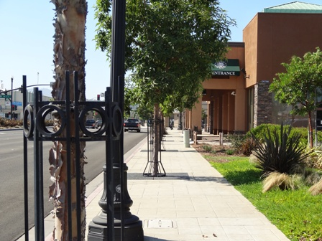
To this!
From this…
27
Notes:
A pleasant walking environment with tree cover and a buffer between pedestrians and cars makes it more inviting to walk.

Slide 28
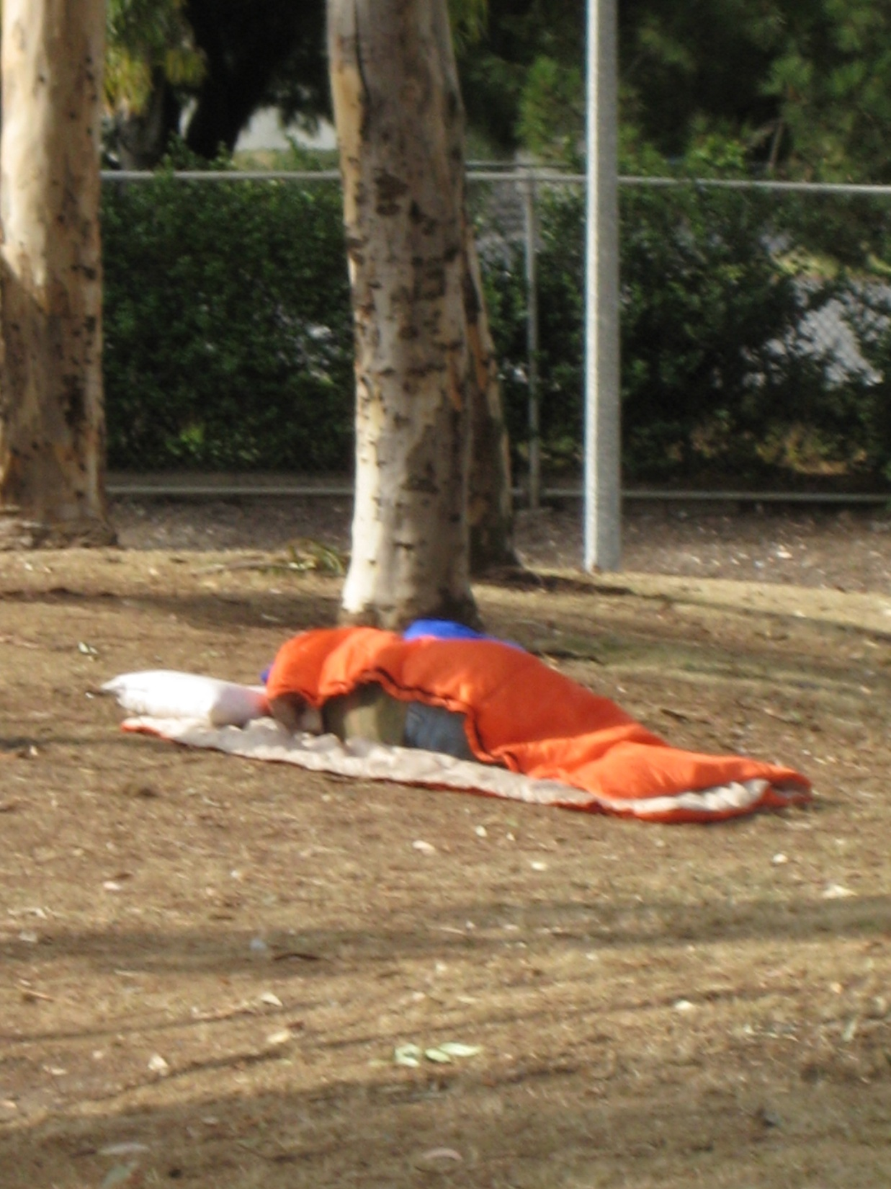
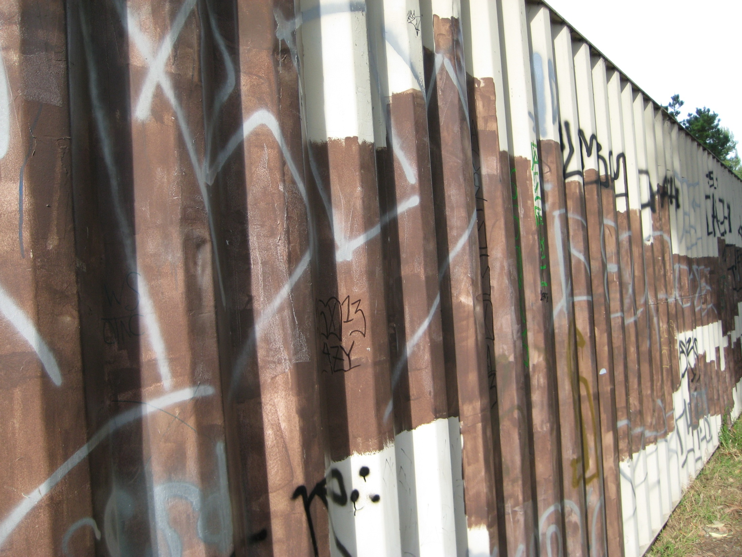
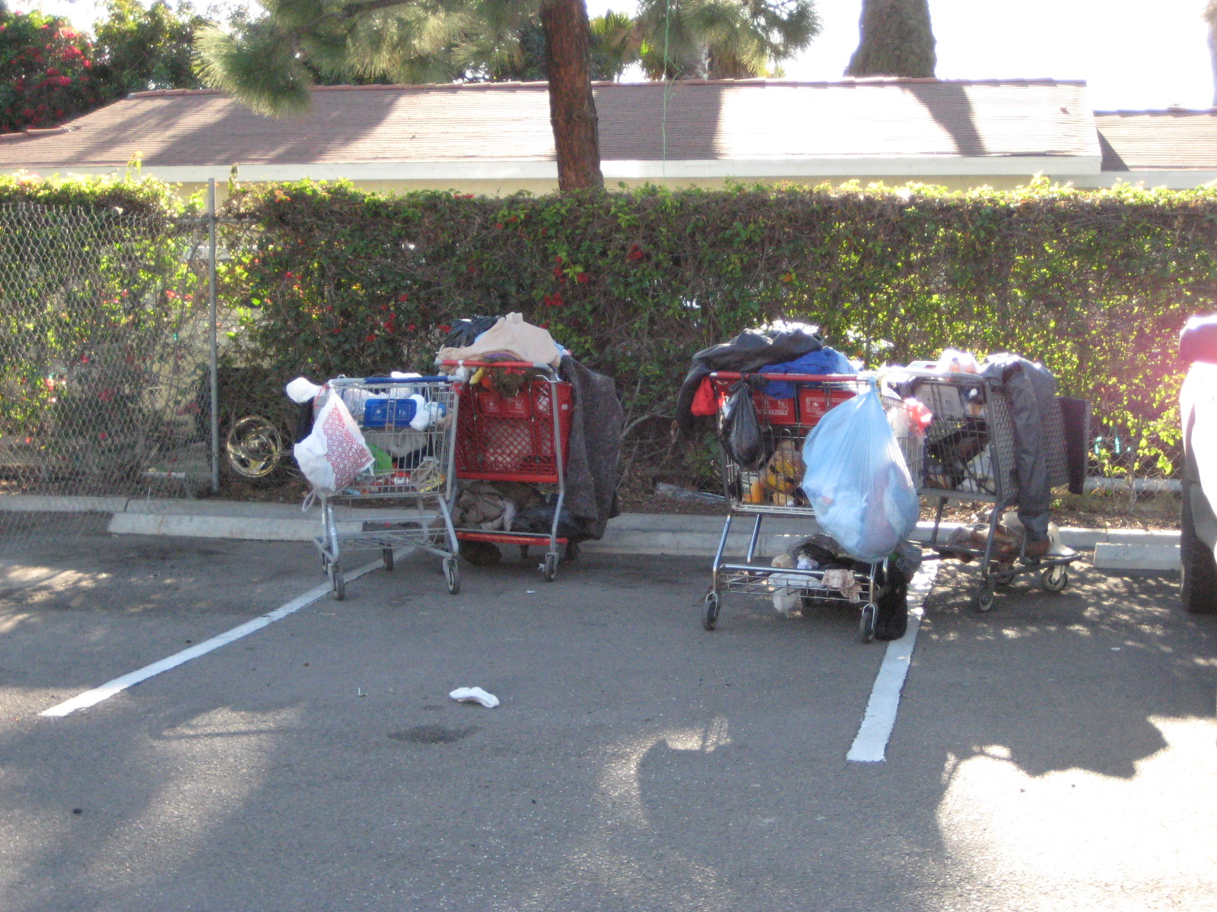
28
Notes:
In cities where there are not facilities for people who are homeless, it’s common to see people without homes living on the streets.

Slide 29
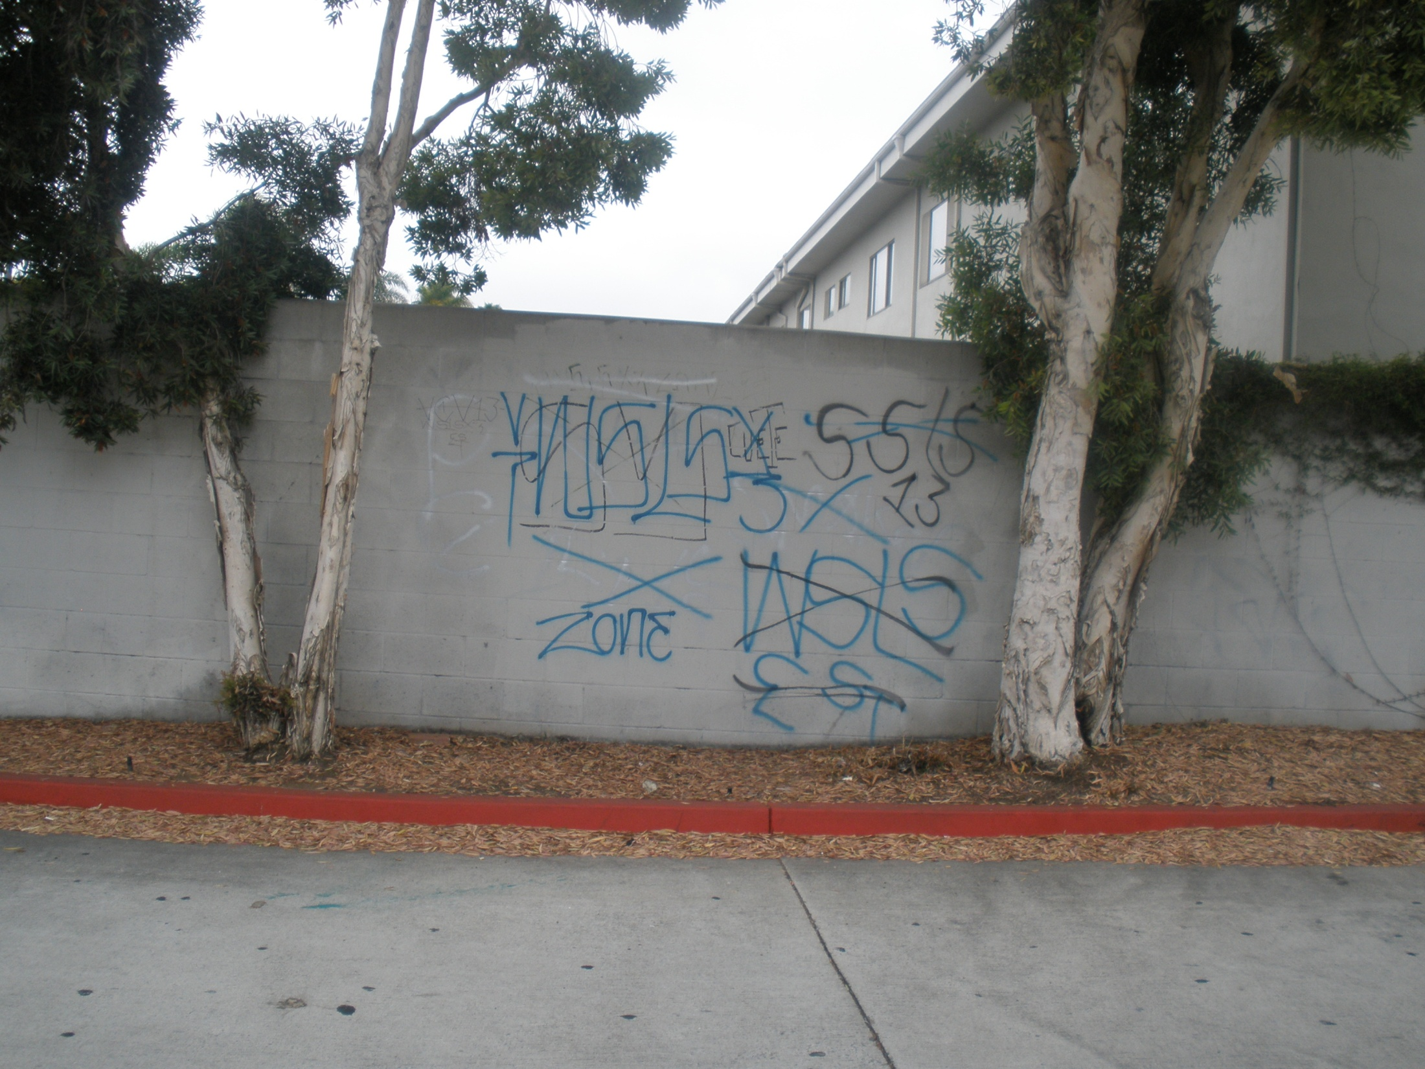
29
Notes:
Do you feel safe walking through a neighborhood with graffiti?

Slide 30
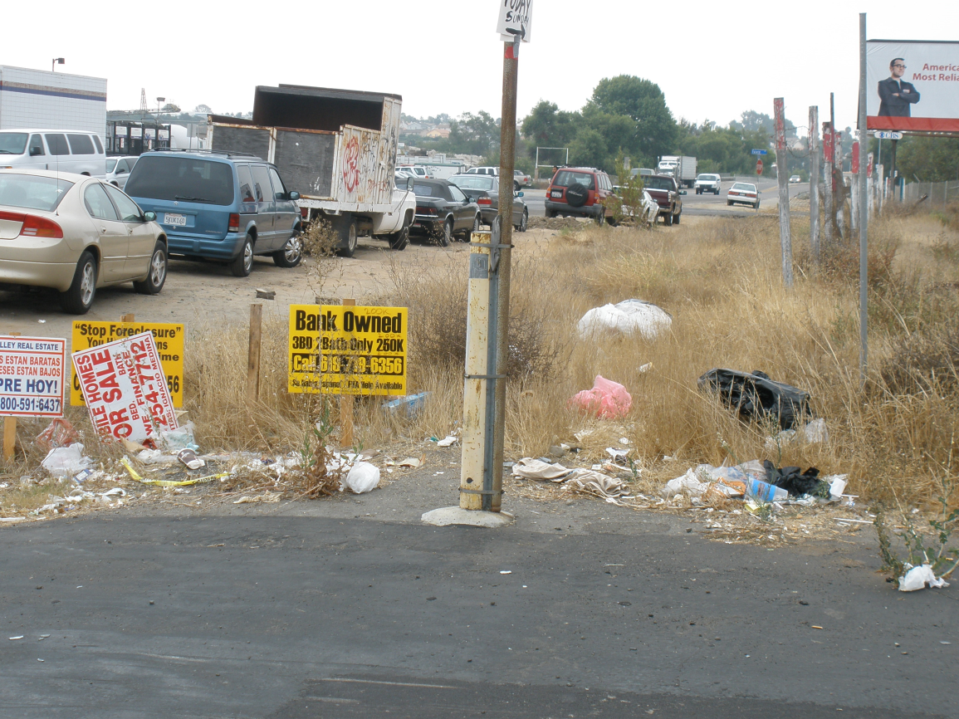
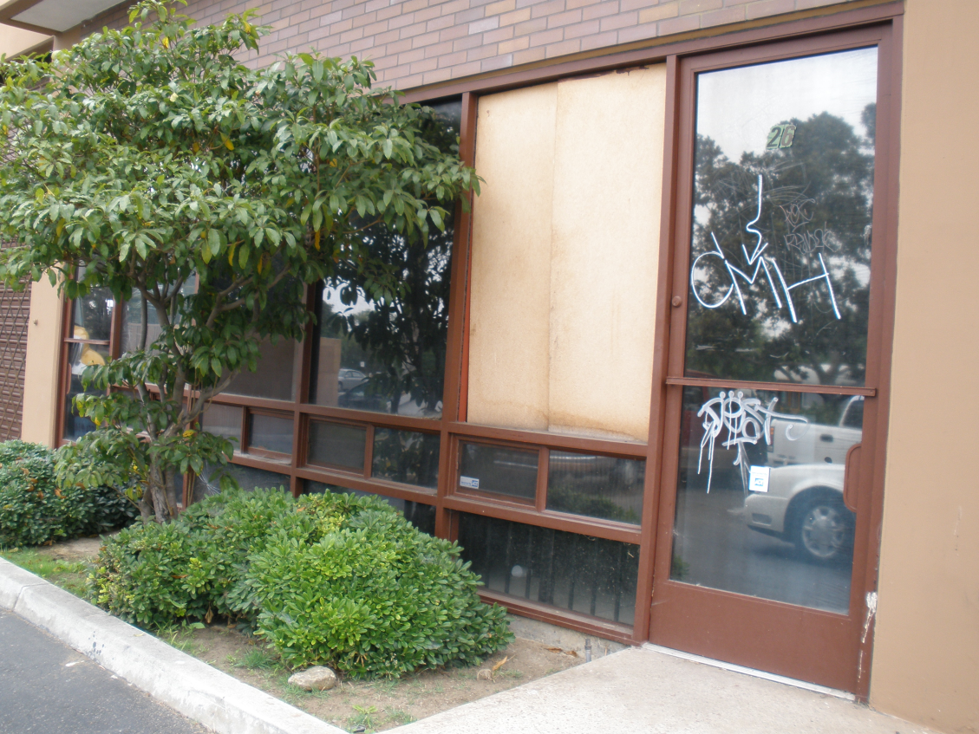
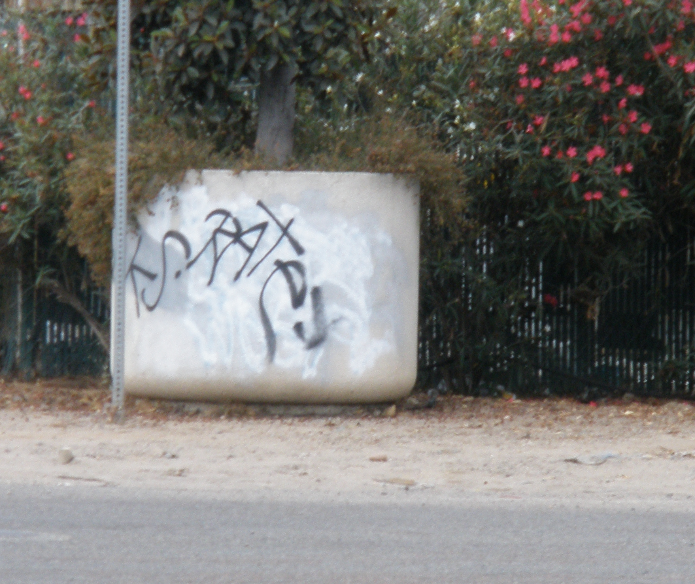
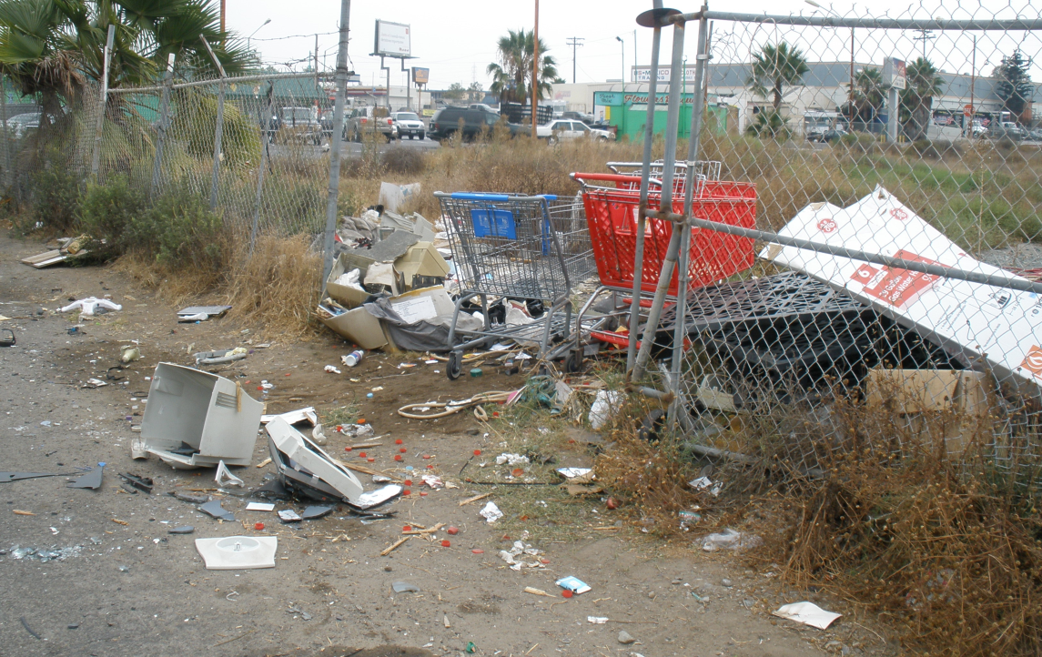
30
Notes:
How do you feel about a neighborhood that has a lot of trash in the streets, vandalism, and empty lots?

Slide 31
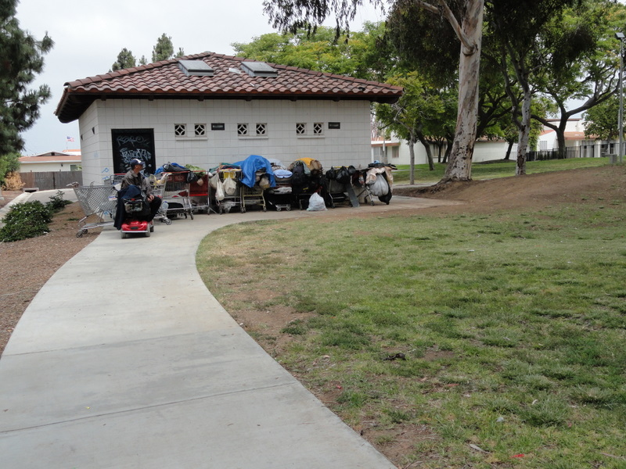
31
Notes:
Do you feel safe in your neighborhood park?

Slide 32
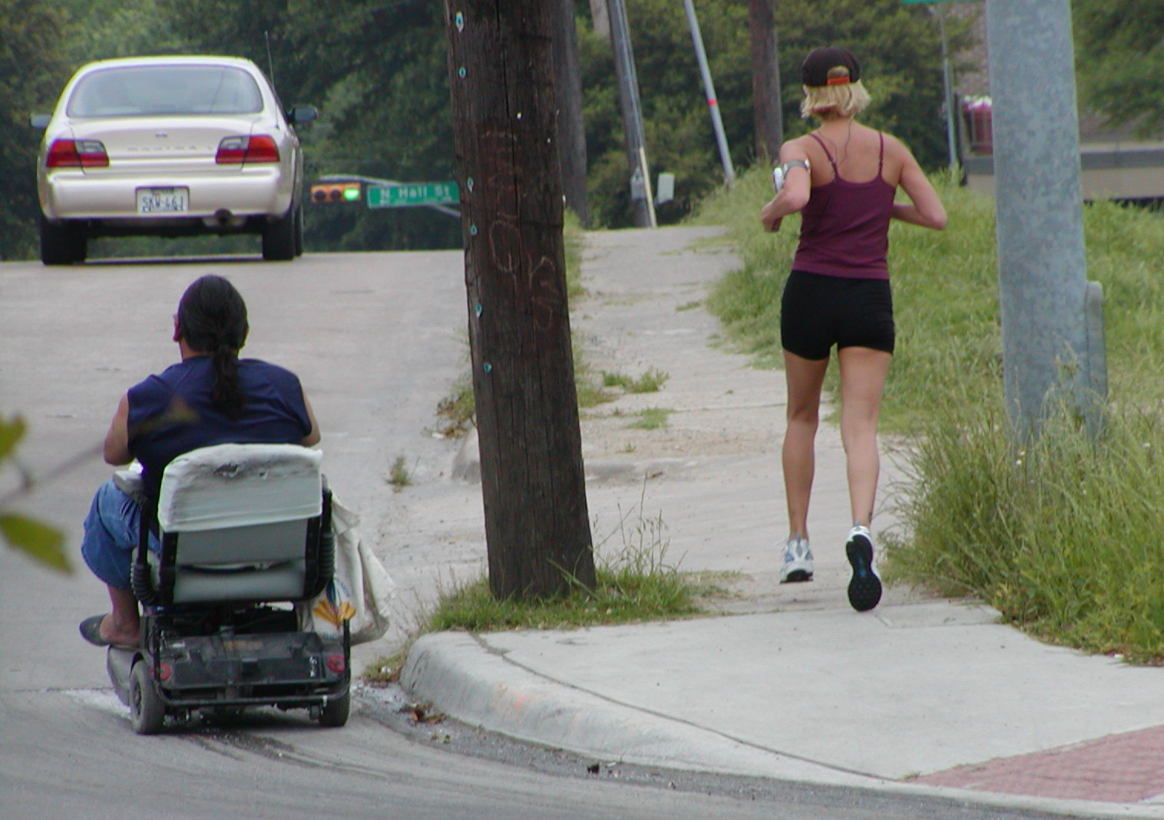
32
Notes:
What’s wrong with this picture?

Slide 33
Why Environmental Strategies?
WHY ENVIRONMENTAL STRATEGIES?
“It is unrealistic to place the burden of resolving this crisis on parents and children alone. Though personal responsibility is important, our fast-food, media-saturated, unsafe streets, car-oriented environment is working against us.
Schools, physicians, food industry leaders and other stakeholders must work with communities to create an environment where it is easier for young people to make healthy choices about eating and physical activity.”
- Marion Standish, The California Endowment
33
Notes:
Our society has a tendency to blame people rather than the environment they live in. It is important to take a more balanced approach that addresses changes to the environment that will allow people to make the right choices for better health. This quote is from Marion Standish of the California Endowment.

Slide 34
HOW MUCH Is poor health caused by individual choices or by the environment around us?
Individual choice or Environment
1 2 3 4 5 6 7 8 9 10
34
Notes:
Now that you’ve heard some information on how the neighborhood environment impacts health, has your view about the balance between individual lifestyles and the neighborhood environment changed?

Slide 35
RECOGNIZING THE PERSISTENT CHALLENGES IN UNDERSERVED NEIGHBORHOODS
Less access to green spaces
Disproportionate share of liquor stores
Violence in school and on the street
Presence of toxins and pollutants
Reduced access to libraries
Unstable housing
More fast food outlets and less healthy food options
Poor walking and biking paths
35
Notes:
These risk factors are what typically characterize poor, underserved neighborhoods. People often blame individuals for their poor health, but where someone lives has a much more profound affect on their health and behaviors.
For example:
Unstable housing leads to disruptions in social support and lack of continuity in school attendance
Source: Reaching for a Healthier Life, The John D. and Catherine T. MacArthur Foundation Research Network on Socioeconomic Status and Health

Slide 36
TARGET AREAS
36
Notes:
[Insert map of neighborhood]

Slide 37
TARGET NEIGHBORHOOD
37
Notes:
[Insert maps of neighborhood (Example of smaller area, if needed)]

Slide 38
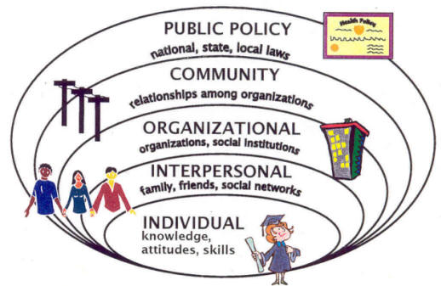
WORKING ON SOLUTIONS AT ALL LEVELS
Notes:
In order affect change, we must try to assure that multiple levels in our community support healthy choices.
Government policies and laws - have many influences on our lives such as: nutrition standards in schools; accessibility to public transportation; zoning impacts the way communities are laid out as well as where sidewalks and crosswalks are placed.
Businesses and organizations– can improve our health by offering healthy choices that are appealing to customers. It needs to be economically beneficial to the business owner to be viable.
Community and neighborhoods – with green spaces and parks encourage outdoor activity; availability of healthy food options in communities influences our health - for example, there is a 52% higher obesity prevalence in neighborhoods with access only to convenience stores versus grocery stores.
Families – have tremendous influence on the choices of others, eating home-cooked meals together often means less calories and healthier food.
Individuals – choices are still up to individuals – and parents – so the healthy choice should be the easy choice - and the norm.
We can model the successful efforts that decreased tobacco use and worked on these multiple levels, including the economics of smoking (i.e. when prices go up, cigarette use goes down).

Slide 39
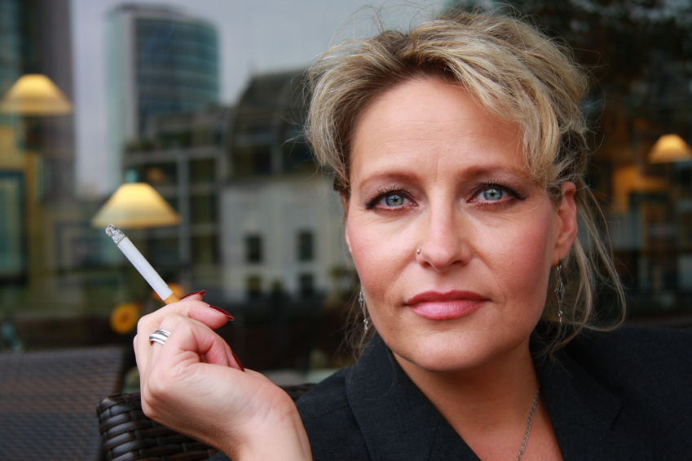
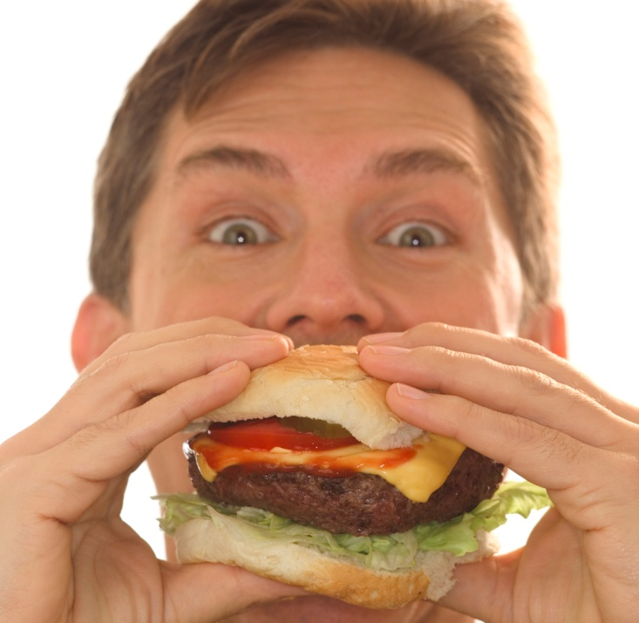
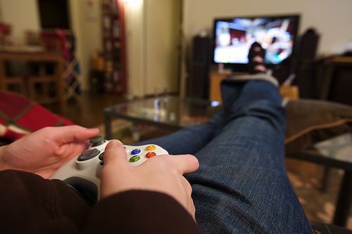
3
FOUR
50
OVER
NO ACTIVITY
POOR DIET
TOBACCO USE
CANCER
HEART DISEASE & STROKE
TYPE II DIABETES
LUNG DISEASE
DEATHS
BEHAVIORS
DISEASES
PERCENT
39
Notes:
These days, public health focuses on what are called preventable diseases. In San Diego County, 3 behaviors cause 4 types of diseases that account for more than 50% of the deaths in our County. Our neighborhoods, communities, and laws, not our genetics, have the largest impact on these three behaviors. If we can change these our communities and society so that they support healthy behavior instead of unhealthy behavior, then working together, we could save a lot of lives!

Slide 40
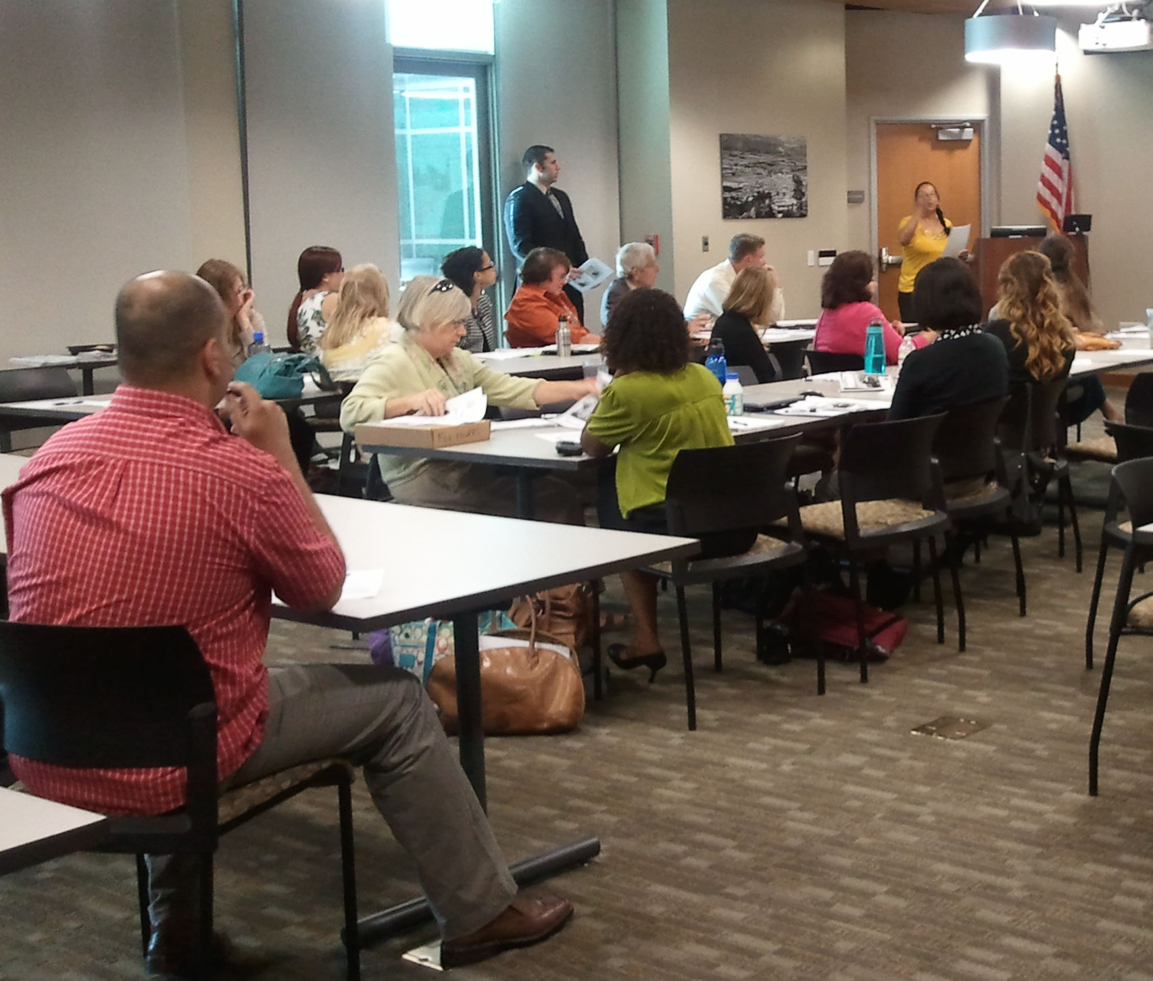
WHY IS COMMUNITY EMPOWERMENT IMPORTANT?
Community residents are the true “protectors” of neighborhoods
Authentic community leadership moves policy
Community leadership is sustainable
40
Notes:
When community leaders come from the neighborhood that they are advocating from, they are have a good understanding of the community and ask for what community members really want to see in their community. Community leaders are more invested in their community, so they will continue to move community interests forward for a long time, even if grant money disappears, or if change takes many years and others have moved on.
When community members of different ages, backgrounds, and perspectives come together to advocate for their neighborhood, they often learn from each other. Community groups that include both youth and seniors, for instance, can create meaningful opportunities to unite and share experiences. Purposeful and mutually beneficial community work can foster understanding, increase compassion, promote shared values, and encourage respect for all segments of our community.

Slide 41
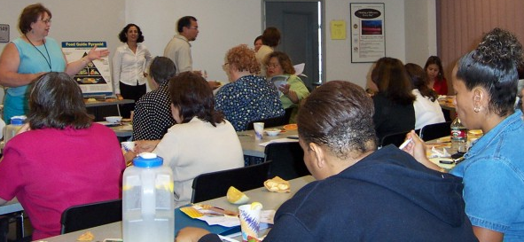
HOMEWORK OPTIONS
Review Module 1 Orientation
Read Module 2: Community Building Principles
THANK YOU!!!
Questions?
Comments?
41

