Slide 1


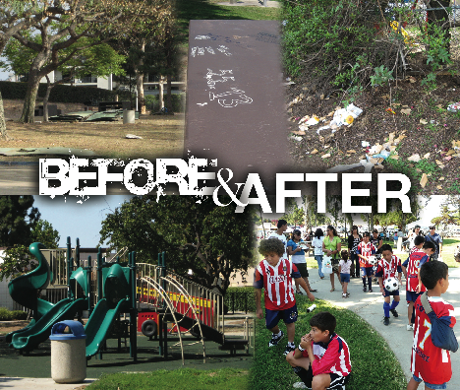
SESSION TEN
community
improvement
project
evaluation &
celebration

Slide 2
AGENDA
SESSION 10
OBJECTIVES
To understand how to assess, document and implement the effect of your Community Improvement Project (e.g., pre/post survey, before-after photos, identify meaningful measure of change created)
To understand the value of community celebration as a way to recognize achievements and stimulate future community action
To describe the issue, the implementation steps, evaluation strategies, and celebration associated with the successful Community Improvement Project
Welcome
Evaluation
Outcomes and Measures
Resident Leadership Academy CIP Evaluation Plan
Chula Vista Evaluation Example
Break
Action Plan Development
Complete the Planning and Implementation Plan for the Community Improvement Project(s) (CIP)
Celebrate
Smart Celebrations
Resident Leadership Academy Community Presentation & Celebration
Conclusion
Notes:
As participants identify their CIP’s, be cognizant of diverse backgrounds and viewpoints. Ensure that all voices are heard and that the projects that are identified represent the community as whole and benefit those in need. Remind the participants of the following:
Focus on team results rather than individual accolades/honors
Avoid any public confrontation and/or ridicule
Speak positively and respectfully to all community members/leaders
Identify, appreciate, and acknowledge each other’s skills and strengths

Slide 3
session review
Community Improvement Project Planning & Implementation Session
  What you learned or remember from the session
  A question you have
  Review homework
  Changes or improvements you would make to the session

Slide 4
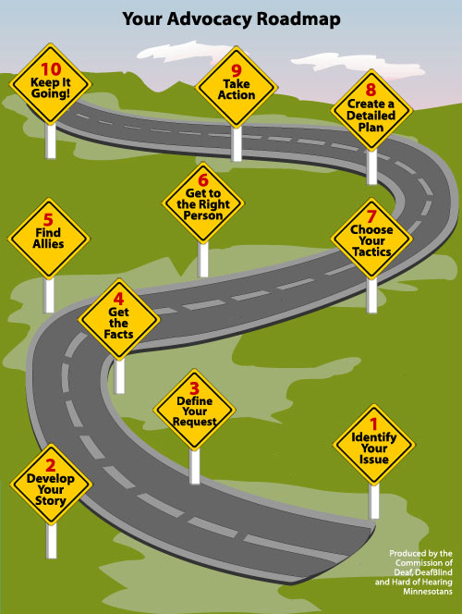
THE OVERALL PROCESS
    Where are we on this map?
    What’s next?

Slide 5
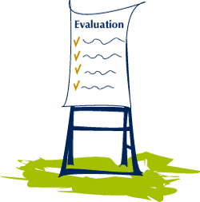
evaluation
  What is evaluating?
  Why evaluate?
  How to evaluate?

Slide 6
evaluation
Evaluation is the comparison of actual (project) impacts against the agreed strategic plans. It looks at the original objectives, at what was accomplished, and how it was accomplished. It can be formative, that is taking place during the life of a project, with the intention of improving the strategy or way of functioning of the project. It can also be summative, drawing learning's from a completed project that is no longer functioning.

Slide 7
community action plan – Logic model
SUPPORTS
    Community leaders
    Organizations
    Partnerships
STRATEGIES
    Preparation
    Promotions
    Programs
    Policy Influence
SHORT TERM CHANGES
    Partnership capacity to promote active living
    Awareness of health benefits of routine activity
INTERMEDIATE CHANGES
    Mainstreaming Opportunities for Active Living
    Community Environment
HEALTH & LIFESTYLE CHANGES
    Physical Activity
    Obesity
    Diabetes
    High Blood Pressure
    Heart Disease
    Stroke Cancer

Slide 8
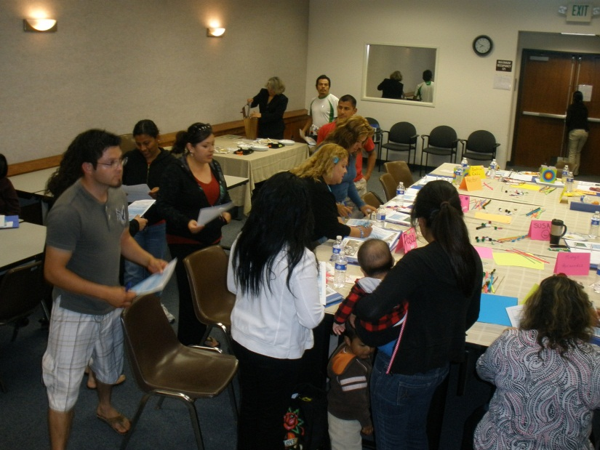
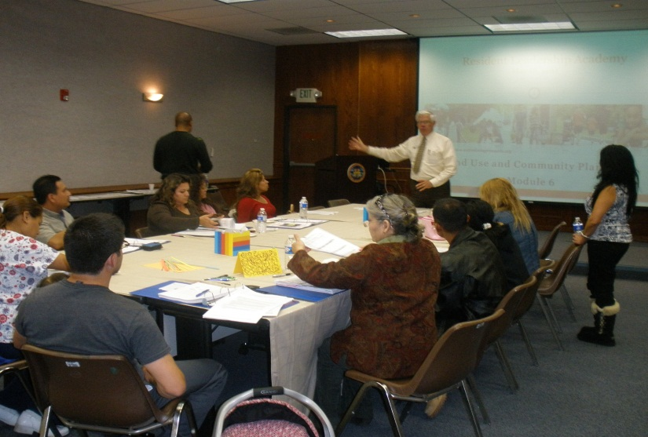
outcome and measures
Increased/strengthened social networks among residents (and organizations)
Increased partnerships and opportunities for creative and meaningful participation for residents (and organizations) to improve their community
Increased social capital and leadership among decision makers and departmental staff on issues related to improving the built environments to improve overall public health
Source: Centers for Disease Control and Prevention

Slide 9
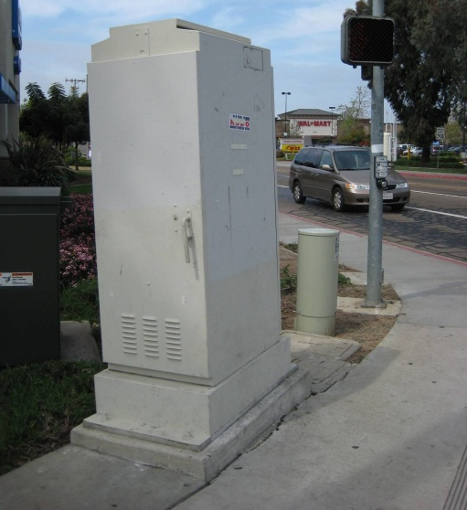
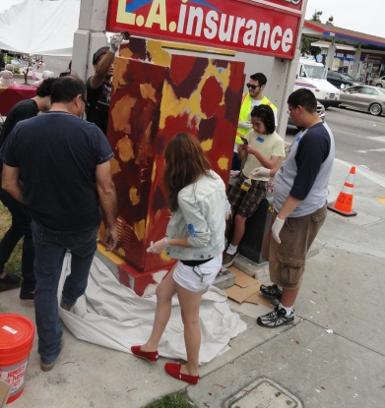
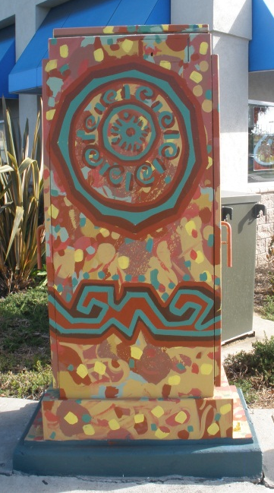
outcome and measures
Increased capacity of community residents and youth to engage in policy change efforts
  Qualitative data
  Pre/Post CPTED training assessments
Safer and improved physical environment (built environment) at site location including lighting and improvement of physical design features at site locations.
  Tracking changes made to physical environment in 6 sites
  (comparison to baseline assessment)
Source: Centers for Disease Control and Prevention

Slide 10

outcome and measures
Long-range policy change strategies (ex: increased enforcement of alcohol and tobacco laws, implementation of community garden projects, making significant strides toward the implementation of crime prevention through environmental design ordinances, the implementation of a citywide responsible retailer program policy, and the implementation of complete streets policies and public art programs)
  Tracking policy changes
Source: Centers for Disease Control and Prevention

Slide 11
Impact of Community Design on Activity
Variable | Outcome
Mix of Land Use | 19% increase in walk/bike trips in areas with appropriate land use mix
Presence/Proximity of Convenience Services | 27% increase in walk/bike trips in areas having high presence and good proximity
Perceived Traffic Safety | 88% increase in walk/bike trips in areas perceived as more safe
Perceived Aesthetics | 50% increase in walk/bike trips in areas perceived as more aesthetically pleasing
Development of Bikeway | 57% increase in bicycling in areas with dedicated bikeways
Availability of Parks and Trails | 75% of inactives believe there are too few parks and recreation facilities. 56% of Nebraskans would use trails if provided in their community
Policy Support | 55% support more bike paths, 62% more sidewalks, 60% for improved connections to destinations, and 57% improving mass transit.
Sources: Cambridge Systematics 1994; UNC-Highway Safety Research Center 1994; EPA/CDC Greenstyles Survey 1999; Nebraska Social Indicators Survey 1999

Slide 12
key elements of effective community health initiatives
Multi-level interventions including environmental and policy change
A geographic, place-based focus
Multi-sectorial collaboration
Community engagement
Leveraging the assets and strengths of communities and our own organization
Long-term partnerships (7-10 years)
A focus on addressing health inequities and disparities
Evaluation and evidence-informed public health
Sources: KP Community Health Initiative 2004-2005

Slide 13
rla evaluation plan overview
Resident Leadership Academy & Community Improvement Project

Slide 14
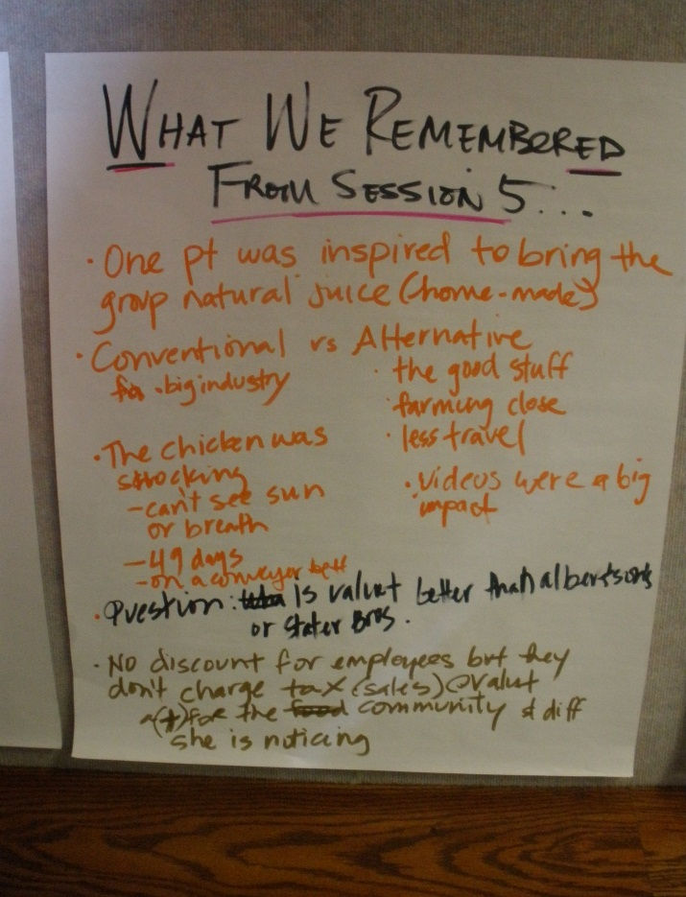
evaluation
Evaluation Steps:
1 ½ hour Focus Group to provide feedback
Knowledge-based Survey
Review Community Improvement Project Plans & Photos
Weekly participant check-in at each session
Document positive changes in the community
PARTICIPANT CHECK-IN EXAMPLE

Slide 15
EXAMPLE: CHULA VISTA ELECTRIC BOXES EFFORT
Video testimonials
and documentaries
Before and after photos
Using community
art to create interactive environments

Slide 16
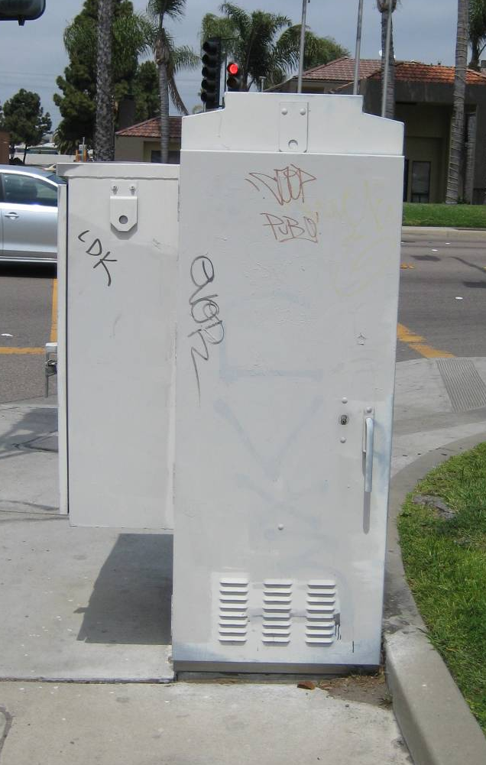
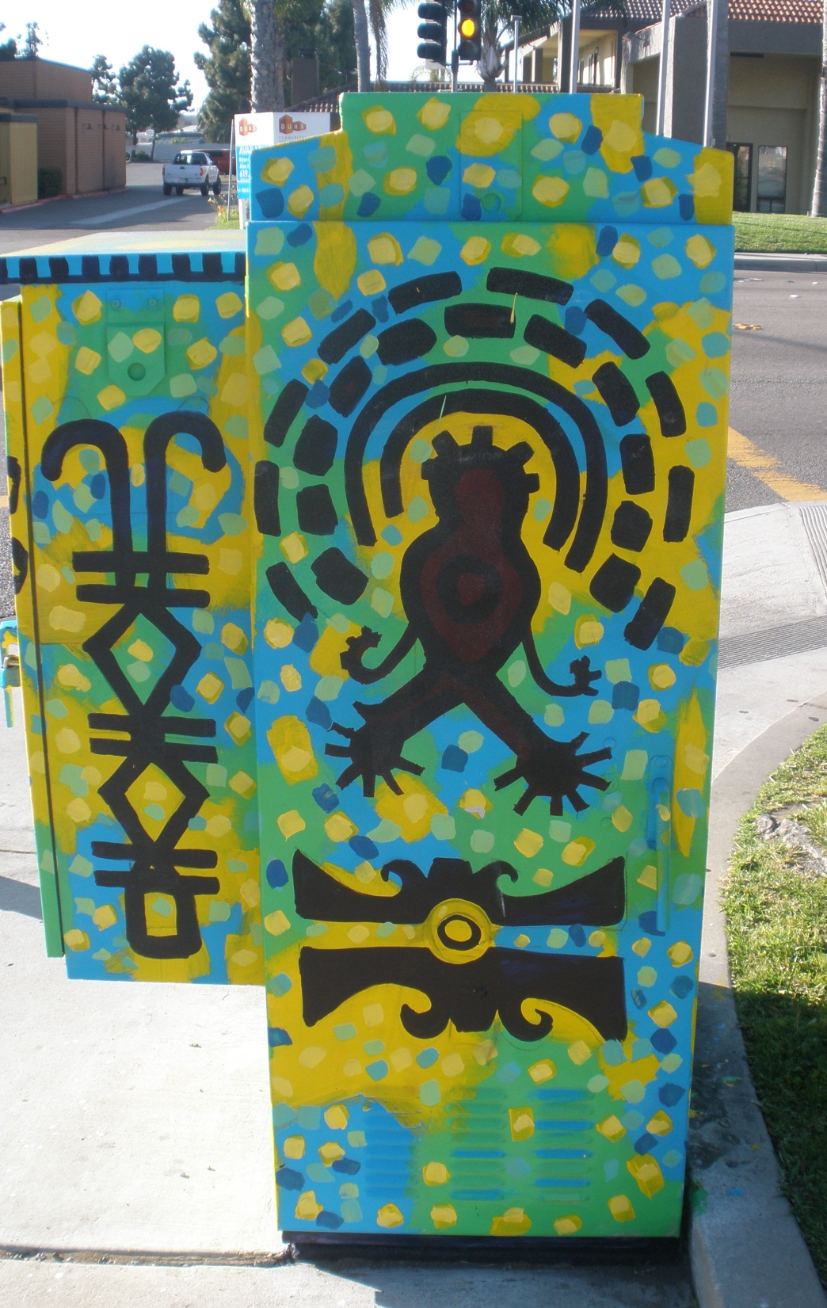
EXAMPLE: CHULA VISTA ELECTRIC BOXES EFFORT

Slide 17
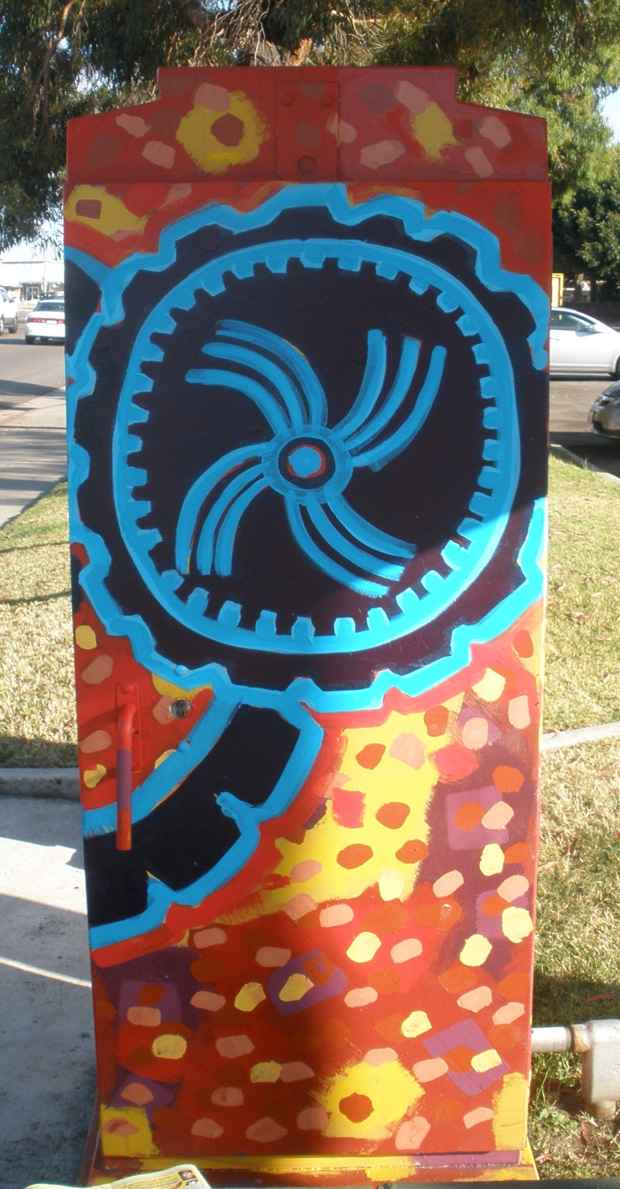
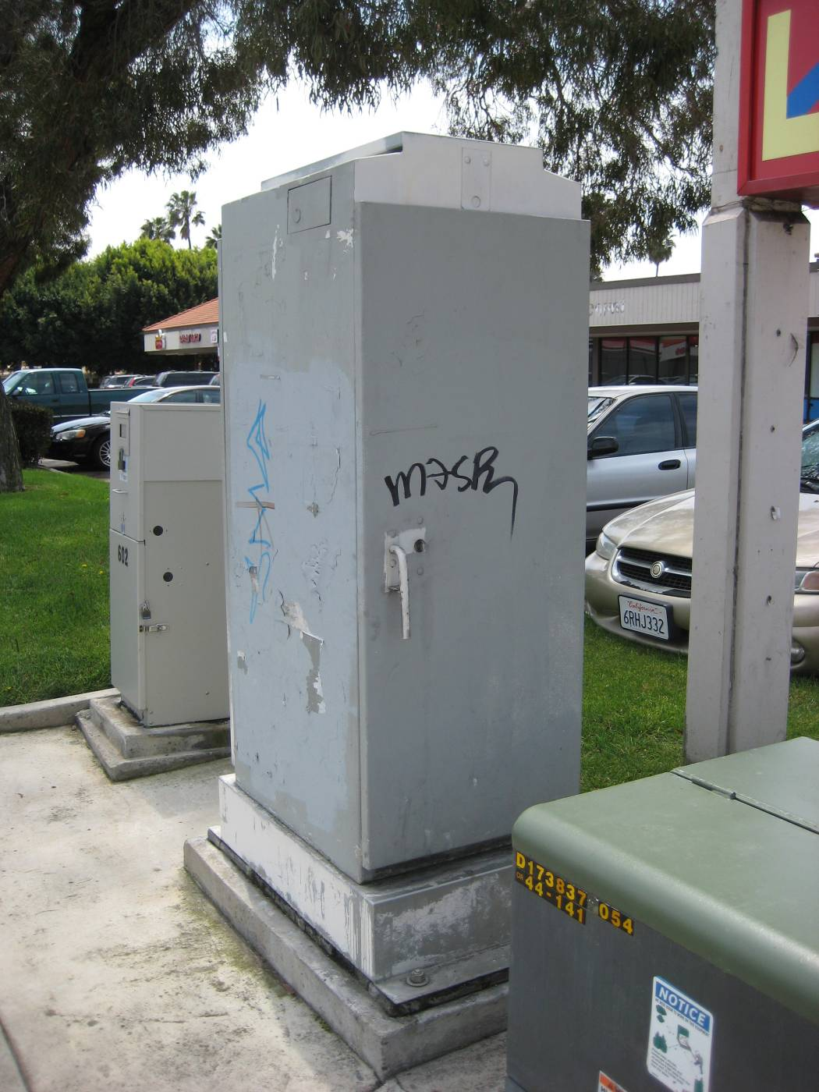
EXAMPLE: CHULA VISTA ELECTRIC BOXES EFFORT

Slide 18
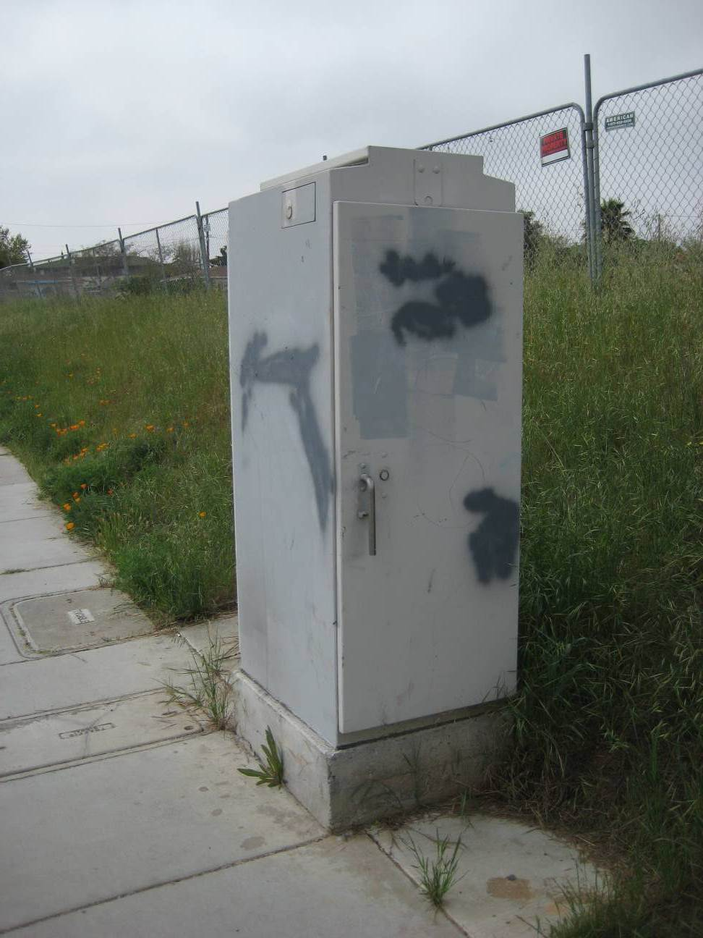
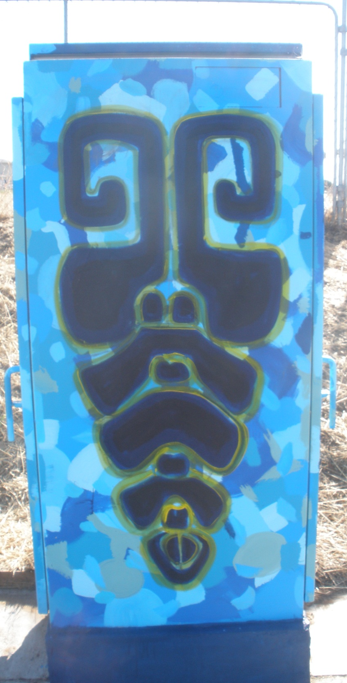
EXAMPLE: CHULA VISTA ELECTRIC BOXES EFFORT

Slide 19
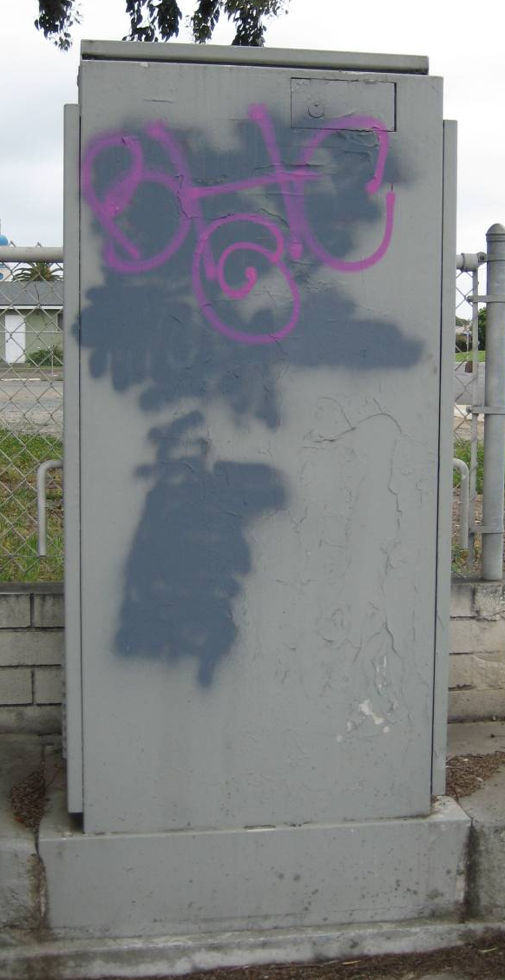
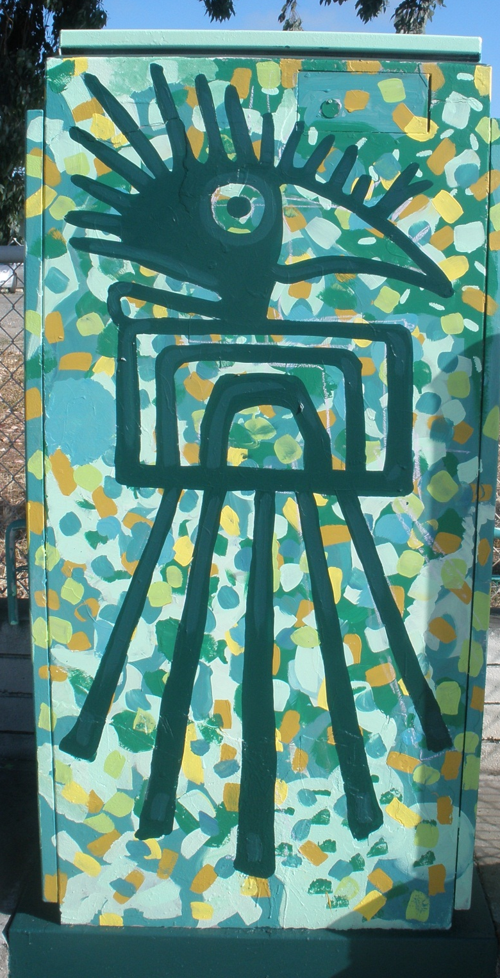
EXAMPLE: CHULA VISTA ELECTRIC BOXES EFFORT

Slide 20
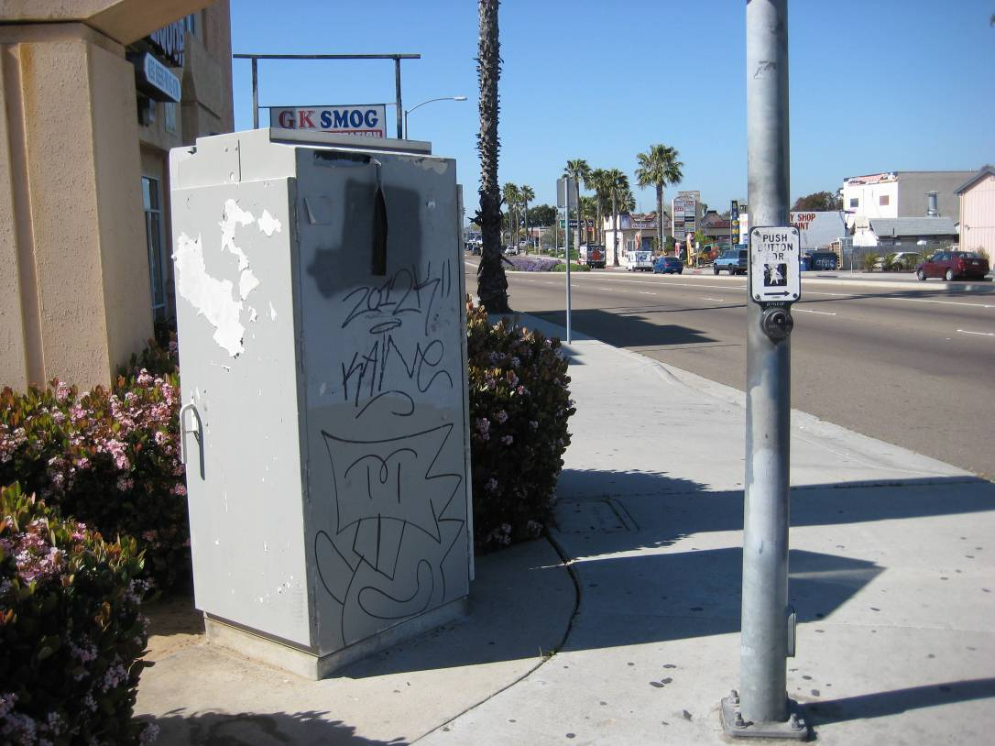
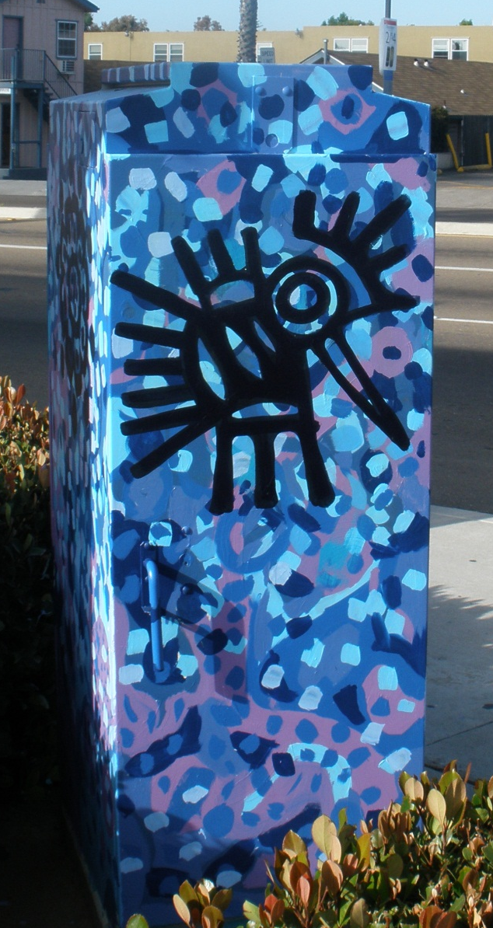
EXAMPLE: CHULA VISTA ELECTRIC BOXES EFFORT

Slide 21
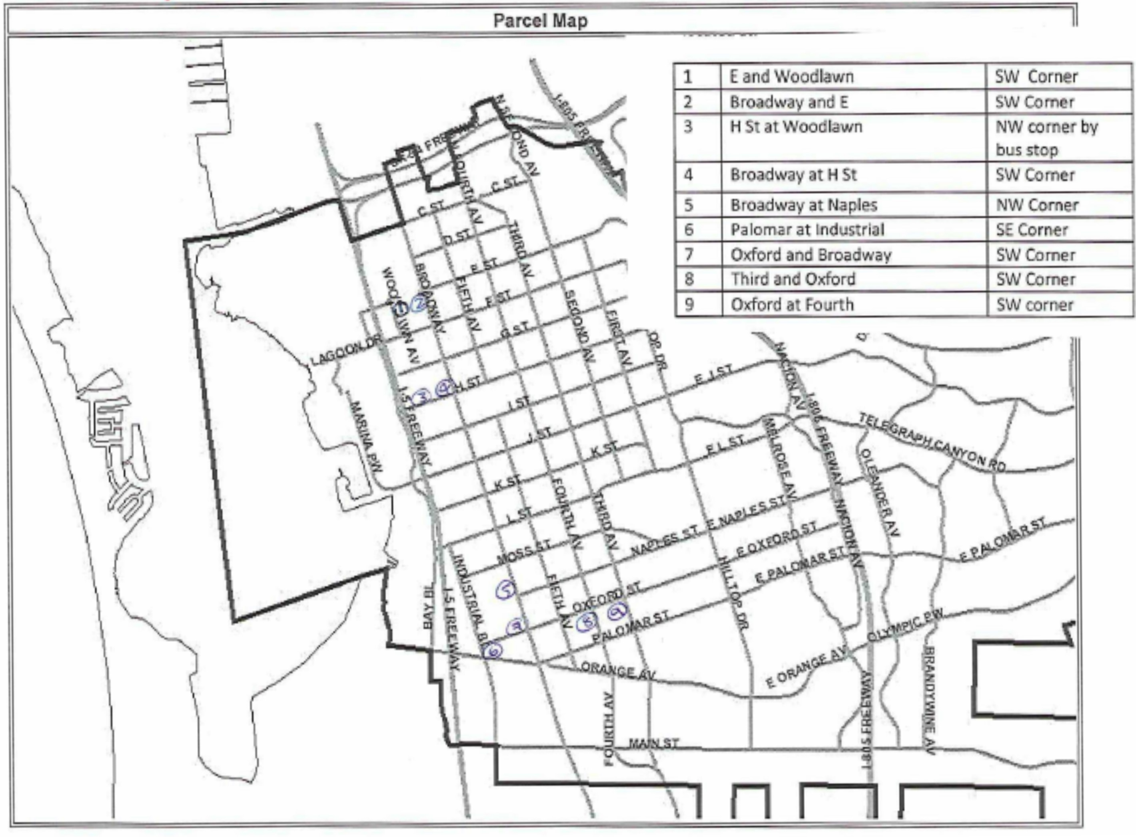
CHULA VISTA ELECTRIC BOXES EFFORT planning

Slide 22
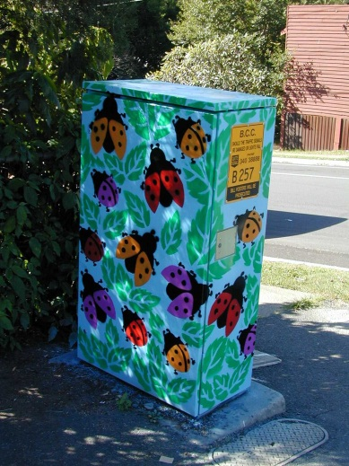
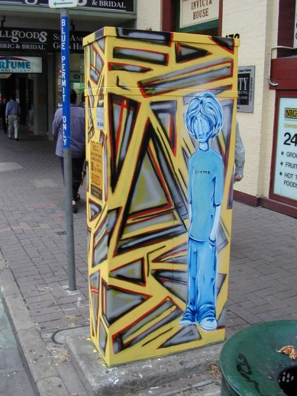
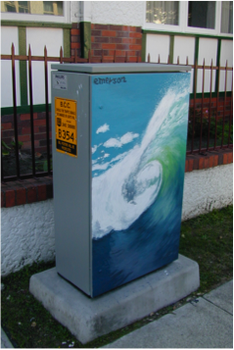
public art & CPTED: Outcomes from the project
  Huge reduction in vandalism on ‘painted’ assets
  Reduction in associated removal costs
  Improved appearance in local communities
  Improved relationships between BCC, Council and the community
  Positive feedback and support from all sections of the community
Notes:
CPTED: Crime Prevention Through Environmental Design

Slide 23
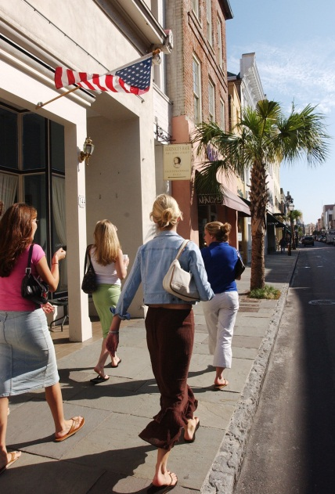
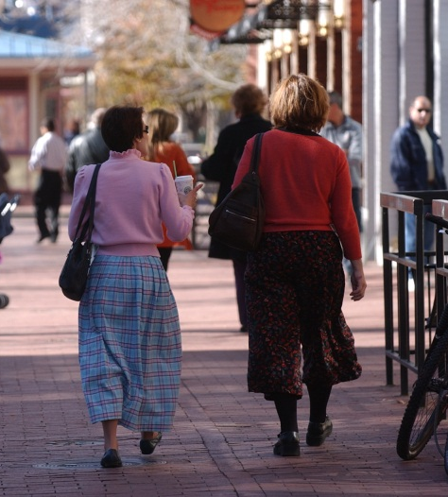
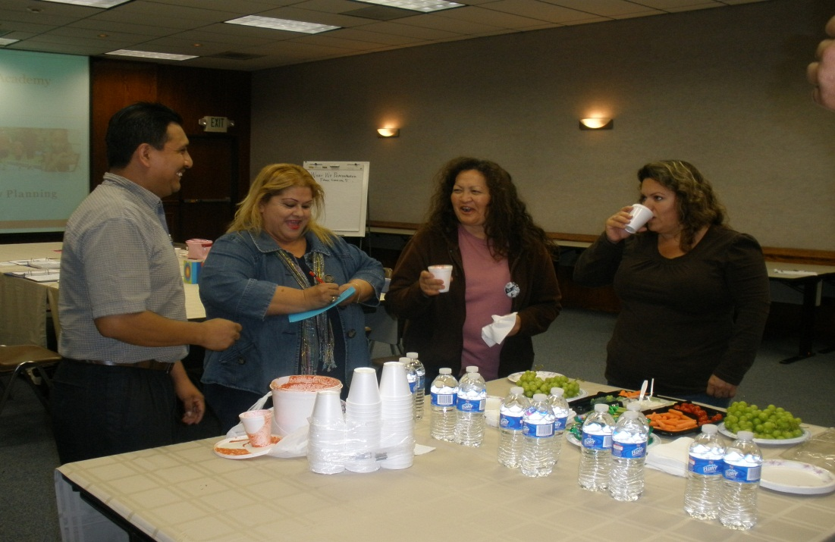
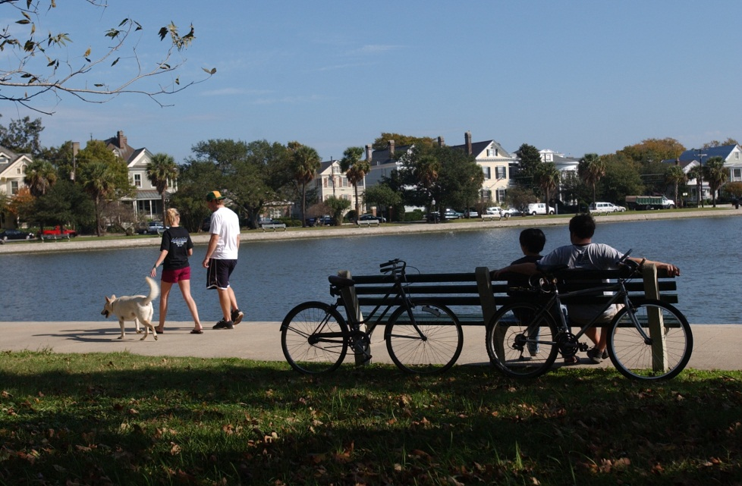
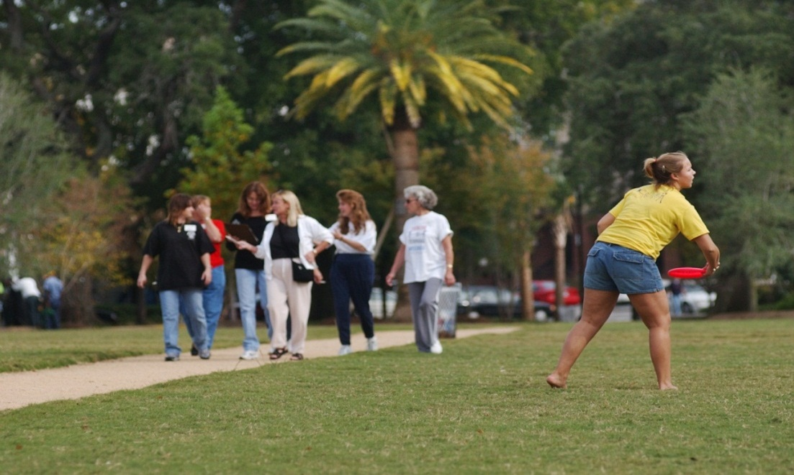
public art & CPTED: Outcomes from the project
  The Simple Elegance…of walking, riding a bike, playing with friends and family, engaging in the conviviality, joy and opportunity of community.
Notes:
CPTED: Crime Prevention Through Environmental Design

Slide 24
action plan development
Complete the planning and implementation plan for the issues addressed in the community improvement project(s)

Slide 25
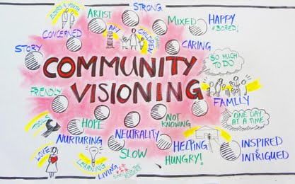
the collective vision

Slide 26
the collective vision
Group Leader
Spokesperson
Organizer
Documentation
Data Collection
Community Builder
Represents group as a whole
Communicates with media, elected officials and staff
Share information in different community circles and mobilize around community issues
Tracking community issues through photos, observation, and reporting.
Find sources of data to substantiate the community issues
Support activities, events and tasks related to the community issue

Slide 27
community improvement project objectives
List prioritized community issue areas
List prioritized community issue areas
List prioritized community issue areas
List prioritized community issue areas

Slide 28
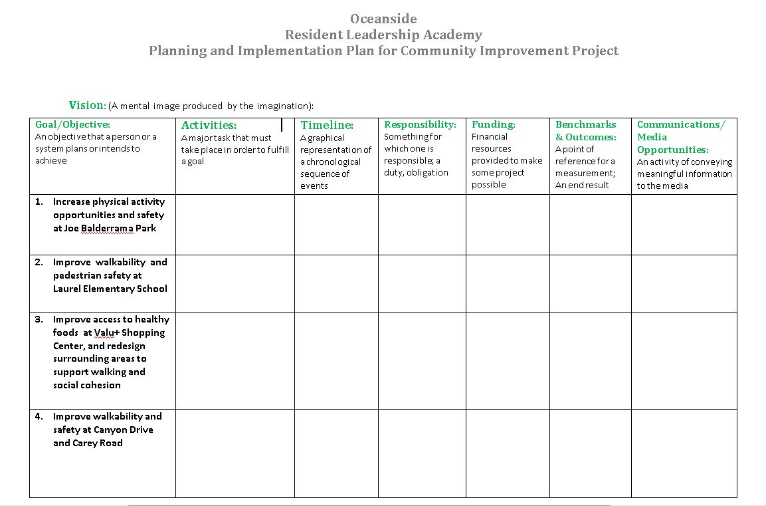
sample implementation plan

Slide 29
insert map of your neighborhood (specific target area)
<<< Insert Participants Community Photo >>>

Slide 30
community priority #1 photos
<<< Insert Participants Community Photo >>>

Slide 31
community priority #2 photos
<<< Insert Participants Community Photo >>>

Slide 32
community priority #3 photos
<<< Insert Participants Community Photo >>>

Slide 33
community priority #4 photos
<<< Insert Participants Community Photo >>>

Slide 34
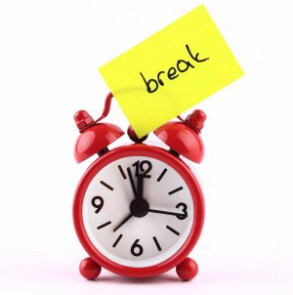

IT’S TIME
FOR A BREAK

Slide 35
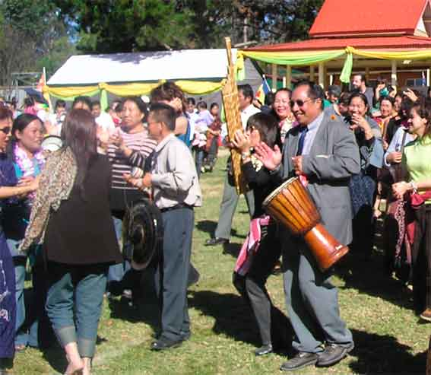
celebration
Discussion on the importance of taking the time to celebrate
Discuss how it takes a team to pull together a celebration
Smart celebrations coupled with a launch, interactive and for the public to engage in

Slide 36
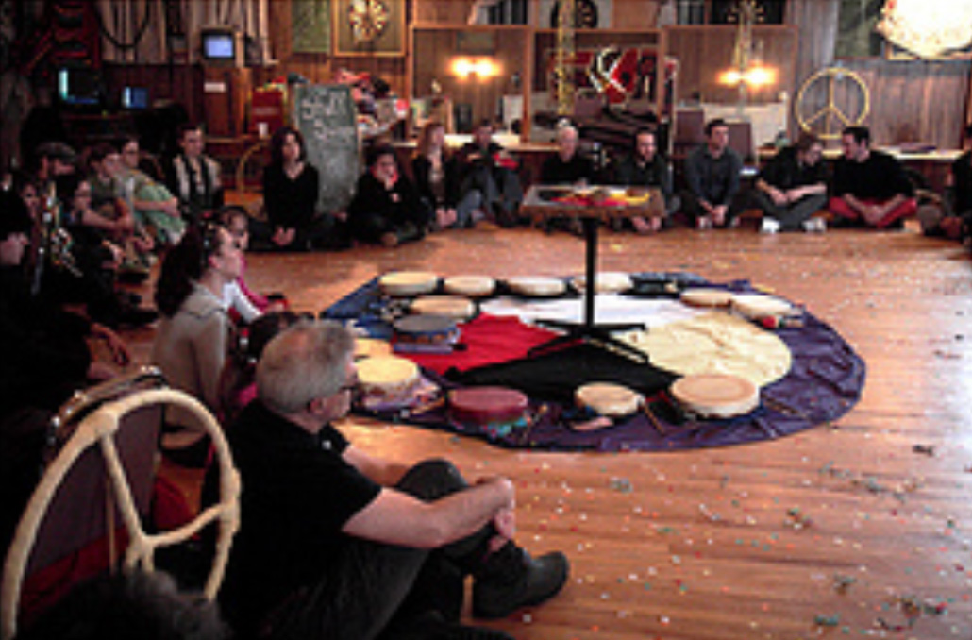
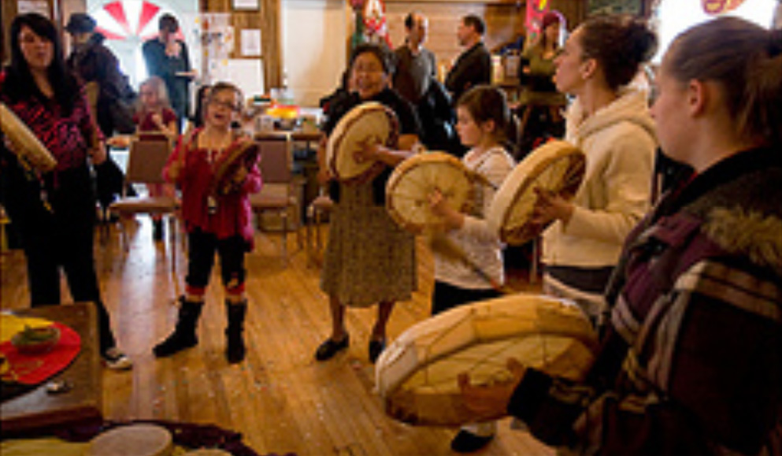
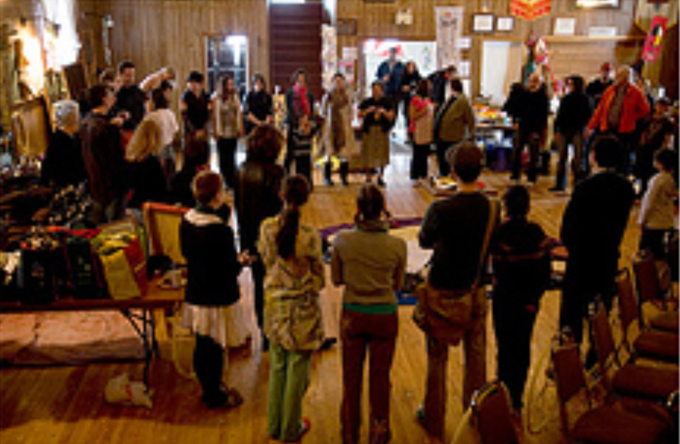
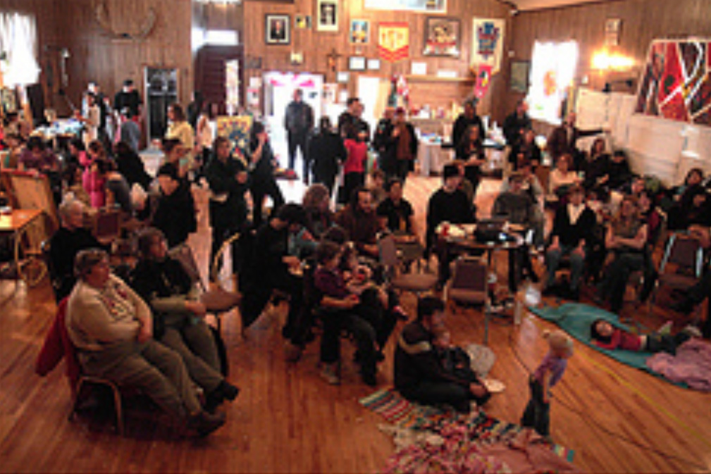
celebration
To observe a day or event with
ceremonies of respect, festivity, or rejoicing

Slide 37
community showcase and celebration
Welcoming – Community Leader(s)
Healthy WorksSM - County Representative
Resident Leadership Academy (RLA) Background - CHIP Representative
RLA Community Contractor –Subcontractor Representative
RLA Testimonials – Community Leaders
Community Improvement Project Action Plan Presentation – Community Leaders

Slide 38
community showcase and celebration
Date: Text
Time: Text
Location: Text
Logistics:
Food
Music
Invitees
Language Interpretation (optional)
Community Displays and Assignments
Presenting-easy to do (capture your own experience)

Slide 39
simulation #1
Text

Slide 40
simulation #2
Text

Slide 41
simulation #3
Text

Slide 42
simulation #4
Text

Slide 43
CONCLUSION
PLANNING FOR THE
COMMUNITY PRESENTATION & CELEBRATION
Attend dress rehearsal meeting on (insert date/location)
Prepare yourself for the Community Presentation and Celebration on (Insert date/time/location)
Thank You!
Questions?
Comments?

