Slide 1

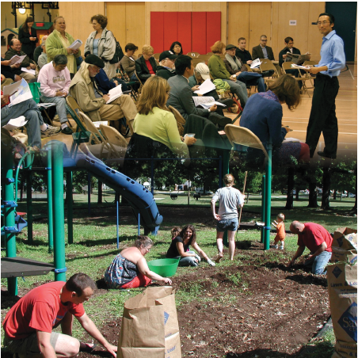
SESSION TWO:
Community building
Principles
Objectives:
1. Define Social Capital & identify ways to enhance it in Diverse Communities
2. Discover how Community Building can result in effective Community Action
3. Identify necessary steps
for Effective Community
Leadership
1

Slide 2
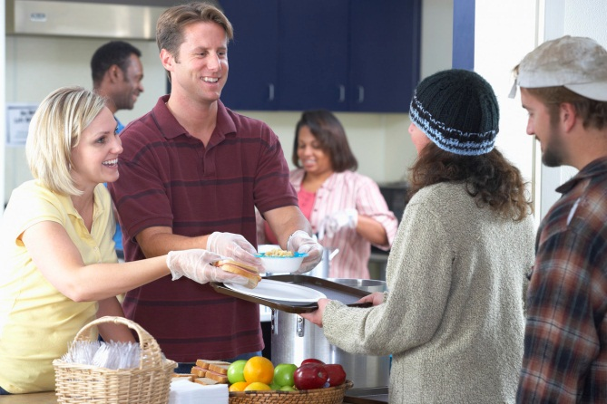
AGENDA
SESSION 2:
Community Building Principles
Activity
Welcome/Review
Icebreaker
Social Capital Presentation
Community Building
Block by Block Video
Conclusion
2

Slide 3
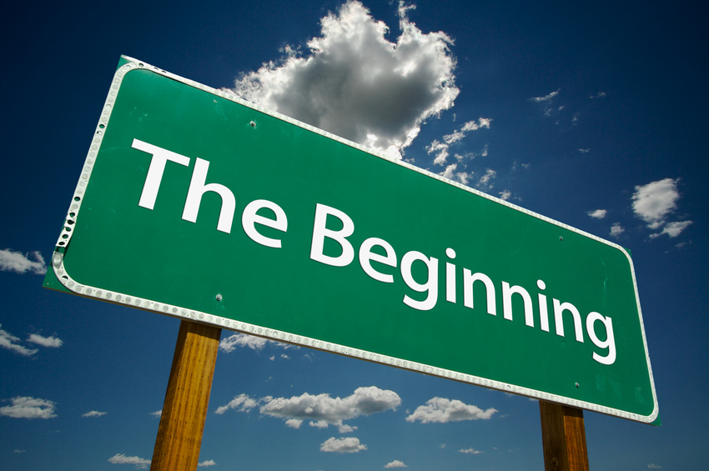
INTRODUCTIONS AND SESSION REVIEW
Name
Review Session 1:
  Something you remember
  Any questions/suggestions
Homework: Share any interactions you have had with community members in the past week
3
Notes:
Ask RLA participants to share something they learned in session one that is useful.
Ask participants if they have any questions and/suggestions to improve session one.
Also, ask participants to share any interactions they have had in their neighborhoods and/or communities this past week.

Slide 4
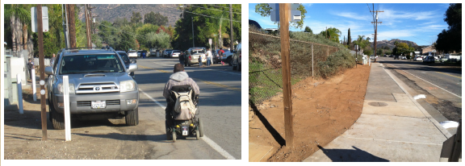
LAKESIDE PARENTS MAKE A DIFFERENCE
Watch this inspiring video about how a few Lakeside moms joined forces with local organizations to have sidewalks built outside their children's school. As lead mom Kelly Bailey says in the video: "It's amazing what just a few people can do.”
http://www.youtube.com/watch?v=saUjx_WTvMY
4
Notes:
Introduction - Community Building is a critical component to creating positive social environments in our communities. Neighborhoods that demonstrate high levels of involvement and ownership benefit from social connections, harmony, and increased safety and security as compared to other communities where residents do not exhibit these behaviors. This type of community engagement can begin with very basic interactions among neighbors that set the stage for more active community involvement later on. One of the key components to success in the community building process is social capital.
[If possible, use an example from your community or ask participant to share examples they know about.]

Slide 5
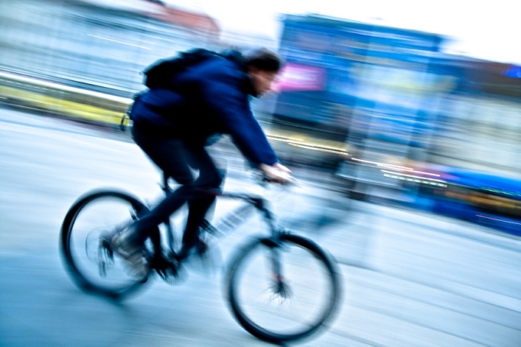
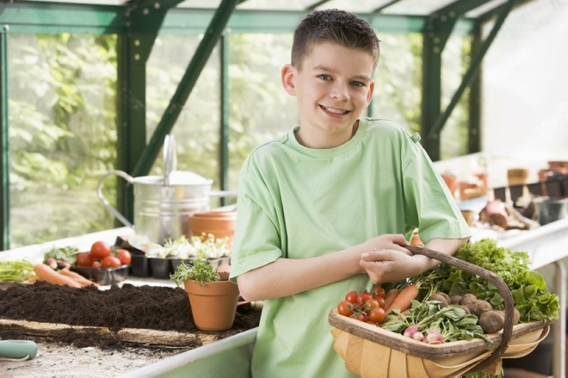
HEALTH CONCERNS
Why address health concerns
with a community-involvement approach?
5
5
Notes:
There is only so much that public agencies can do to address community health concerns due to limited staff and resources. In addition, public agency staff may not stay in one community whereas community members are more likely to maintain their ties to the community. So, when it comes to addressing community concerns, it is important to involve the community members for more effective, meaningful, and sustainable change to occur.

Slide 6
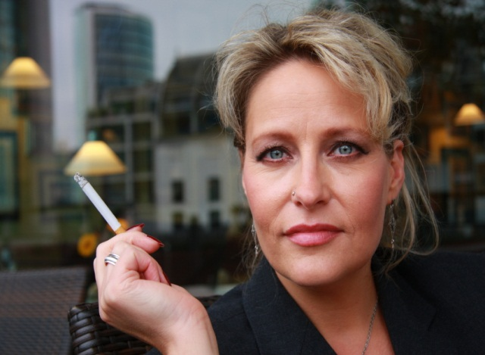
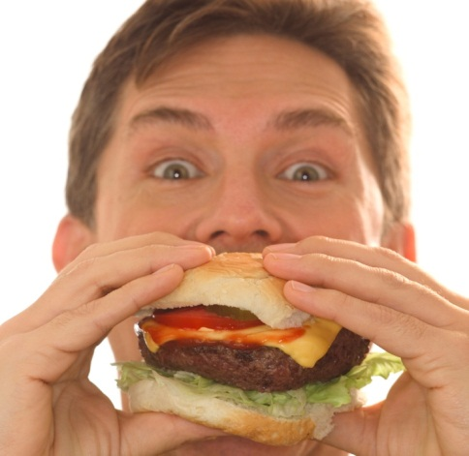

3
FOUR
50
OVER
NO ACTIVITY
POOR DIET
TOBACCO USE
CANCER
HEART DISEASE & STROKE
TYPE II DIABETES
LUNG DISEASE
DEATHS
BEHAVIORS
DISEASES
PERCENT
6
6

Slide 7
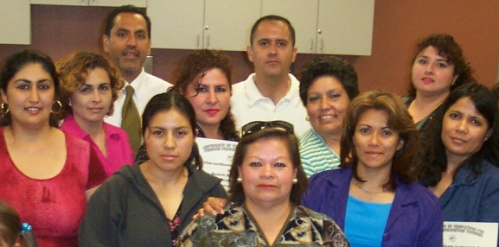
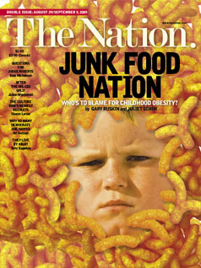
WHY INVOLVE THE COMMUNITY?
Community residents are the true
“protectors” of neighborhoods
Authentic community leadership
moves policy
Community leadership is sustainable
7

Slide 8
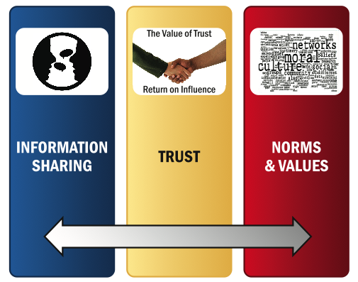
Social Capital is…
WHAT IS NEEDED TO BUILD SOCIAL CAPITAL?
…resources that make communities stronger.
8
Notes:
The three principle forms in which social capital exists is through Information Sharing, Trust that you will help each other, and through Norms and Values that are set by our groups, like churches, schools, families and other settings
Social Capital refers to the skills, knowledge, values and interactions established in social relations among people and organizations that build cooperation and teamwork in communities. For example, involved parents (human capital) help their children by spending time with them (social capital). Social capital exists in three principal forms:
Information Sharing uses social relations to pass on valuable information. Thus, a parent seeking child care may consult friends, relatives, or neighbors who have experience with local child care providers.
Trust generated through social relations establishes generalized exchange as a norm within a community: “I’ll do this for you now because you (or someone else) will assist me later.” This process does not require specific trades; rather it is a shared belief that if residents need help, they will receive it.
Norms and Values that maintain social order are passed on in families, schools, churches, and other settings. These may include social beliefs such as delaying childbearing until marriage or investing in education. They are reinforced by social support, honors, and rewards. Failure to comply with beliefs is criticized, and typically results in a loss of status.

Slide 9
TWO FORMS OF SOCIAL CAPITAL: BONDING AND BRIDGING
Bonding
Bridging
Positive, sharing relationships in which residents know and help one another.
Additional relationships with people outside of your existing bonds.
9
Notes:
There are two major ways that Social Capital happens. The first is through Bonding. Bonding happens practically automatically. It tends to reinforce exclusive identities and similar groups and is beneficial for securing a specific exchange of support and mobilizing solidarity. Examples of where bonding social capital tends to form: extended families, clubs, support groups, faith communities, neighborhoods.
The second type of Social Capital is Bridging. Bridging happens where we don’t have as much in common with another person, but you can take extra time and create a broader group of stakeholders that work on a specific issue that they have in common. Examples of bridging include:
--meetings with civic leaders,
--interviews with business representatives,
--participation w/groups outside of our immediate community
You need both types of social capital to be the most successful.
*Intergenerational (IG): IG relationships are an example of bridging, considering the intentionality of building relationships outside your usual bonds with grandparents, older adults, and children.
Source: Robert D. Putnam, Bowling Alone 2000

Slide 10
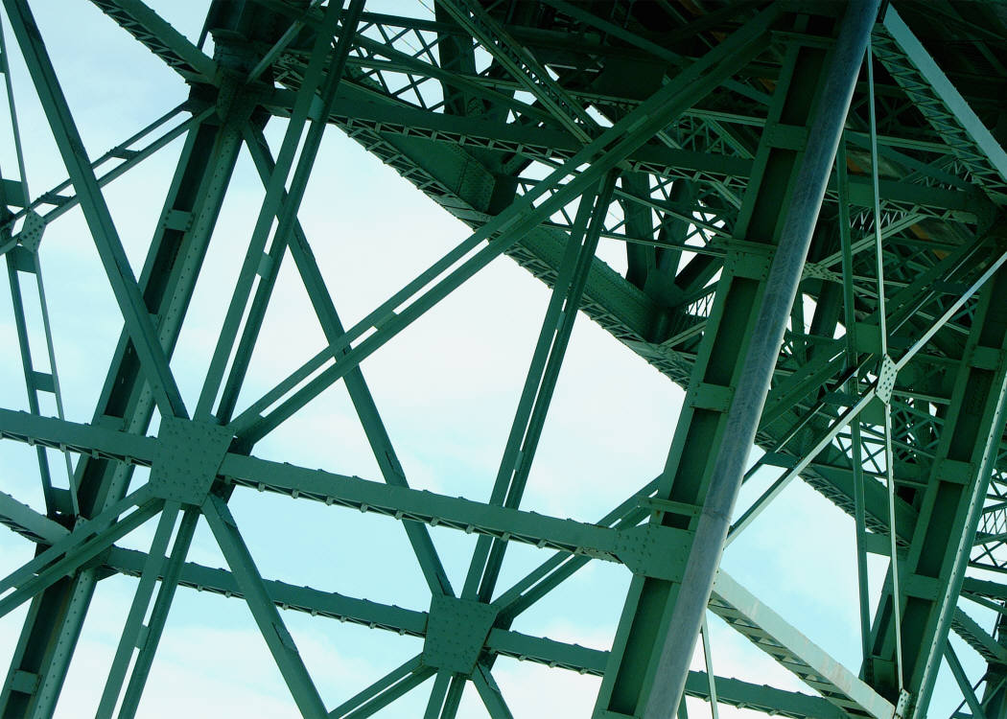
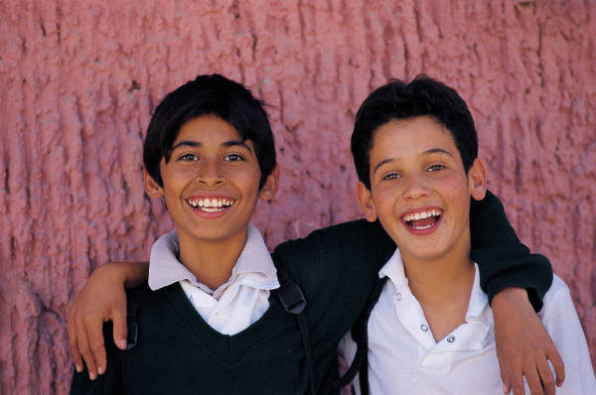
DISCUSSION QUESTIONS
What groups are you a part of?
Of the groups mentioned which ones are created from bonding and which from bridging?
What is the difference between bridging and bonding?
10
Notes:
Facilitator can also use the Bingo Activity found in Facilitator Manual, Appendix 2a
*Intergenerational (IG): For IG audience, add potential discussion question: Think of where you have interactions with older adults and where you have interactions with youth?

Slide 11
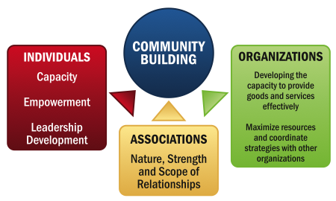
THE FOCUS OF COMMUNITY BUILDING…
11
Notes:
Fundamentally, community building concerns strengthening the capacity of neighborhood residents, associations, and organizations to work, individually and collectively to foster and sustain positive neighborhood change.
Individuals
*Capacity
*Empowerment
*Leadership Development
Associations
*Nature, Strength, and Scope of Relationships
Organizations
*Develop the capacity to provide goods and services effectively
*Maximize resources and coordinate strategies with other organizations
From: Community Building: What Makes It Work A Review of Factors Influencing Successful Community Building Amherst H. Wilder Foundation

Slide 12

Guest Speaker
GARRY DAVIS
2nd Street Leadership Council
“When the community was in need of an expert problem solver, Garry Davis assumed a leading role with the El Cajon 2nd Street Leadership Council.
As a business owner of El Cajon Auto Electric on Second Street, Garry witnessed serial inebriates, gang members, and aggressive panhandlers negatively impact the local business community. Garry worked diligently with other merchants to take back Second Street and make it an attractive and safe place to conduct business. His ardent participation has ensured a unified approach to fighting crime on Second Street.”
12
Notes:
OPTIONAL: Guest Speaker who is a community-builder from your community.
[Add additional slides, as needed]

Slide 13
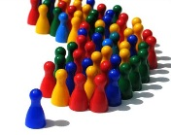
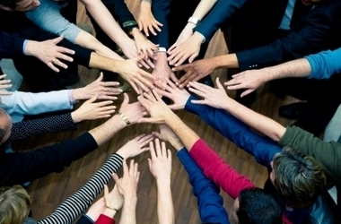

Community Leader
Community Organizer
Community Builder
Community Builder
Community Builder
Community Leadership Roles…
…are necessary in bringing about positive change in the community.
13
Notes:
Point of slide: To identify the leadership roles involved in community building. You can be any one of these roles and still have an impact in your community.
The Community Builder that helps create the initial bonding and connections,
The Community Leader takes on more responsibility and is charged with representing the community needs and assuring there is agreement from the community to take action on the things that matter to them.
Finally, the Community Organizer identifies resources and links to other organizations and associations to move projects forward. This person can either be from the community or be from outside the community to help support the leaders and builders of the community.

Slide 14
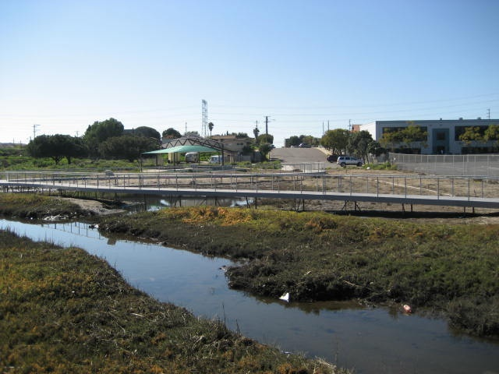
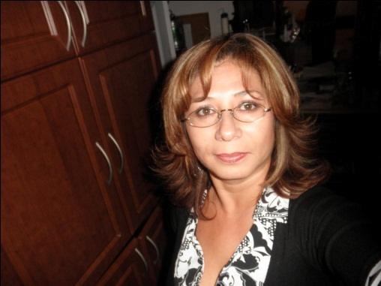
The Story of a Community Leader
From Paradise Creek Clean-Up to Old Town Specific Plan (2004-Present)
National City, CA
A local resident, mother and wife from National City who began by participating in her children's’ school activities had the opportunity to participate in a clean-up for a local creek in her community that was located adjacent to the school. This effort started simply with teachers, students and parents getting together and deciding that they wanted to make some improvements. Eventually, this led to a successful long-term community organizing effort of five years to reduce toxic exposure in the Old Town neighborhood.
14
Notes:
Share a story where you can see community building principles in a real life example
Images: OTSP and National City
[You can also use an example successful long-term efforts from your community.]

Slide 15

CONTEXT OF COMMUNITY BUILDING
Widespread participation
System of communication
Minimal competition in pursuit of goals
Beneficial to many residents
15
Notes:
Refer to community leader in National City (from prior slide)
From: Community Building: What Makes It Work A Review of Factors Influencing Successful Community Building Amherst H. Wilder Foundation

Slide 16
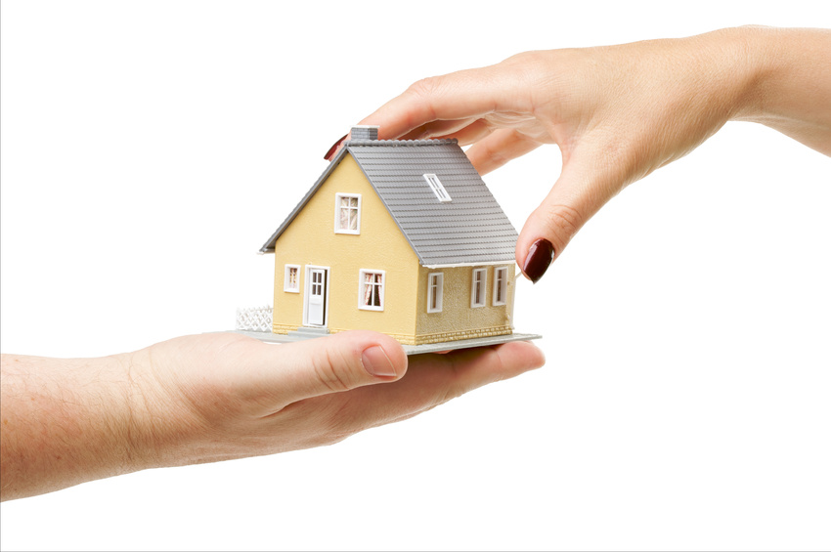
COMMUNITY BUILDING PROCESS
Training to gain community building skills
Early involvement & support from existing organizations
Use of technical assistance
Progress from simple to complex activities
Focus on product and process simultaneously
Efficient information gathering & analysis of issues
Continual emergence of new leaders
Community control over decision making
16
Notes:
Refer to community leader in National City (from prior slide)
From: Community Building: What Makes It Work A Review of Factors Influencing Successful Community Building Amherst H. Wilder Foundation

Slide 17

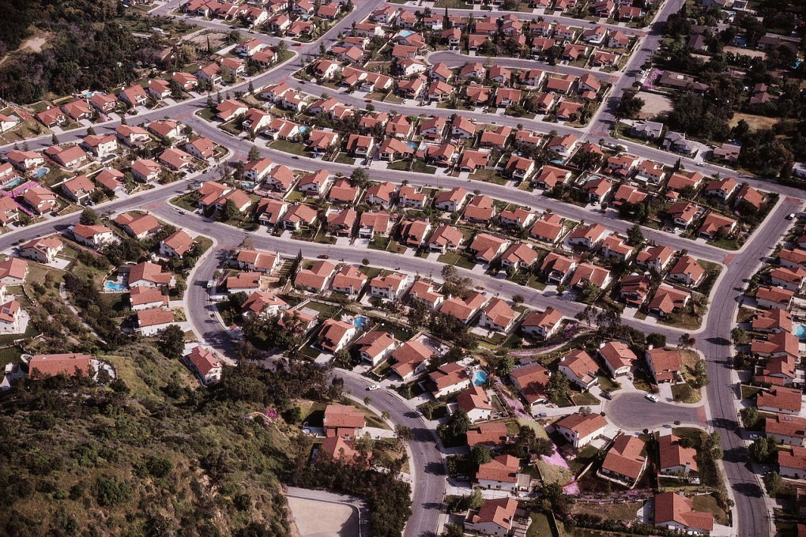
“BLOCK BY BLOCK”
RECLAIMING NEIGHBORHOODS BY DESIGN
Questions:
Are there any similarities between what you saw and your own community?
What about the video caught your attention?
17
Notes:
Point of the Video: To have participants reflect that this is something that is very attainable and that other communities have already been successful so they can be inspired and get ideas on how to improve their communities.
These neighborhoods that had been left behind were brought to the forefront by people wanting to make a difference. They joined together and took their neighborhood back, one block at a time.
After some time had passed the communities began seeing positive changes that inspired broader, more impactful efforts.
About the video:
This video shows an example of a community in Atlanta, Georgia where Neighborhood members, Community builders, and Public leaders worked with local Businesses, City officials, and Other interested parties to bring improvements to
their community.
-Atlanta, Georgia
Source: The Mc Graw Hill Companies and Otis

Slide 18
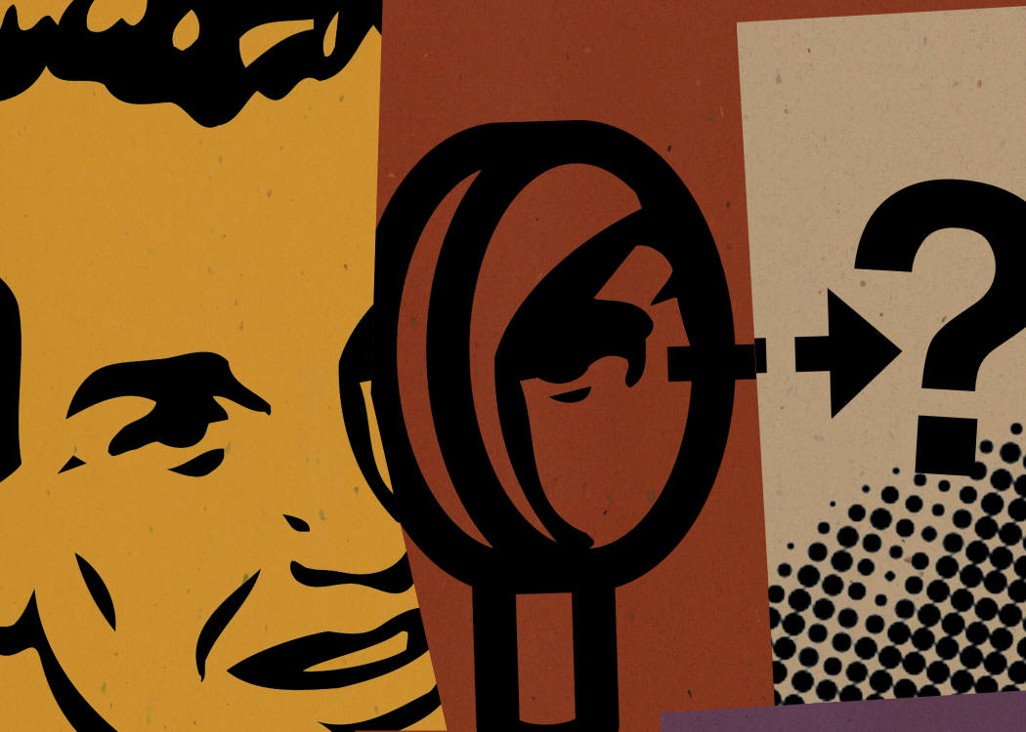
CONCLUSION
THANK YOU!
Questions or Comments?
HOMEWORK
1. Think about ways to learn more about what is happening in your community.
2. Identify 1 or 2 upcoming community events (community meeting or gathering, city council meeting, 5K run event, etc.) that you can attend.
3. Read Module 3 -Social Determinants of Health
18
Notes:
Community building is an important component to successful community improvement. It is an ongoing comprehensive effort that consists of leadership, organization, and hard work that will enhance a community improvement project.
Graphic Source: Cartoonchurch.com

