Slide 1


SESSION THREE:
SOCIAL
DETERMINANTS
OF HEALTH
Notes:
The social determinants of health are influenced by a person’s access to health-related resources, such as: healthy food, clean water, safe housing, transportation, education, health care, employment, and social relationships. Access to these health-related resources is determined by the circumstances into which people are born, grow up, live, work, and age. These circumstances are influenced by a wider set of forces – economics, social policies, laws, and political forces. Therefore, each person occupies a position that generates certain advantages and risks and makes some health outcomes more likely than others. In other words, while the path to health is fairly direct for some, it can be long and hard for others.

Slide 2
Session 3:
Social Determinants of Health
AGENDA
Welcome/Review
Do Neighborhood Environments & Social
Conditions Matter?
Social Determinants of Health
Unnatural Causes – “In Sickness & In Wealth”
Moving Toward Health Equity
Conclusion
Session Objectives:
DEFINE:
Social determinants of health
Health inequities
DESCRIBE:
Socio-economic factors & neighborhood characteristics
Impact on health outcomes
IDENTIFY STRATEGIES:
That can impact the “quality of life” outcomes
That can reduce health inequities
2

Slide 3
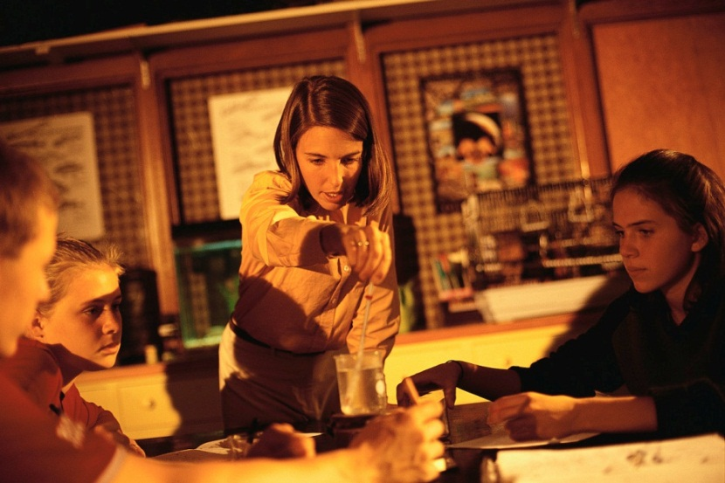
SESSION REVIEW
Last Week
Community Building Principles Session
  Something you learned that is useful
  A question you have
  A homework activity that you completed
  Things that you would change/improve from Session 2
3
Notes:
Ask participants to share something they learned from last week’s session that has been useful.
Invite participants to ask questions and/or provide recommendations for previous session.
Ask participants to share upcoming events they have heard about in the community.

Slide 4
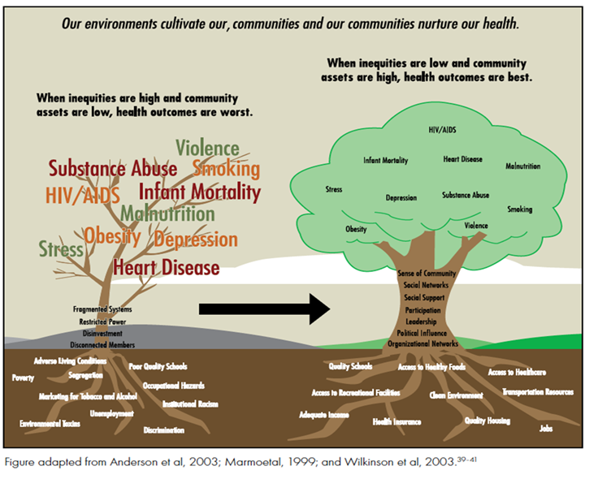
SOCIAL DETERMINANTS OF HEALTH
3
Notes:
Where you live, work, and play has a profound impact on your health. Most people think that genetics or lifestyle are the primary factors influencing health. However, the environments in which people live are proving to have much greater influence. We call these the social determinants of health.
This image is hard to read, but pay less attention to the words, and think of the trees. If an individual grows up in a neighborhood with low-quality schools, unsafe parks, and few job opportunities, then it will be more challenging for them to grow and thrive.
According to the World Health Organization, the social determinants of health are the circumstances in which people are born, grow up, live, work, and age, as well as the medical and other systems put in place to deal with illness. These circumstances are in turn shaped by a wider set of forces: economics, social policies, and politics.

Slide 5
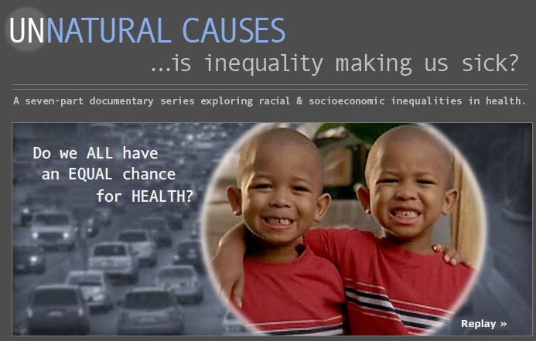
Unnatural Causes Video: Twins
NEIGHBORHOODS AND SOCIAL CONDITIONS
4
Notes:
As they watch the video clip, ask participants to make a list of community resources that can lead to better health and greater opportunities. Examples of these resources might include preschool, healthcare, education, living-wage jobs, safe and affordable housing, access to nutritious foods, and safe places in which to play and exercise.

Slide 6
NEIGHBORHOODS AND SOCIAL CONDITIONS
NEIGHBORHOOD
SOCIAL CONTEXT
ECONOMICS
HEALTH
ACCESS TO HEALTH CARE
EDUCATION
4
Notes:
There are five major components of social determinants of health: economics, education, access to health care, neighborhood environment, social context.

Slide 7
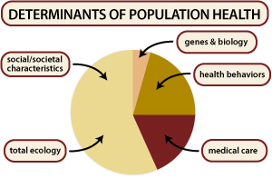
6
Notes:
Source: http://www.cdc.gov/socialdeterminants/faq.html

Slide 8

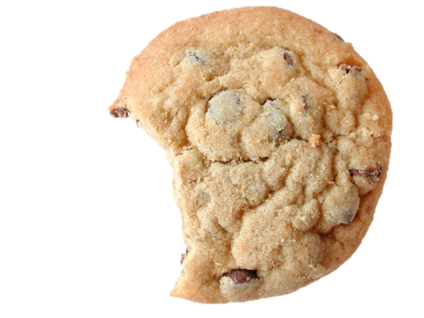
One Nation, Many Health Outcomes
SOCIAL DETERMINANTS OF HEALTH
Genetics (5%)
Social Conditions (55%)
Health differences based on genetic variations.
Examples:
  Sickle Cell Disease
  Breast Cancer Rates
  Skin Cancer Rates
Avoidable health differences resulting from unequal access to resources
& uneven exposure to risk
Examples:
  Obesity
  Type 2 Diabetes
  Heart Disease
  Infant Mortality
  Asthma
7
Notes:
Point of slide: Our genes do have an influence on our health, but that influence is far smaller than the influence of social determinants and the environments we live in.
Remember the 3-4-50.

Slide 9
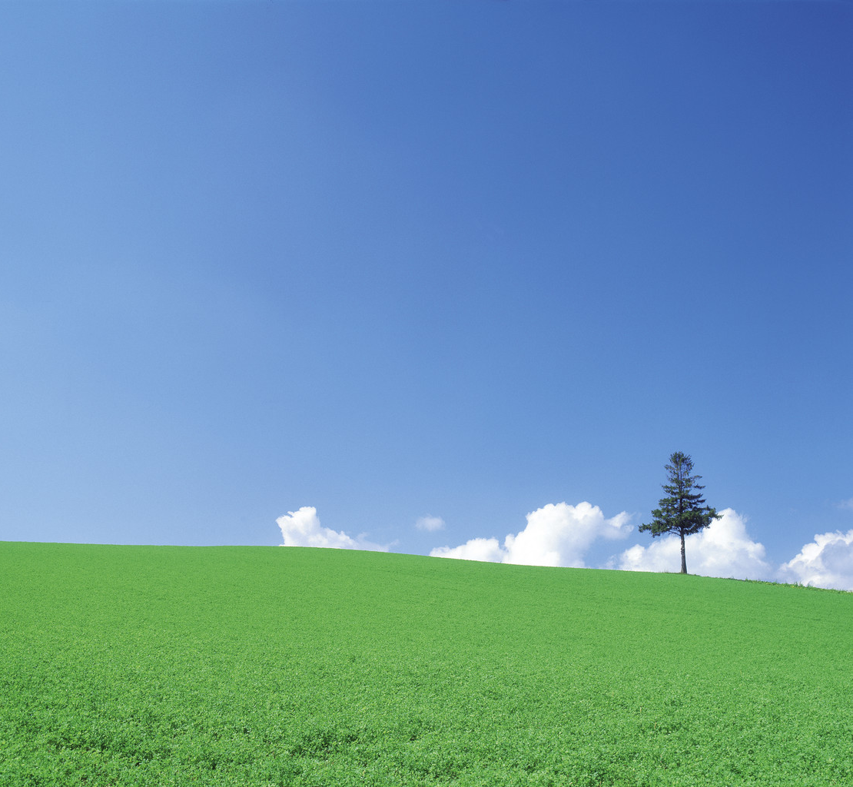
HOW DO ENVIRONMENTS MATTER?
How Do Environments Matter?
Communities of Opportunity
Good Health Status
Low- Income Communities
Parks
Sidewalks
Grocery Stores
Financial Institutions
Better Performing Schools
Good Public Transportation
Fast Food Restaurants
Liquor Stores
Unsafe/Limited Parks
Poor Performing Schools
Increased Pollution and Toxic Waste Sites
Limited Public Transportation
Poor Health
Status
contributes to health disparities:
Obesity
Diabetes
Asthma
Infant mortality
9
Notes:
9
Good health is the goal of every community but is more easily attainable when the environment and resources contribute to this goal. It is important to have safe and accessible parks, sidewalks, grocery stores, and public transportation in a healthy, safe, thriving community. This type of community also has excellent schools, financial institutions, and medical centers. The resources that contribute to “Good Health Status” are most often found in communities of opportunity while low-income communities are often inundated with fast food restaurants, liquor stores, and toxic waste sites. Low-income communities are typically faced with poor-performing schools, unsafe and/or limited parkland, and inadequate access to banks and public transportation. These contribute to “Poor Health Status” which can lead to serious health problems such as diabetes, obesity, asthma, and high infant mortality rates.

Slide 10
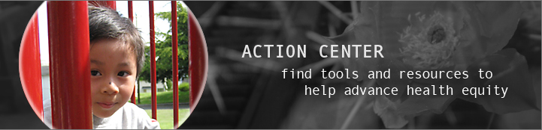
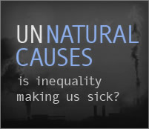
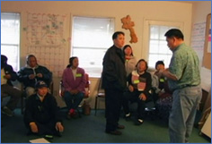
UNNATURAL CAUSES VIDEO: IN SICKNESS & IN HEALTH
10
Notes:
Before viewing the video clip, ask participants: “What are the connections between healthy bodies, healthy bank accounts and skin color?”
In this video clip, the lives of a CEO, a lab supervisor, a janitor, and an unemployed mother illustrate how class shapes opportunities for good health. Those on the top have the most access to power, resources and opportunity – and thus the best health. Those on the bottom are faced with more stressors – unpaid bills, jobs that don’t pay enough, unsafe living conditions, exposure to environmental hazards, lack of control over work and schedule, worries over children – and the fewest resources available to help them cope.

Slide 11
DISCUSSION: UNNATURAL CAUSES VIDEO: IN SICKNESS & IN HEALTH
Follow-up Questions:
What is the wealth-health gradient?
How is chronic stress different than “normal everyday” stress?
How might chronic stress increase risk of illness and disease?
How does racism threaten health?
11
Notes:
Concluding question: What impacts our health more?;
Individual responsibility
Social determinants?

Slide 12
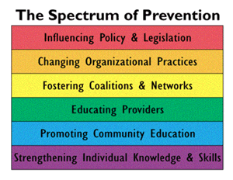
TOWARD SOLUTIONS:
12
Notes:
What do you think makes the most difference for communities?
The bottom of the spectrum, in the purple, is reaching one person at a time, is less sustainable, and puts the responsibility on the individual. How can we expect someone to make a change if their entire environment is conspiring against positive change?
Collaborations between community members, local government, businesses, schools, health care organizations, and public safety providers are needed in order to change the social conditions that negatively impact opportunities for healthy, safe, and thriving communities.

Slide 13
MOVING TOWARD HEALTH EQUITY
What is health equity?
All people have a right to health
No one is disadvantaged from achieving their health potential because of their social position or other socially determined circumstance
13
Notes:
*Intergenerational (IG): More likely to feel isolated and depressed due to ageism, which then can lead them to having many health issues

Slide 14


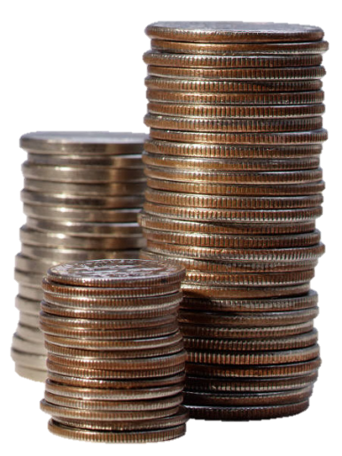
STRATEGIES TO CREATE SOCIAL EQUITY
Fiscal
Policies
Education
Skills Training Policies
-construction
-green jobs
-logistics
-utilities
-water and
waste water
14
Adapted from: Reaching for a Healthier Life, The John D. and Catherine T. MacArthur Foundation Research Network on Socioeconomic Status and Health
Notes:
All of these pieces work together to create social equity.
Education
Pre-school for all children
Reform school financing
College access for qualified students
Fiscal Policies
Minimum wage increase
Earned income tax credits
Increased incentives for saving
Income support for families with newborns
Skills Training Policies
New or enhanced job skills training
Training for middle-skill jobs projected for future growth:
-construction
- transportation construction
-green jobs
- solar roofing
- building retrofitting for efficiency
-logistics
- shipping and movement of goods
-utilities
- telecommunications
- power
-water and waste water
- storm water systems

Slide 15
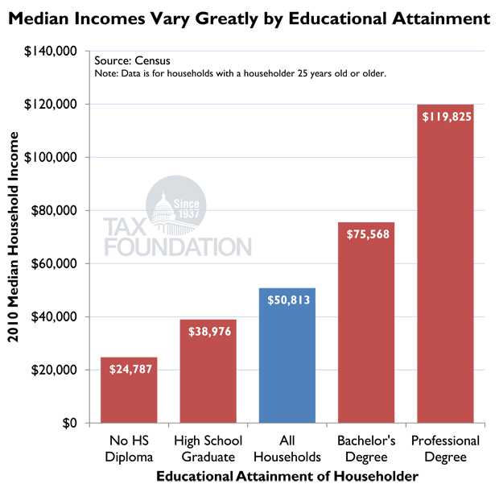
EDUCATION & EMPLOYMENT
15
Notes:
Source: http://taxfoundation.org/article/putting-face-americas-tax-returns-chart-24

Slide 16
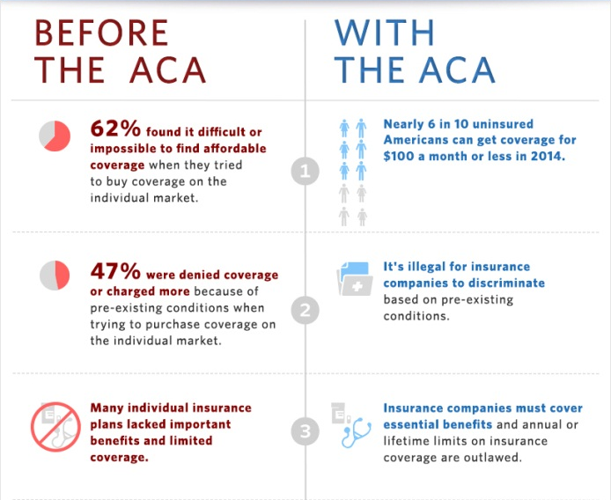
HEALTH CARE AND HEALTH INSURANCE
16
Notes:
Many people who cannot afford health insurance face challenges in receiving medical care, or do not go to the doctor when they are ill because they lacked health insurance. The Affordable Care Act, which began in 2014 and is sometimes known as Obamacare or Covered California, has changed that for many families. Since the Affordable Care Act passed, more than 7 million people now have private health insurance. The Affordable Care Act is a good example of a law that community members, health care providers, and elected officials advocated and championed for many decades before it was passed, but has already changed who has access to key services in our country.
Having health insurance is just the first step. It’s also important to have access to clinics and hospitals, access to health screenings and preventive health.

Slide 17
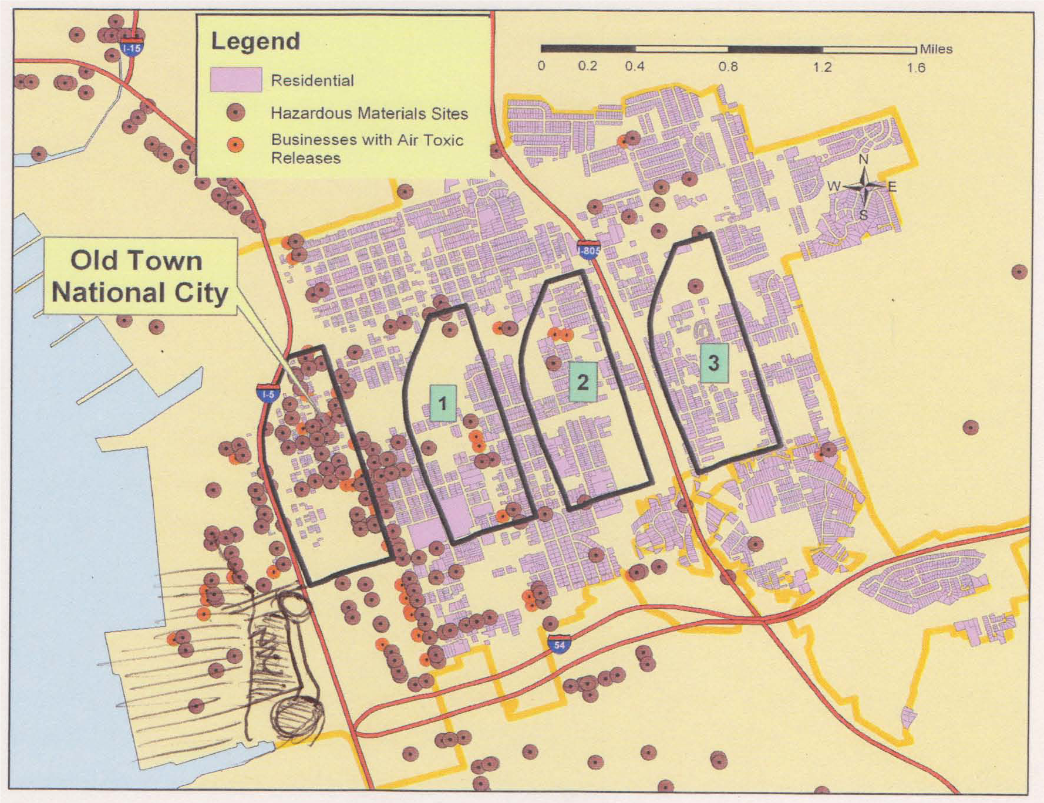
DISADVANTAGED NEIGHBORHOODS: TOXINS
17
Notes:
[Explain that toxins and chemical industry are close to where people live. The red circles represent hazardous materials sites, and the light purple represent residential areas.
Source: www.environmentalhealth.org

Slide 18
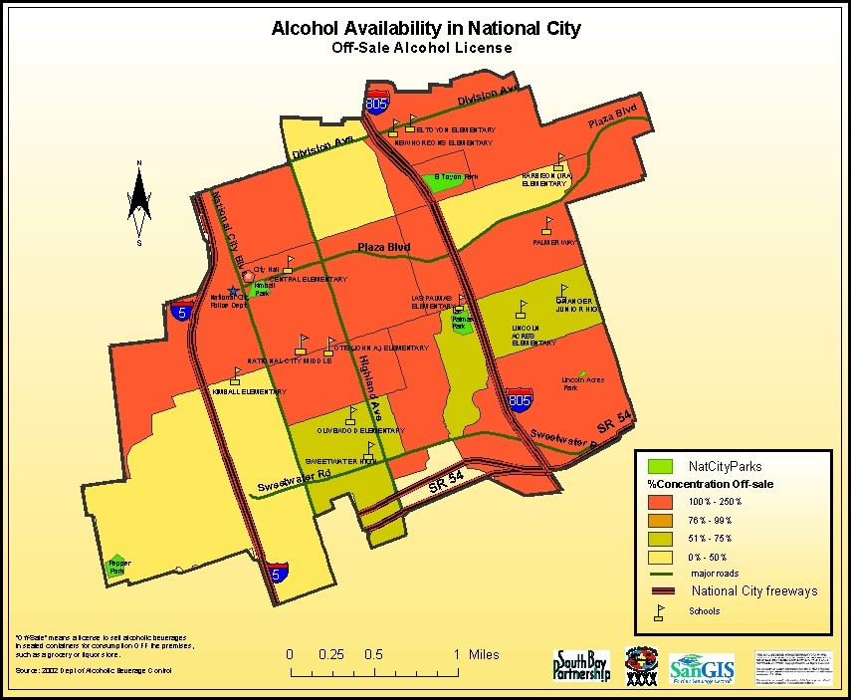
DISADVANTAGED NEIGHBORHOODS: ALCOHOL
18
Notes:
This slide shows the density of stores that sell liquor in National City.

Slide 19
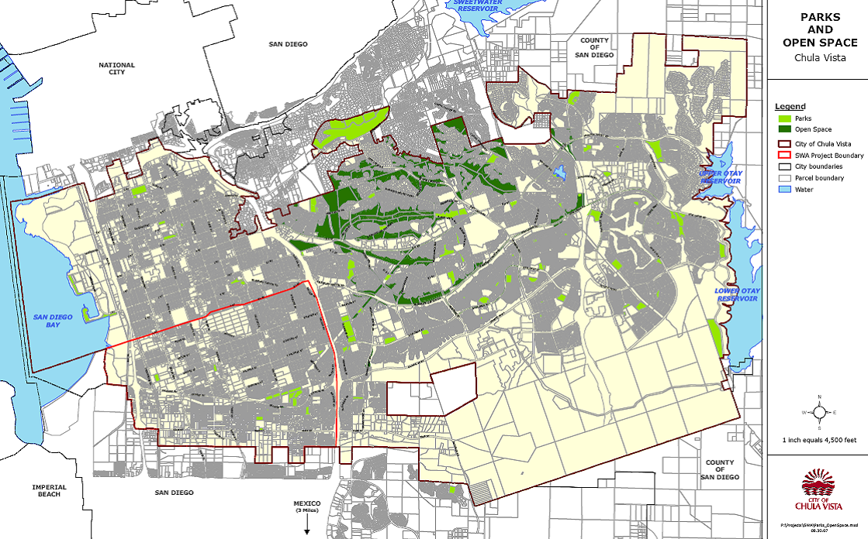
DISADVANTAGED NEIGHBORHOODS: PARK SPACE
19
Notes:
This slide shows how much park space there is in Chula Vista.

Slide 20
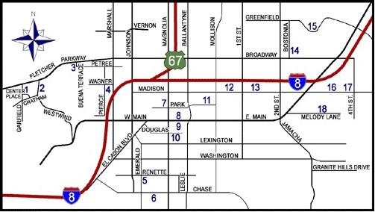
EL CAJON PARK SPACE
20
Notes:
The numbers shows park spaces. Areas with lots of housing with a high concentration of immigrants and refugees lack park space. This is an example of health inequity.

Slide 21

Social Determinants to Health
SUMMARY
MORE LIKELY in Lower-income Communities:
More exposure to violence
Unstable and unhealthy housing
Presence of toxins and pollutants
Less playgrounds, parks, and safe places to exercise
More fast food (than healthy food)
More liquor stores
Less libraries
21
Adapted from: Reaching for a Healthier Life, The John D. and Catherine T. MacArthur Foundation Research Network on Socioeconomic Status and Health
Notes:
The characteristics of low income neighborhoods undermine health. Neighborhoods are where poverty, race, ethnicity, and other social factors converge with the physical environment to produce the overall conditions that affect health.

Slide 22
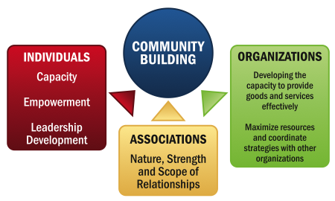
COMMUNITY BUILDING
22
Notes:
COMMUNITY BUILDING
generally refers to building the social networks within the community, and developing group and individual problem-solving and leadership skills.
Source: Community Building: What Makes it Work A Review of Factors Influencing Successful Community Building
Amherst H. Wilder Foundation

Slide 23

DOES COMMUNITY BUILDING MATTER?
YES
NO
22
23

Slide 24
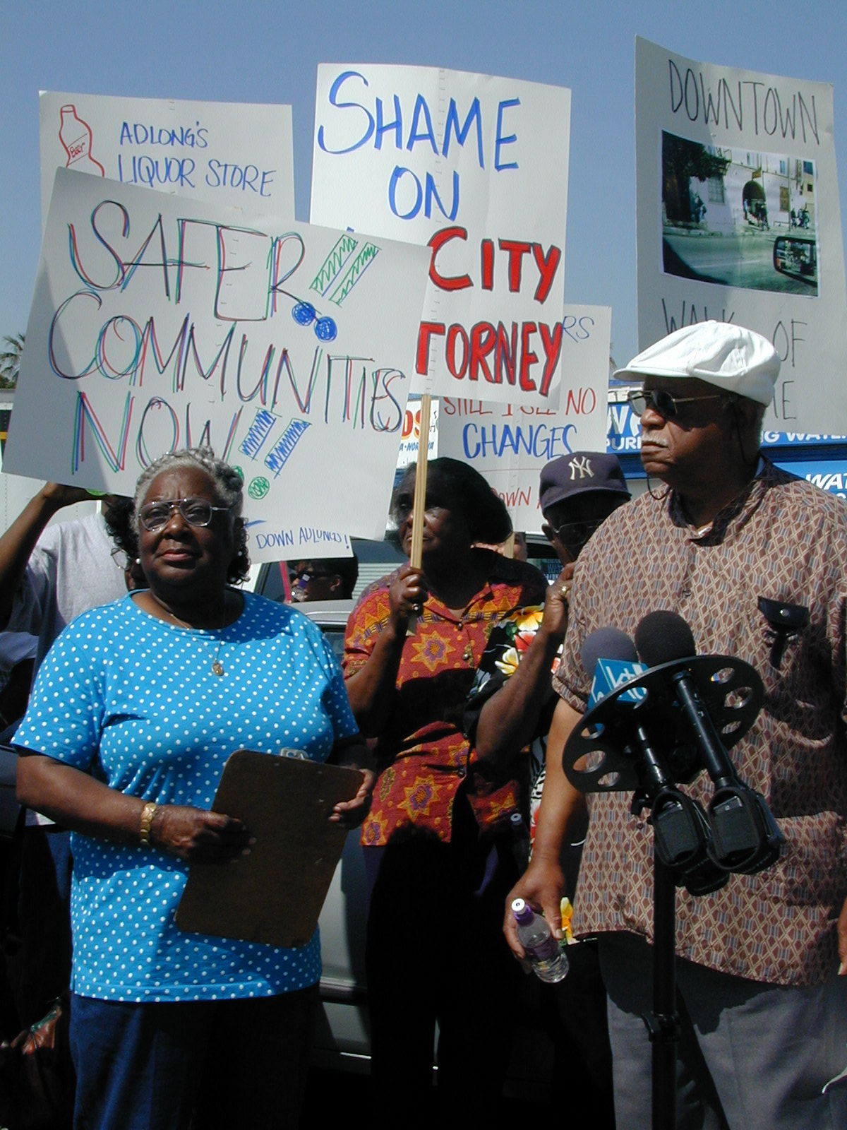
COMMUNITY-BUILDING
South Los Angeles Liquor Store Closures Example
Residents were concerned about the high number of liquor stores and high crime rates in their community
Shut down 200 liquor stores in 3 years
An average 27% reduction in crime within a four-block radius of each closed liquor outlet
23
Notes:
In South Lost Angeles, evaluations documented a 27% reduction in violent crime/felonies, drug-related felonies or misdemeanors and vice (e.g. prostitution) within a four-block radius of each liquor store that was closed.

Slide 25
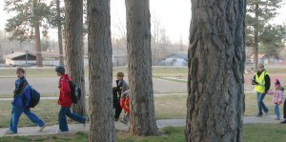
Flagstaff, Arizona Safe Routes to School Example
COMMUNITY-BUILDING
Due to safety concerns at the nearby park, parents did not allow children to walk to school
A neighborhood committee
began a walking school bus
A “No Sales 40” initiative banned
  the sale of 40-ounce glass bottles of alcohol around the park to reduce crime
24
Notes:
Evidence that these kinds of efforts can have an impact on health and safety….
70% of students live within walking distance of the elementary school, but didn’t walk because the park was unsafe.
Community started a walking school bus – walking school bus is often led by a parent or other community member. The parent walks to “stops” on the route to school and picks up children, who join the group. This allows children to walk together, which safer and more fun.
With safe routes to school funding…

Slide 26
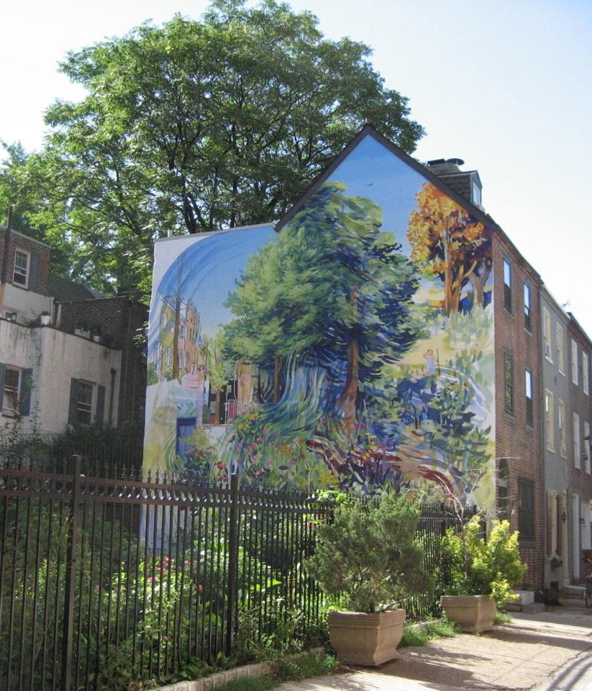
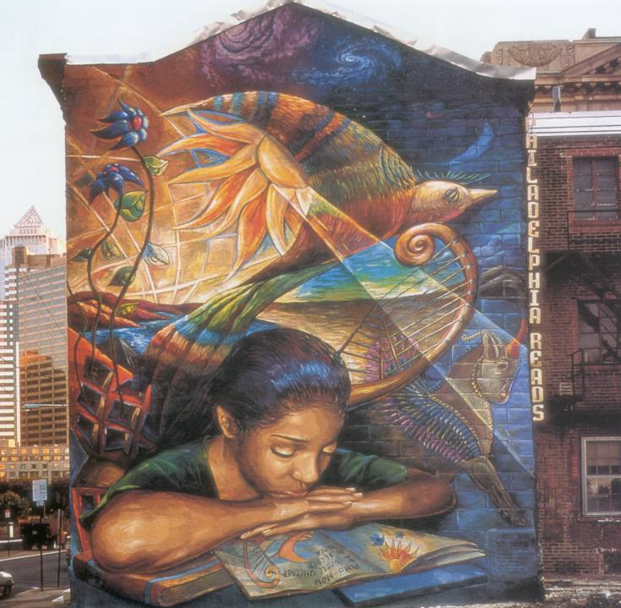
COMMUNITY-BUILDING
Philadelphia Mural Arts Program Example
25
Notes:
Has created nearly 2,500 murals citywide since the mid-1980’s
Employs youth and engages community residents in mural design and creation
Research suggests that public art increases sense of well-being and social connectedness

Slide 27

Homework Options:
CONCLUSION
TAKE PHOTOS:
- Take a walk in your local park or neighborhood.
Document your concerns in photos
PRACTICE ASSESSMENTS:
- Use the “Park Audit” and/or “Neighborhood Assessment” tools to asses your neighborhood and/or park.
SHARE YOUR FINDINGS:
- Turn in your completed assessment forms NEXT WEEK
- Email your photos
THANK YOU!
Questions or Comments?
26
Notes:
Hand out copies of “Park Audit” and/or “Neighborhood Assessment” found in the appendix of the facilitator manual.

