Slide 1

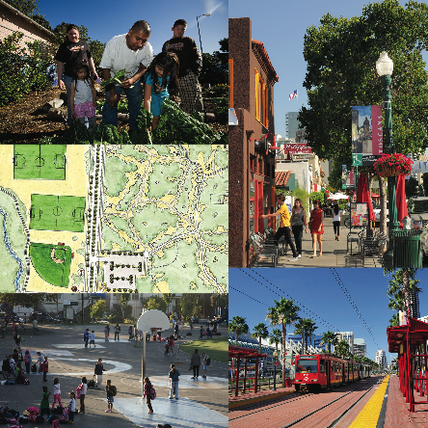
Resident Leadership Academy
SESSION SIX
LAND USE
AND COMMUNITY
PLANNING
1

Slide 2
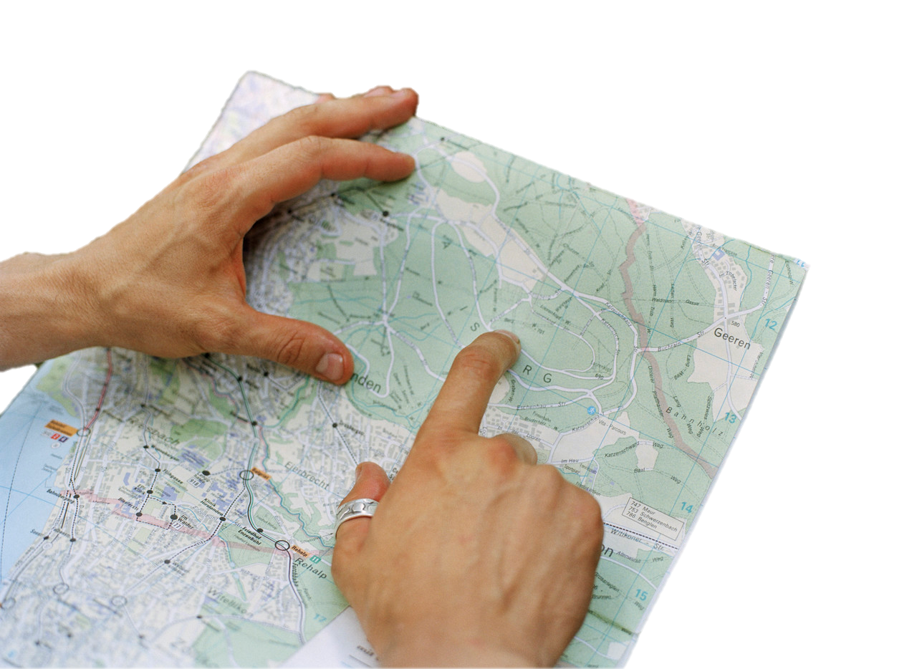
Session 6:
Land Use & Community Planning
AGENDA
Welcome/Review
Community Design
Guest Speaker
Community Planning 101
Taking Action
Conclusion
Session Objectives:
1. To build awareness of the link between community design & health
2. To understand the mechanics behind how we build our environments
3. To learn how people can shape and influence their community’s design to support more active, healthier living
2

Slide 3

SESSION REVIEW
Healthy Food Systems Session
  Something you learned that is useful
  A question you have
  A homework activity you completed
  Things that you would change/improve from session
  Report by participants
3

Slide 4

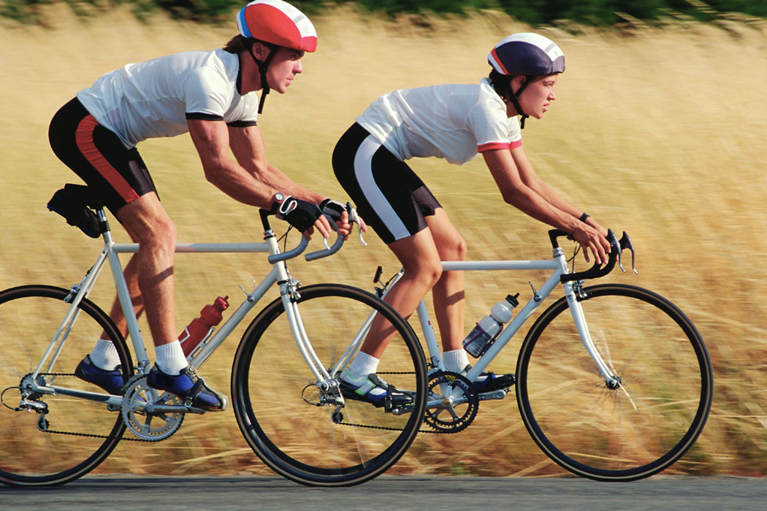
HOW DID YOU GET TO THE WORKSHOP TODAY? WHY?
4
Notes:
Q: (For those who drove) Why did you drive?
Explain that, as the facilitator, you want to understand a little more about the community context, e.g., was the location too far away to walk to? Is transit poor in the community? Are there no bike routes?
Q: Our meeting here today is just one example of getting from place to place, how often are you able to utilize these different modes of transportation? Why or why not?
Many of the transportation decisions are often influenced by the built environment of the community and the way our communities are designed and laid-out either expands or limits our transportation choices and that they can make biking, walking, and transit possible and even easy to use.

Slide 5
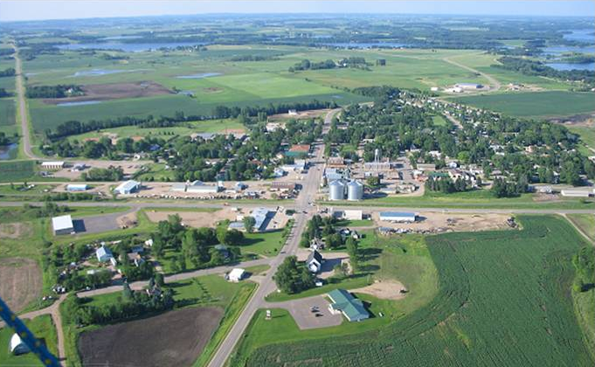
What is the built environment?
Q: WHAT IS THE BUILT ENVIRONMENT?
A: All aspects of our surroundings that are constructed by people: buildings, roads, parks, etc.
5

Slide 6
HOW DOES OUR BUILT ENVIRONMENT AFFECT OUR HEALTH?
Research shows there is a relationship between how our communities are laid out and our health
Strong links exist between the transportation choices we make
and health risk factors
Clear links exist between limited
physical activity opportunities and
obesity & chronic diseases
(heart disease, stroke, diabetes, etc.)
6
Notes:
Our transportation choices affect our health in that, many of us spend more than an hour a day in our automobiles going to and from work, running errands, and doing our other daily activities. Making even a small number of those trips by walking, cycling, or transit would increase our daily exercise enough to significantly reduce our risk for chronic diseases.

Slide 7
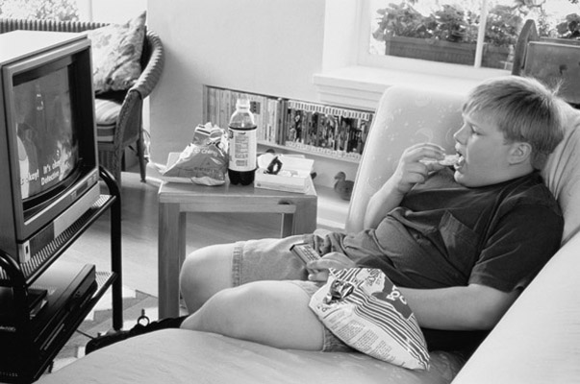

TRENDS AMONG YOUTH
1 in 3 high school youth do not engage in vigorous physical activity
Less than 30% regularly attend a daily physical education class
Children spend more time watching TV and playing video games each year than they do attending school
7

Slide 8
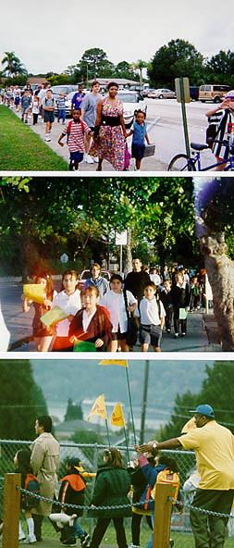
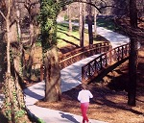
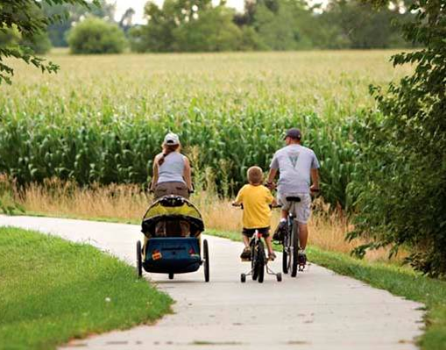
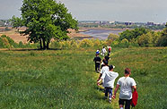
PLACES THAT HAVE DEVELOPED AN ACTIVITY-FRIENDLY ENVIRONMENT
WITH ACCESS TO FRESH, HEALTHY FOODS WILL HAVE HEALTHIER PEOPLE
8

Slide 9
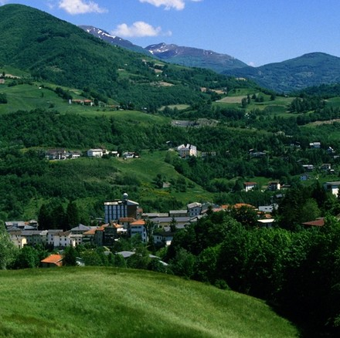
COMMUNITY PLANNING 101
I. Land Use and Community Planning 101
  i. Land Use Documents
  ii. Transportation &
  Regional Planning
II. Local Decision-
Makers & Key
Stakeholders
9

Slide 10
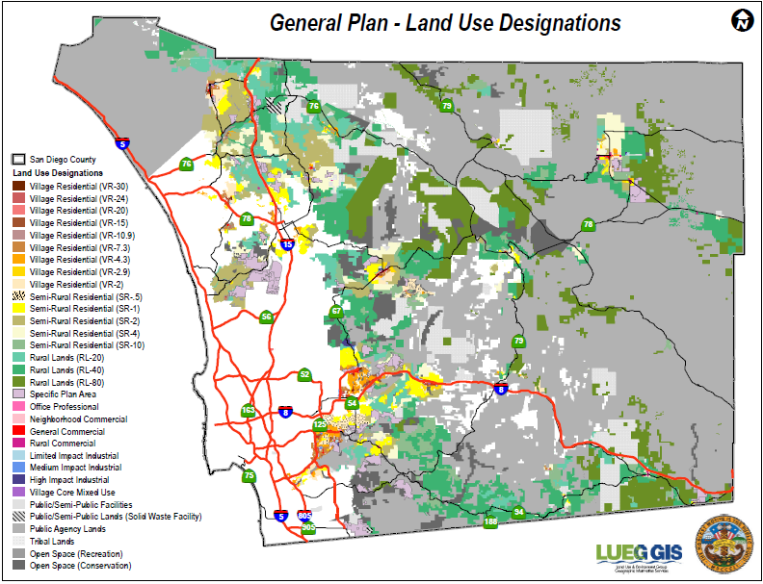
GENERAL PLAN
10
Notes:
Required by state law for all cities & counties
•“Blueprint” for guiding growth & development
•Must consist of 7 elements: Land Use, Circulation, Housing, Safety,
Conservation, Noise, and Open Space
• Board of Supervisors adopted update to General Plan in August 3, 2011

Slide 11
Implementing the General Plan
GENERAL PLAN
SPECIFIC PLAN / ZONING
FACILITY / SERVICE MASTER PLANS
PROJECTS
11
Notes:
The GP provides the 30,000 foot view/vision for the City; Zoning and SP start to taper down to the District Level;

Slide 12
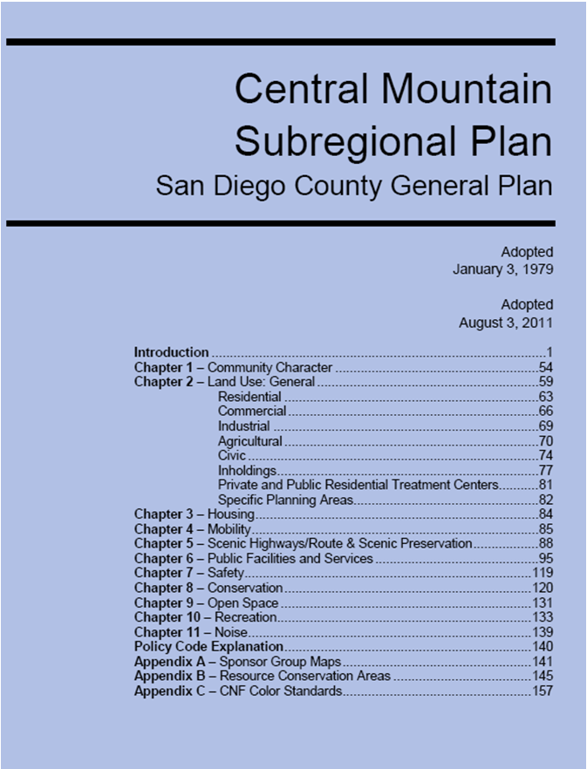
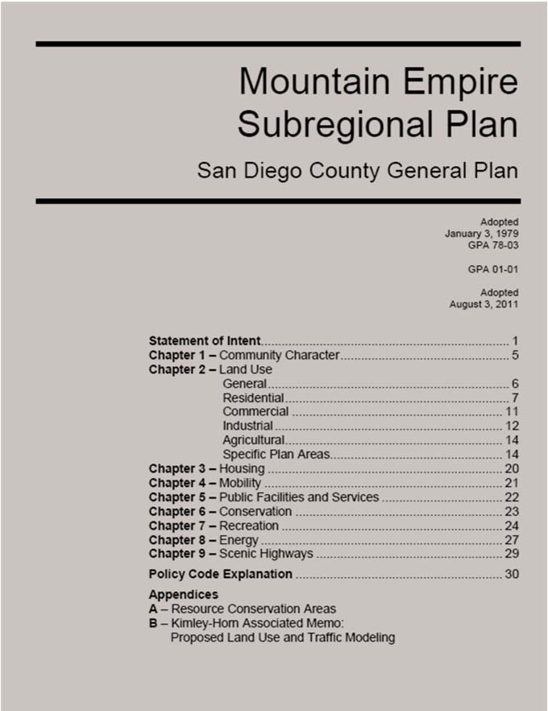
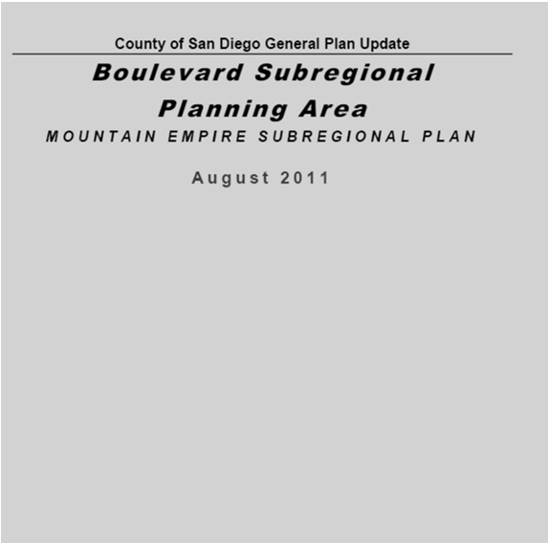
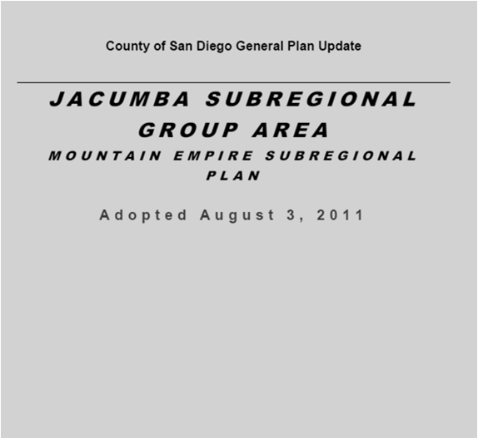
COMMUNITY AND SUBREGRIONAL PLANS
12

Slide 13


IMPLEMENTING THE GENERAL PLAN
Community & Subregional Plans (Mountain Empire, Pine Valley, Boulevard, Potrero)
Specific Plans (Ketchum Ranch)
Zoning Ordinance
Other County Ordinances (Subdivision, Resource Protection, Grading, Groundwater, Noise, Landscaping, Watershed Protection, Biological Mitigation)
13

Slide 14
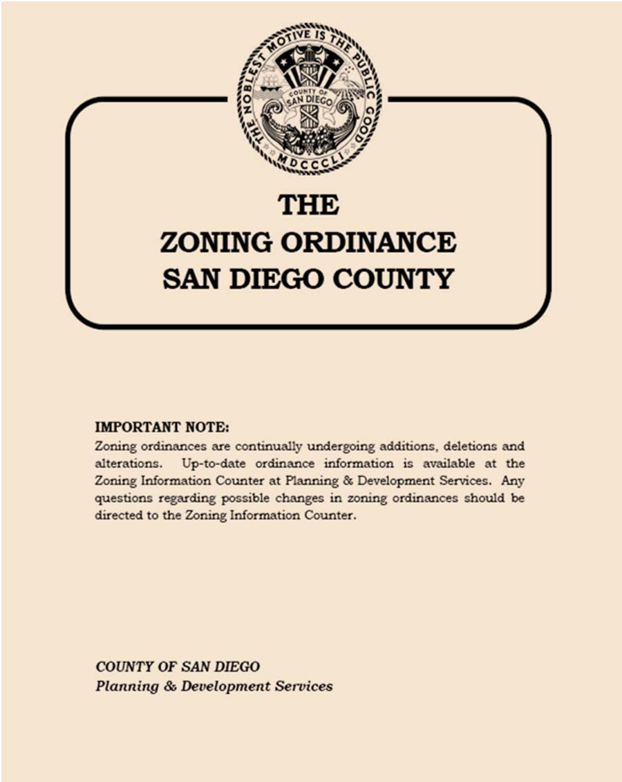
SAN DIEGO COUNTY ZONING ORDINANCE
Regulates land uses by assigning zones to each property
Zones distributed based on General Plan
Each zone identifies allowable uses and sets development standards (minimum lot size, building height limits, and building setbacks)
Zoning Use Regulations:
  Residential (R)
  Agricultural (A)
  Commercial (C)
  Manufacturing and Industrial (M)
  Special Purpose (S)
14

Slide 15
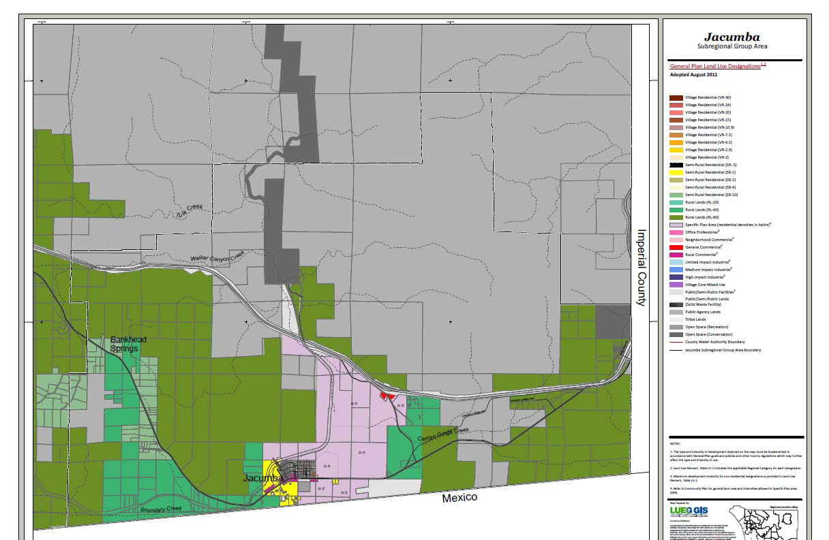
SPECIFIC PLANS
Establish new zoning for a portion of a community
Describe allowable land uses, identify open space areas, & detail infrastructure availability and financing
Must always be consistent
Ketchum Ranch Specific Plan
• 1,300 acre multi‐use community
• Density: 1.7 dwelling units per acre
• Residential uses mixed with recreational
and visitor‐oriented commercial uses
15

Slide 16
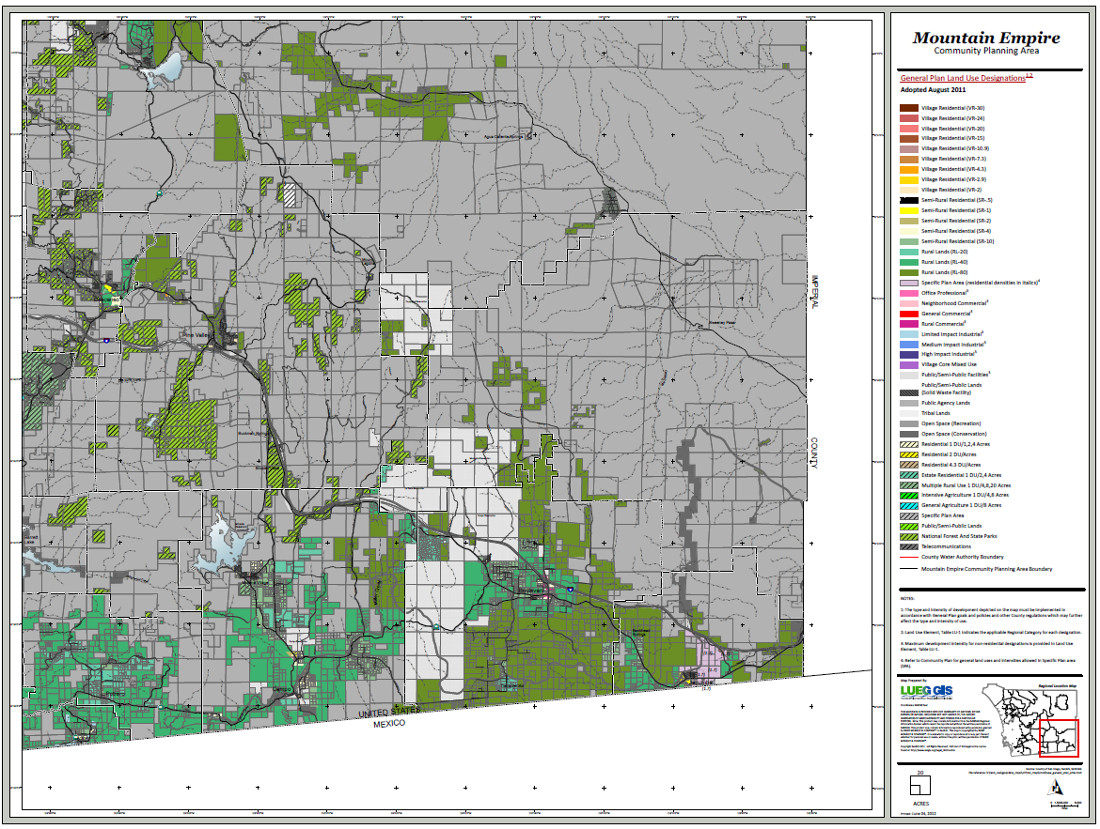
MOUNTAIN EMPIRE SUB-REGIONAL PLAN
16

Slide 17
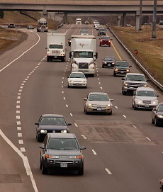

TRANSPORTATION
Transit Access
Transit-Oriented Development
Traffic Safety and Reduction
“Continuing to build freeways is not exactly good planning … it’s inefficient and not good for the environment”
– San Diego Resident
17

Slide 18
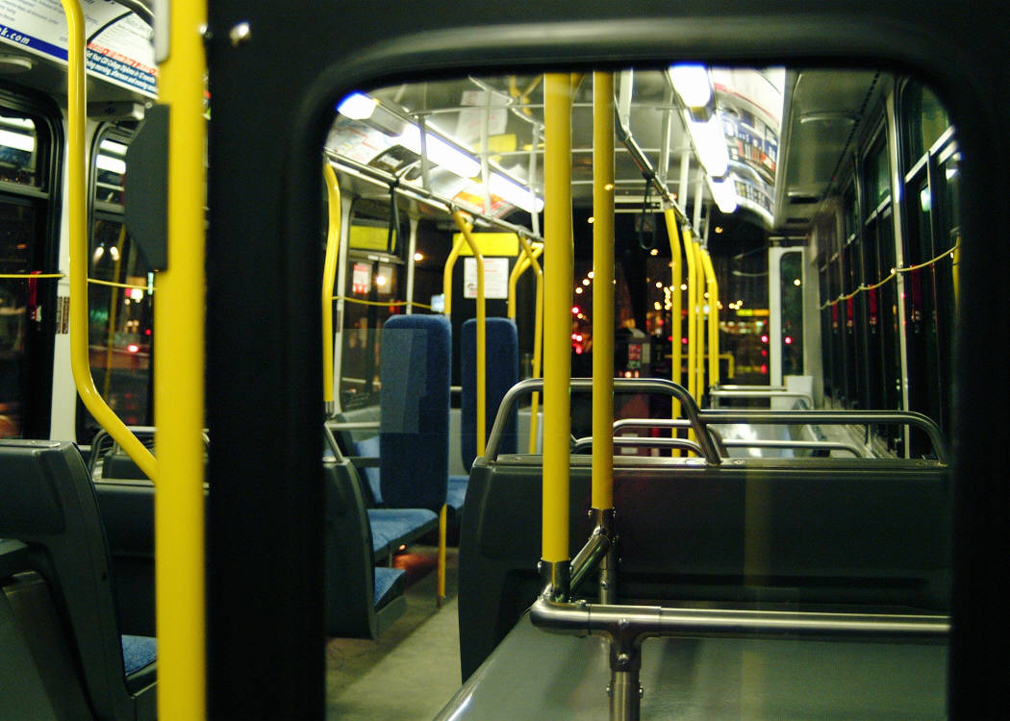
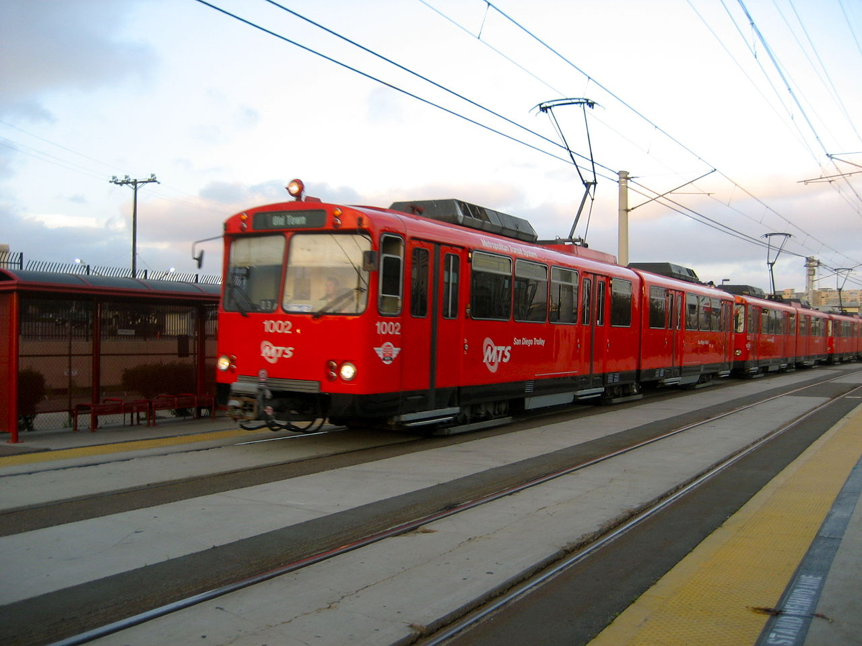
ACCESS TO BUS STOPS
Access to
Bus Stops
Trolley Extension
18

Slide 19
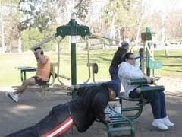

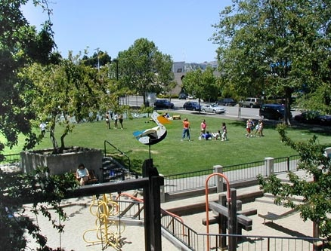
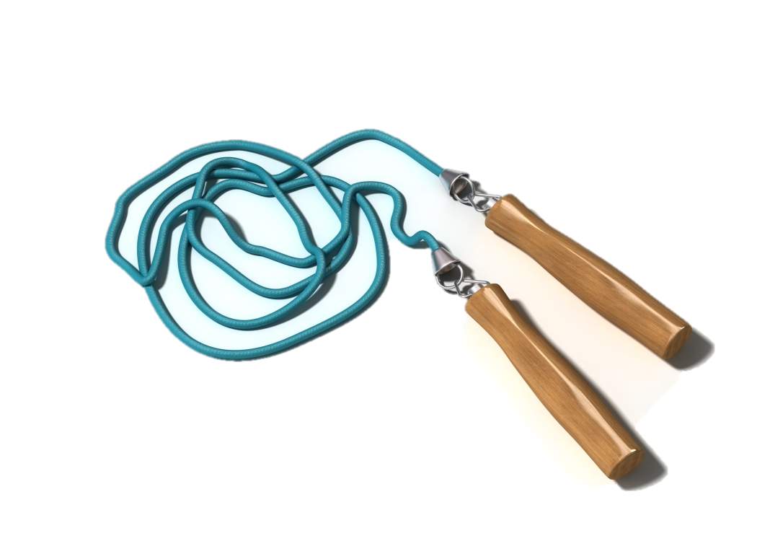
PHYSICAL ACTIVITY
Bicycle and Pedestrian Access
Parks and Recreation Facilities
Joint Use
Healthy Fitness
Zones
19

Slide 20
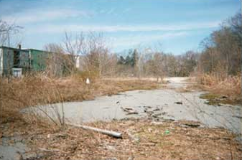
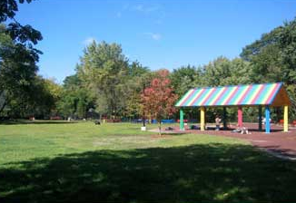
ENVIRONMENTAL QUALITY
BEFORE
AFTER
Pollution
Brownfield Clean-up
Brownfield is property that may involve complicated redevelopment efforts due to the presence or potential presence of a hazardous substance, pollutant, or contaminant.
20
Notes:
Source: EPA webpage: http://www.epa.gov/brownfields/about.htm

Slide 21
Impact of Community Design on Activity
Variable | Outcome
Mix of Land Use | 19% increase in walk/bike trips w/ mixed land use
Presence/Proximity of Convenience Services | 27% increase in walk/bike trips w/ high presence and good proximity of convenience stores
Perceived Traffic Safety | 88% increase in walk/bike trips in areas perceived as more safe
Perceived Aesthetics | 50% increase in walk/bike trips in areas perceived as more aesthetically pleasing
Development of Bikeway | 57% increase in bicycling in areas with dedicated bikeways
Availability of Parks and Trails | 75% of inactive people believe there are too few parks and recreation facilities.
Policy Support | 55% support more bike paths, 62% more sidewalks, 60% for improved connections to destinations, and 57% improving mass transit.
21
Notes:
Mix of Land Use – land use that allows for a variety of users (including bicyclists, walkers, drivers, transit riders, sports teams, hikers, shoppers, picnickers, etc.)
Sources: Cambridge Systematics 1994; UNC-Highway Safety Research Center 1994; EPA/CDC Greenstyles Survey 1999; Nebraska Social Indicators Survey 1999

Slide 22
Financial Cost of Sedentary Lifestyle
  Sedentary Active
  Smoker $1,448 $1,079
  Non-smoker $1,234 $953
  All $1,349 $1,019
  Population level cost estimates
  1987 $ 29.2 billion
  2000 $76.6 billion
  2002 $104.4 billion
  2004 $117.1 billion
22
Notes:
Source: Michael Pratt et al, Physician and Sports Medicine, 28,10, October 2000. CDC 2004

Slide 23


Healthy Community Design
Video Source: Dr. Frumkin, Center for Disease Control
23
23
Notes:
[VIDEO: Summarizing health benefits and healthy community design principles: http://www.cdc.gov/healthyplaces/healthy_comm_design.htm ]

Slide 24
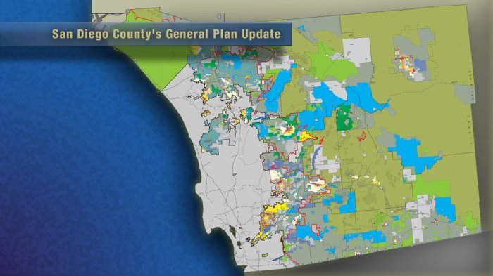
Land Use
*General Plan – Cities or County’s “blueprint” – every 20 years – project into the future
*Area, Community and Specific Plan - adjusts to General Plan’s vision
*Master Plans (e.g. Pedestrian, Bicycle)
*Zoning Ordinances uses and density (i.e. Re-zoning an area to include residential)
24
Notes:
GENERAL PLAN:
defines and communicates the county’s vision
Provides long-term outlook
identifies the types of development that will be allowed, the spatial relationships among land uses
Required by state law that each city and each county adopt a general plan containing (at least) the following seven components or "elements": land use, circulation, housing, conservation, open-space, noise, and safety.
AREA/COMMUNITY PLANS:
optional components of the local general plan
Focus particular area or community
SPECIFIC/MASTER PLANS:
focus heavily on implementation for a specific area
adopted separately from the general plan & required to include: land use plan, an infrastructure development and financing plan, and development standards
ZONING:
local law that spells out the immediate, allowable uses for each piece of property
regulates present development through specific standards such as lot size, building setback, and a list of allowable uses
DENSITY:
intensity of the use is a particular area
Caveats: Applying for variances, “grandfather in” clauses, conditional use permits,

Slide 25
WHO MAKES LAND USE DECISIONS?
Citizens of San Diego County
Planning Commission (Appointed)
Board of Supervisors
Chief Administrative Officer
Public Safety Group
Health & Human Services Agency
Land Use & Environment Group
Community Services Group
Finance & General Gov’t Group
Planning Director
25
Notes:
Board of Supervisors - Working to provide San Diegans with an environment that is safe, healthy, thriving and innovative.

Slide 26

Land Use & Environment Group
  • Air Pollution Control District
  • Agriculture, Weights and Measures
  • Environmental Health
  • Farm and Home Advisor
  • Parks and Recreation
  • Planning and Development Services
  • Public Works
Working to provide San Diegans with an environment
that is safe, healthy, thriving and innovative.
26

Slide 27
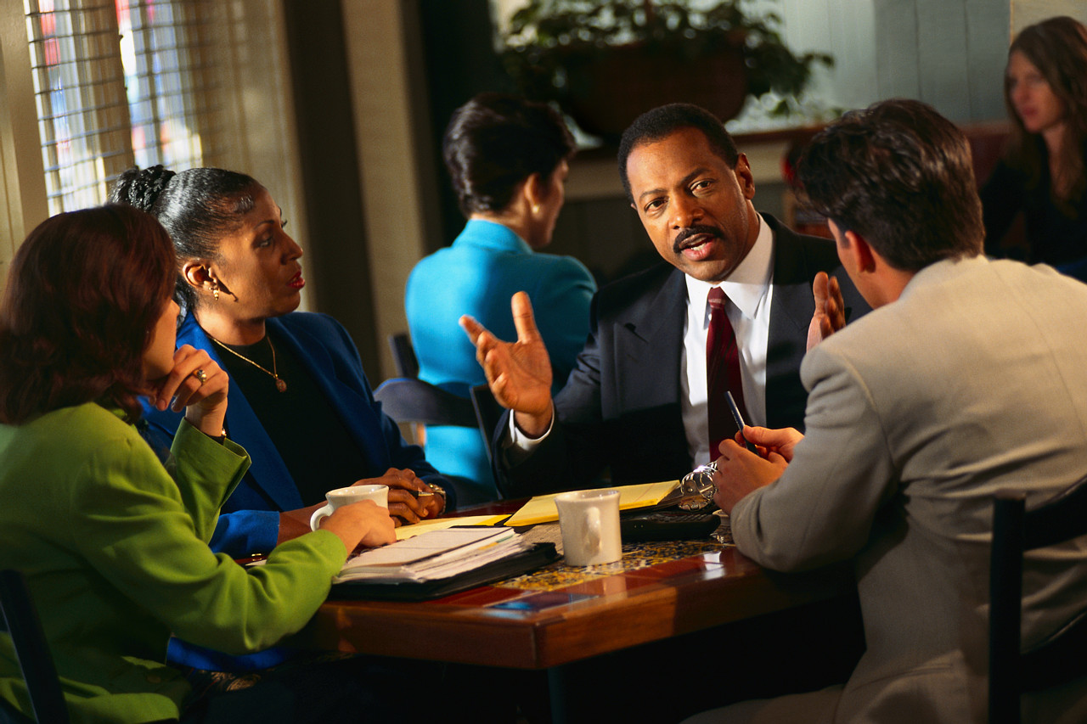
What Role Do Stakeholders Play?
Elected Officials (i.e. Board of Supervisors)
• Appointed Officials (i.e. planning commission)
• Agency Staff (i.e. health dept., schools, parks & rec)
• Community Planning, sponsor groups, and other stakeholders
27

Slide 28
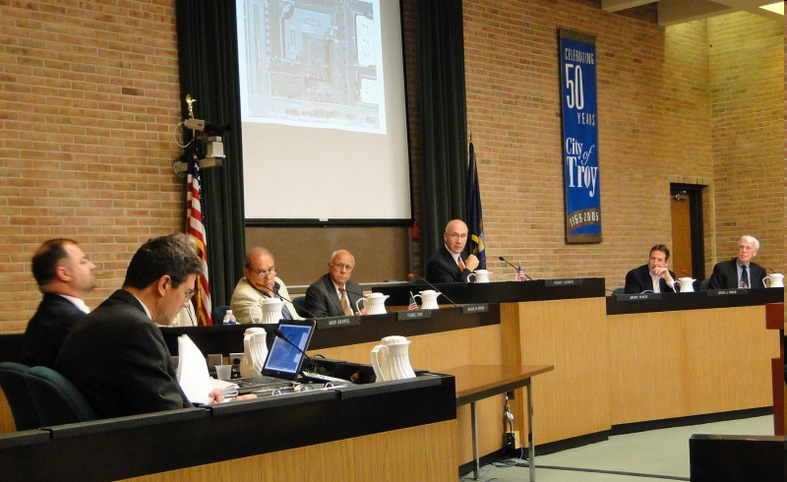
Commissions:
Advise policymaking & development process
Review proposed developments
Set conditions for development
Direct agency staff
28
© Planning CommissionerJournal

Slide 29
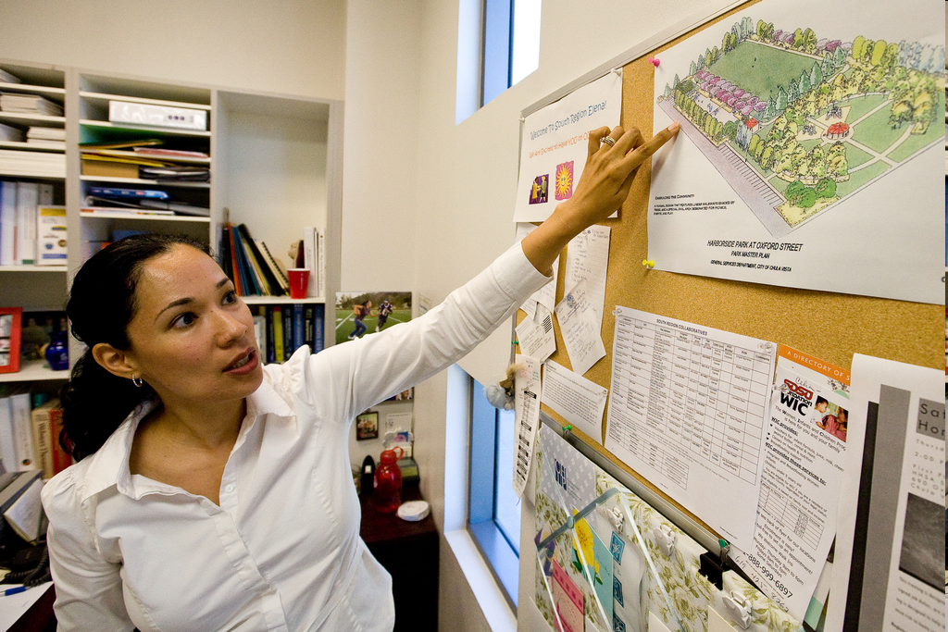
City Planners:
Prepare, review, & revise plans/ordinances
Implement & interpret plans/ordinances
Oversee development
Seek funding for implementation
29
Photo courtesy of Tim Wagner for HEAC

Slide 30
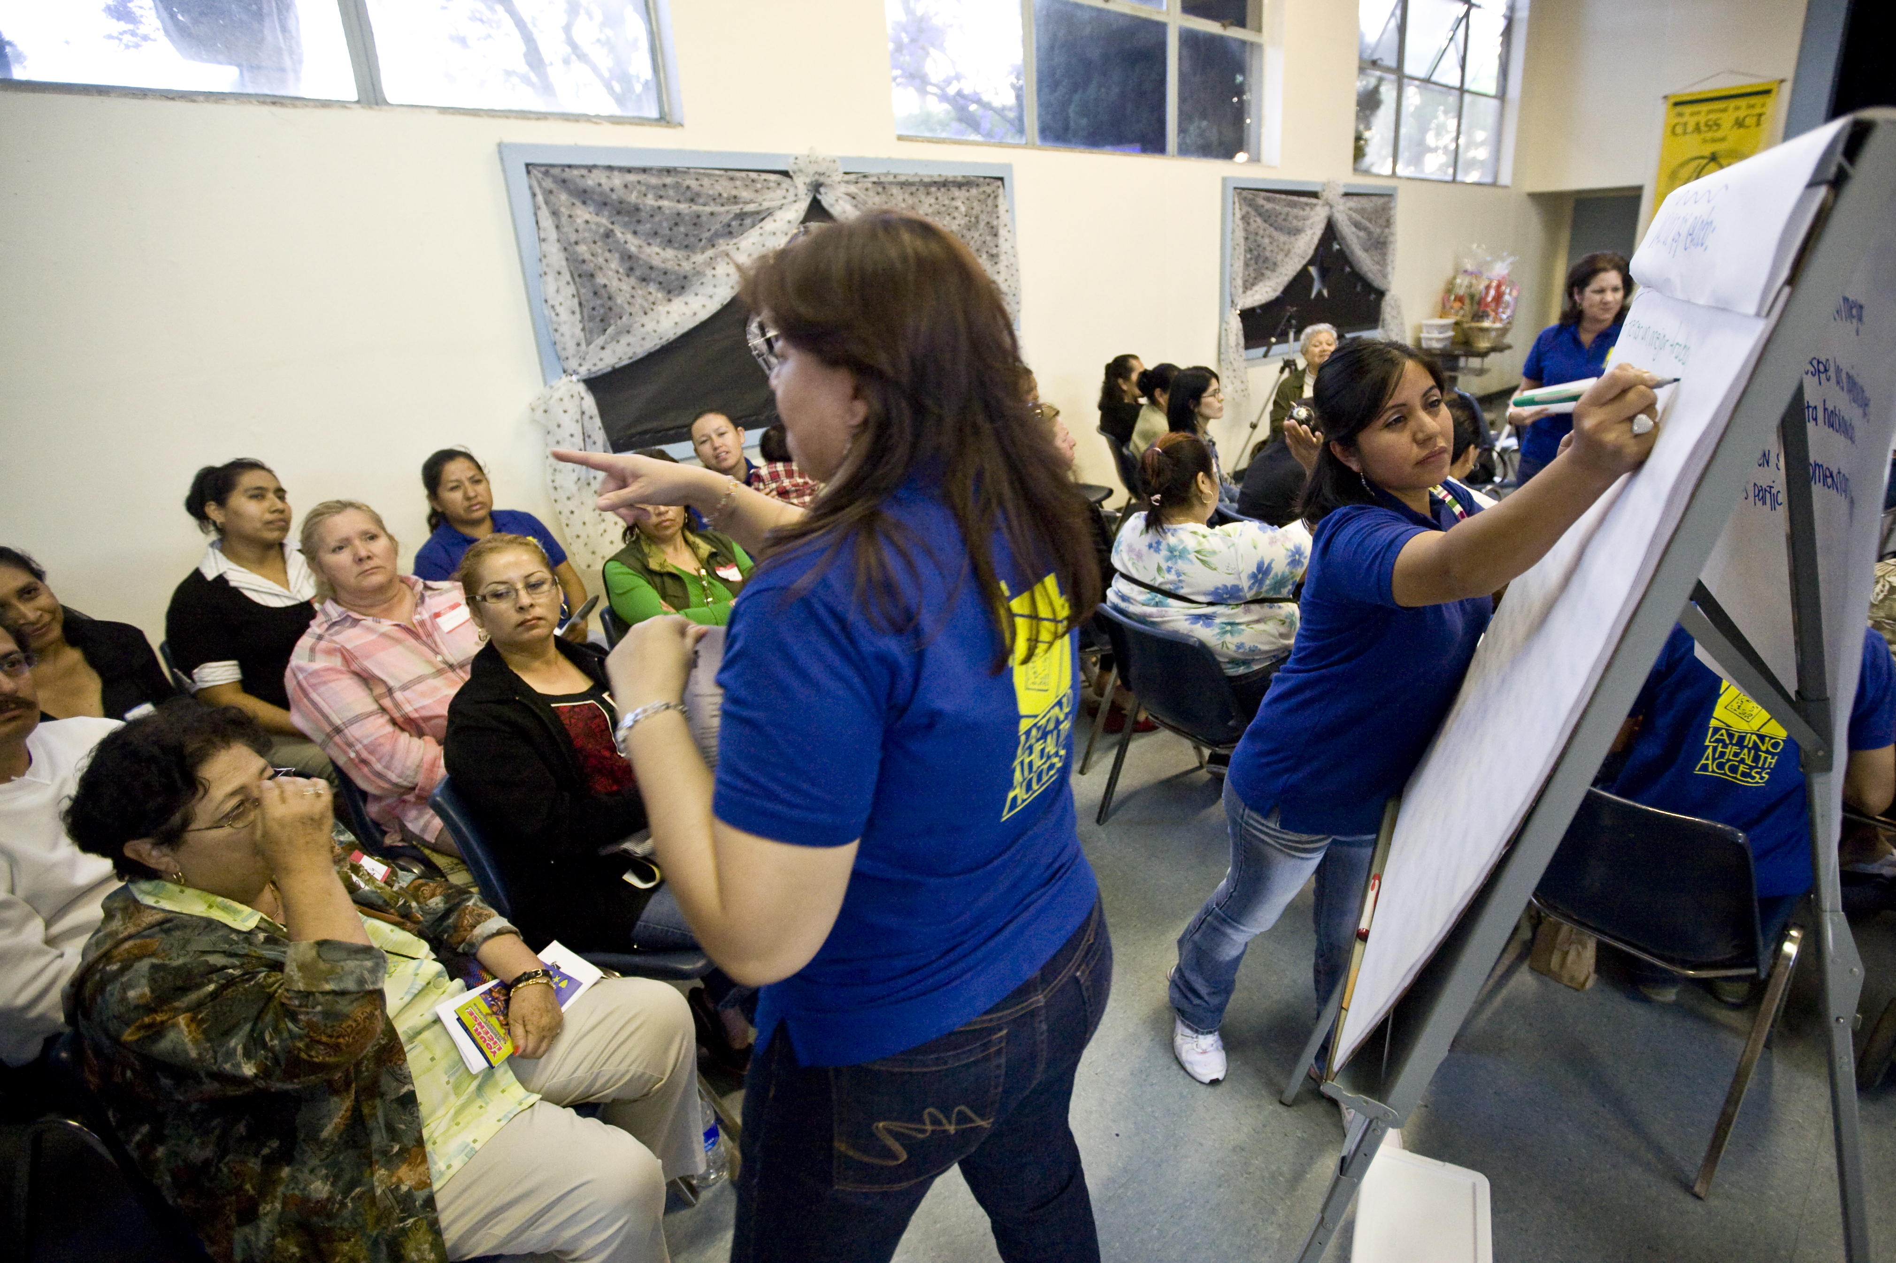
Public Health:
Share health data
Organize community participation
Partner on implementation
Participate in development review
30
Photo courtesy of Tim Wagner for HEAC

Slide 31
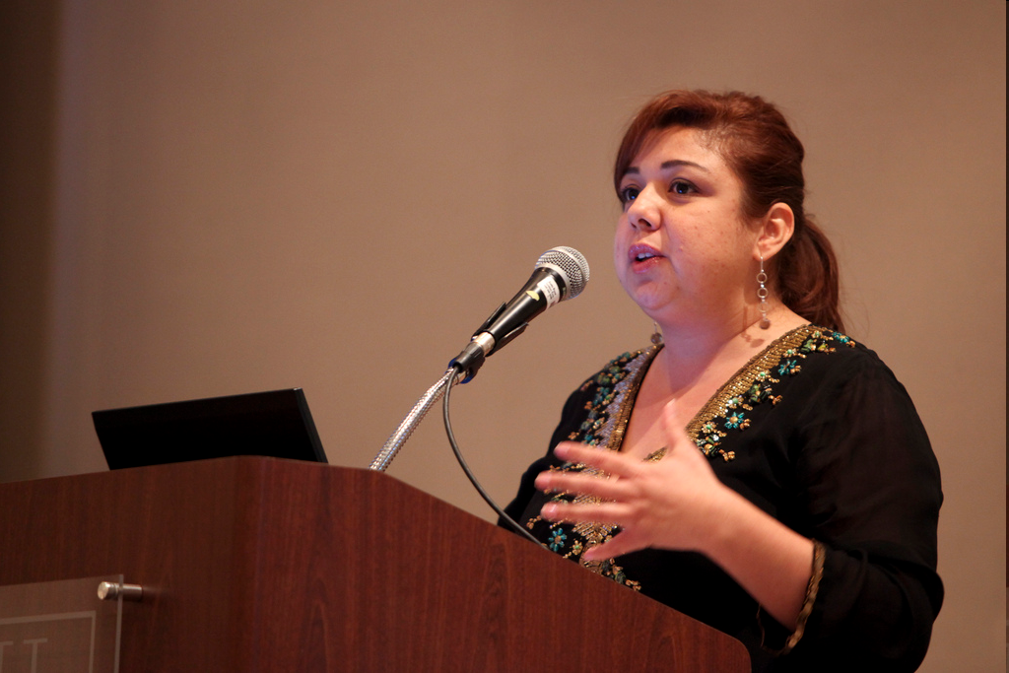
Other Agencies:
Schools (joint use)
Parks & Rec (maintenance, programming)
Public Works (complete streets, sidewalks, traffic calming)
Photo courtesy of Tim Wagner for HEAC

Slide 32
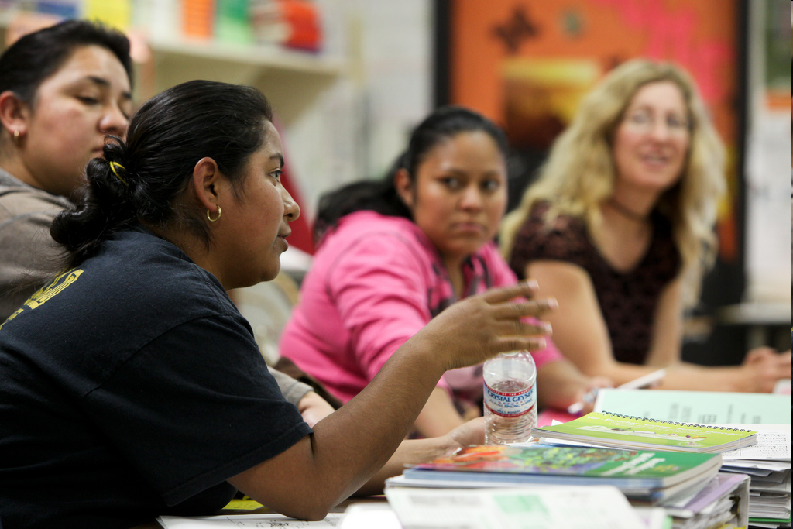
Community Residents:
Cultivating elected champions
Sharing community priorities
Public-private partnerships
32
Photo courtesy of Tim Wagner for HEAC

Slide 33
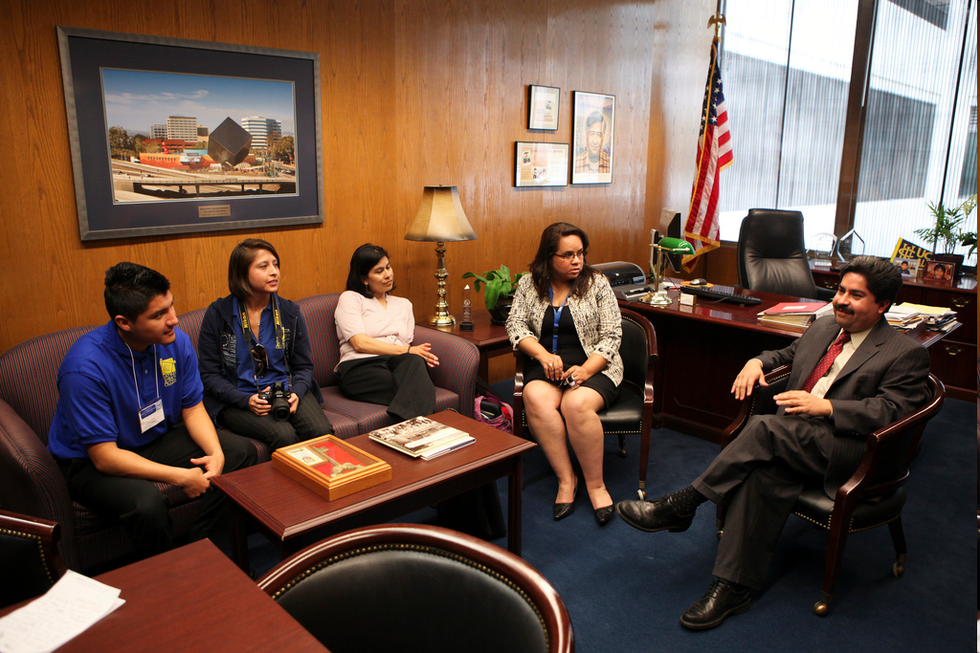
We’re interested in building a new community park!
Let’s talk about what it will take to make that happen.
33
Photo courtesy of Tim Wagner for HEAC

Slide 34
What Powers? | SANDAG | SD County | City
Land Use Decision-making | Can encourage cities, county to plan for smart growth with funds | Power in unincorporated areas | Decision-making power for land
Taxation | Must be approved by voters | Must be approved by voters | Must be approved by voters
Services (libraries, recreation centers, parks) | Administers MTS, some other transportation improvements | Provides municipal-type services to unincorporated areas | Trash, Police, Fire, Library, street maintenance, recreation
Social Services (affordable housing, MediCal) | Does not administer social services | Administers MediCal, Section 8, Unemployment | Administers some social services through CDBG
Public Safety | Collects data and supports research on crime in member jurisdictions | County Sheriff—police force for unincorporated areas | City Police Department
34
Notes:
One of the challenges of community change is understanding who has the power to change different parts of a community. If you want to improve lighting around your local park, one city department will be in charge of the lighting inside the park, and a different city department will be in charge of lighting in the streets outside of the park.
In a similar way, different governmental agencies manage different parts of our public services and infrastructure. While the city takes care of trash pick-up, the best person to talk to about concerns about the post office is your congresswoman or congressman.
If you’re not sure who takes care of what, then it’s always okay to ask an elected official, elected official’s aide, or staff person from a city agency. Explain the issues that you’re concerned about, then ask them if they are the best person to talk or, of if there is someone else that is in charge. Elected officials and their aides will often also be happy to put you in contact with someone that can help you.

Slide 35
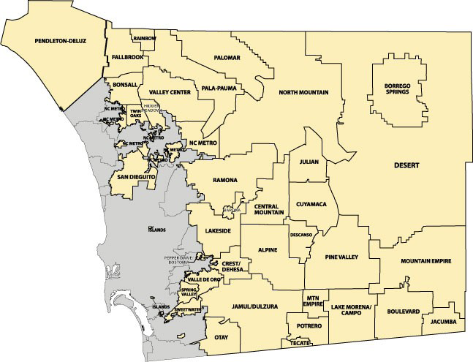
35

Slide 36

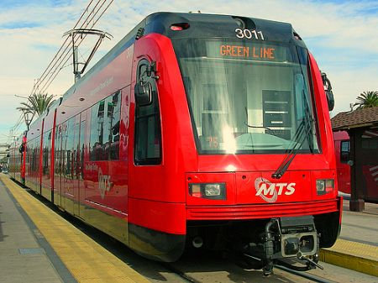

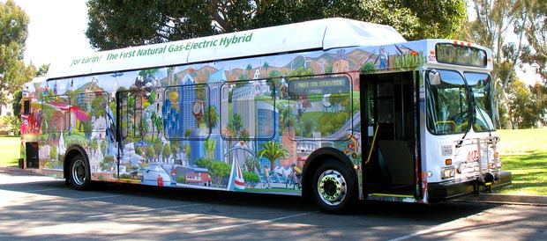
San Diego Association of Governments
36
Notes:
SANDAG is the San Diego region’s primary public planning, transportation, and research agency. Constituted of the 18 cities and county government, SANDAG provides the public forum for regional policy decisions about growth, transportation planning, environmental management, housing, open space, energy, public safety, and bi-national topics. SANDAG also is responsible for transit planning, funding allocation, project development, and construction in the San Diego region.¹³
¹³ SANDAG Factsheet, September 2010.

Slide 37
SANDAG
SANDAG is the regional planning authority.
Coalition of 18 City governments and the County Government of San Diego
Monitors transportation and other funding
Coordinates cross-border planning, housing programs, Smart Growth and others
The Board of Directors is composed of mayors, councilmembers, and a county supervisor from each of the region's 19 local governments
37
Notes:
SANDAG is the regional planning authority.
Coalition of 18 City governments and the County Government of San Diego
Monitors transportation (transit , freeway and road networks) and other funding
Coordinates cross-border planning, housing programs, Smart Growth and others
The Board of Directors is composed of mayors, councilmembers, and a county supervisor from each of the region's 19 local governments
MPOs formed to acknowledge the challenge of coordinating planning across multiple local governments.

Slide 38

SANDAG
Negotiates conflicts across jurisdictions
Projects populations 30 years into the future.
Makes sure that all jurisdictions coordinate well with one another and plan for the future
Federal government has $$$ for transportation, and that money is given to the regional planning authority, which is SANDAG
38
Notes:
SANDAG negotiates conflicts against each other across jurisdictions, ensures coordination
The agency also projects populations 30 years into the future. Asks cities to tell them where they’ll be building housing for persons expected to move into the region (e.g. placement of residential)
Makes sure that all jurisdictions coordinate well with one another and plan for the future and is supposed to promote the equitable distribution of transportation resources across County
Federal government has $$$ for transportation, and that money is given to the regional planning authority, which is SANDAG

Slide 39
How to make changes at SANDAG
Communicate with your elected representatives who serve on the SANDAG Board
Attend SANDAG Board Meetings, workshops, and public meetings and participate in dialogue
Areas of interest: use of federal transportation funds, administration of transit in San Diego, including MTS
39

Slide 40
The focus of Community Building …
Community Building
Individuals
*Capacity
*Empowerment
*Leadership Development
Associations
*Nature, Strength, and Scope of Relationships
Organizations
*Developing the capacity to provide goods and services effectively
*Maximize resources and coordinate strategies with other organizations
…generally refers to building the social networks within the community, and developing group and individual problem-solving and leadership skills.
40
From: Community Building: What Makes It Work A Review of Factors Influencing Successful Community Building Amherst H. Wilder Foundation
Notes:
Fundamentally, community building concerns strengthening the capacity of neighborhood residents, associations, and organizations to work, both individually and collectively, to foster and sustain positive neighborhood change.

Slide 41
Understanding & Influencing Positive Changes In Your Community
Your Planning Department:
Learn how planning works in your community: decision-making process, project timelines, key players, new developments
Find your local planning strategy documents - Do the documents reflect your community’s vision / your neighborhood’s desires?
41

Slide 42
Framework For Change
5 Strategies for
Active Living
Preparation
Promotion
Programs
Policies
Physical Projects
42
Notes:
ALBD has identified 5 “P” strategies: preparation, promotion, programs, policy and physical projects. These strategies represent a comprehensive approach to increasing physical activity in a community. Each strategy comprises specific tactics, which characterize the type of work necessary to create a more active community. See the accompanying Active Living by Design 5 P Strategies and Tactics for more detailed descriptions.
www.activelivingbydesign.org

Slide 43
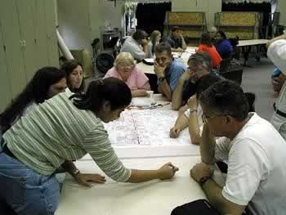
Strategy 1: Preparation/Planning
Build diverse partnerships
Build a vision
Assess policies and environments
Build a plan of action
Identify a champion(s)
Prepare for no $$$
43
Notes:
While not limited to the early stages of an active living initiative, preparation is a critical first step in creating a physically active community. Preparation is the deliberate process of getting ready for action. This includes developing and maintaining a community partnership to work collectively. This strategy also entails collecting relevant data to inform program planning and pursuing financial and other resources.
www.activelivingbydesign.org

Slide 44
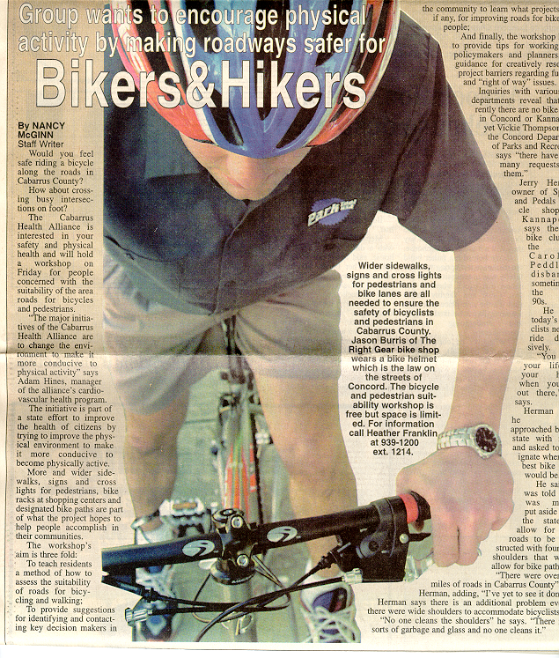
Strategy 2: Promotions
Utilize mass media for awareness and public education
Utilize mass media for policy advocacy
Develop key messages for target groups and new partnerships
44
Notes:
Effective promotion or communications efforts are vital to the success of any active living program. Communications are the means by which the project connects with the public. Specific messages include the benefits of active living and the importance of community environments in promoting healthy living. As part of this process, presentations, news releases, fact sheets, and other forms of communication are evaluated to determine whether they truly connect with the intended audiences. Promotion strategies should also help to ensure that other policy, programmatic and infrastructure goals are successfully achieved.

Slide 45
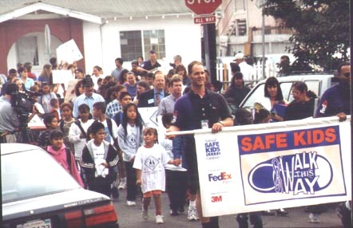
Strategy 3: Programs/Projects
Active Transportation
Safe Routes to School
Commuter Choice Programs
Incentive Campaigns: Bicycle Friendly Communities
Walking/Bicycle Clubs
45
Notes:
Programs are organized on-going activities that engage individuals in physical activity either directly or indirectly. Active living programs provide direct access to physical activity opportunities; such as walking clubs or bicycle recycle initiatives. Other programmatic approaches reward individuals for adopting more active habits through incentives or other encouragements, such as benefits for employees or students who walk or bicycle to work or school.

Slide 46
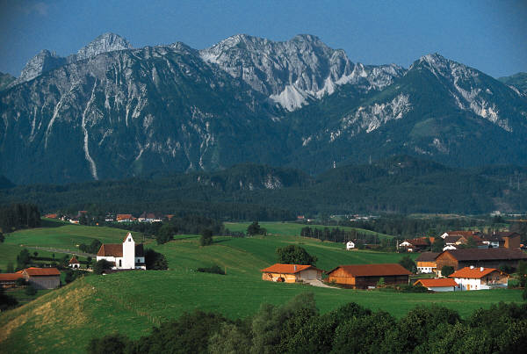
Strategy 4: Policies
School Siting – provide pedestrian accessible elementary school sites
Update codes regarding density and mixed land use
Develop and update guidelines for new development
46
Notes:
Policy development is the key to institutionalizing health-supportive environments. Active living partnerships should identify and attempt to influence changes in public policies and standards as well as organizational practices. These efforts will include advocacy, relationship building with policy makers, presentations to policy boards, and influencing employer or school policies. Educating policy makers - as well as citizens, professionals and advocates - about the need for local environments that support active living -- is an essential component of this strategy. In general, policy tactics are those that end with a policy change (e.g., adoption of greenway master plan, pedestrian friendly street design guidelines).

Slide 47
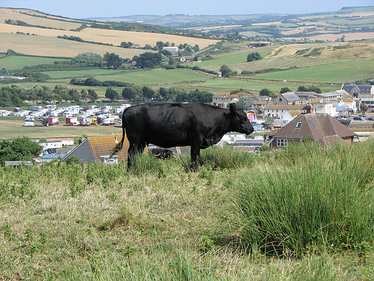
Strategy 5: Physical (Built) Projects
Build safe and well-connected pedestrian and bicycle networks
Encourage mixed-use developments
Adopt traffic calming measures to reduce speed, noise & volumes
Create pleasant and attractive pedestrian & bicycling settings
47
Notes:
Physical projects are strategies to directly impact built environments, removing barriers to physical activity and enhance safety (e.g., trails, pedestrian improvements at intersections). While the built environment is heavily determined by public policies, active living partnerships should also look for opportunities to improve physical spaces that do not rely on a policy decision per se. Physical projects include a wide range of sizes from community trails to sidewalks to signage pointing out active living opportunities on taking the stairs.

Slide 48
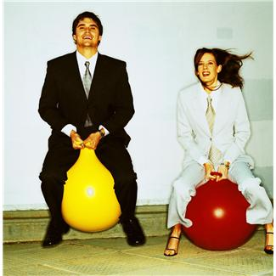

Homework Options
          THANK YOU!!!
Questions?
Comments?
1. Complete the Healthy Design Checklist
2. Attend a Planning Commission Meeting
3. Read Article for Module 7 Leadership, Advocacy and Policy Development
48

