Slide 1
SESSION EIGHT
community
improvement project
needs & opportunity
assessment

Slide 2
agenda
SESSION 8 OBJECTIVES
To build awareness of the link between community design and health, and understand which design strategies can better support health
To identify the steps of effective community action including issue identification, coalition building, strategic planning and implementation
To identify different mechanisms for creating community change, including environmental enhancement (e.g., park clean-up, light bulb replacement) and policy change
To be able to advocate as an effective community leader, connecting the grassroots to the “tree tops”
Welcome
Compilation of Effective Strategies from Sessions 1-7
Prioritizing Projects
Ranking: Community Feedback
Reality Checklist Group Activity
Roles and Responsibilities
Discussion
Nominations
Break
Data Sources
Local Police Department (PD)
San Diego Association of Governments (SANDAG)
Transportation Injury Management Systems (TIMS)
Automated Regional Justice Information System (ARGIS)
Community Health Statistics Unit
Qualitative Assessment Review
Photo Data Review with CPTED and Walkability
Conclusion

Slide 3
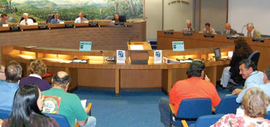
SESSION REVIEW
Leadership, Advocacy and Policy Development Session
What you learned or remember from the session
Question or comments you have
Observations regarding homework activities
3

Slide 4
the focus of community building
COMMUNITY BUILDING
generally refers to building the social networks within the community, and developing group and individual problem-solving and leadership skills.

Slide 5
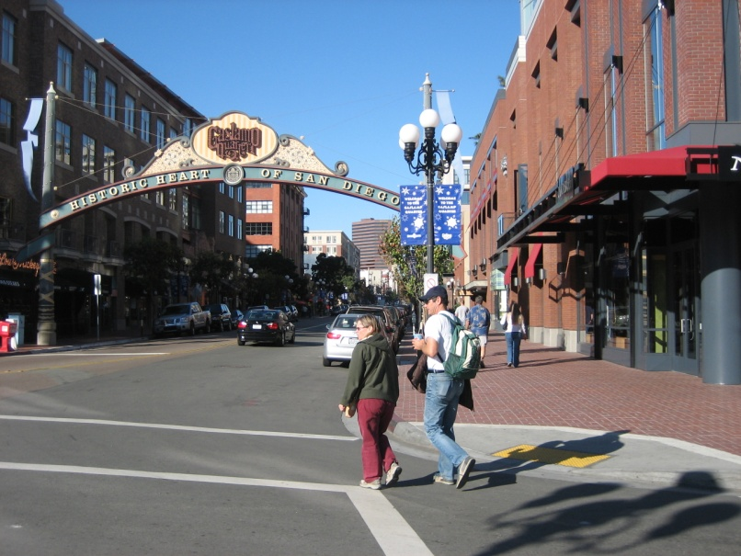
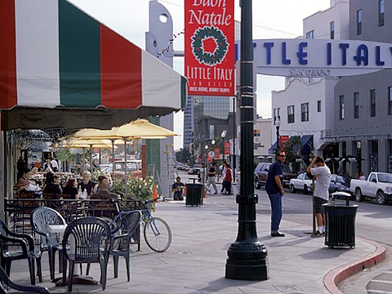
the focus of community building
Good Sidewalks
Safe and Easy Street Crossings
(approximately every 300 ft.)
Slow Cars Down
Safety, Comfort and Beauty
Great places to walk to (that connect you to people)

Slide 6
crime prevention through environmental design (CPTED)
1st Generation CPTED
Concepts and strategies
Access Control—How people get into & out of an area
Target Hardening
Natural Surveillance—Create opportunities for people to watch an area
Territoriality—How people show they own or care for an area
Activity Support
Resident-generated territorial signage
Image & Maintenance—How people perceive & protect an area

Slide 7
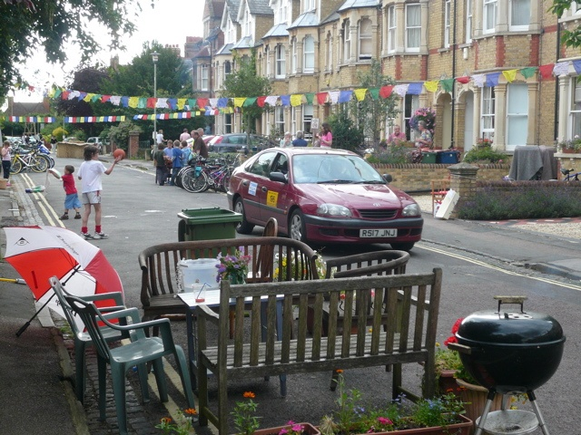
crime prevention through environmental design (CPTED)
2ND Generation CPTED:
Social Management
Capacity
Balance of resources in the area
Cohesion
Positive neighborhood attachment (e.g. neighborhood meetings)
Connectivity
Good Relationships with government and organizations
Culture
Artistic images and activities

Slide 8
who do you need to build relationships with?
City Organizational chart
City Clerk
Electorate
Commissions,
including:
Mayor/City Council
City Attorney
Rec & Park
Planning
City Manager
City Treasurer
City Departments, including:
Rec & Park
Planning

Slide 9
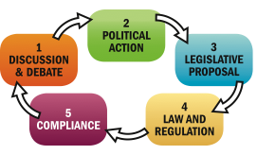
who do you need to build relationships with?
A system of courses of action, regulatory measures, laws, and funding priorities concerning a given topic disseminated by a governmental entity or its representatives
Notes:
Ask the group for a sample law or policy from another country and how it impacts that country’s health.

Slide 10
SEVEN ASPECTS OF THE BUILT ENVIRONMENT THAT APPEAR TO BE CENTRAL TO REDUCING HEALTH DISPARITIES
Activity-promoting Environments: Foster incidental and recreational activity
Nutrition-promoting Environments: Provide and promote safe, affordable, healthy food
Housing: Availability of safe, affordable, available housing
Transportation: Safe, reliable, accessible and affordable methods for moving people around
Environmental Quality: Safe, clean water, soil, air, and building materials
Product Availability: Availability of safe, health-promoting or unsafe, unhealthy products
Aesthetic/Ambiance: Well-maintained, appealing, clean environment
Source: The Prevention Institute

Slide 11
violence prevention framework: risk & resilience factors
RISK FACTORS
Poverty and economic disparity
Illiteracy and school failure
Alcohol and other drugs
Incarceration/Reentry
Community deterioration
Discrimination and oppression
Experiencing and witnessing violence
RESILIENCE FACTORS
Economic Capital
Meaningful opportunities for participation
Positive attachments and relationships
Good physical and mental health
Services and institution
Artistic and creative opportunities
Ethnic, racial, and intergroup relations

Slide 12
HEALTH STRATEGIES THAT ADDRESS ENVIRONMENTAL AND SOCIAL CONDITIONS
Environment
Provide affordable housing
Tighten zoning to restrict noise and pollution
Enforce lead abatement ordinances
Increase traffic safety
Reduce violence and crime
Cigarettes and Alcohol
Ban smoking in public areas
Control advertising of tobacco and alcohol products
Limit the concentration and operating hours of stores selling alcohol
Recreation
Increase access to recreational facilities through policies to open up schools and other institutions evenings or weekends
Nutrition
Modify school lunch programs to improve nutrition
Provide incentives for green markets and grocery stores that sell fresh produce
Notes:
Source: Reaching for a Healthier Life, The John D. and Catherine T. MacArthur Foundation Research Network on Socioeconomic Status and Health

Slide 13
questionnaire review of neighborhood needs
What are your
priority projects?

Slide 14
questionnaire review of neighborhood needs
Insert Community
Issue Areas

Slide 15
ranking community feedback
What community issues had the most votes of 1-Very interested?
What community issues has the most votes of 2-Interested?

Slide 16
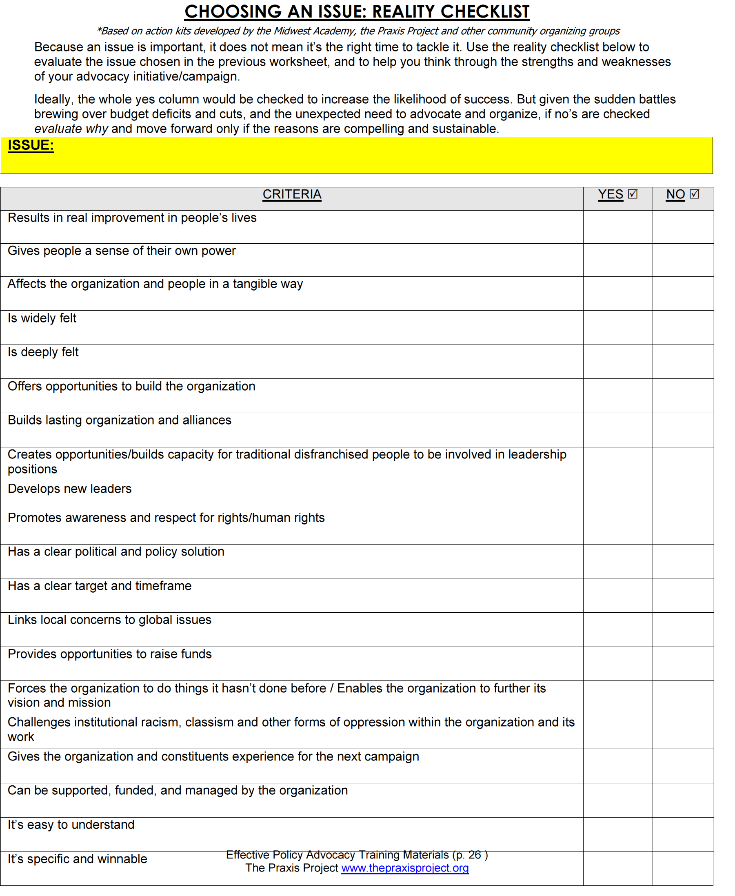
choosing an issue: reality checklist

Slide 17
impact analysis: reality checklist questions
Does this goal improve people’s lives?
Is the neighborhood as a whole affected by the issue?
Will relationships improve between associations, residents and organizations as part of conducting this work?
Does this activity build new leadership in the community?
Does this potential campaign promote awareness, respect, & equity for all in the community?
Is this goal easily understandable, specific and winnable?
Is there opportunity for fundraising? Will there be a need?
Does this campaign give organizations and constituents experience for the next campaign?

Slide 18
final priority projects: top 3
Which 3 community projects have the highest priority?

Slide 19
roles and areas of responsibilities
Group Leader
Spokesperson
Organizer
Documentation
Data Collection
Community Builder
Represents group as a whole
Communicates with media, elected officials and staff
Share information in different community circles and mobilize around community issues
Tracking community issues through photos, observation, and reporting.
Find sources of data to substantiate the community issues
Support activities, events and tasks related to the community issue
Notes:
Discuss in further detail how each of the roles and area of responsibility connect to one another, highlighting the importance of participants working together to accomplish the group’s mission.

Slide 20
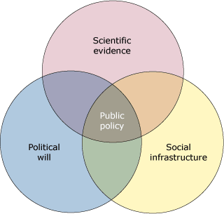
POLICY PROCESS
A system of "courses of action, regulatory measures, laws, and funding priorities concerning a given topic disseminated by a governmental entity or its representatives”
31

Slide 21
TIPS ON EFFECTIVELY ADVOCATING FOR CIP
Brevity
Accuracy
Preparation
Courtesy
Follow-up
Appreciation
32

Slide 22
IT’S TIME
FOR A BREAK

Slide 23
DATA SOURCES
Local Police Department (Crime Analysis Unit)
San Diego Association of Governments
www.sandag.org
Transportation Injury Management System (TIMS)
tims.berkeley.edu
Automated Regional Justice Information System
www.arjis.org
Community Health Statistics Unit
http://www.sdcounty.ca.gov/hhsa/programs/phs/communi ty_health_statistics/
33
Notes:
Point of slide:

Slide 24
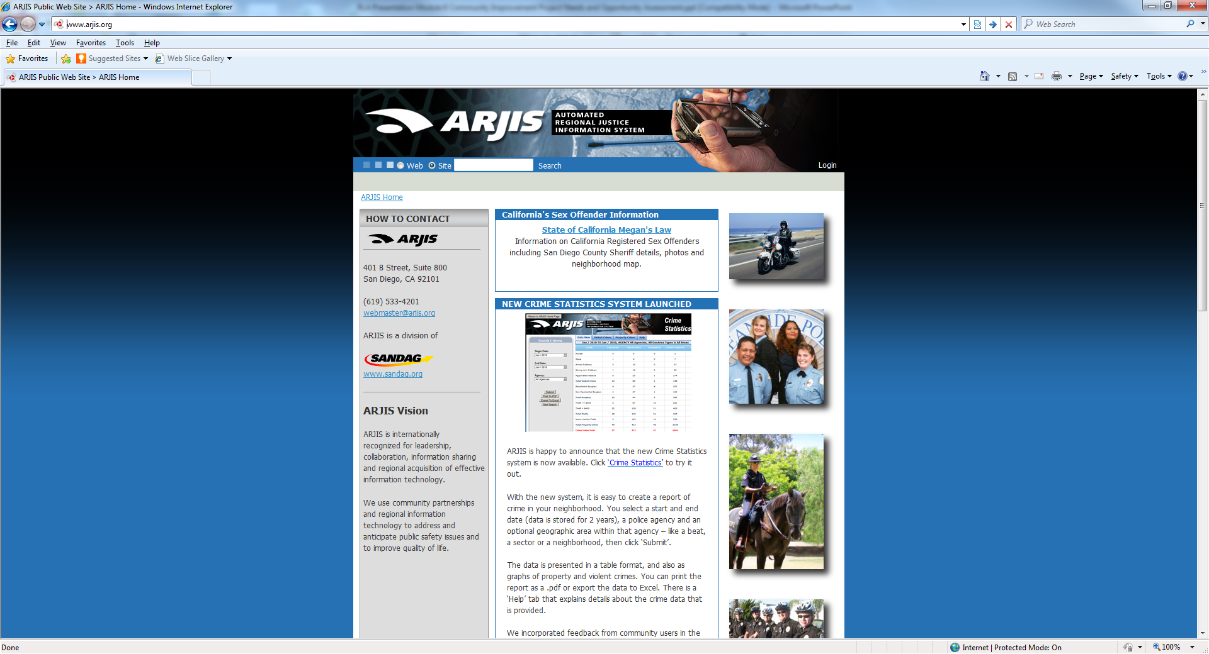
arjis “Crime maps”

Slide 25
how this qualitative assessment will be used to improve your neighborhood
1. Advocacy meetings with elected officials & other decision makers
2. Advocacy meetings with potential allies & supporters
3. Community improvement project presentations
4. Will be used in conjunction with quantitative data to justify focus on improvements in target areas

Slide 26
qualitative assessment review
Photos
Written documentation
Concerns
Reactions
Potential solutions
Recommendations

Slide 27
insert issue area photos (site 1)
<<< Insert Participants Community Photo >>>

Slide 28
(insert participant names) on (insert site location #1)
Concerns
Concern #1
Concern #2
Concern #3
Recommendations
Concern #1
Concern #2
Concern #3

Slide 29
(insert participant names) on (insert site location #1)
Concerns
Concern #1
Concern #2
Concern #3
Recommendations
Concern #1
Concern #2
Concern #3

Slide 30
insert issue area photos (site 2)
<<< Insert Participants Community Photo >>>

Slide 31
(insert participant names) on (insert site location #2)
Concerns
Concern #1
Concern #2
Concern #3
Recommendations
Concern #1
Concern #2
Concern #3

Slide 32
(insert participant names) on (insert site location #2)
Concerns
Concern #1
Concern #2
Concern #3
Recommendations
Concern #1
Concern #2
Concern #3

Slide 33
insert issue area photos (site 3)
<<< Insert Participants Community Photo >>>

Slide 34
(insert participant names) on (insert site location #3)
Concerns
Concern #1
Concern #2
Concern #3
Recommendations
Concern #1
Concern #2
Concern #3

Slide 35
(insert participant names) on (insert site location #3)
Concerns
Concern #1
Concern #2
Concern #3
Recommendations
Concern #1
Concern #2
Concern #3

Slide 36
insert issue area photos (site 4)
<<< Insert Participants Community Photo >>>

Slide 37
(insert participant names) on (insert site location #4)
Concerns
Concern #1
Concern #2
Concern #3
Recommendations
Concern #1
Concern #2
Concern #3

Slide 38
(insert participant names) on (insert site location #4)
Concerns
Concern #1
Concern #2
Concern #3
Recommendations
Concern #1
Concern #2
Concern #3

Slide 39
conclusion
HOMEWORK OPTIONS
Contact Local Police Department (Ask for Representative to attend future meetings of the group, and share data)
Invite a Special Guest to the Community Celebration and Presentation (Start Now!)
Thank You!
Questions?
Comments?

