Slide 1
SESSION NINE
community
improvement
project
planning &
implementation

Slide 2
Agenda
SESSION 9
OBJECTIVES
To be able to identify and evaluate potential mechanisms to address the issue and establish a strategic plan appropriate for the selected issue (e.g., citizen patrol, identify a policy)
To identify actions to mobilize community stakeholders and decision makers to support the Community Improvement Project (CIP)
Welcome
The Vision Exercise
Break
Recommendations and Strategies for the CIP
Potential Crime Prevention through Environmental Design (CPTED) and Walkability Strategies
Community Photos to Develop Recommendations
CPTED & Public Art Strategies and Examples
Break
City Planning Documents
Highlight Existing Planning Documents that Complement Community Improvements Project(s)
Action Plan Development
Action Plan Development Format
Complete the Planning and Implementation Plan for the Community Improvement Project(s)
Conclusion
Notes:
As participants identify their CIP’s, be cognizant of diverse backgrounds and viewpoints. Ensure that all voices are heard and that the projects that are identified represent the community as whole and benefit those in need. Remind the participants of the following:
Focus on team results rather than individual accolades/honors
Avoid any public confrontation and/or ridicule
Speak positively and respectfully to all community members/leaders
Identify, appreciate, and acknowledge each other’s skills and strengths

Slide 3
session review
Community Improvement Project Needs and Assessment Session
What you learned or remember of the session
A question you have
Review homework
Changes or improvements you would make to the session

Slide 4
the focus of community building
COMMUNITY BUILDING
generally refers to building the social networks within the community, and developing group and individual problem-solving and leadership skills.
Source: Community Building: What Makes it Work A Review of Factors Influencing Successful Community Building
Amherst H. Wilder Foundation

Slide 5
roles and areas of responsibilities
Group Leader
Spokesperson
Organizer
Documentation
Data Collection
Community Builder
Represents group as a whole
Communicates with media, elected officials and staff
Share information in different community circles and mobilize around community issues
Tracking community issues through photos, observation, and reporting.
Find sources of data to substantiate the community issues
Support activities, events and tasks related to the community issue

Slide 6
your neighborhood: Community priorities
List prioritized community issue areas
List prioritized community issue areas
List prioritized community issue areas
List prioritized community issue areas
List prioritized community issue areas

Slide 7
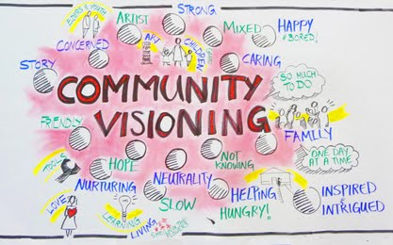
the collective vision

Slide 8
IT’S TIME
FOR A BREAK

Slide 9
creating recommendations
Review potential policies for food environment as options for the CIP
Review walkability and crime prevention through environmental design strategies as options for the CIP
Use strategies to assist in identifying recommendations FOR INCLUSION in (CIP) Action plan
Notes:
CIP: Community Improvement Project

Slide 10
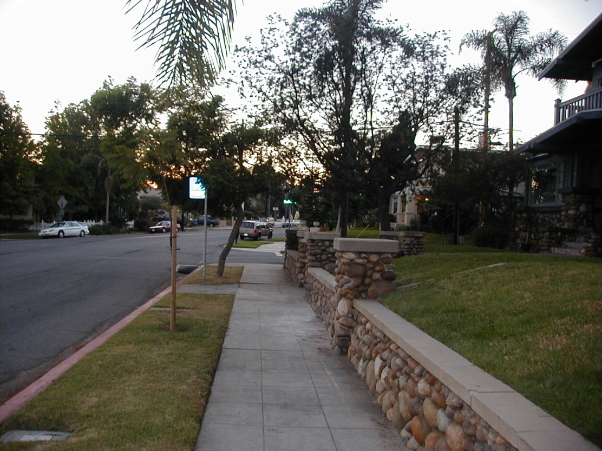
Step 1: good sidewalks
Good Sidewalk Design: Residential Areas
Pedestrian Zone
sidewalks are level, unbroken, and at least 5 feet wide
Buffer Zone
plants, trees, mailboxes, etc.
Façade Zone
area between sidewalk and building
Curb Zone
protects buffer zone, ADA ramps at street crossing

Slide 11
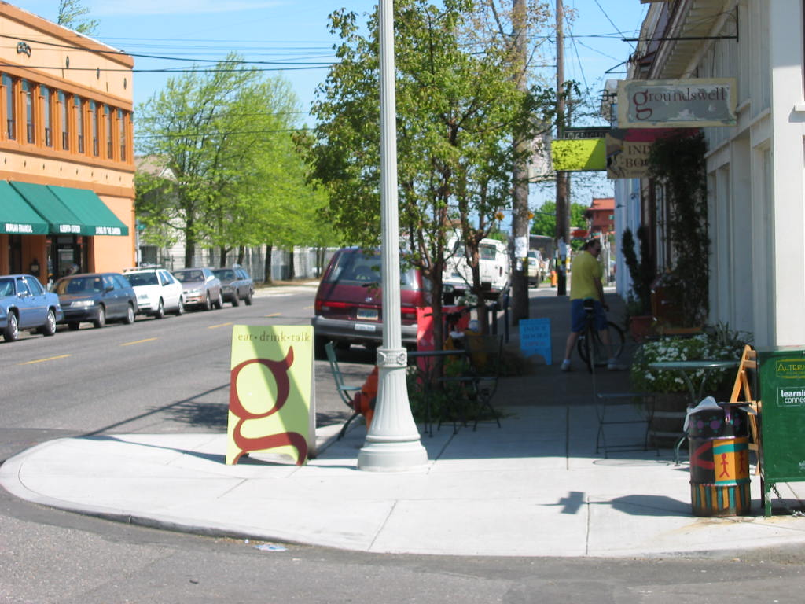
Step 1: good sidewalks
Good Sidewalk Design: Commercial Areas
Pedestrian Zone
sidewalks are level, unbroken, and at least 8 feet wide
Façade Zone
Buffer Zone
trees, mailboxes, outdoor seating, lighting, etc.
Curb Zone
protects buffer zone, ADA ramps at street crossing

Slide 12
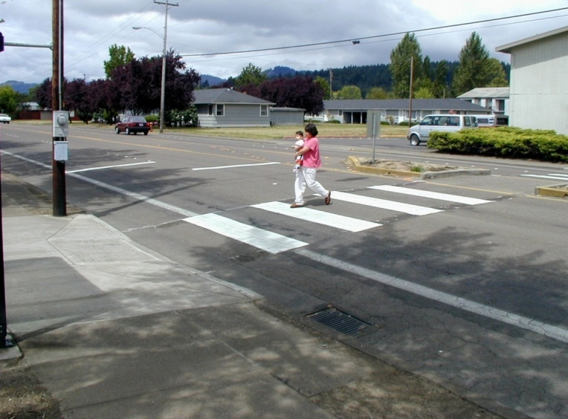
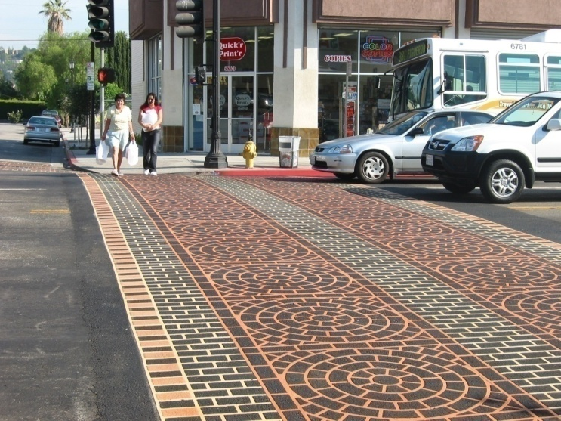
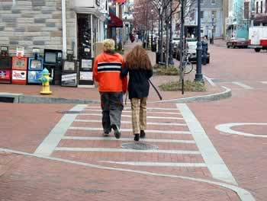
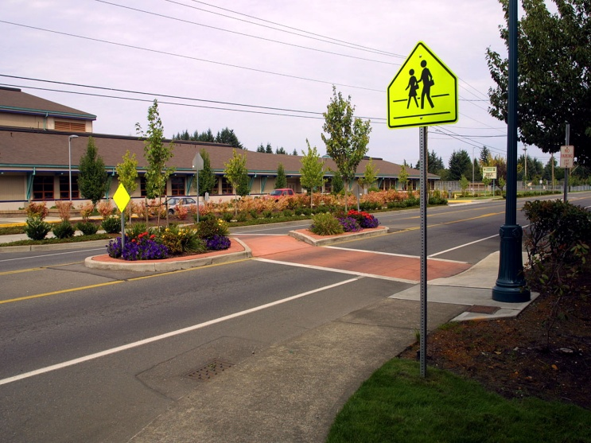
Step 2: safe and easy street crossings
Crosswalks can be painted for high visibility or decorated and textured with brick or pressed concrete

Slide 13
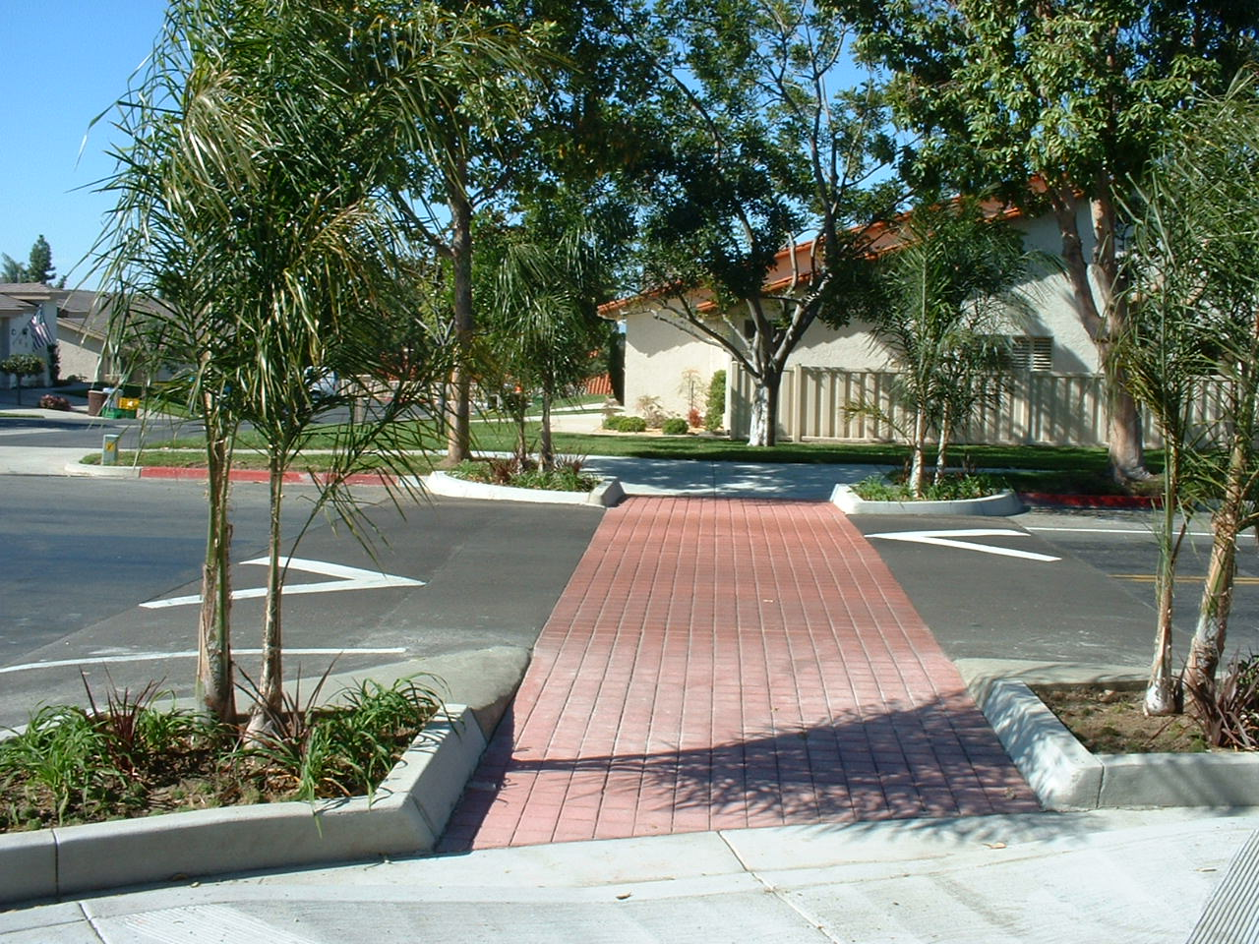
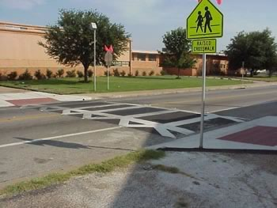
Step 2: safe and easy street crossings
Raised
crosswalks

Slide 14
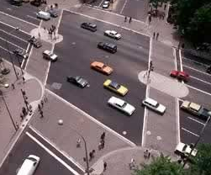
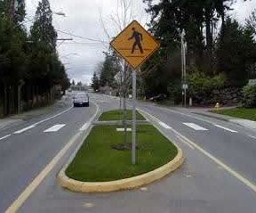
Step 2: safe and easy street crossings
Medians
Shorten the crossing distance
Provide refuge for pedestrians
May slow traffic

Slide 15
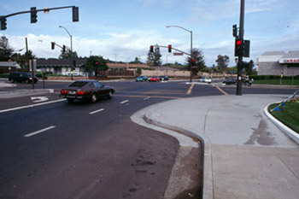
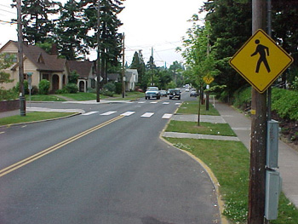
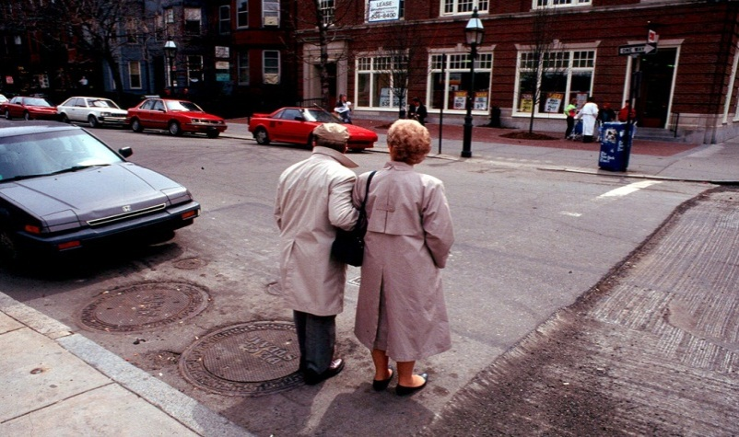
Step 2: safe and easy street crossings
Curb Extensions
Shorten the crossing distance
Driver can see pedestrians
Slows cars in intersection

Slide 16
step 3: Slow cars down (Traffic Calming)
Not Recommended as a Traffic Calming Tool:
Stop signs
Speed limit signs
Speed bumps (except in some situations)
Law enforcement alone
TRAFFIC CALMING
STOP SIGNS
40 mph
30 mph
20 mph
10 mph
0 mph
Stop Stop Stop STOP

Slide 17
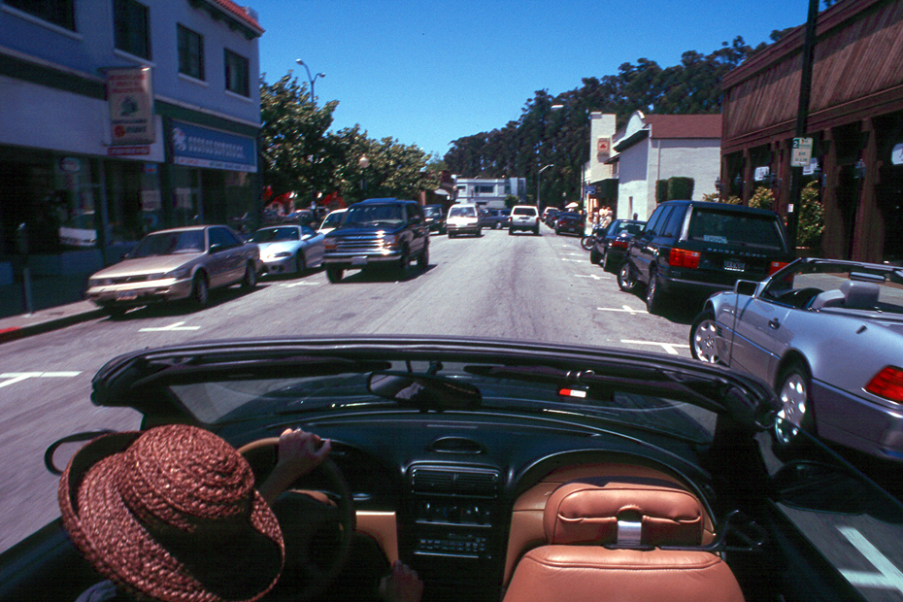
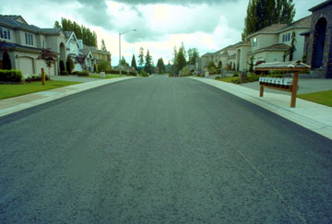
step 3: Slow cars down (Traffic Calming)
On Which Road Would
You Drive Faster?

Slide 18
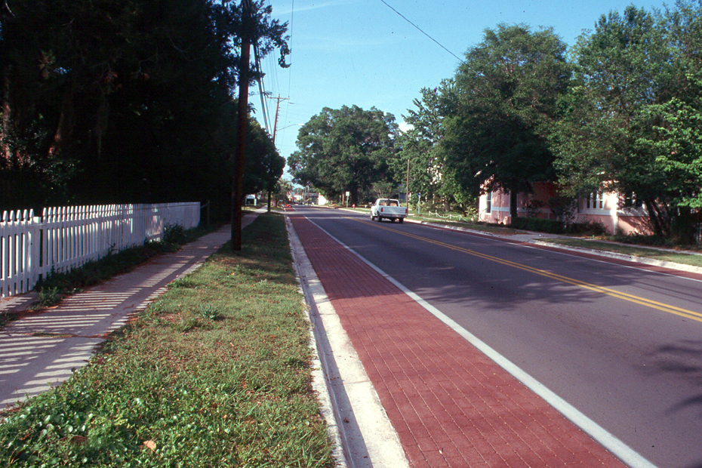
step 3: Slow cars down (Traffic Calming)
Traffic Calming Tool
Narrow Road Visually

Slide 19
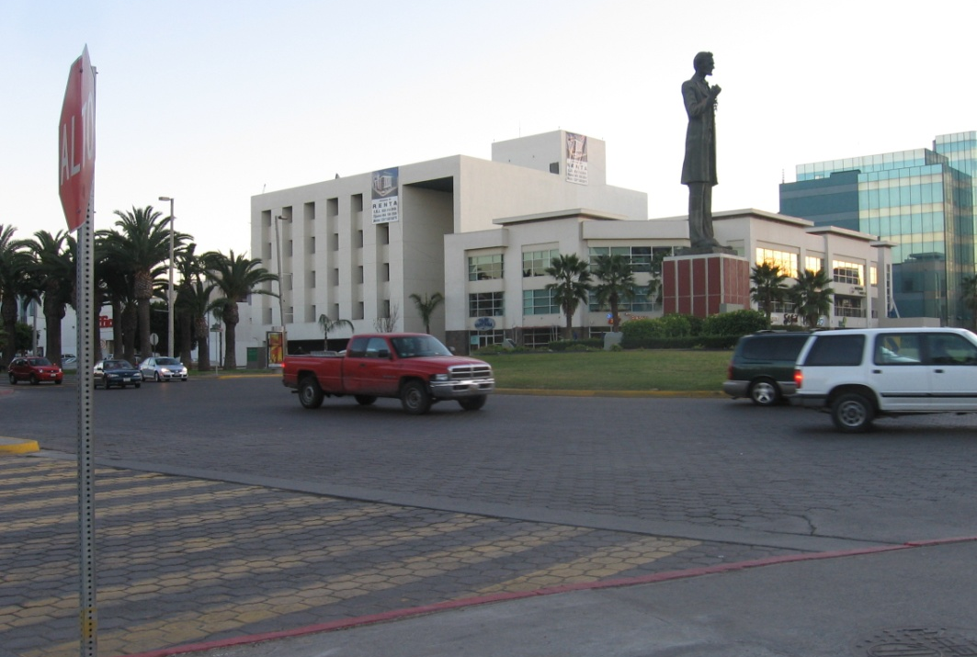
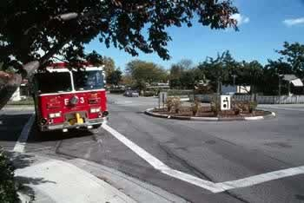
step 3: Slow cars down (Traffic Calming)
Traffic Calming Tool
Traffic Circle or Roundabout

Slide 20
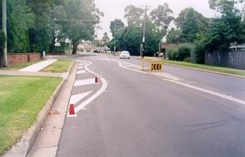
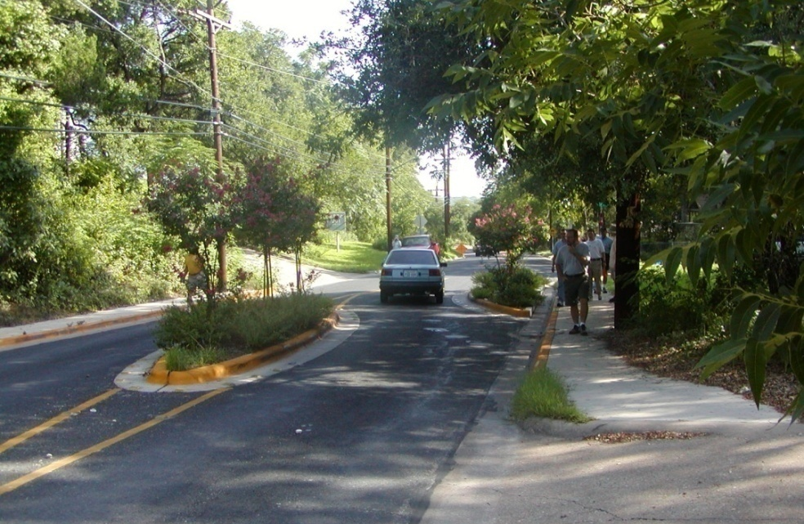
step 3: Slow cars down (Traffic Calming)
Traffic Calming Tool
Islands or Curves (Chicanes)

Slide 21
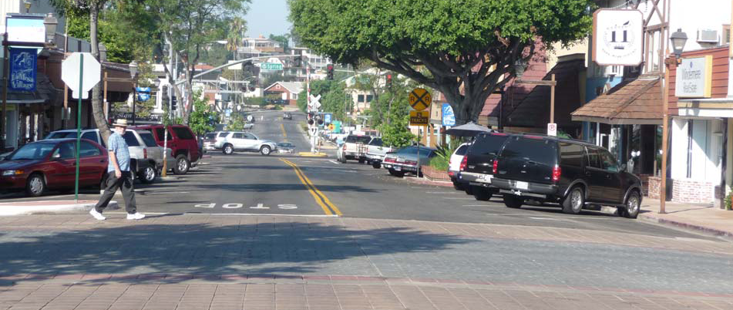
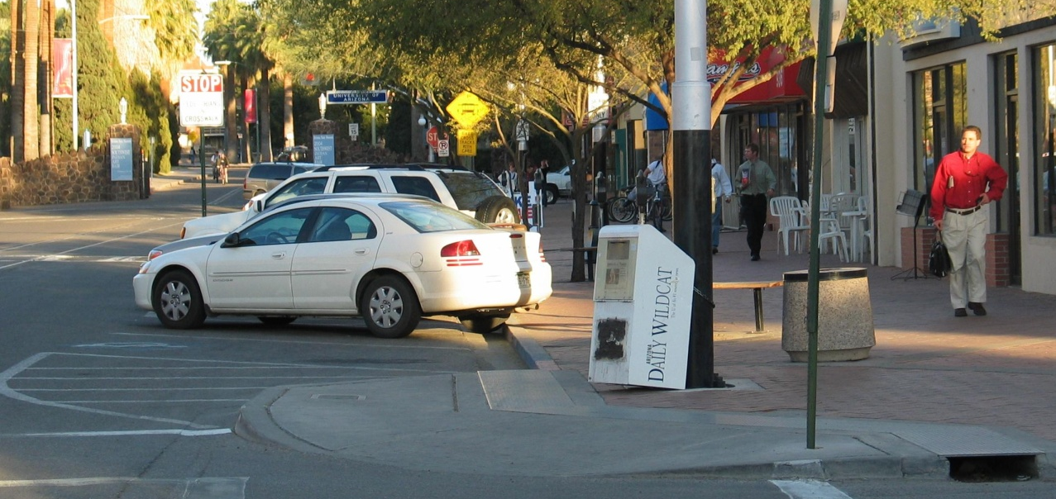
step 3: Slow cars down (Traffic Calming)
Traffic Calming Tool
Diagonal Parking
Typical
back-out
Parking
Reverse angle
or head-out
parking

Slide 22
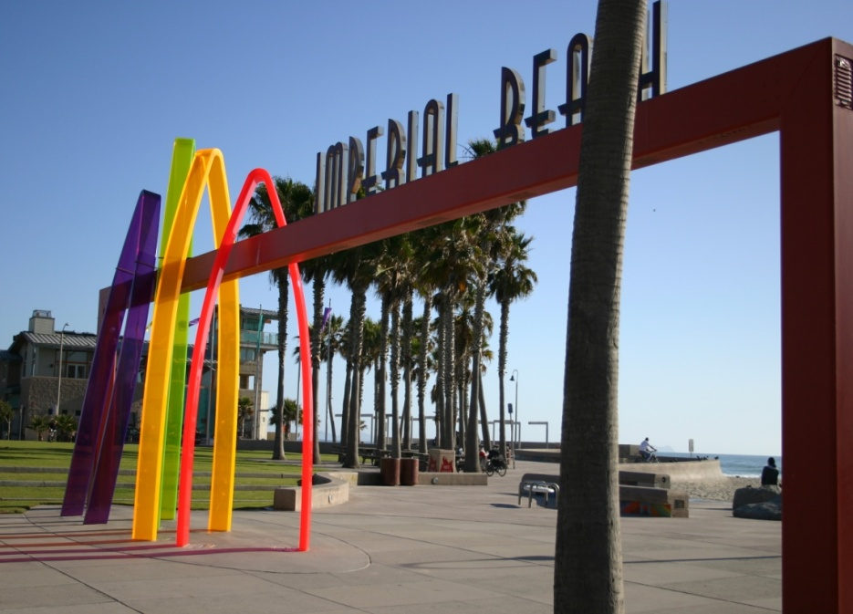
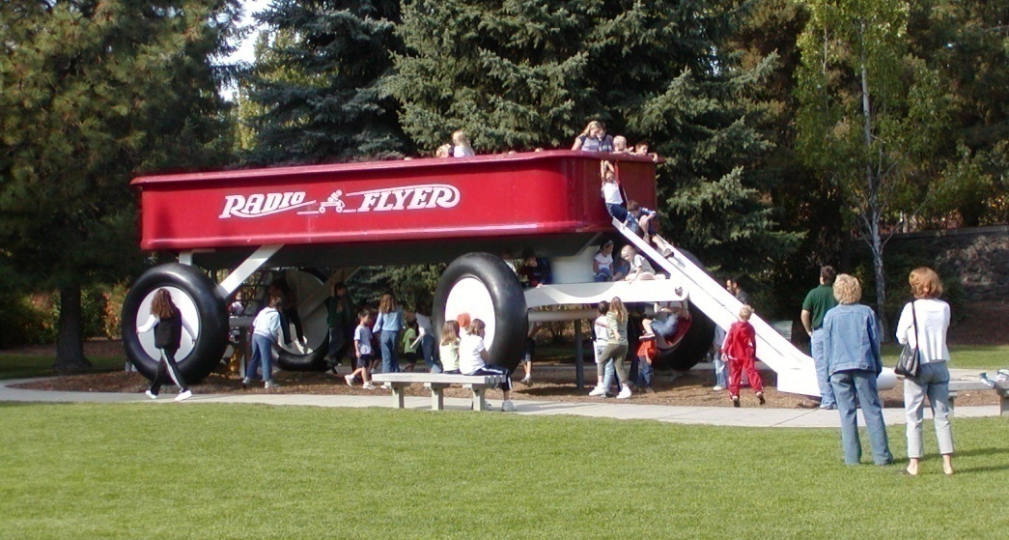
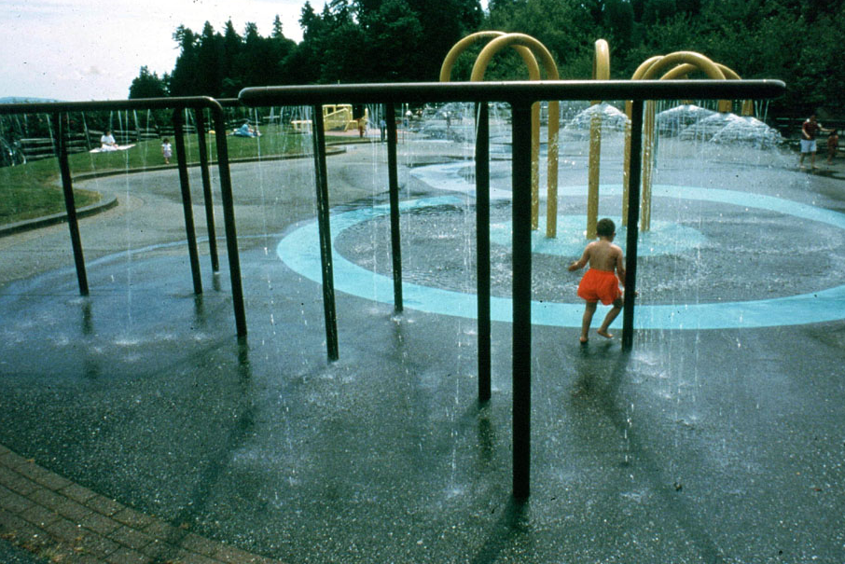
step 4: safety, comfort & beauty
Public Art
that reflects
the community

Slide 23
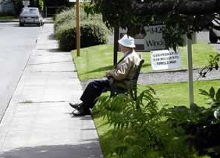
step 4: safety, comfort & beauty
Trees
Places to sit and rest
Clean and maintained
Pedestrian lighting
Access to water and bathrooms

Slide 24
cpted & public Art
Creating Interactive Public Spaces
Notes:
CPTED: Crime Prevention Through Environmental Design

Slide 25
cpted & public Art
“I want to make sure that the arts are part of everything we do. We need to make sure that the arts are part of every neighborhood. We need to make sure that we continue to have art in public places...we want people to know that Tampa is a city of the arts.”
- Mayor Pam Iorio

Slide 26
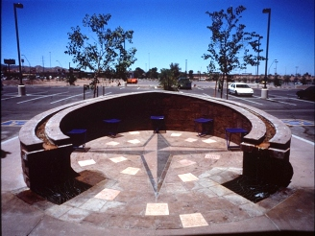
cpted & public Art: Strategies
Phoenix
Tempe
Notes:
CPTED: Crime Prevention Through Environmental Design

Slide 27
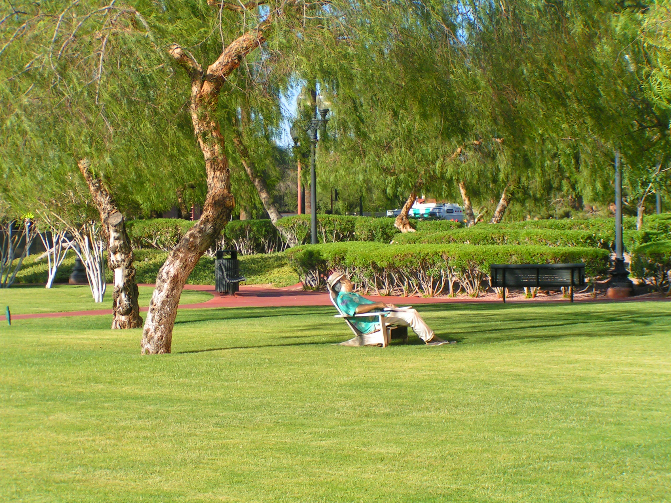
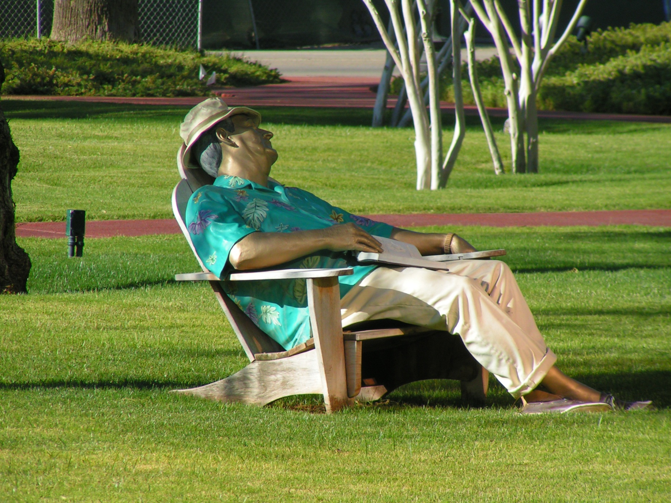
cpted & public Art: visuals of people
Notes:
CPTED: Crime Prevention Through Environmental Design

Slide 28
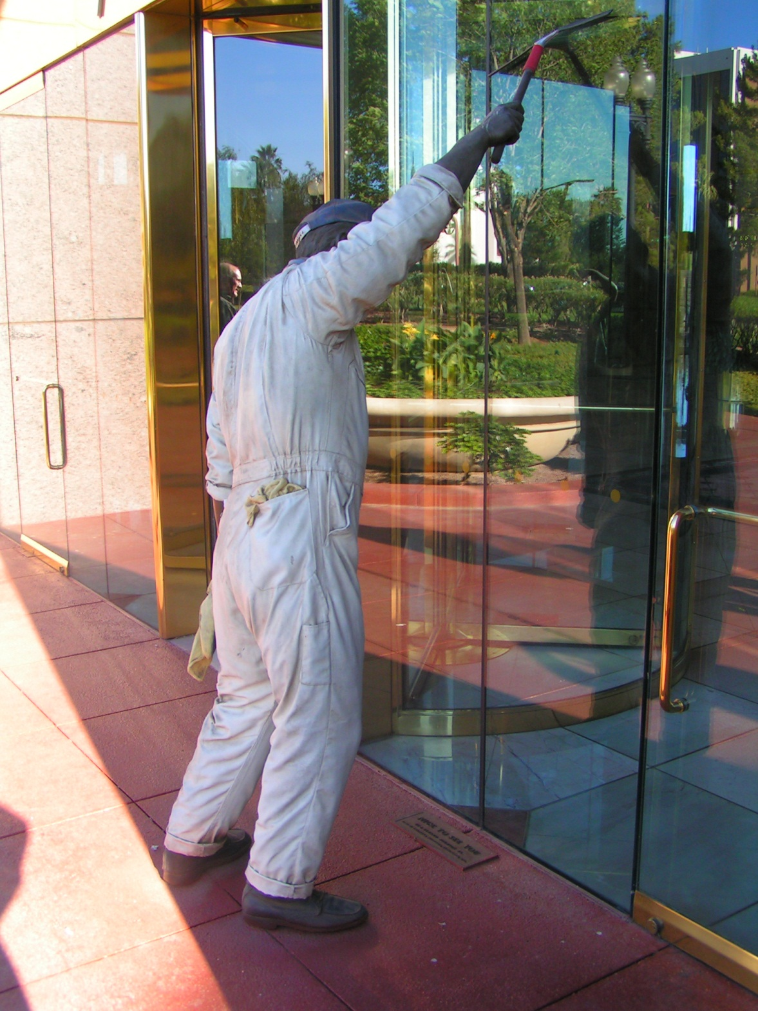
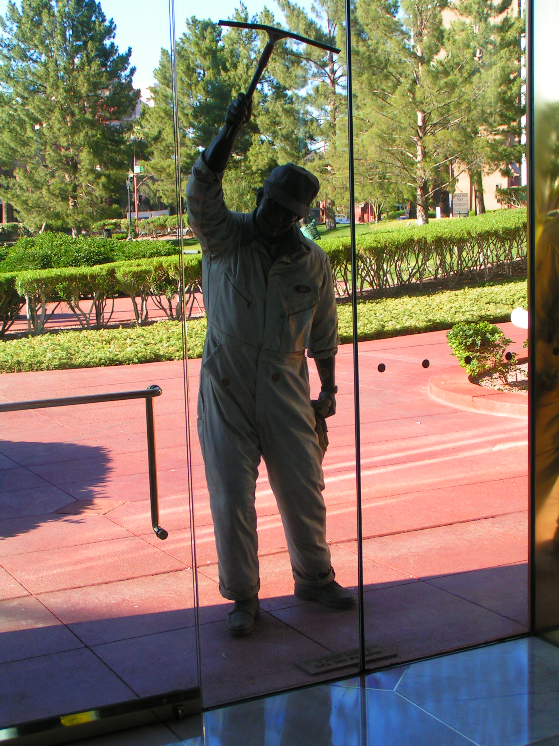
cpted & public Art: visuals of people
Notes:
CPTED: Crime Prevention Through Environmental Design

Slide 29
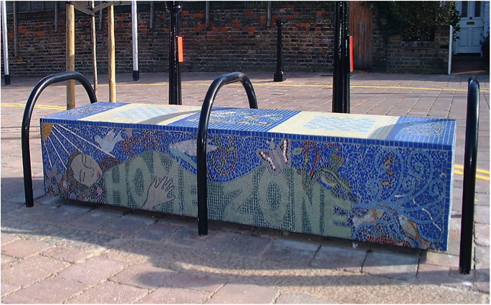
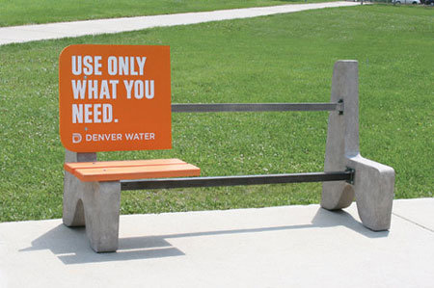
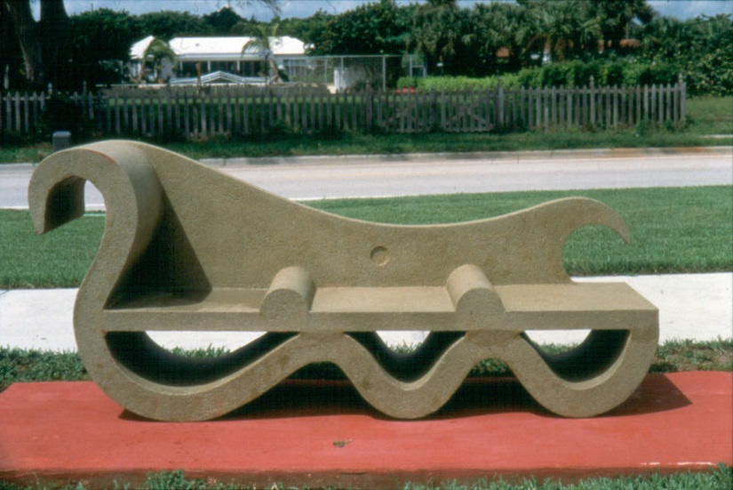
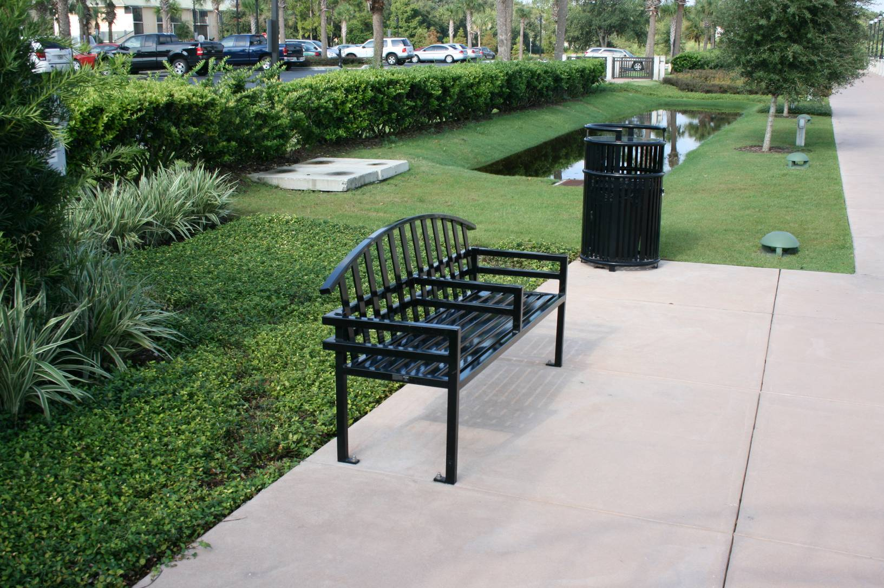
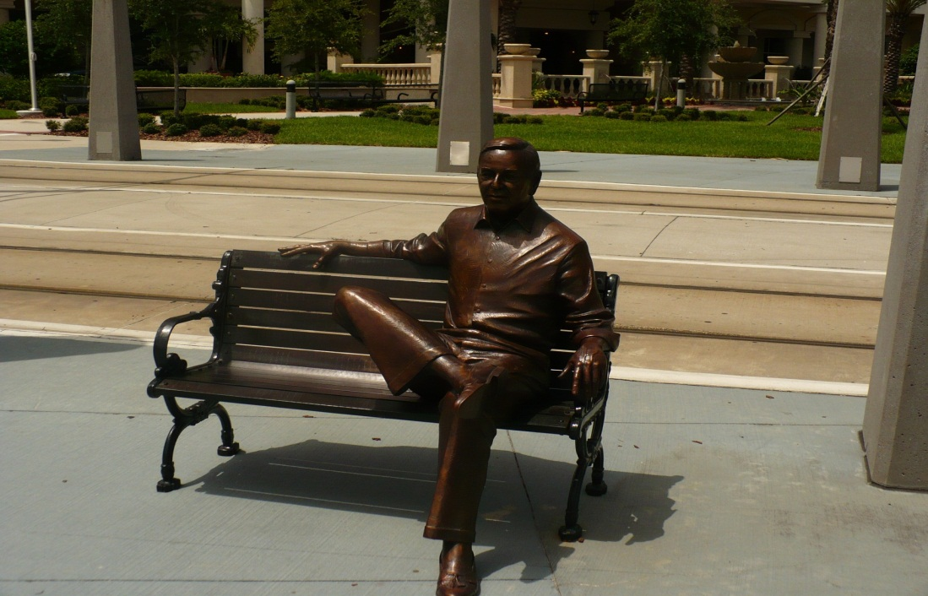
cpted & public Art: Benches
Camden, UK
denver, co
boston, ma
florida
tampa, fl
Notes:
CPTED: Crime Prevention Through Environmental Design

Slide 30
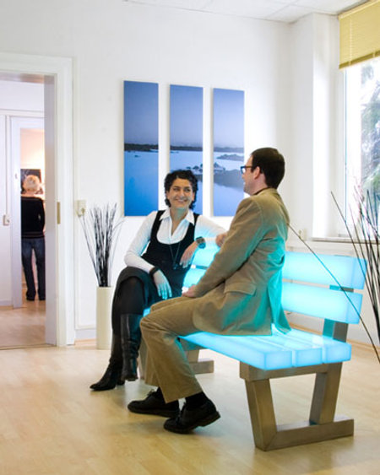
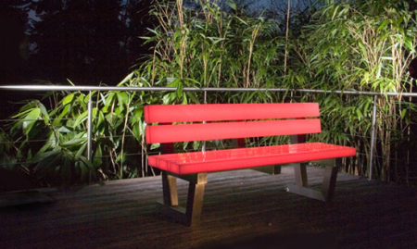
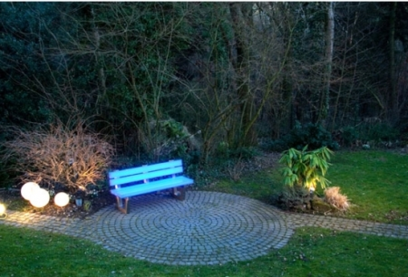
cpted & public Art: Benches
Illuminated Benches

Slide 31
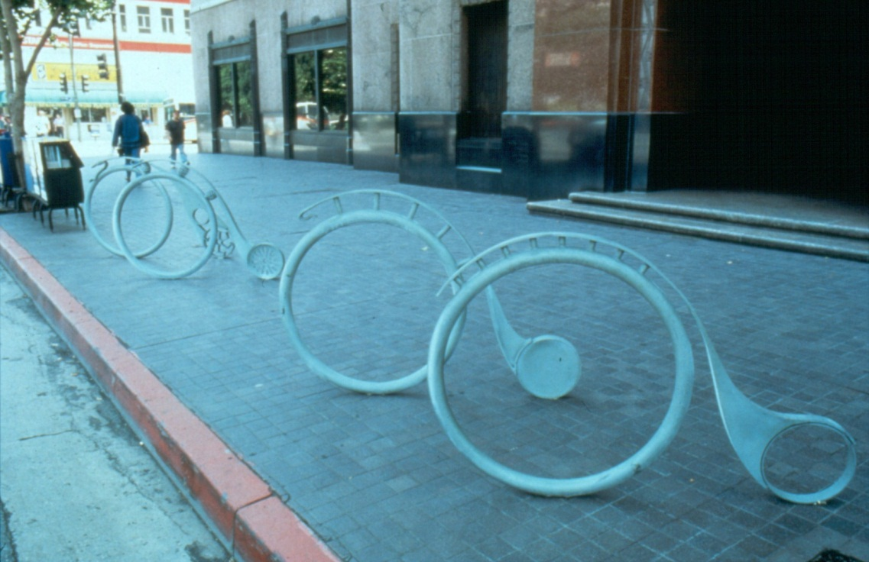
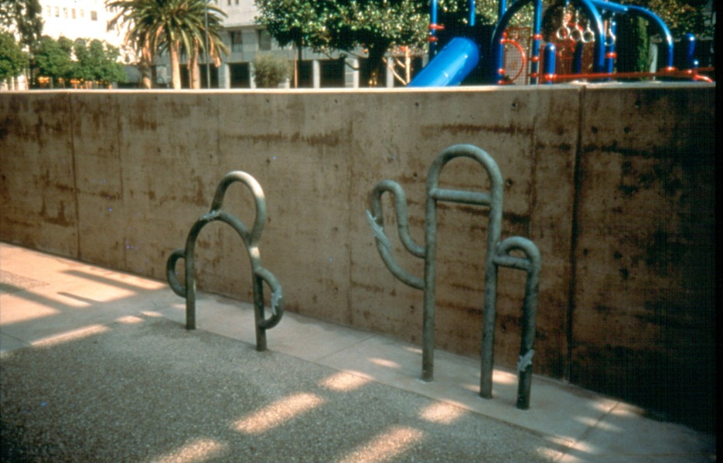
cpted & public Art: Bicycle racks
Notes:
CPTED: Crime Prevention Through Environmental Design

Slide 32
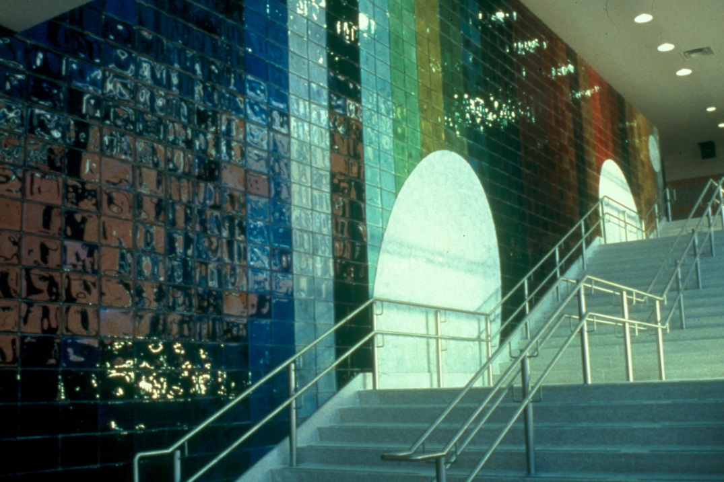
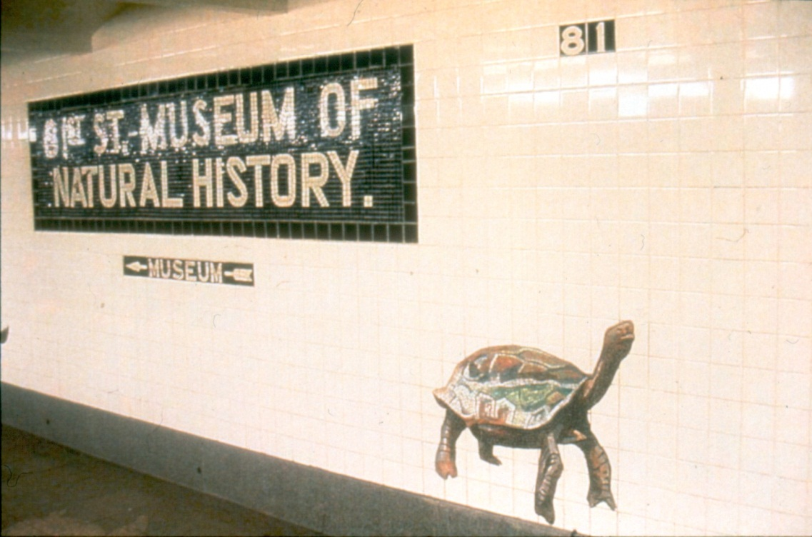
cpted & public Art: mosaic designs
Notes:
CPTED: Crime Prevention Through Environmental Design

Slide 33
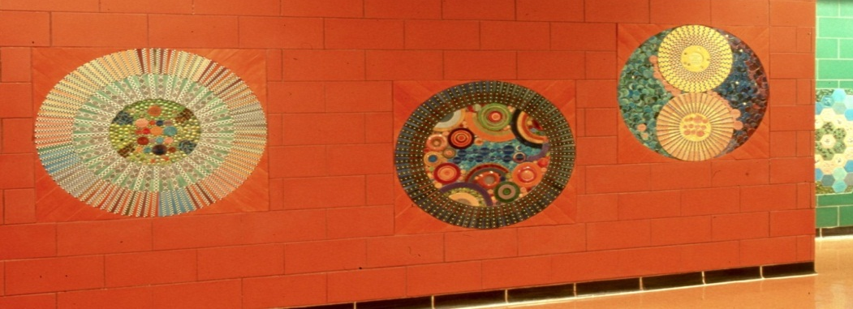
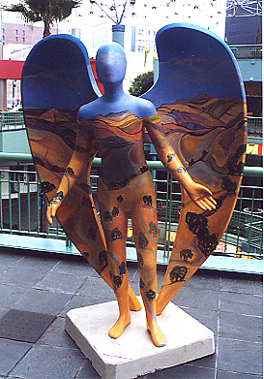
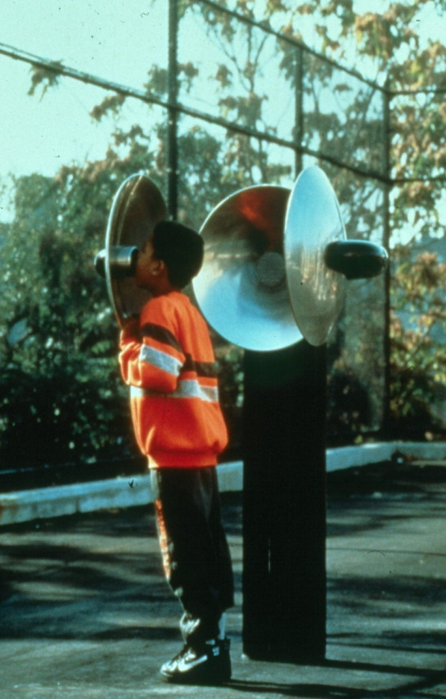
cpted & public Art: wayfinding
new york city
los angeles
san antonio
Notes:
CPTED: Crime Prevention Through Environmental Design

Slide 34
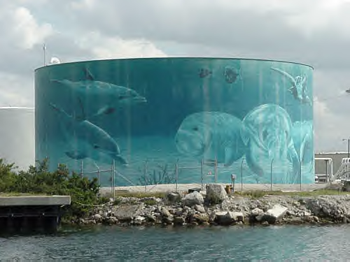
cpted & public Art: murals
port of tampa
Notes:
CPTED: Crime Prevention Through Environmental Design

Slide 35
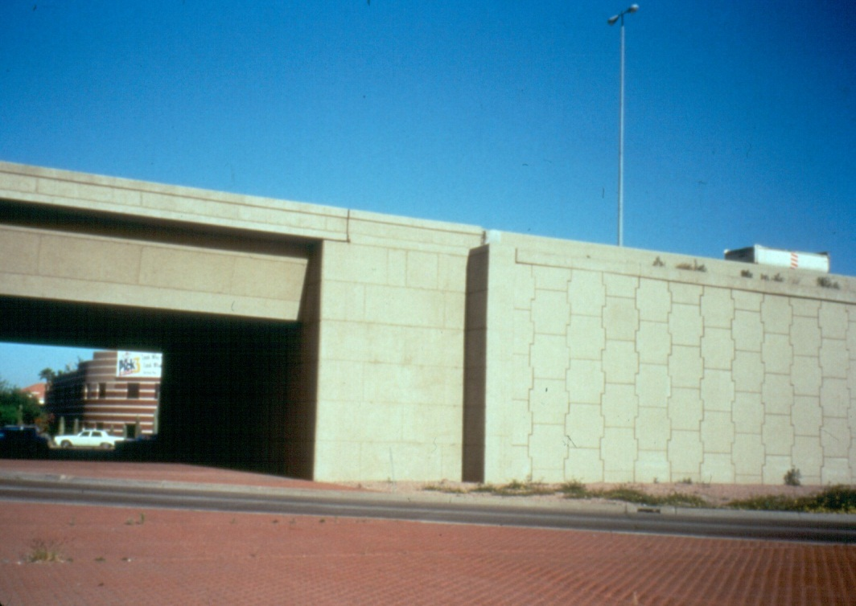
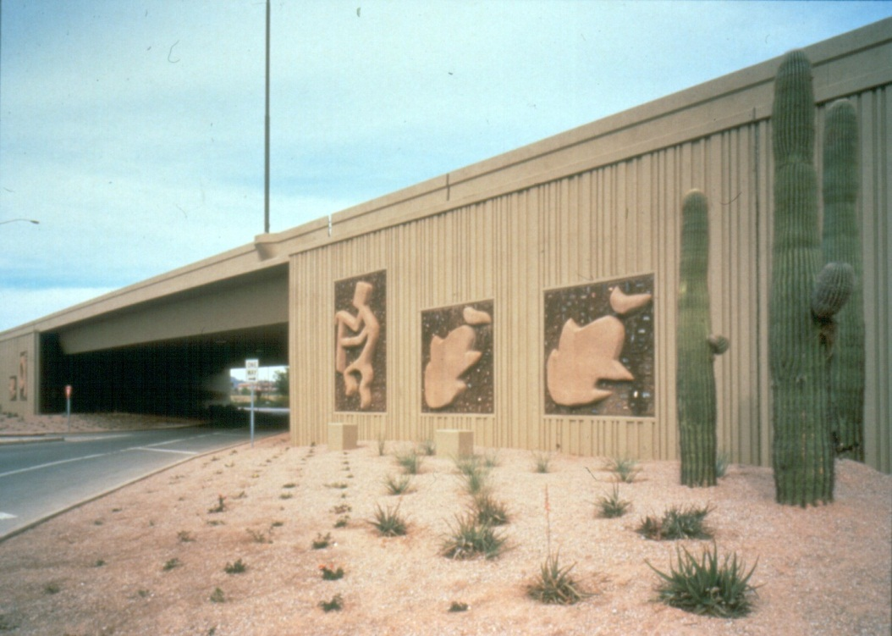
public Art in Phoenix: before & after
Notes:
CPTED: Crime Prevention Through Environmental Design

Slide 36
public Art in chicago: before & after
Notes:
CPTED: Crime Prevention Through Environmental Design

Slide 37
public Art in tampa: designs
Notes:
CPTED: Crime Prevention Through Environmental Design

Slide 38
painting electric boxes: Outcomes
Huge reduction in vandalism on ‘painted’ assets
Reduction in associated removal costs
Improved appearance in local communities
Improved relationships between BCC, Council and the community
Positive feedback and support from all sections of the community

Slide 40
“Blending” into the surroundings…

Slide 41
public art in tampa: traffic signal boxes

Slide 42
IT’S TIME
FOR A BREAK

Slide 43
photo documentation of community issue #1
<<< Insert Participants Community Photo >>>

Slide 44
photo documentation of community issue #1
<<< Insert Participants Community Photo >>>

Slide 45
photo documentation of community issue #1
<<< Insert Participants Community Photo >>>

Slide 46
photo documentation of community issue #1
<<< Insert Participants Community Photo >>>

Slide 47
link community issue #1 to evidence-based strategy
Subtitle
Text

Slide 48
photo documentation of community issue #2
<<< Insert Participants Community Photo >>>

Slide 49
photo documentation of community issue #2
<<< Insert Participants Community Photo >>>

Slide 50
photo documentation of community issue #2
<<< Insert Participants Community Photo >>>

Slide 51
photo documentation of community issue #2
<<< Insert Participants Community Photo >>>

Slide 52
link community issue #2 to evidence-based strategy
Subtitle
Text

Slide 53
photo documentation of community issue #3
<<< Insert Participants Community Photo >>>

Slide 54
photo documentation of community issue #3
<<< Insert Participants Community Photo >>>

Slide 55
photo documentation of community issue #3
<<< Insert Participants Community Photo >>>

Slide 56
photo documentation of community issue #3
<<< Insert Participants Community Photo >>>

Slide 57
link community issue #3 to evidence-based strategy
Subtitle
Text

Slide 58
city planning documents
Review and Highlight areas in the City Planning documents that can help with the CIP goals and activities

Slide 59
Area Map
Subtitle
Text

Slide 60
insert name of planning document
Insert Section Name of Document
ALLIES & TARGETS
Entry 1
Entry 2
OBJECTIVES & ACTIVITIES
Entry 1
Entry 2

Slide 61
insert name of planning document
Insert Section Name of Document
ALLIES & TARGETS
Entry 1
Entry 2
OBJECTIVES & ACTIVITIES
Entry 1
Entry 2

Slide 62
insert name of planning document
Insert Section Name of Document
ALLIES & TARGETS
Entry 1
Entry 2
OBJECTIVES & ACTIVITIES
Entry 1
Entry 2

Slide 63
insert name of planning document
Insert Section Name of Document
ALLIES & TARGETS
Entry 1
Entry 2
OBJECTIVES & ACTIVITIES
Entry 1
Entry 2

Slide 64
action plan development
Complete the planning and implementation plan for the issues addressed in the community improvement project(s)

Slide 65
sample implementation plan

Slide 66
conclusion
HOMEWORK OPTIONS
Brainstorm Community Presentation (e.g. music, food, type of invitations, media outreach)
Identify 5 people in the community you would like to invite to the Community Presentation and Celebration
Thank You!
Questions?
Comments?

