Slide 1
Section 2: Strategies
Land Use
Notes:
Overview: Welcome to our next session!
Facilitator Note: An alternative for this session is to have a guest speaker come in from the planning commission or local official’s office to talk about Land Use in their community.

Slide 2
Agenda
Section 2.2: Land Use
Icebreaker/Review
Community Planning
Crime Prevention Through Environmental Design (CPTED)
Built Environments
Safer Communities
Conclusion
Notes:
Overview: Brief review of agenda.

Slide 3
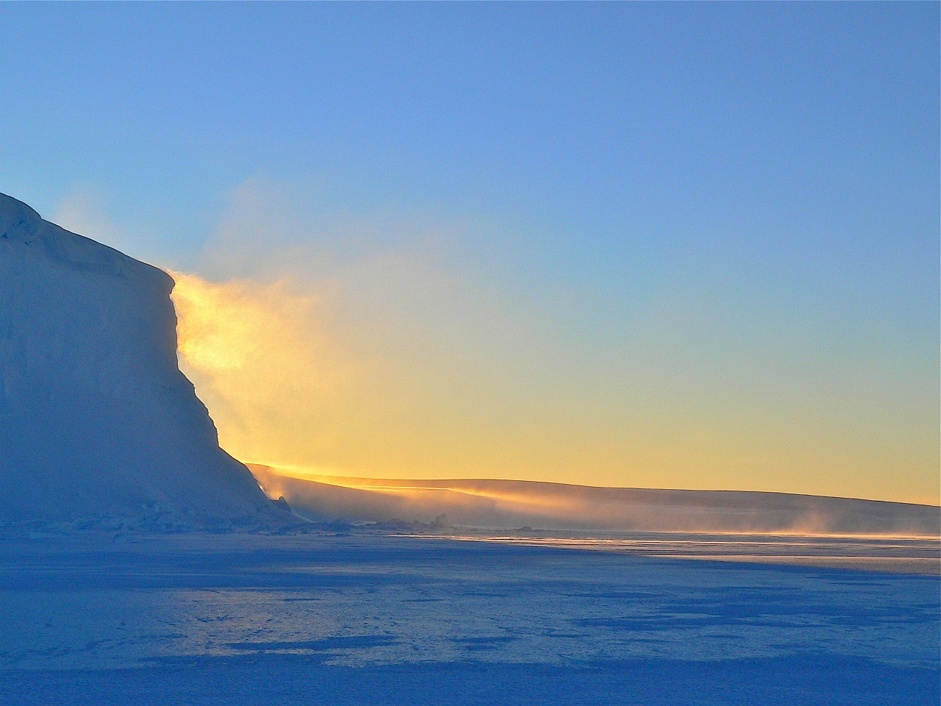
Ice Breaker
Notes:
Overview: Use the resources in the Digital Library to choose an icebreaker activity for your group.
Group Discussion: Did anyone have any “aha” moments this week, if the facilitator had an “aha” moment share it here.
Facilitator Tip: Choose ice breaker and other activities based on your observations of the group and community. There may be emerging ideas or areas that you can support or help develop a skill with the right icebreaker activity (found in the Ice Breaker section of your Digital Library or borrow the book, Great Group Games from the Resource Library). If you have not already done so, connect with other facilitators to share ideas, challenges, and successes.

Slide 4
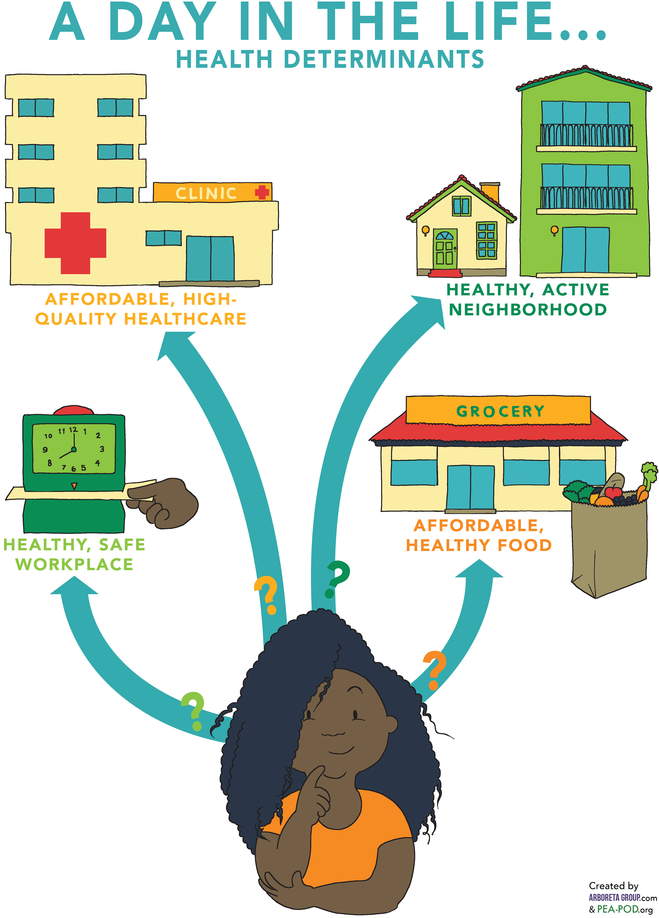
Health access Review
What did we learn about Health Access
Health Systems
Home and Neighborhoods
Workplace
Marketplace
Notes:
Overview: Basic review of the previous section.
Group Discussion: Check in with the group to see if they have any questions from the last session. Ask about any of the connections they may have noticed or ideas they might have had from their readings of Section 2.1 Supporting Health and Section 2.2 Land Use about how both effect their neighborhood.

Slide 5
Section 2: Strategies
Learning Objectives:
Identify health determinants and how they affect health.
Identify changes that can be made in communities to improve health.
Notes:
Overview: We are working our way through strategies that support health on a community and society level. Give the group a reminder that they are doing high level learning about complex issues, so this is a great place to ask questions and think through challenges together.

Slide 6
Activity
How did You get to the workshop today?
Why?
Notes:
Overview: Land Use and community planning are very complicated, but help make it practical for the group by using laymen's terms and by referring to further information in the Deep Dive. This activity in particular is related to Active Transportation and Land Use so it is also a preview for the next reading assignment and training session.
Group Discussion: Discuss the question above and then expand to get to the underlying reasons behind why we make the decisions we make.
For those who drove, why did you drive? Explain that, as the facilitator, you want to understand a little more about the community context, e.g., was the location too far away to walk? Is transit unreliable, too expensive, or not available in the community? Are there bike lanes and good sidewalks?
Our meeting here today is just one example of getting from place to place, how often are you able to utilize different modes of transportation? Why or why not?
Discuss the ways the built environment influences transportation decisions and how our communities are designed that either expands or limits our transportation choices.

Slide 7
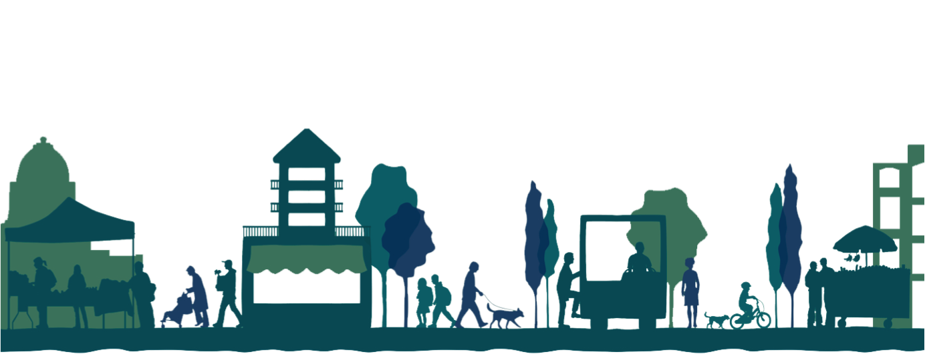
Community Planning
What is it?
How people live, work and play together in the same place.
Notes:
Overview: Review what land use and community planning are and emphasize that the community planning process includes a public hearing. This is the point in the decision-making process that is designed for hearing the voices of the community. If people do not speak up it is less likely that their needs will be met.
Group Discussion: Discuss what they learned about land use in their reading. Did they have any ideas about how land use and built environment decisions were being made in their community and how they are being implemented? Talk about what parts of their neighborhoods they enjoy and what improvements they would like to see.

Slide 8
General Plan
Notes:
Overview: It looks complicated and frankly, it is complicated. Remind your group that they are part of a supportive team of people working together. You do not have to know all of the answers to begin making positive changes in your community.

Slide 9
Built Environments
All aspects of our surroundings that are constructed by people: homes, buildings, roads, parks, etc.
Notes:
Overview: Review built environments.
Group Discussion: Ask for any observations about this photo and the built environment it represents.

Slide 10
Built environments
Notes:
Overview: Review built environments.
Group Discussion: Ask for any observations about this photo and the built environment it represents. How are the land use and community planning decisions different here versus the picture from the previous slide?

Slide 11
Accessing Information
How to access your local planning documents
Start by searching online for “[city name] general plan.”
Other types of plans include:
Specific plans or Downtown Plans
Pedestrian master plans
Bicycle master plans
Park master plans
Urban Agriculture Plans
Notes:
Overview: In order to influence the community planning process you have to first learn about the plans for your neighborhood. These are some of the ways to access your area’s plans and planners.
Facilitator Note: Do some research ahead of time for your group so that you can help them connect with the right local resources. You can also load up some of the information on your computer ahead of time to show the group what they will be looking at, and some of the main websites they may access depending on what they choose for their Community Improvement Project (CIP).

Slide 12
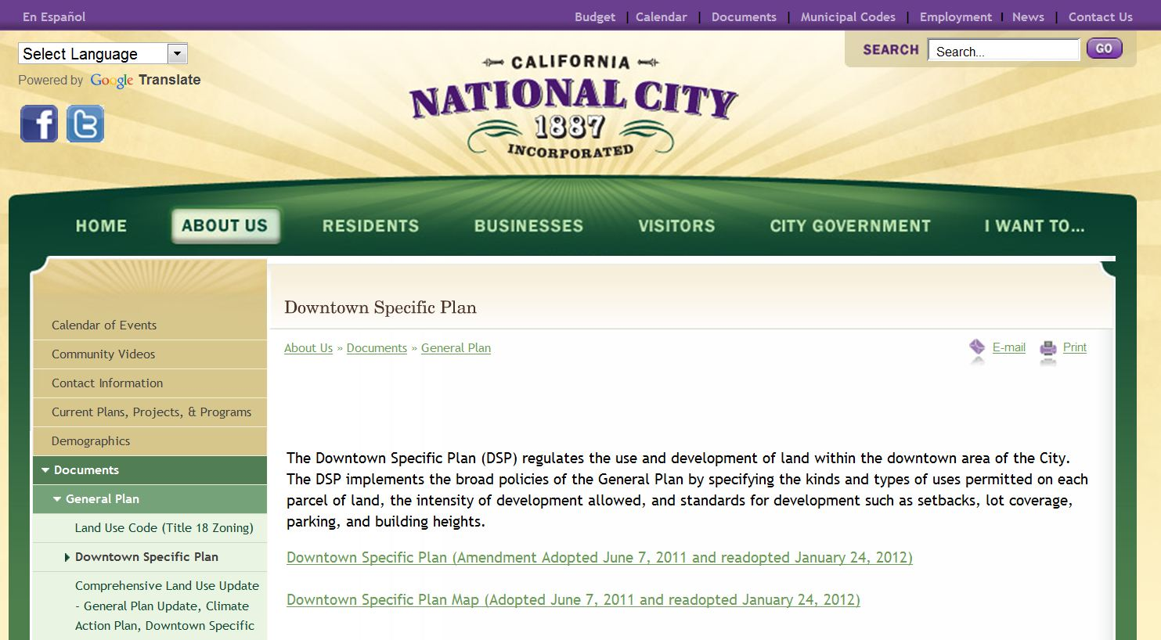
Accessing Your Community’s Information
Insert a screen shot of your City’s Website
Example:
Notes:
Overview: Most cities have their major planning documents, like the general plan, online. The files are very large, so sometimes the general plan is broken into different sections before it is posted on the website. If your group decides on a CIP that involves land use you may want to begin to think about who among you loves research and details and might be interested in taking the lead on doing this research for the group.
Facilitator Note: Replace this photo with the screen shot of your city’s website.

Slide 13
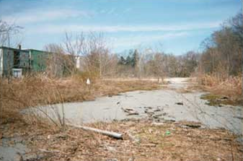
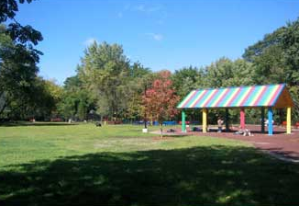
Development/Redevelopment
BrownField
Before
After
Notes:
Overview: This is an example of redevelopment. This example is a brownfield, which is a property that may involve complicated redevelopment efforts due to the presence or potential presence of a hazardous substance, pollutant, or contaminant.
Group Discussion: Discuss recent and/or current developments or redevelopments in their neighborhood.
Source: http://www.epa.gov/brownfields/about.htm

Slide 14
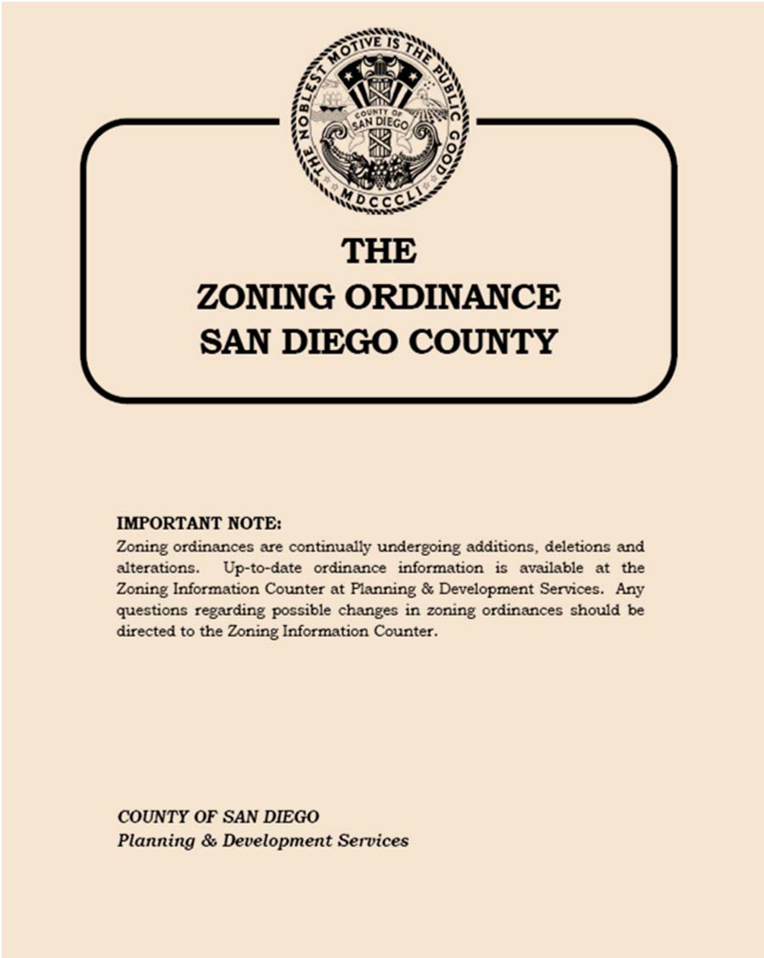
Zoning Ordinances
Zoning ordinance
Written regulations and laws that define how property in specific geographic zones can be used.
Zoning ordinances specify whether zones can be used for residential or commercial purposes, and may also regulate lot size, placement, bulk (or density) and the height of structures.
Notes:
Overview: After discussing this, tell the group there is a great video series on page 106 of the Deep Dive resources for adults and children called “Little Kids, Big City” that explains zoning in more detail.
Group Discussion: What do you think Commercial zoning means? Residential? Mixed use? How do you think these regulations affect your neighborhood now and in the future?
Source: www.investopedia.com/terms/z/zoning-ordinance.asp

Slide 15
Land Use
Visual
Insert photos of your neighborhood
Notes:
Group Discussion: What kind of zoning do you think this building has? Why? What were your clues? Thinking of the health determinants that you learned about last week, do any of these examples support the health of residents?
Facilitator Tip: Take photos of different buildings and places in the local neighborhood like parks, apartments, mixed use developments, etc. and discuss them and how they effect community health.

Slide 16
Break Time
Notes:
Facilitator Tip: Use this time for a break. Give participants a five to ten minute break depending on the needs of the group and the length of the meeting. Use the resources in the Digital Library to choose one stretch for your group.

Slide 17
Concerns of Land Use Stakeholders
Notes:
Overview: Part of the reason land use and community planning is so complex is because there are a lot of interested parties.
Group Discussion: Discuss what is happening in the group’s neighborhood. What do they wish was happening or not happening?

Slide 18
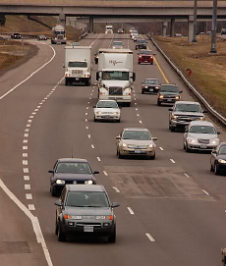
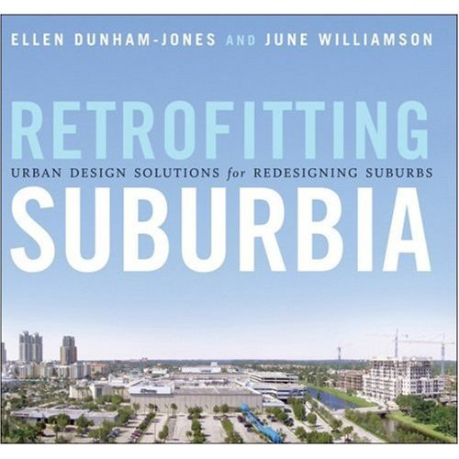
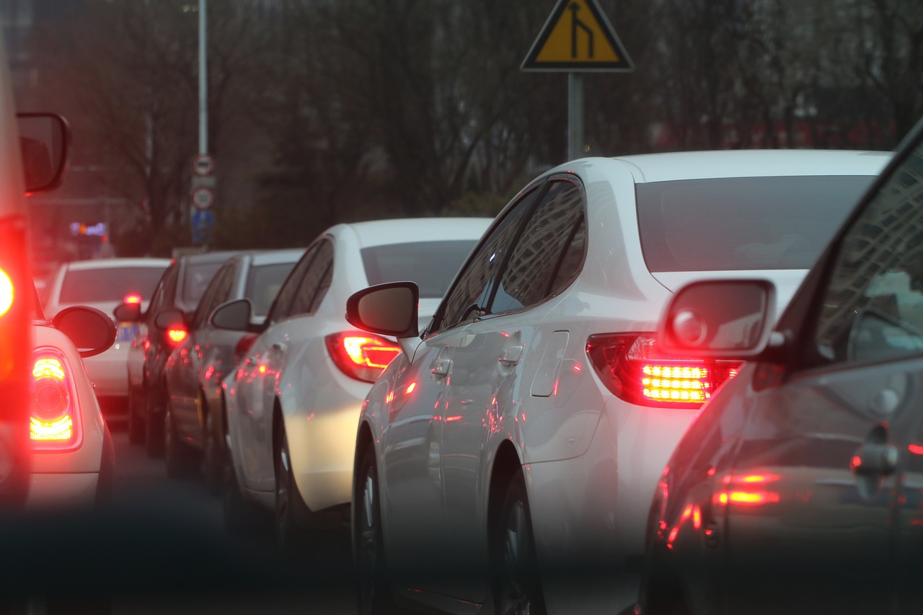
A Social Mess
Notes:
Group Discussion: Discuss the case study in the workbook about urban sprawl. Discuss how that relates to San Diego and their neighborhood. Some ideas to address include stress and time spent commuting, effects on activity levels, and contribution to greenhouse gasses and climate change.
Picture on top right side from: http://bungalowhouseplans.com/craftsman-house-plans-blog/a-retro-fit-of-suburbia/

Slide 19
7 Steps to understand and Influence Land Use
1. Do the Research
Notes:
Overview: Again, remember that your RLA is a team and bet that there are some natural researchers out there.
Facilitator Tip: They have already reviewed these steps in theory. Make this discussion practical. One option is to discuss the steps and then put the participants in small groups to identify how they would apply the steps in their own community using a land use CIP idea (it does not have to be the CIP they ultimately work on). There is a lot of discussion in the following slides. Check on your time and manage the discussion on each slide accordingly. Depending on the group you may spend more than one session on this topic.

Slide 20
7 Steps to understand and Influence Land Use
2. Connect with other residents
Notes:
Overview: Otherwise known as neighborhood organizing: talking to people, listening and sharing your concerns, and analyzing the information you received.

Slide 21
7 Steps to understand and Influence Land Use
3. Create an action Plan
Notes:
Group Discussion: Discuss the value of having a well-organized plan. How does it help? Who should develop it and who should have a copy of it?
Hint: the answer to the last two questions is EVERYONE!

Slide 22
7 Steps to understand and Influence Land Use
4. Develop your Message
Notes:
Overview: Discuss different ways to frame a message. Think about who you are trying to influence. In this case it is elected city officials and community planners, how can you deliver your message in a way that makes them pay attention?
Facilitator Tip: Let people know there are actual strategies already created that they can find in the Deep Dive and that you have in the Digital Library.

Slide 23
7 Steps to understand and Influence Land Use
5. Build Support with Traditional and Non-Traditional Partners
Notes:
Overview: We are learning that everything is interconnected so think outside the box and get creative about who your partners can be.
Group Discussion: Who are the players in your neighborhood and why? Get some examples of non-traditional partners. For example, why would the neighborhood pastor, Imam, or other faith leader be interested in a partnership with the owner of a local fast-food franchise?

Slide 24
7 Steps to understand and Influence Land Use
6. Meet with planners, elected officials, and their staff members
Notes:
Overview: Focus on relationships. At the end of the day, it comes down to a human being (or a small group of them) making a decision.

Slide 25
7 Steps to understand and Influence Land Use
7. Be persistent and patient
Notes:
Overview: Persistence is one of the most potent weapons at your disposal and it is low-cost! Land use changes can take years to complete so patience is necessary for this type of change strategy.

Slide 26
Social Connectedness
Relationships are important
Builds social capital
Linked to increase health
Contribute to the prevention of chronic disease
Notes:
Group Discussion: How does social capital help you? What social capital do you contribute to friends, neighbors, and families?

Slide 27
Crime Prevention through environmental Design
What is it?
CPTED is a crime prevention philosophy that promotes the proper design and effective use of the built environment to:
Reduce Criminal Activity
Reduce the Fear of Crime
Improve Quality of Life
Notes:
Overview: Review Live Well San Diego’s goals, safety is a primary issue, this is a tool that can help people address it
Facilitator Tip: You may choose to use the law enforcement perspective on Crime Prevention Through Environmental Design (CPTED) video located in the Deep Dive or have a guest speaker (law enforcement, neighborhood watch captain, or architect/urban planner).

Slide 28
1st Generation CPTED
Natural Surveillance
Territorial Reinforcement
Access Control
Maintenance
Notes:
Group Discussion: Discuss examples in their neighborhood and potential ideas to improve CPTED.
Facilitator Tip: If you are not familiar with the neighborhood, take time to explore the community so you have some examples to share and can be more familiar with the examples presented by the group.

Slide 29
2nd Generation CPTED
Capacity
Social Cohesion
Connectivity
Community Culture
Notes:
Group Discussion: Discuss examples in their neighborhood and potential ideas to improve CPTED.

Slide 30
Video Clip
Health Benefits and Healthy Community Design
Notes:
Overview: Shows that how a community is built affects people’s health.
http://www.cdc.gov/healthyplaces/healthy_comm_design.htm

Slide 31
El Cajon Utility Box Art Project
Notes:
Overview: RLA Success! These boxes in El Cajon, painted by local artists, add beauty and a sense of pride to the neighborhoods and prevents graffiti.

Slide 32
Conclusion
Homework
Read Section 2.3
Questions?
Comments?
Concerns?
Notes:
Group Discussion: Any outstanding questions? Let the group know that if they want more information you can email them more resources, or use your thumb drive to put materials from the Digital Library onto their computer. And ask them to share if they come across good information to add to the library.

Slide 33
"This curriculum was supported by the Cooperative Agreement Number DP005528-01, funded by the Centers for Disease Control and Prevention through the County of San Diego, Health and Human Services Agency. Its contents are solely the responsibility of the authors and do not necessarily represent the official views of the Centers for Disease Control and Prevention or the Department of Health and Human Services."

