Slide 1
Section 2: Strategies
Active Transportation
Notes:
Overview: Welcome to our next session!

Slide 2
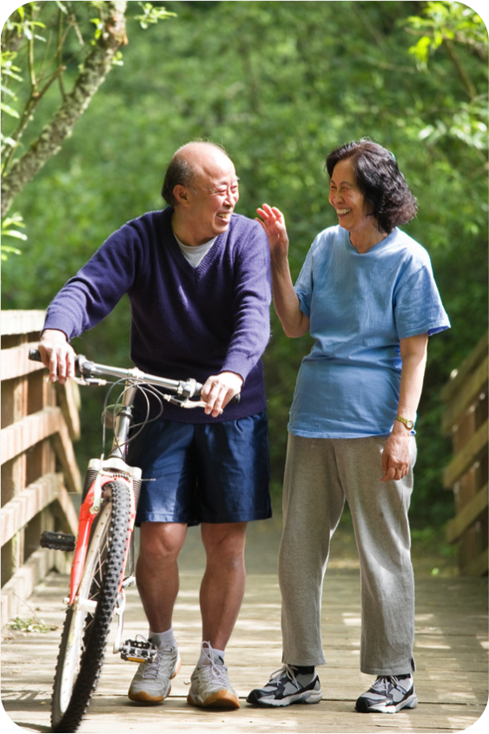
Agenda
Section 2.3: Active Transportation
Icebreaker/Review
Active Transportation
Walkability
Bikeability
Conclusion
Notes:
Overview: Brief review of agenda.

Slide 3
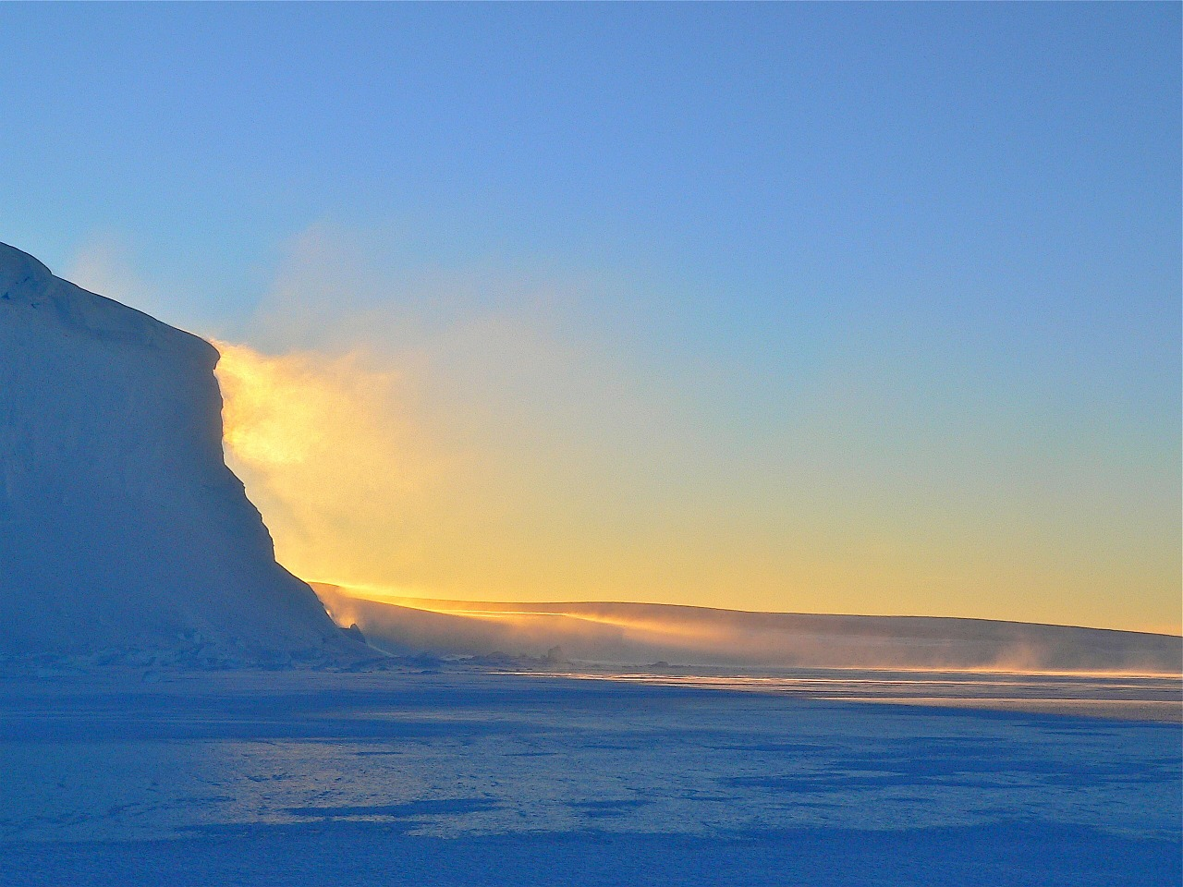
Ice Breaker
Notes:
Facilitator Tip: choose an icebreaker activity from the Digital Library, or get an idea from another RLA facilitator for suggestions on icebreakers that were successful in their groups.

Slide 4
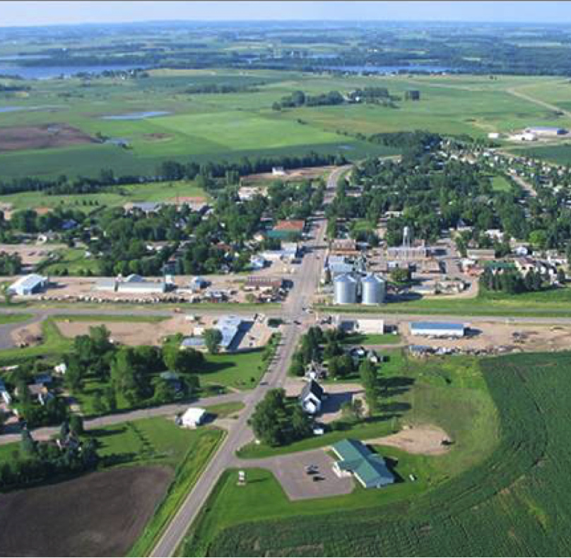
LAND USE REVIEW
What did we learn ABOUT LAND USE?
Any observations in your neighborhood since we met last?
How did your reading about Active Transportation connect with the previous sections?
Notes:
Group Discussion: There are a lot of connections between Land Use and Active Transportation so this conversation might take a little longer than other section reviews.

Slide 5





Section 2: Strategies
Learning Objectives:
Identify health determinants and how they affect health.
Identify changes that can be made in communities to improve health.
Notes:
Overview: Review the learning objectives.

Slide 6
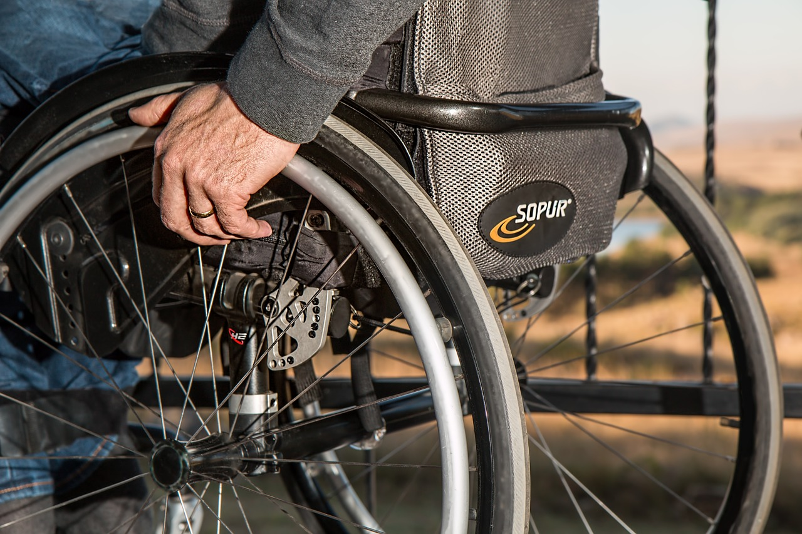
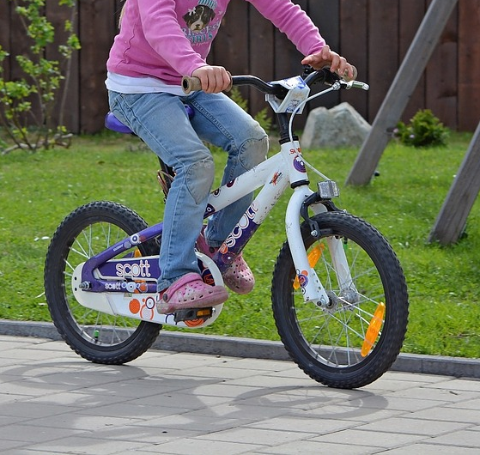
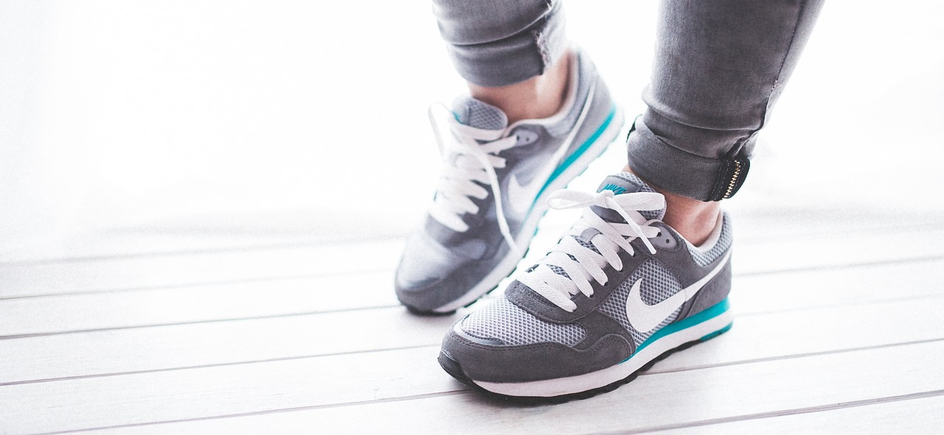
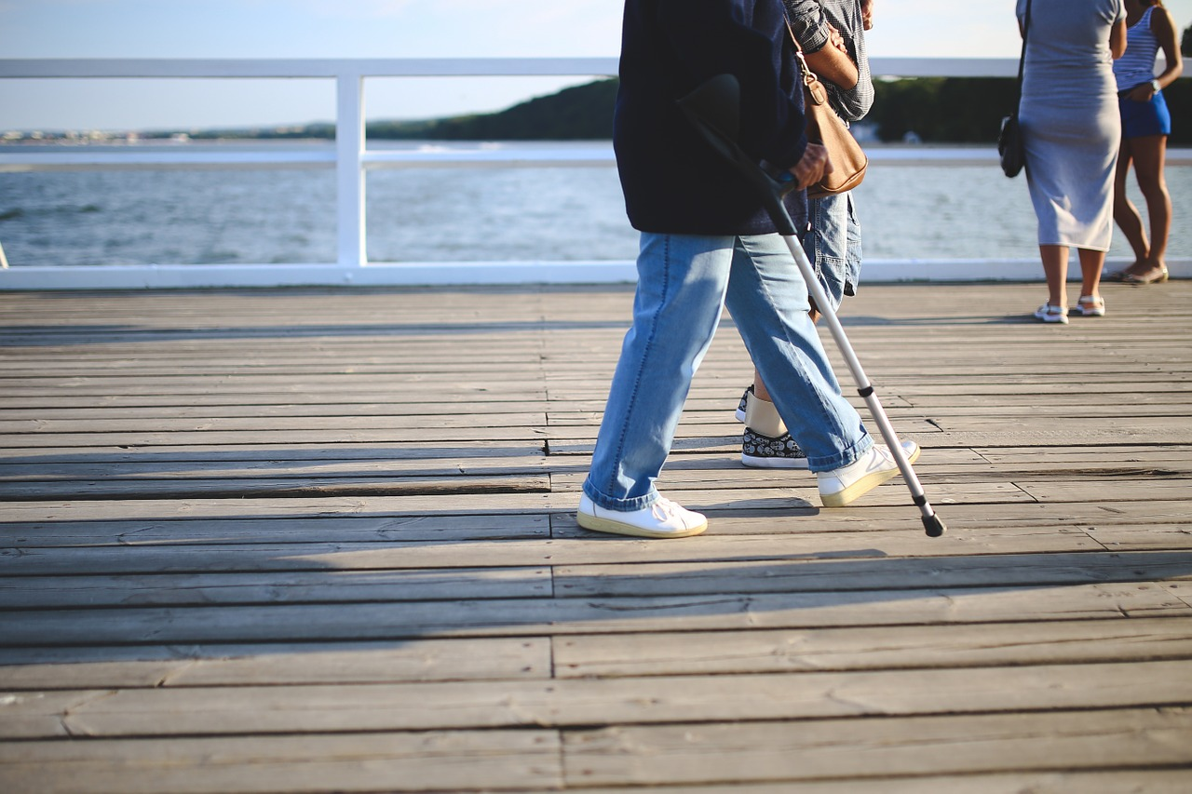
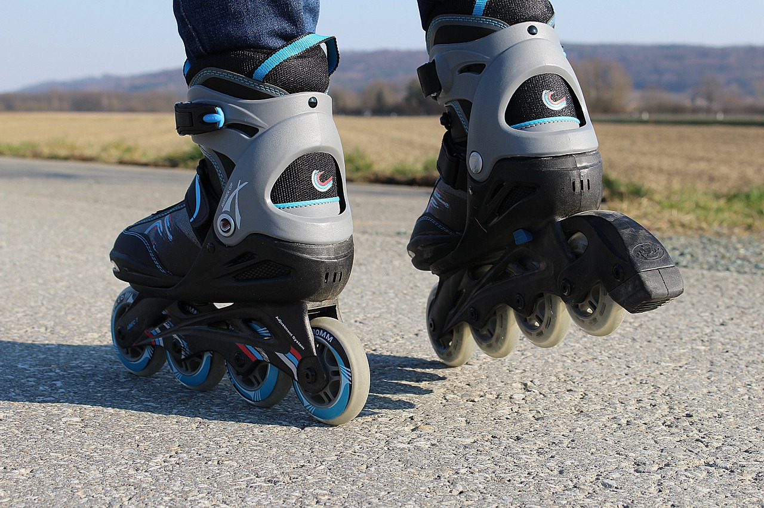
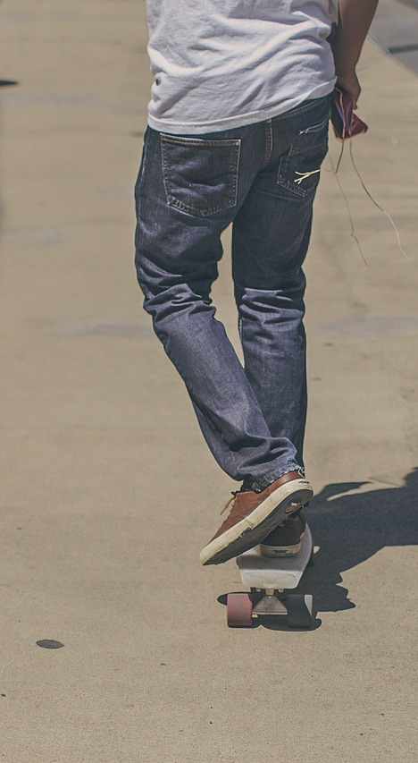
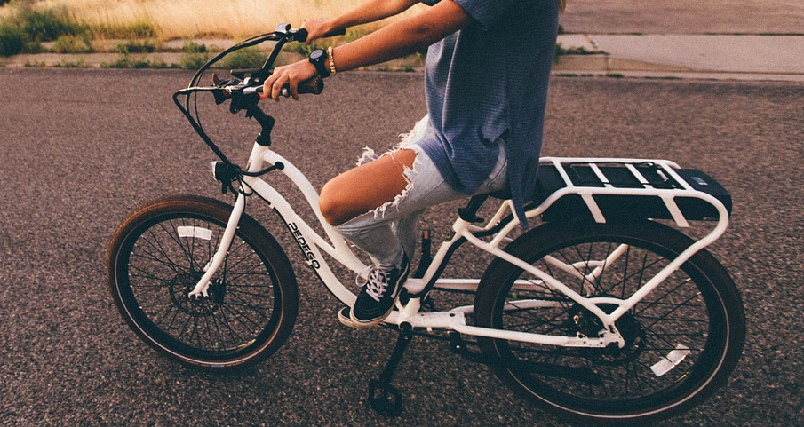
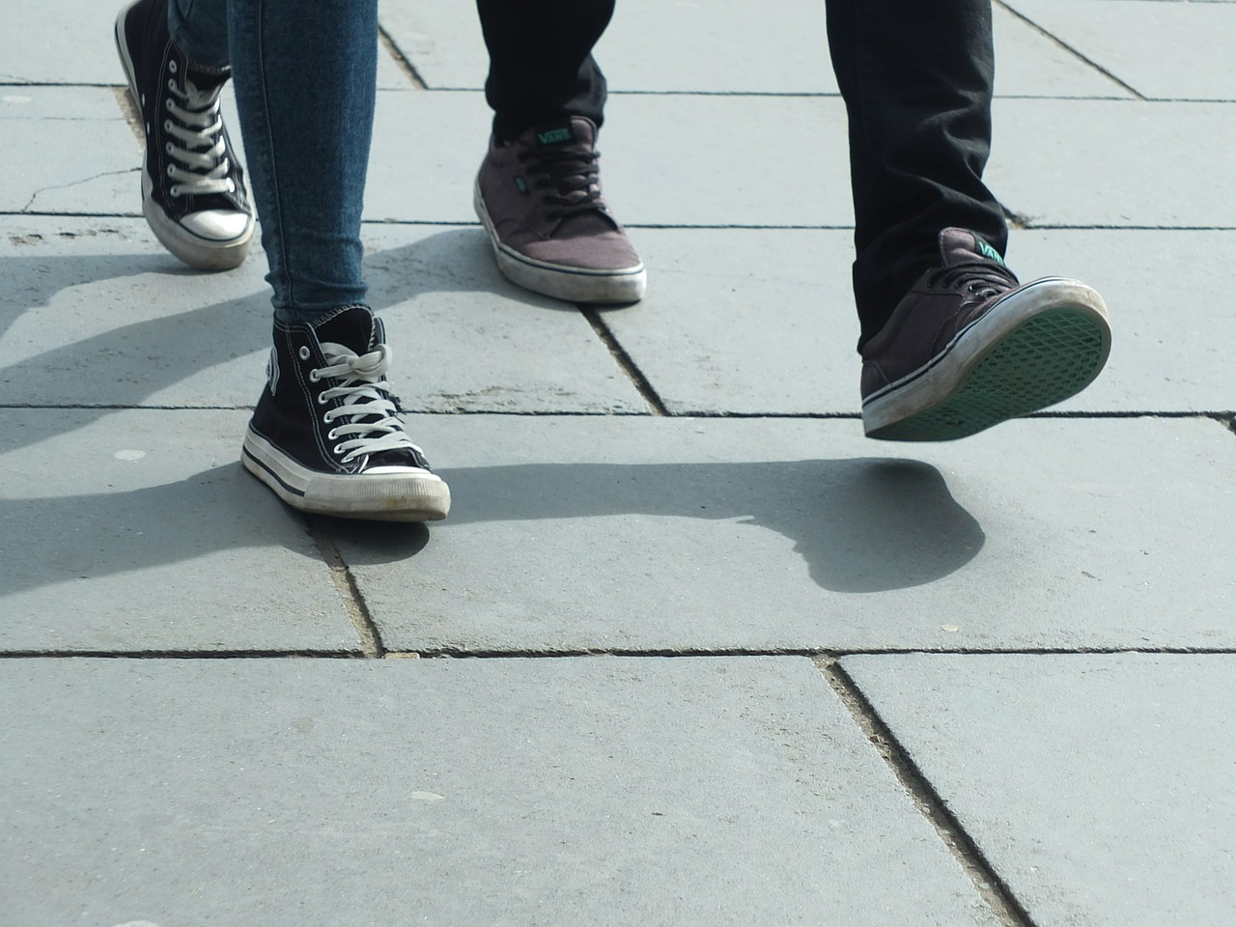
Active Transportation
Notes:
Overview: Active transportation is how people move about under their own power. It is walking, cycling, wheelchairs, and skateboards; it is whenever you use your own muscles to move forward. Active transportation makes you healthier, it is inexpensive, and it is good for the environment.
Group Discussion: How much movement is in your life? What method of active transportation do you use and why?

Slide 7

Video Clip
Active Transportation – Planning 101
Notes:
Overview: This video gives an overview of active transportation as it relates to city planning and how important it is to healthy people and sustainable communities.
https://www.youtube.com/watch?v=dT93bnZk7U8

Slide 8
Video Clip
8-80 Cities
Notes:
Overview: Great overview of active transportation that features Gil Penalosa and the 8-80 Cities concept.
https://vimeo.com/118453984

Slide 9
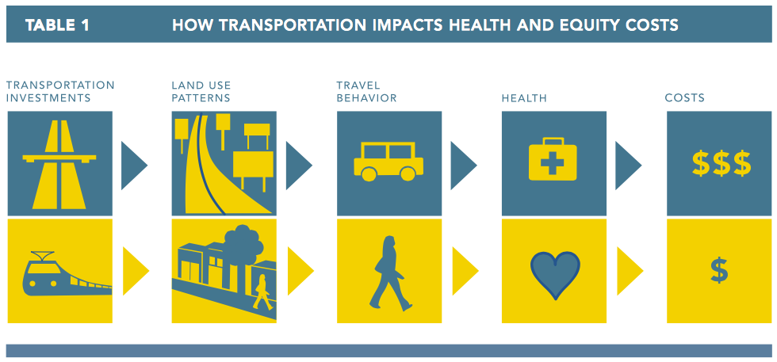
Active Transportation
Notes:
Group Discussion: Break down the sections of this slide and talk about what each of these sections look like in San Diego and in the participants’ neighborhood. What supports active transportation and what does not? What could change to make active transportation more accessible? Start small but it is ok to think big also.
Some topics that might come up are:
Cost and convenience of public transportation, safe neighborhoods, cost of having a car, and the effects of greenhouse gasses on the environment.
Source: Hidden Costs of Transportation

Slide 10
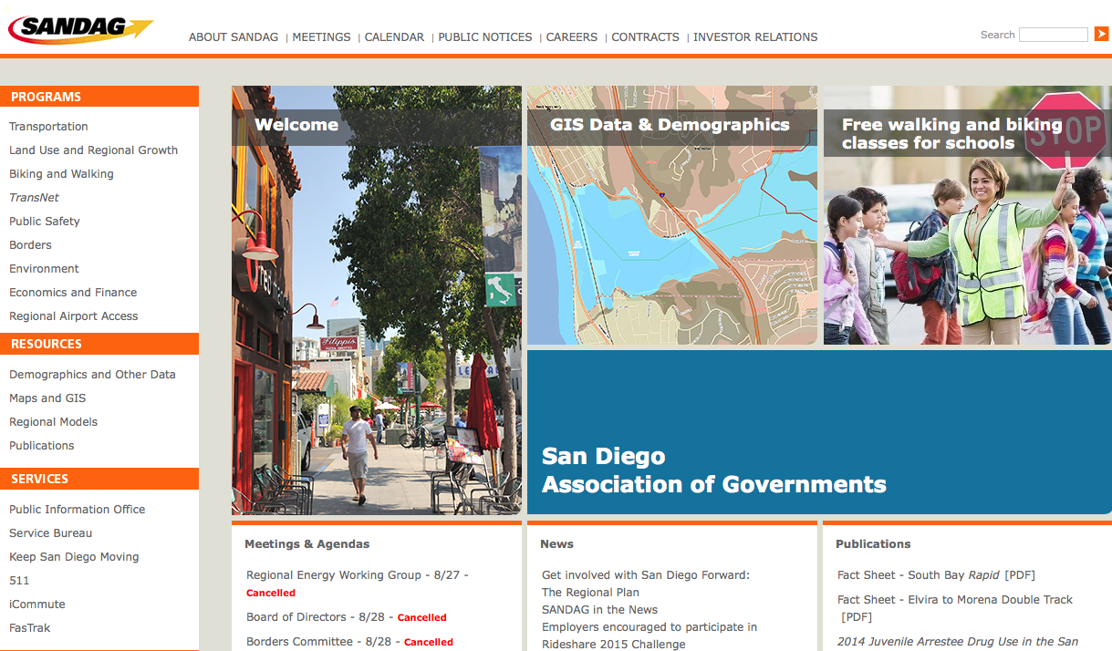
SANDAG
The San Diego Association of Governments
Notes:
Overview: Talk in more detail about SANDAG’s role in the community and who is a part of SANDAG.
Facilitator Tip: This may be a good place for a guest speaker, like a transportation planner, SANDAG representative, or staff member from Circulate San Diego.

Slide 11

Circulate San Diego
Notes:
Overview: Direct the participants to the comparison of Clairemont and Normal Heights.
Group Discussion: Were they surprised by the outcome of the study? What do they think the results would be if they compared their neighborhood to Normal Heights?

Slide 12

Break Time
Notes:
Facilitator Tip: Use this time for a break. Give participants a five to ten minute break depending on the needs of the group and the length of the meeting. Use the resources in the Digital Library to choose one stretch for your group.

Slide 13
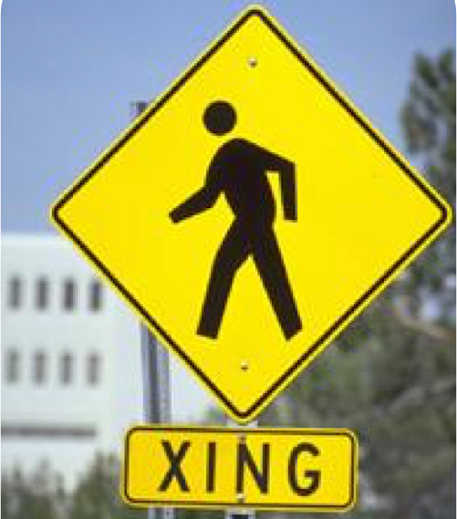
Walkability
Why care about walkability?
For Youth
For Families
For Seniors
For Disabled
For Businesses
For Community
For Environment
Notes:
Overview: Walkability affects everyone in the neighborhood.
Group Discussion: Discuss the concept of completing a walk audit.

Slide 14
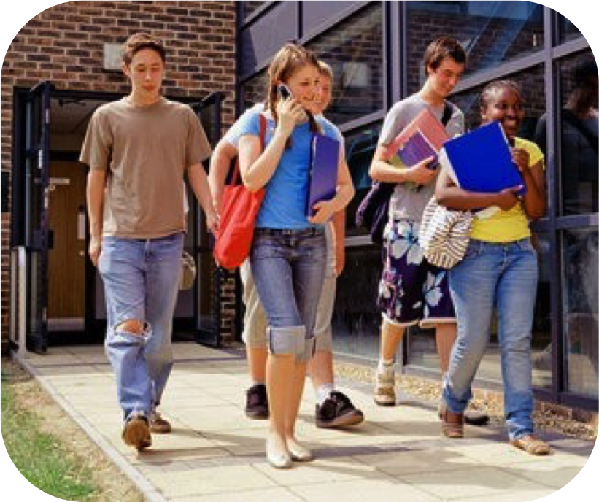
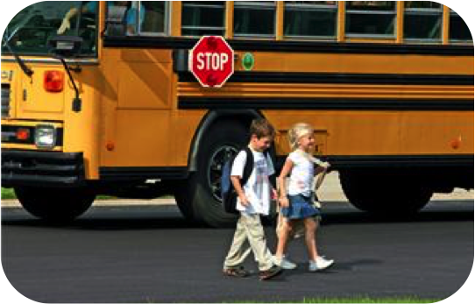
Why care about Walkability?
For youth and families
  Improves health
  Increases mobility without depending on cars
  Independence
  Teaches responsibility
Notes:
Overview: There are lots of reasons to promote walkability in neighborhoods.
Group Discussion: Get a few neighborhood examples from participants.

Slide 15
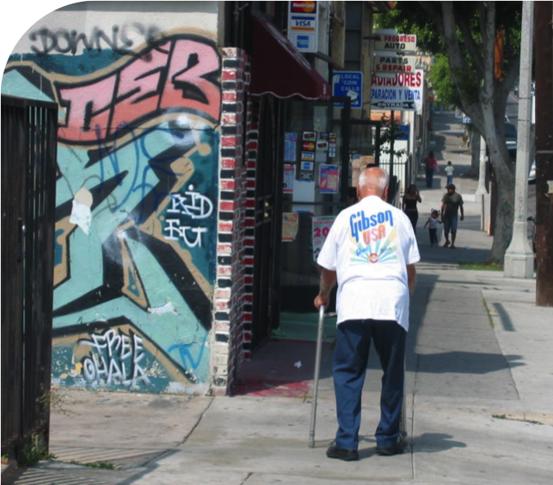
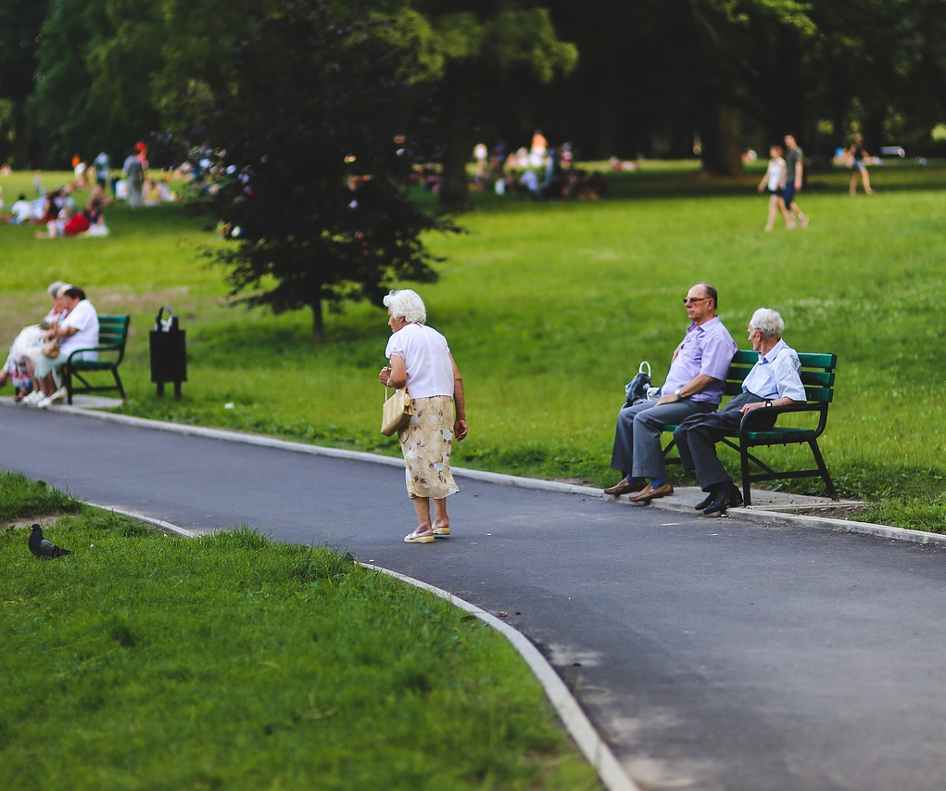
Why care about Walkability?
For seniors and Disabled
  Increases sociability and decreases risk of loneliness and depression
  Improves health and wellness physically and mentally
  Continued independence and mobility
Notes:
Overview: Walkability looks different for everyone.
Group Discussion: Ask one person in the group to respond to the question, why care about walkability?

Slide 16
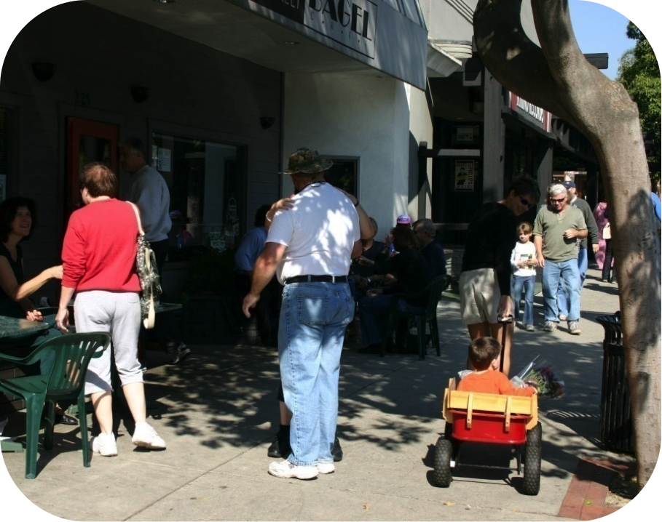
Why care about Walkability?
For the community
  Walking in your neighborhood builds a sense of community
  Walkers interact with neighbors
  & help build social support
Notes:
Overview: Walkability promotes social connectedness.
Group Discussion: Ask a participant, what walking activities they could organize in their neighborhoods and/or workplaces?

Slide 17
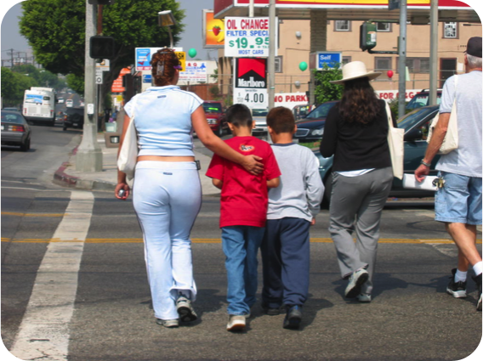
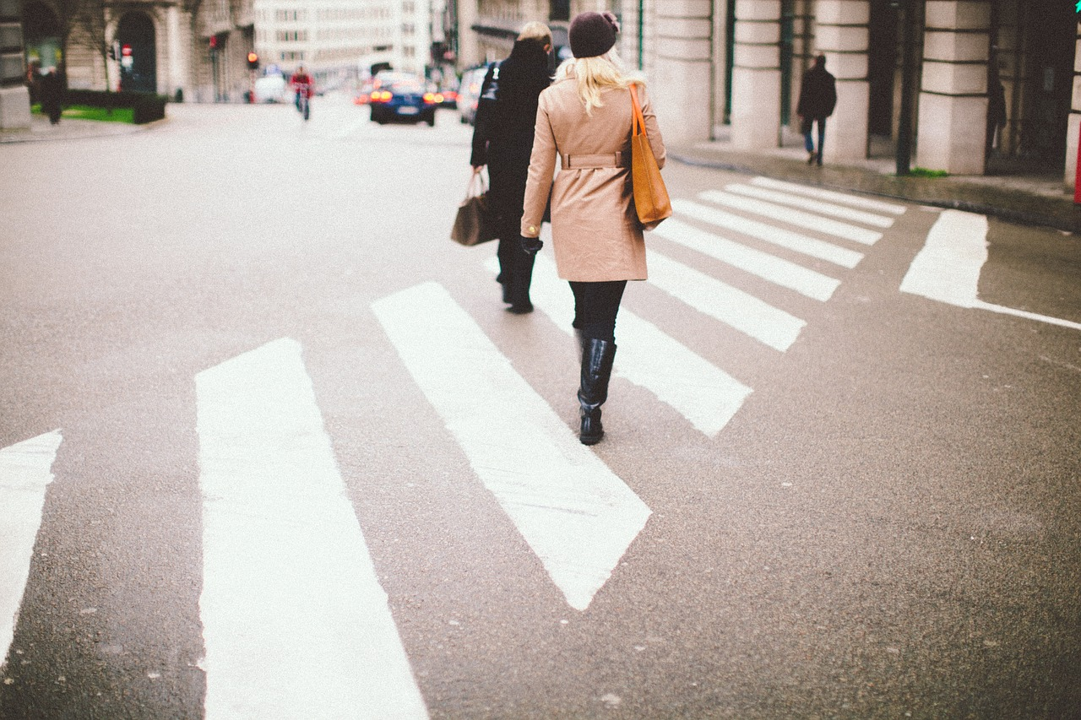

Why care about Walkability?
To prevent crime and improve safety
  “Eyes on the Street”
  Sense of community pride and care
Notes:
Overview: Make a connection to CPTED and social connectedness (i.e. neighbors who are connected to one another are the best security, having each other’s back).
Group Discussion: Ask two participants for a neighborhood example.

Slide 18
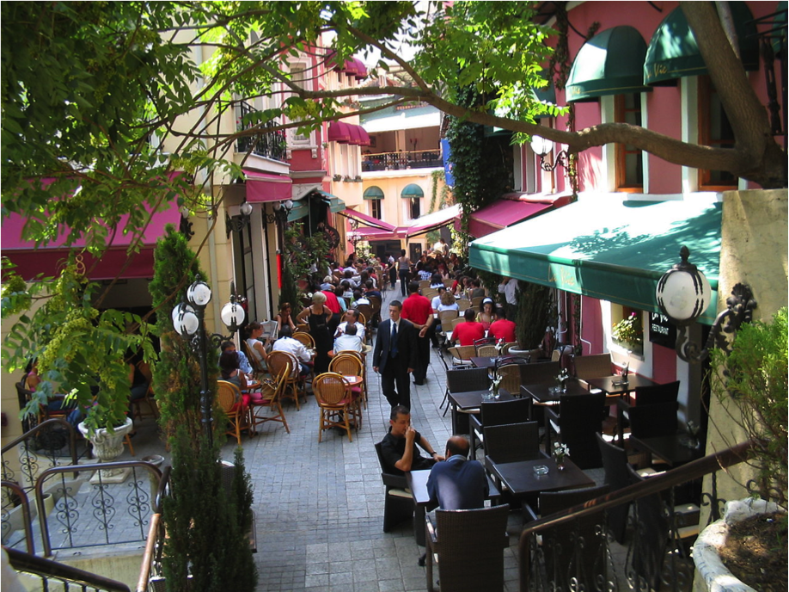
Why care about Walkability?
To improve Business
  Brings business to shop owners
  Increases residential property values
Notes:
Overview: This is why business leaders can be great partners in your RLA, there is a place for everybody.
Group Discussion: Ask two participants for a neighborhood example.

Slide 19
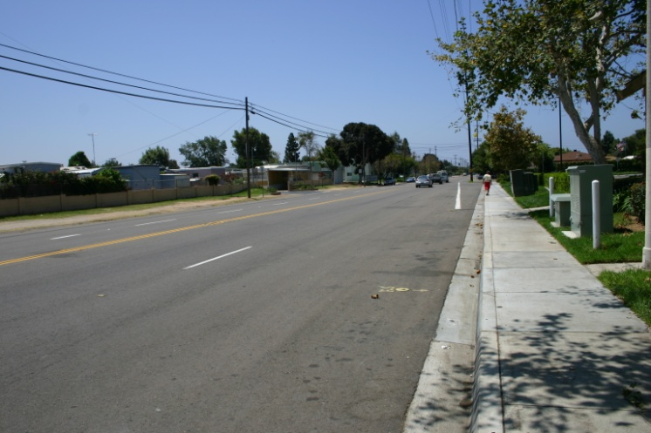

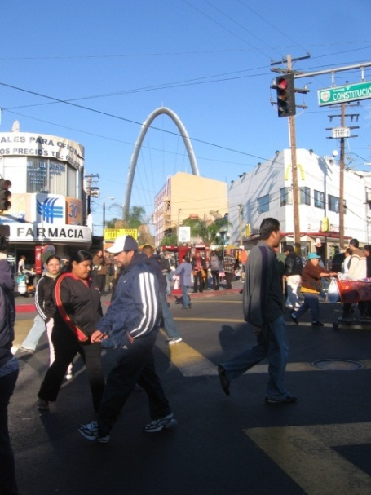
Why care about Walkability?
To improve the environment
MORE
PEOPLE
WALKING
less cars
on the street
less
pollution
Notes:
Overview: Make a connection with the overall goal of public health and how climate change affects health.

Slide 20
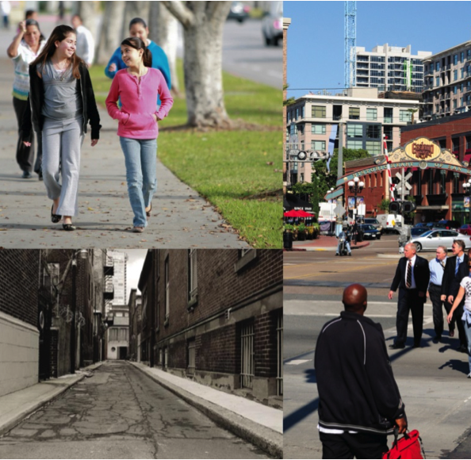
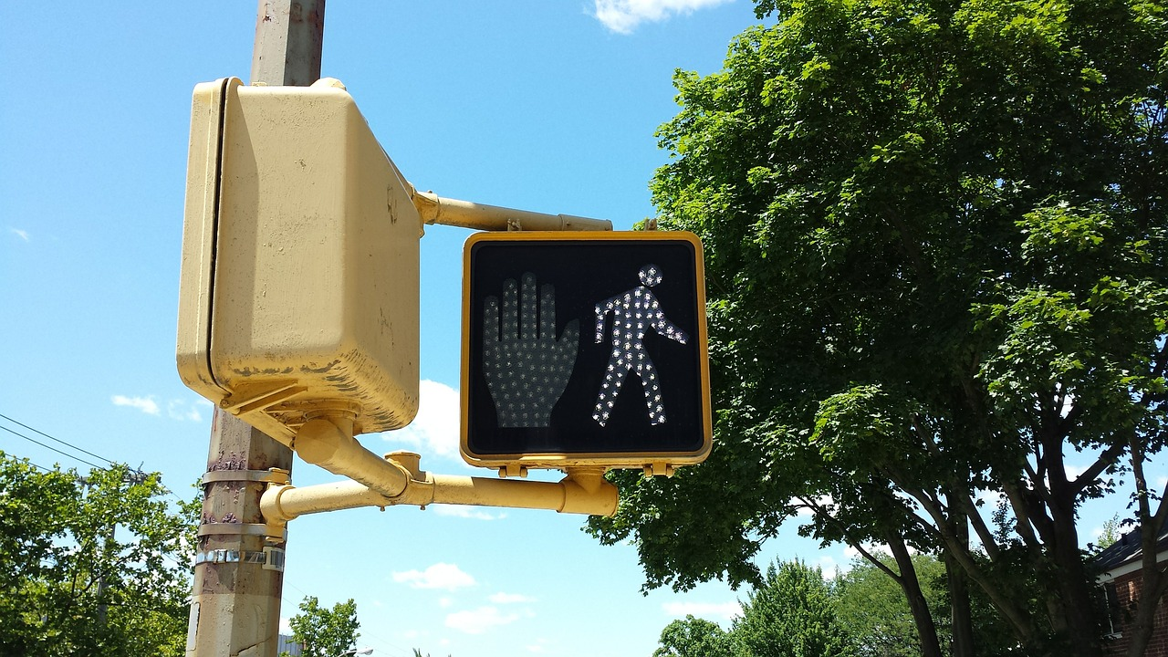
Activity
What is it like to walk in your neighborhood?
Do you live in a walkable neighborhood?
What is one thing you like most about walking in your neighborhood?
What is one thing you like least about walking in your neighborhood?
Notes:
Overview: Relate the information above to the participants’ neighborhood.
Group Discussion: Ask two participants for a neighborhood example.

Slide 21
Break Time
Notes:
Facilitator Tip: Use this time for a break. Give participants a five to ten minute break depending on the needs of the group and the length of the meeting. Use the resources in the Digital Library to choose one stretch for your group.

Slide 22
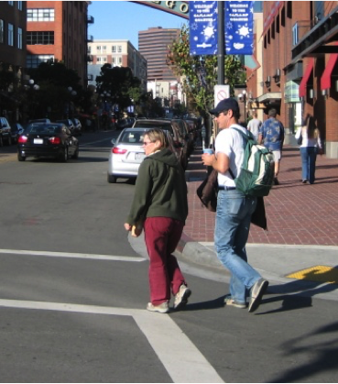
Walkable Neighborhoods Make a Difference
Residents in a highly walkable neighborhood are engaged in about…
70
more minutes
per week of physical activity than residents in a low-walkability neighborhood.
Notes:
Overview: Walkable neighborhoods increase health by increasing physical activity.
Group Discussion: Think about the impact of walking 70 minutes a week over time. What would the benefits be in a week, in a month, and in a year? Limit the discussion to a few responses.

Slide 23
5 Steps to A walkable Community
1
Good Sidewalks
2
Safe and Easy Street Crossings
3
Great Places to Walk
4
5
Safety, Comfort and Beauty
Traffic Calming
Notes:
Overview: The following slides go more into detail and provide specific examples of walkability.

Slide 24
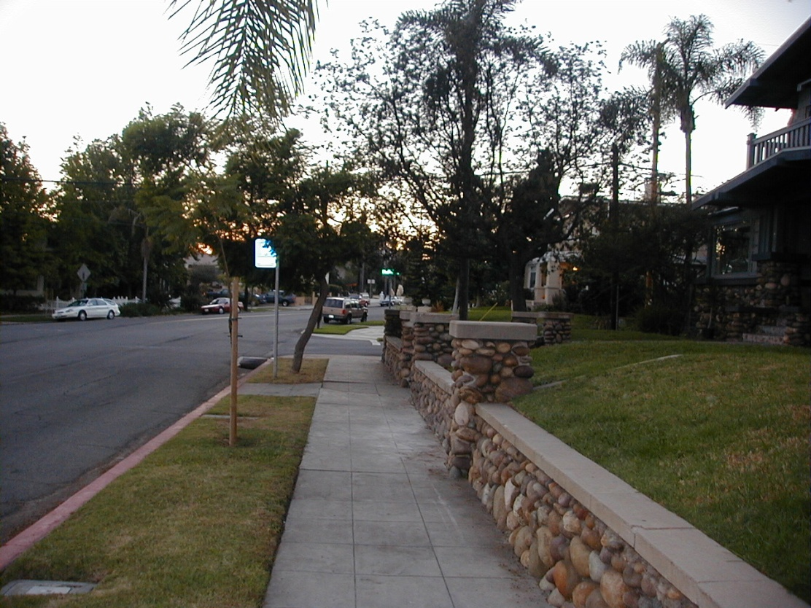
5 Steps to A walkable Community
Step 1: Good Sidewalk Design
Residential Areas
Pedestrian Zone: sidewalks are level, unbroken, and at least 5 feet wide
Curb Zone: protects buffer zone, ADA ramps at street crossings
Façade Zone: between sidewalk and buildings
Buffer Zone: plants, trees, mailboxes, etc.
Notes:
Overview: Introduce the concept of a walk audit and the value of taking pictures of walkability issues in your neighborhood.

Slide 25
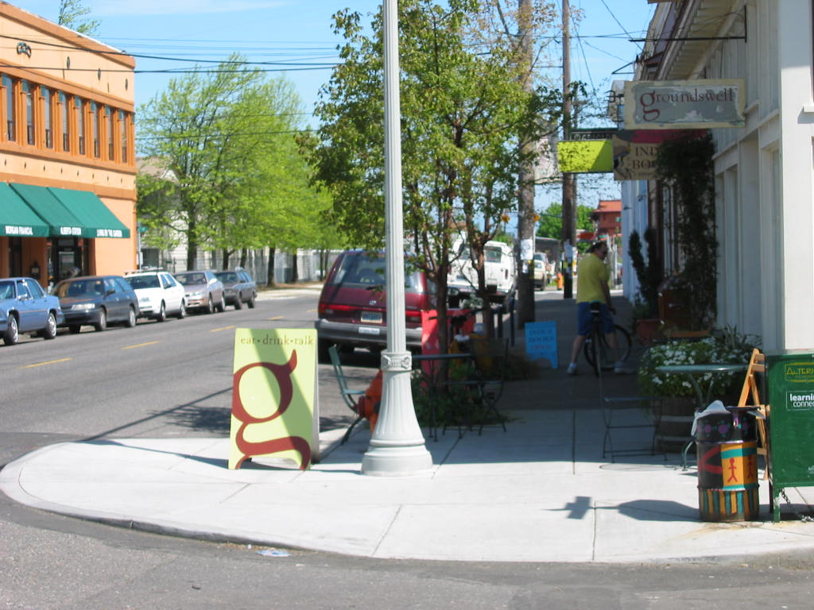
5 Steps to A walkable Community
Step 1: Good Sidewalk Design
Commercial Areas
Pedestrian Zone: sidewalks are level, unbroken, and at least 8 feet wide
Façade Zone
Buffer Zone: trees, mailboxes, outdoor seating, lighting, etc.
Façade Zone: between sidewalk and buildings
Curb Zone: ADA ramps at street crossings
Notes:
Overview: There are five steps to a walkable community.

Slide 26
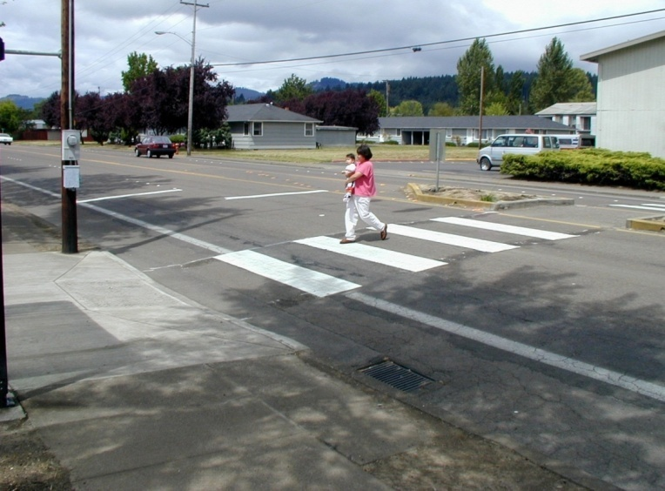
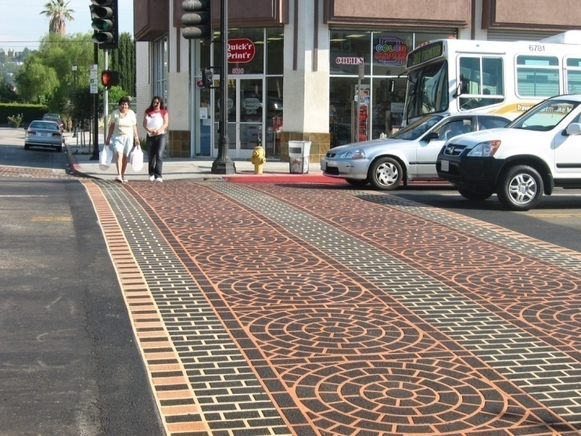
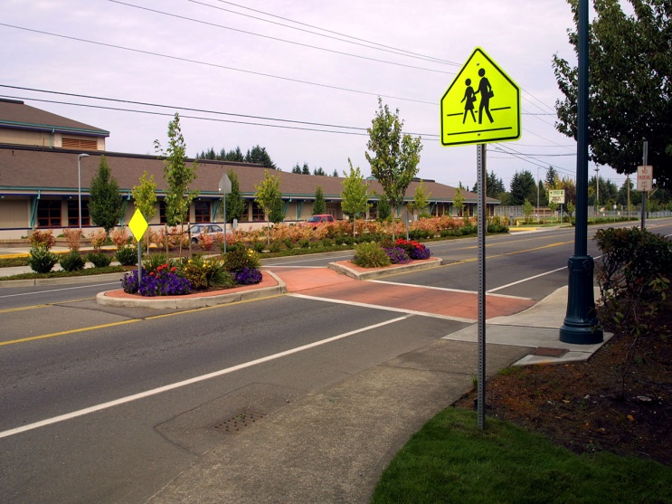
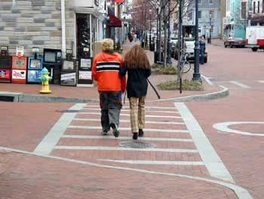
5 Steps to A walkable Community
Step 2: Safe and Easy Street Crossings
Crosswalks can be painted for high visibility or decorated and textured with brick or pressed concrete
Notes:
Overview: The five steps to a walkable community continued.
Group Discussion: Why is this safer?
Facilitator Tip: Research traffic accidents and injuries in the neighborhood to share with the group.

Slide 27
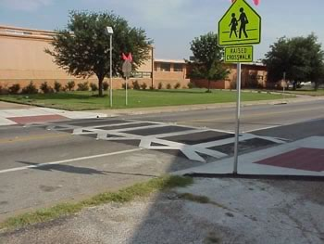
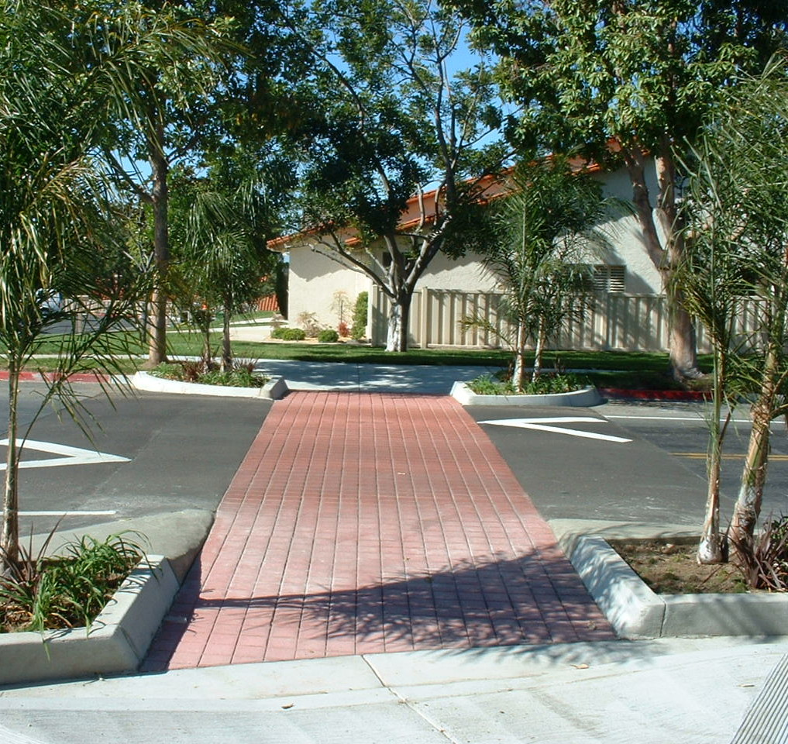
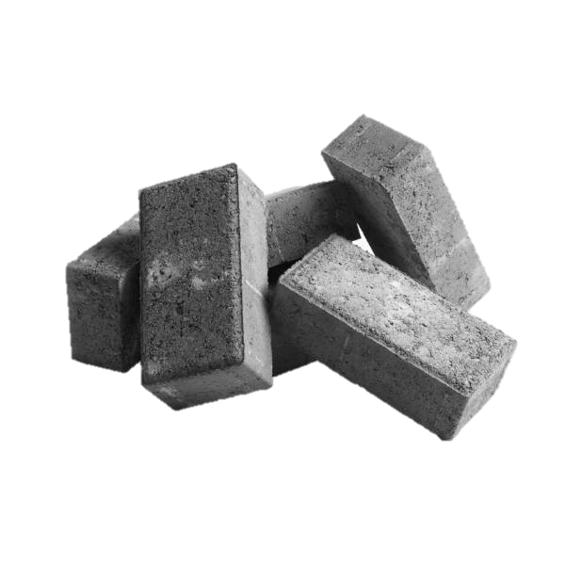
5 Steps to A walkable Community
Step 2: Safe and Easy Street Crossings
Raised Crosswalks
Notes:
Overview: The five steps to a walkable community continued.

Slide 28
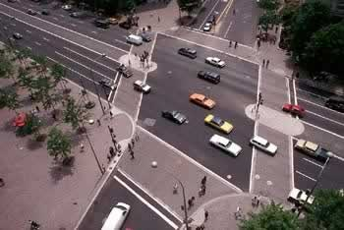
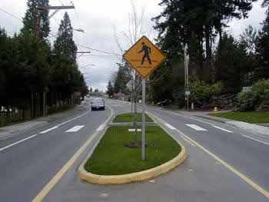
5 Steps to A walkable Community
Step 2: Safe and easy street crossings
Medians
Shorten the crossing distance
Provide refuge for pedestrians
May slow traffic
Notes:
Overview: The five steps to a walkable community continued.
Group Discussion: Thinking about the 8-80 video we watched how do the lessons learned apply to these photos?

Slide 29
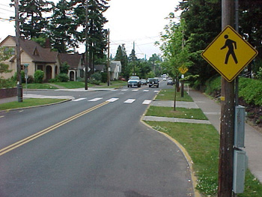
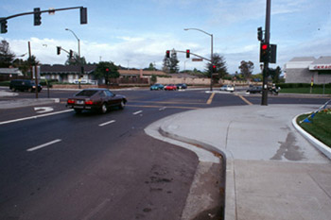
5 Steps to A walkable Community
Step 2: Safe and easy street crossings
Curb Extensions
Shorten the crossing distance
Allow drivers to see pedestrian
Slow cars in intersection
A.k.a. Bulb-outs: an extension of the curb that brings the curb out further.
Notes:
Overview: The five steps to a walkable community continued.
Group Discussion: This is a traffic calming strategy. Why do you think it works?

Slide 30
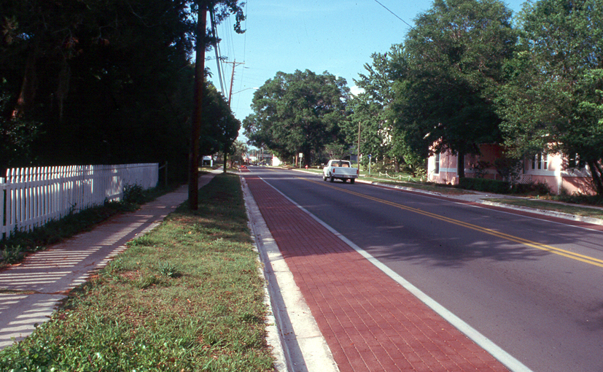
5 Steps to A walkable Community
Step 3: Traffic Calming
Traffic Calming Tool: Narrow Road Visually
Notes:
Overview: The five steps to a walkable community continued.
Group Discussion: Why do you think this one works?

Slide 31
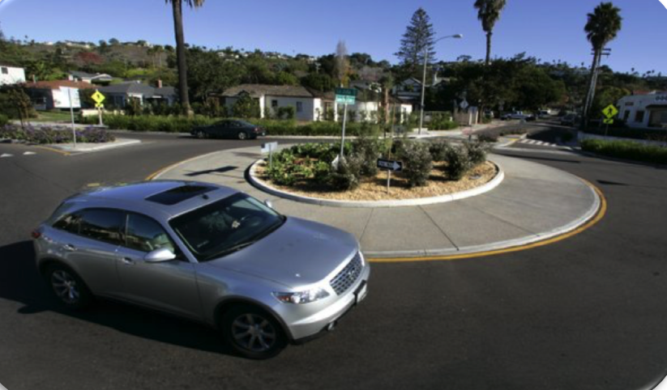
5 Steps to A walkable Community
Step 3: Traffic Calming
Traffic Calming Tool: Traffic circle or Roundabout
Notes:
Overview: The five steps to a walkable community continued.

Slide 32
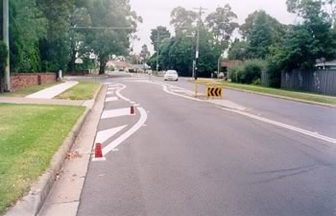
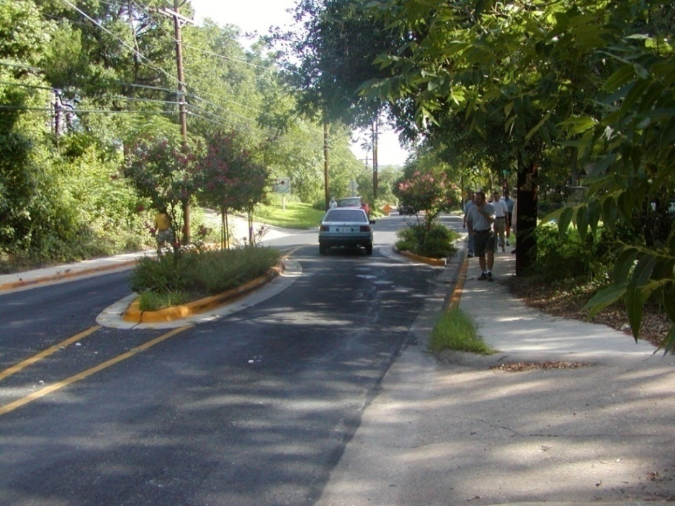
5 Steps to A walkable Community
Step 3: Traffic Calming
Traffic Calming Tool: Islands or Curves
Notes:
Overview: The five steps to a walkable community continued.

Slide 33
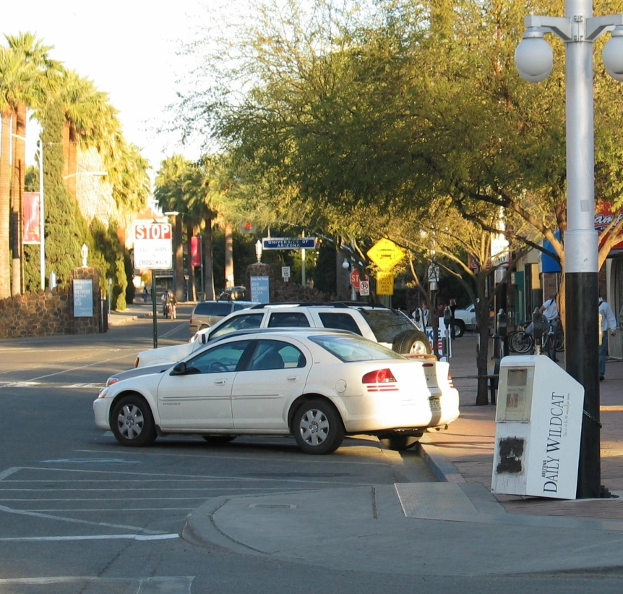
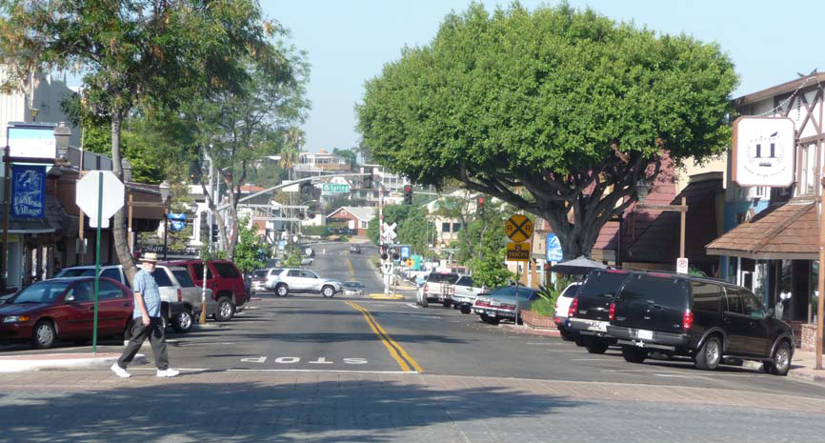
5 Steps to A walkable Community
Step 3: Traffic Calming
Traffic Calming Tool: Diagonal Parking
Reverse angle parking or head-out (left)
Typical back-out Parking (right)
Notes:
Overview: The five steps to a walkable community continued.
Group Discussion: How do you think this works to slow traffic and increase safety?

Slide 34
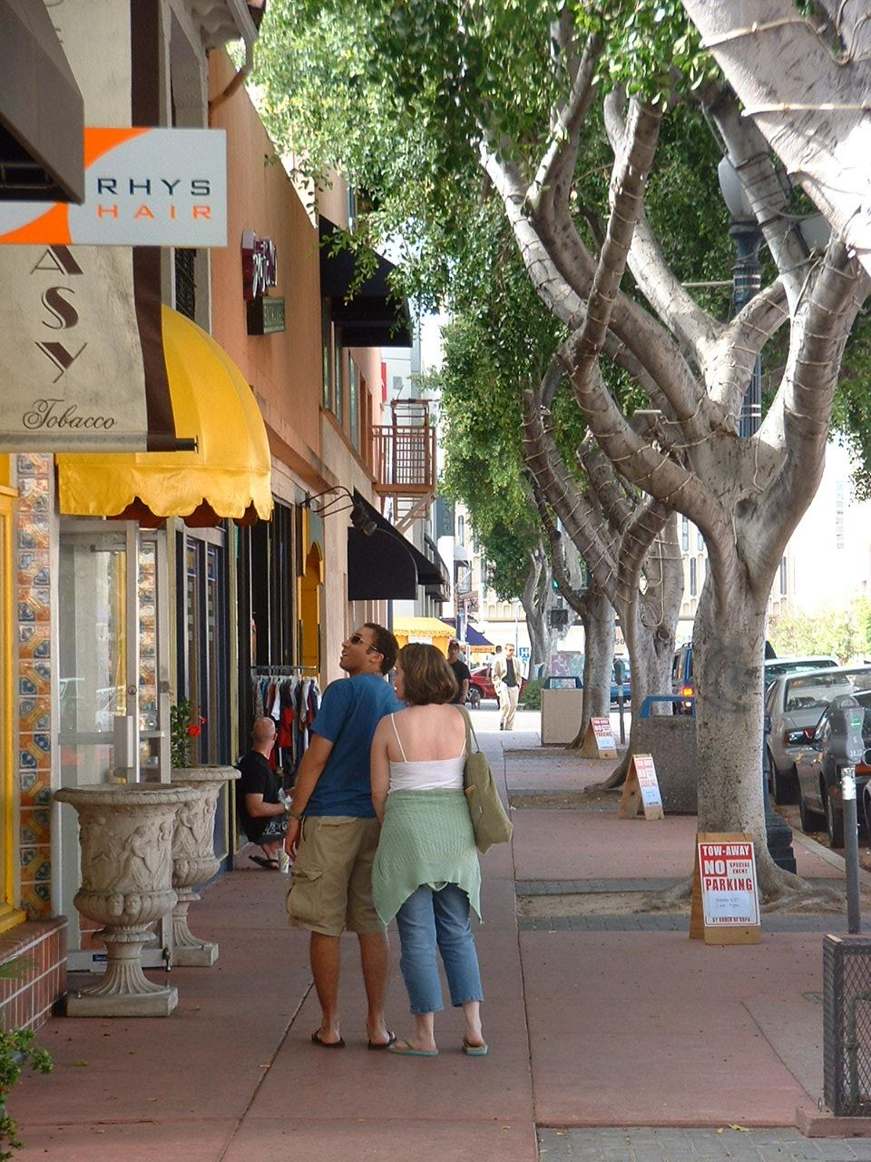
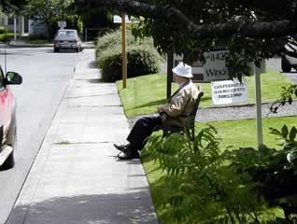
5 Steps to A walkable Community
STEP 4: Safety, Comfort, and Beauty
Trees
Places to sit and rest
Clean and maintained
Pedestrian lighting
Access to water and bathroom
Notes:
Overview: Everyone deserves to be able to walk in a safe and comfortable environment. That is health equity in action.

Slide 35
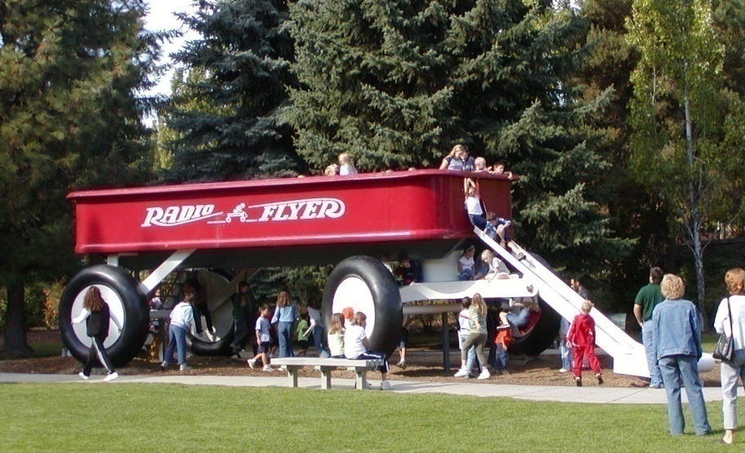
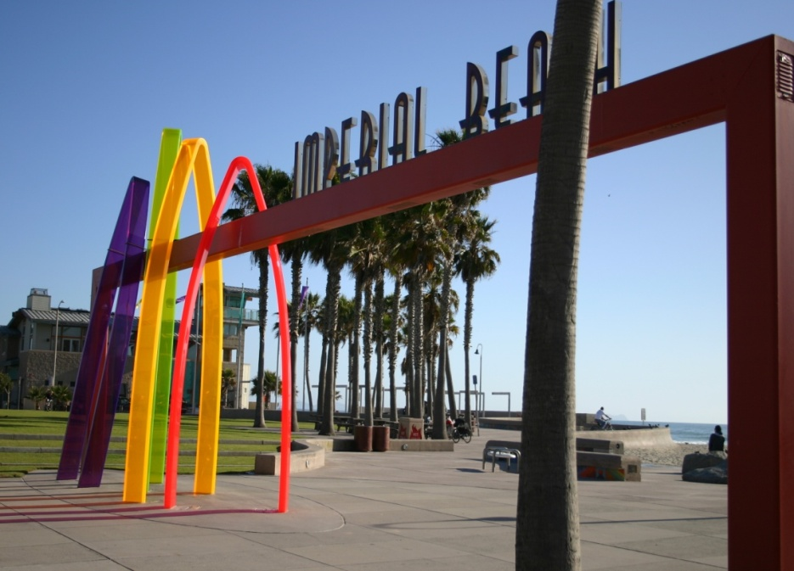

5 Steps to A walkable Community
STEP 4: Safety, Comfort, and Beauty
Public Art that Reflects the Community
Notes:
Overview: Beauty pulls you to enjoy it, which encourages people to move and encourages healthy behaviors.
Group Discussion: Get a few neighborhood examples from participants.

Slide 36

5 Steps to A walkable Community
Step 5: Great Places to walk
Residential Street - Before
Notes:
Overview: The five steps to a walkable community continued. Can you see the differences in walkability between this slide and the next two?

Slide 37

5 Steps to A walkable Community
Step 5: Great Places to walk
Residential Street
Notes:
Overview: The five steps to a walkable community continued. Can you see the differences in walkability between this slide and the last one?
Group Discussion: What is different?

Slide 38

5 Steps to A walkable Community
Step 5: Great Places to walk
Residential Street - After
Notes:
Overview: The five steps to a walkable community continued. Can you see the differences in walkability on this slide and the last one?
Group Discussion: What is different now?

Slide 39

5 Steps to A walkable Community
Step 5: Great Places to walk
Commercial Street - Before
Notes:
Overview: The five steps to a walkable community continued. Can you see the differences in walkability between this slide and the next two?

Slide 40

5 Steps to A walkable Community
Step 5: Great Places to walk
Commercial Street
Notes:
Overview: The five steps to a walkable community continued. Can you see the differences in walkability between this slide and the last one?
Group Discussion: What is different?

Slide 41

5 Steps to A walkable Community
Step 5: Great Places to walk
Commercial Street - After
Notes:
Overview: The five steps to a walkable community continued. Can you see the differences in walkability between this slide and the last one?
Group Discussion: What is different now?

Slide 42
Video CLip
Walkability - Planning 101
Notes:
Overview: Remind the group to think about walkability in relation to their CIP.
https://www.youtube.com/watch?v=EZejDwjNxRg

Slide 43

Bikeability
Notes:
Overview: Similar to walkability, bikability is how easy and safe it is to ride a bike in or through a neighborhood.
Group Discussion: Discuss examples in their neighborhood.

Slide 44
Conclusion
Homework
Complete Circulate San Diego’s Walkability Scorecard paired in intergenerational teams and/or people with physical and sensory disabilities.
Complete a bikeability audit in your neighborhood.
Complete a photo journal of active transportation barriers in their neighborhoods.
Questions?
Comments?
Concerns?
Notes:
Overview: Explain what the walkability audit homework is and provide some instruction. Participants with smart phones can use the Circulate San Diego app www.circulatesd.org/bestwalk and also have printed copies available for those who do not have smart phones.

Slide 45

"This curriculum was supported by the Cooperative Agreement Number DP005528-01, funded by the Centers for Disease Control and Prevention through the County of San Diego, Health and Human Services Agency. Its contents are solely the responsibility of the authors and do not necessarily represent the official views of the Centers for Disease Control and Prevention or the Department of Health and Human Services."

