Slide 1
Section 2: Strategies
Food Systems
Notes:
Overview: Welcome to the next session!

Slide 2
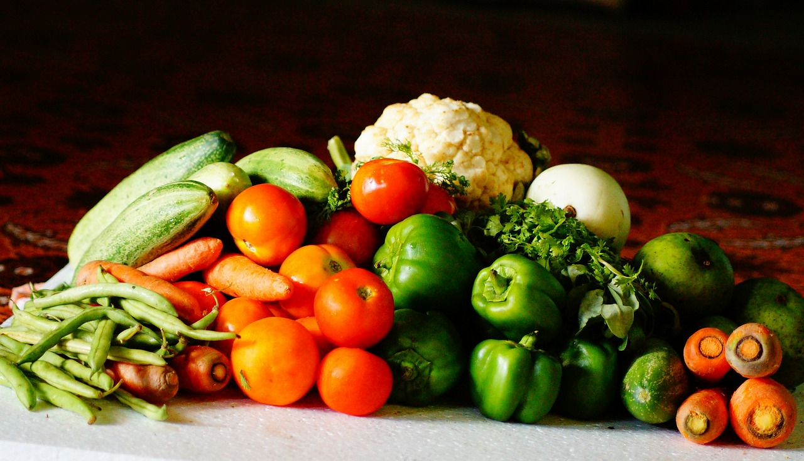
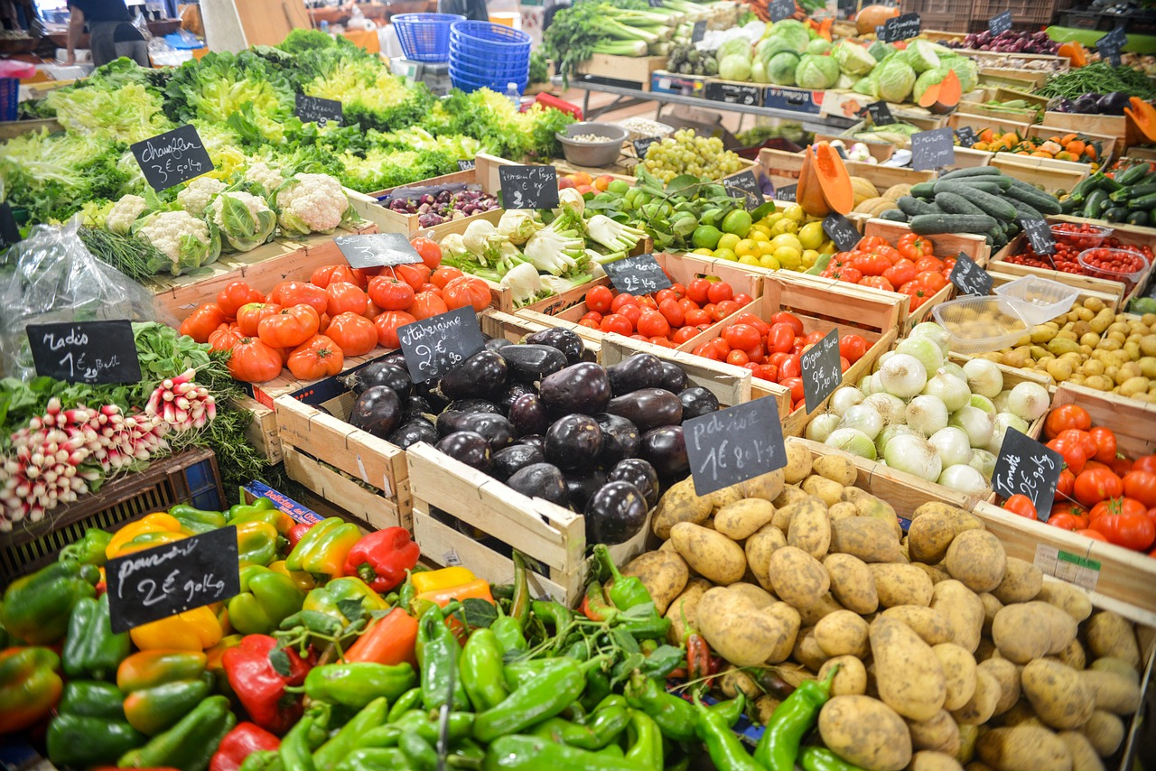
Agenda
Section 2.4: Food Systems
Icebreaker/Review
Food System
Food Policies
Big Businesses
Food Environment
Health Costs
Building a Healthy Food System
Conclusion
Notes:
Overview: Brief review of agenda.

Slide 3
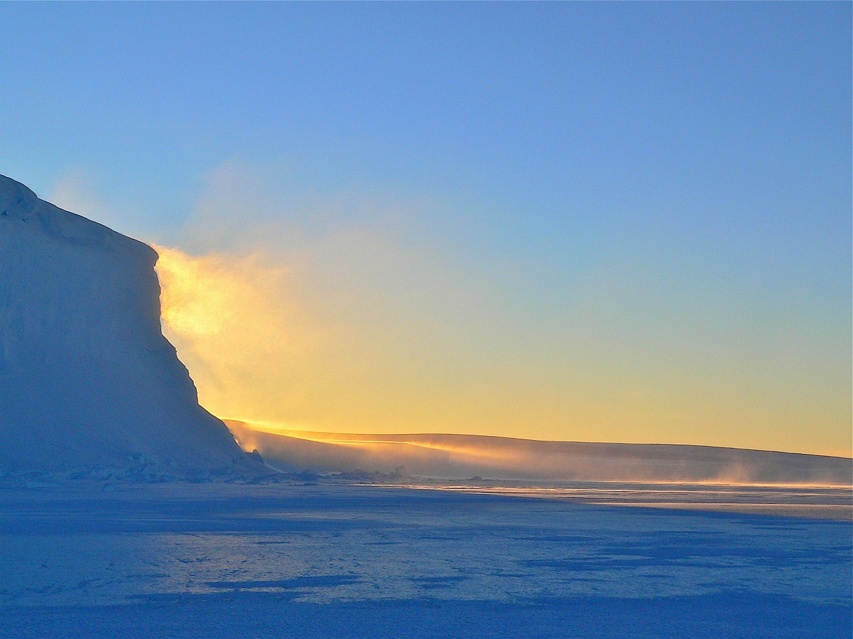
Ice Breaker
Notes:
Overview: Icebreakers help the group get to know one another and gets them warmed up to participate in group discussion.
Facilitator Tip: choose an icebreaker activity from the Digital Library or get an idea from another RLA facilitator for suggestions on icebreakers that were successful in their groups.

Slide 4
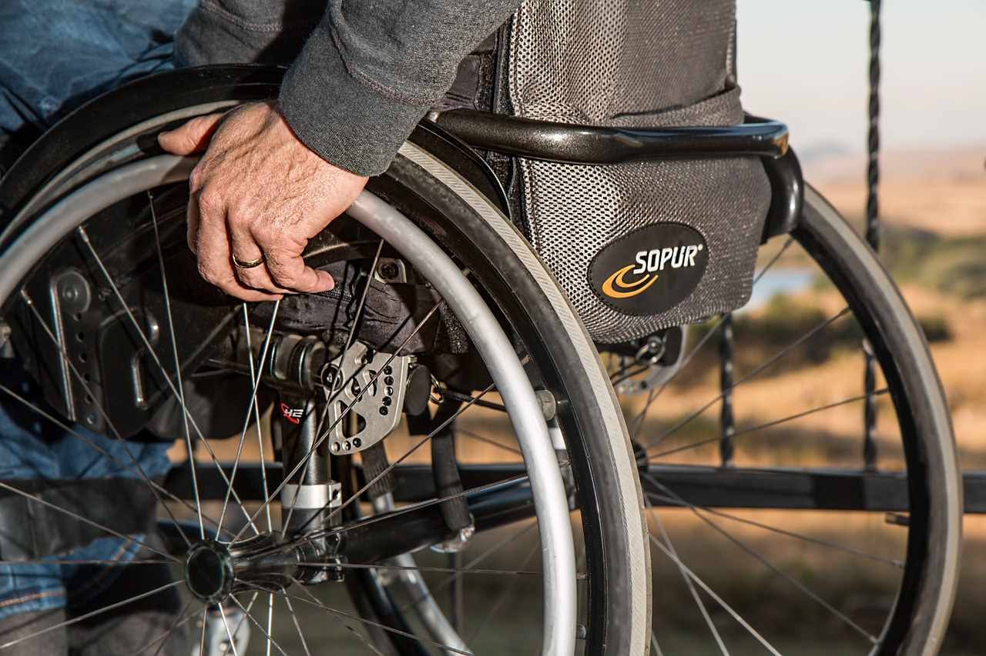
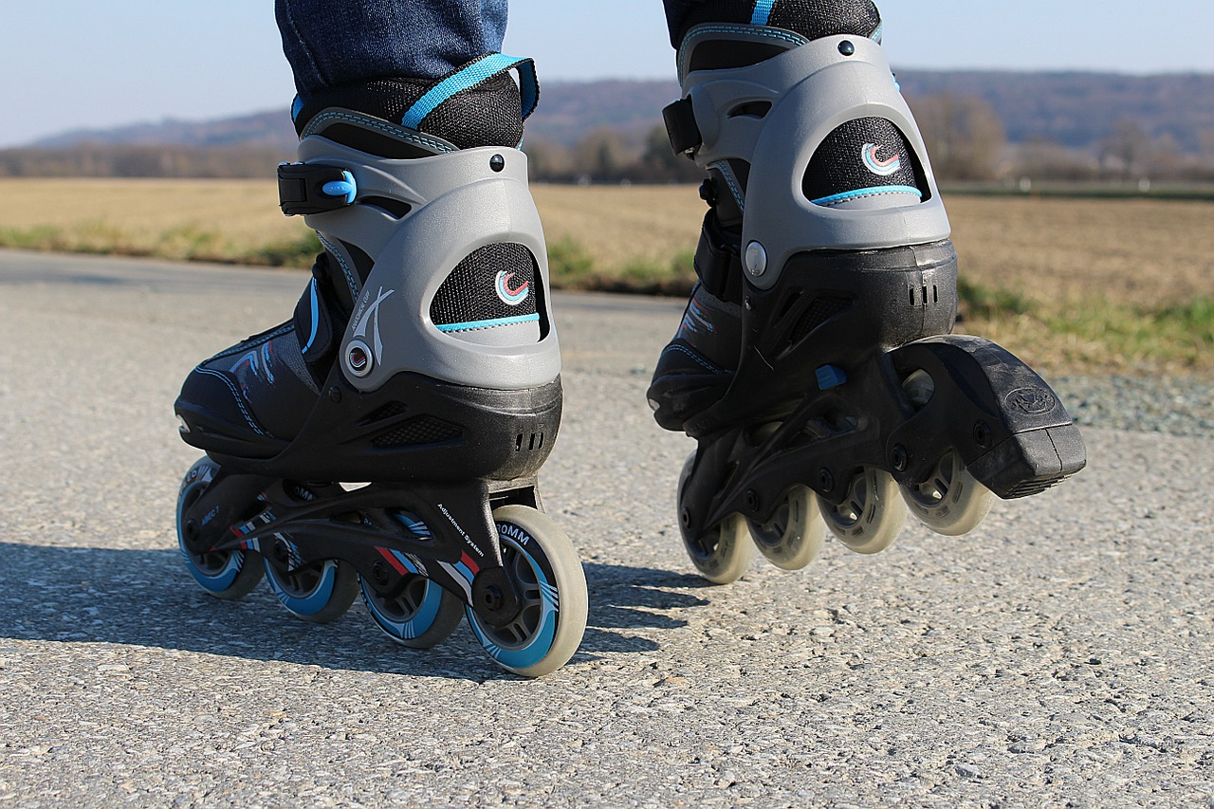
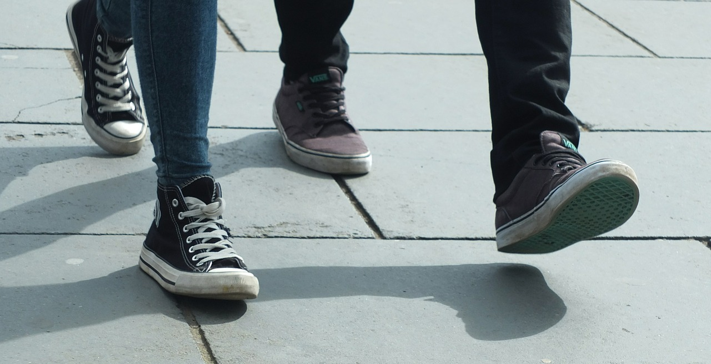
active transportation Review
What did we learn about active transportation?
SANDAG
Walkability
Bikeability
Notes:
Overview: Quick review of last week.
Group Discussion: Did you have any new observations about your neighborhood and ways that it could support better health through the strategies you are learning?
How are the four strategies you have learned and read about so far connected?

Slide 5
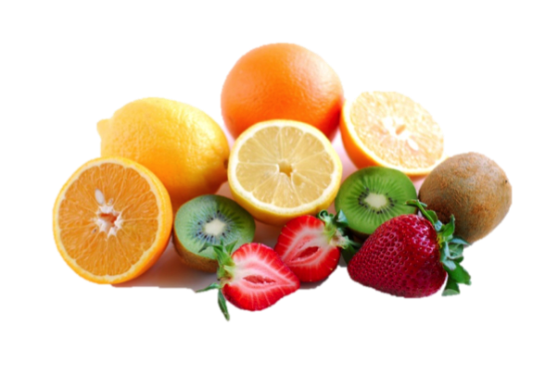
Section 2: Strategies
Learning Objectives:
Identify health determinants and how they affect health.
Identify changes that can be made in communities to improve health.
Notes:
Overview: We know we need to move around (under our own power) to get healthy and stay healthy, and to move around we need fuel. That is food! What we eat, how that food is created, and how it gets to our table is very important.

Slide 6
Video Clip
Insert “Video Clip” Title Here
Notes:
Facilitator Tip: There are a lot of documentaries and films in the Resource Library on food systems. Review a selection of them and use a combination in this session based on the interests of your group. Keep the clips to 5 – 20 minutes in length. There are some suggestions throughout this PowerPoint but please customize the content to your RLA participants. Do not forget to add video clip title to PowerPoint slide.

Slide 7
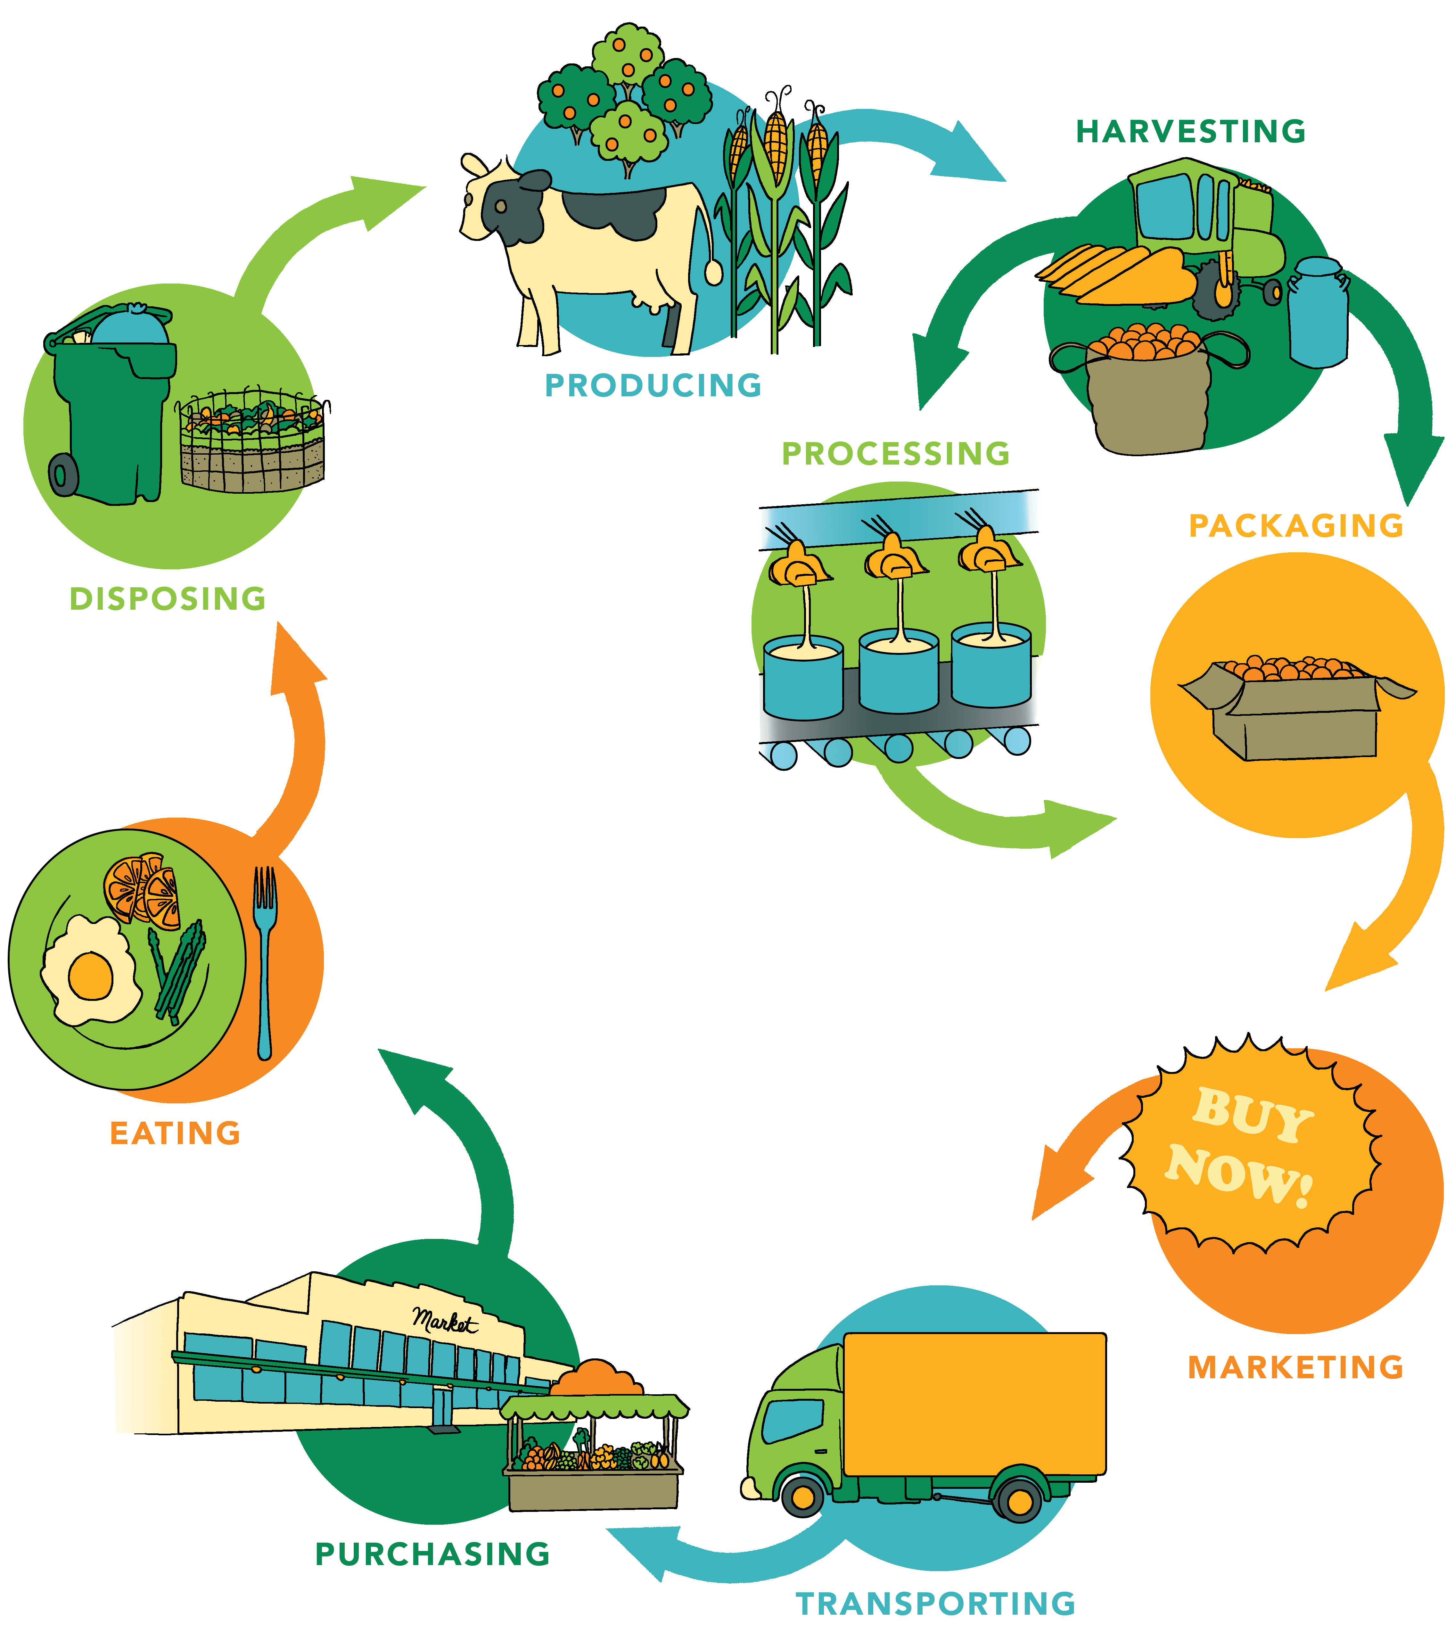
Food Systems
Notes:
Overview: A food system includes all of the processes and infrastructure involved in feeding a population: growing, harvesting, processing, packaging, transporting, marketing, consumption, and disposal of food and food-related items.
Group Discussion: Discuss how reading this section may have expanded how they think about food. What information surprised them?

Slide 8
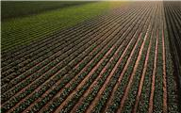
Food Systems
Food Systems
Influenced by
Social
Environment
Political
Economic
Require human resources to provide labor, research, and education. Food systems are either conventional or sustainable according to their model of food lifespan from its origin to the plate.
Notes:
Overview: Highlight the differences between a conventional and sustainable food system.
Group Discussion: Can anyone make any connections to social determinants here? Any connections with the SEM and the levels that are represented here? Where does change have to happen to affect the influencers identified?

Slide 9
Food Systems
Global Conventional
Globalization of our food system is affecting health negatively at a global scale
Regional
Most of the food we buy at our local supermarket has traveled very far to get there
Local
Is a better option for our health, local economy, the environment, and communities
Notes:
Overview: Review the definitions of local and regional in the workbook.

Slide 10
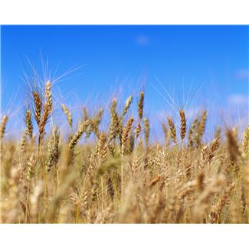
Types of food systems
Conventional | Sustainable
Involves widespread distribution, according to cost Driven by expansion and increasing profits Based on a productivity model Industrial Food Systems Multi-national Corporations | Locally-focused to provide direct benefit to communities Geographically and economically accessible Seasonal, native, sustainable Local Food System Community Food System Organic Food System
Notes:
Overview: Although much of America’s food systems are conventional there is a movement toward more sustainable systems. For example, many neighborhoods have started community gardens.

Slide 11
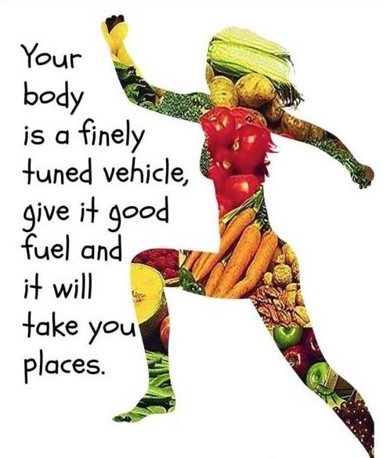
You are what you eat
Notes:
Overview: Healthy food makes us feel healthier. You are what you eat.
Group Discussion: How do you feel after you eat a fast food meal? After a home-cooked meal featuring fresh vegetables?
Image on left from: memecenter.com http://www.memecenter.com/fun/678250/
you-are-what-you-eat
Image on right from: totalwellnesstnetworsk.com http://totalwellnessnetworks.com/you-are
-what-you-eat/

Slide 12
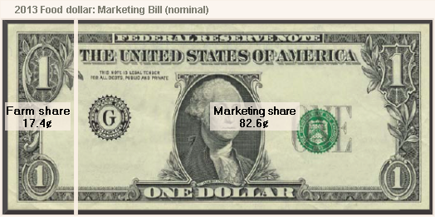
Our Current Food System
Notes:
Overview: More marketing often equals more sales. This is from the United States Department of Agriculture website.
Group Discussion: Discuss the impact of marketing? What if a bigger share went to the farmers? What would the system look like? What if farmers had a million-dollar marketing budget?
Activity: Break the group into smaller groups and have them make a commercial for fruits and vegetables and present it to the group. This is meant to provide levity and have them think critically about advertising.

Slide 13
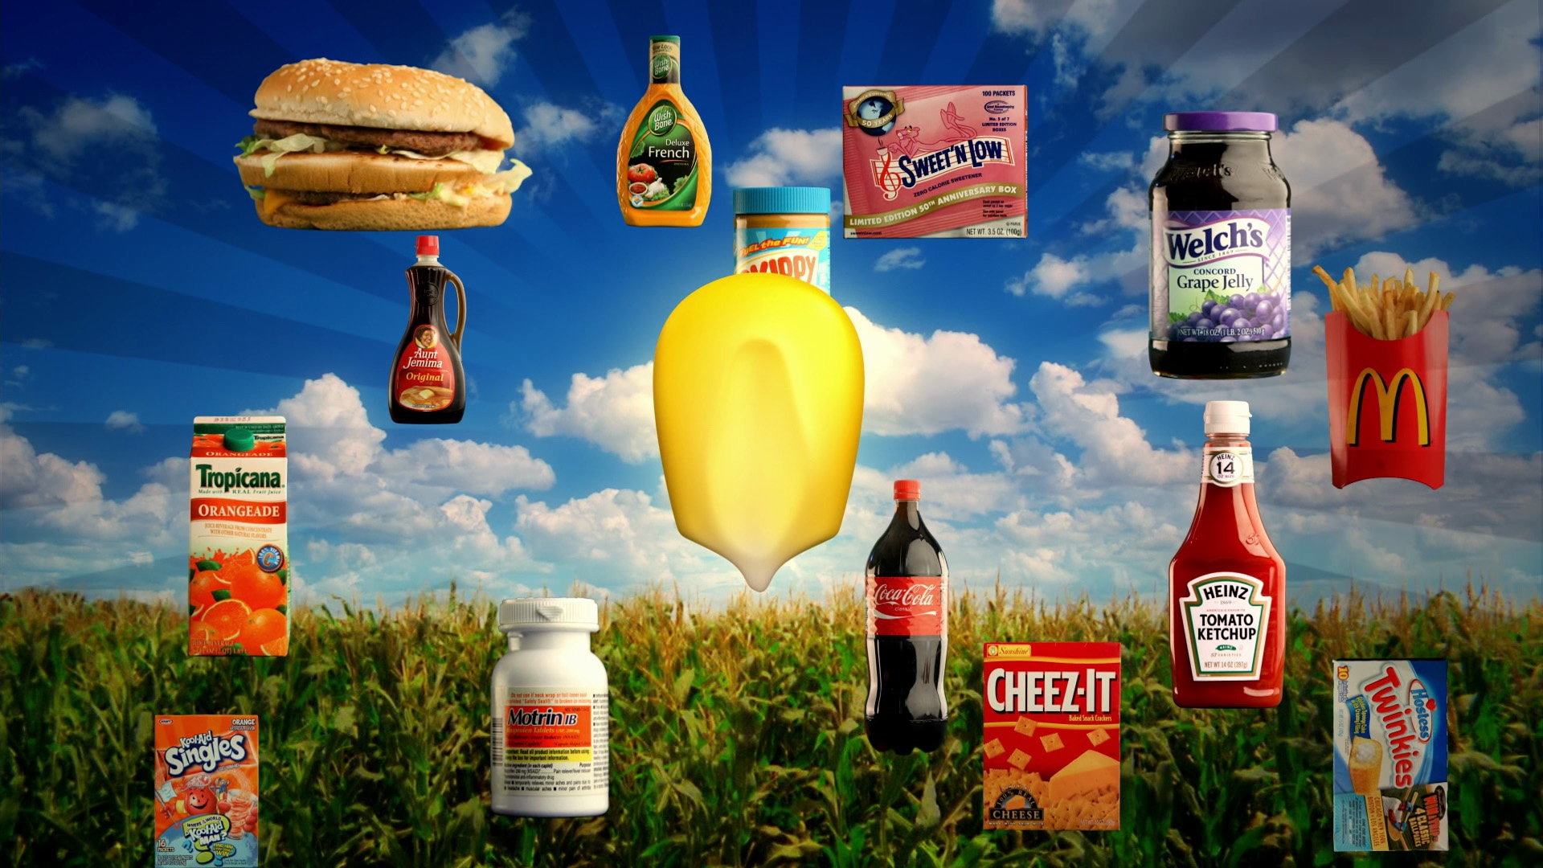
Major Influences on the Food System
Government Policies
Over 100 years old
Subsidies
Often unhealthy products are made with inexpensive crops like sugar and corn
Notes:
Overview: Government policies influence people’s accessibility to healthy foods.
Group Discussion: What level of the Social-Ecological Model (SEM) is this? What are some specific, community level strategies to improve your local food system?

Slide 14
Obesity
Notes:
Overview: Take a moment to revisit the main reason we are here, which is to combat the chronic diseases that are impacting our communities. Obesity increases the chances that a person will get type 2 diabetes, lung disease, cancer, and heart disease
Group Discussion: Did the connection between advertising, government policy, processed foods, and obesity rates surprise anyone? What are their thoughts on how it affects their neighborhood and family?

Slide 15
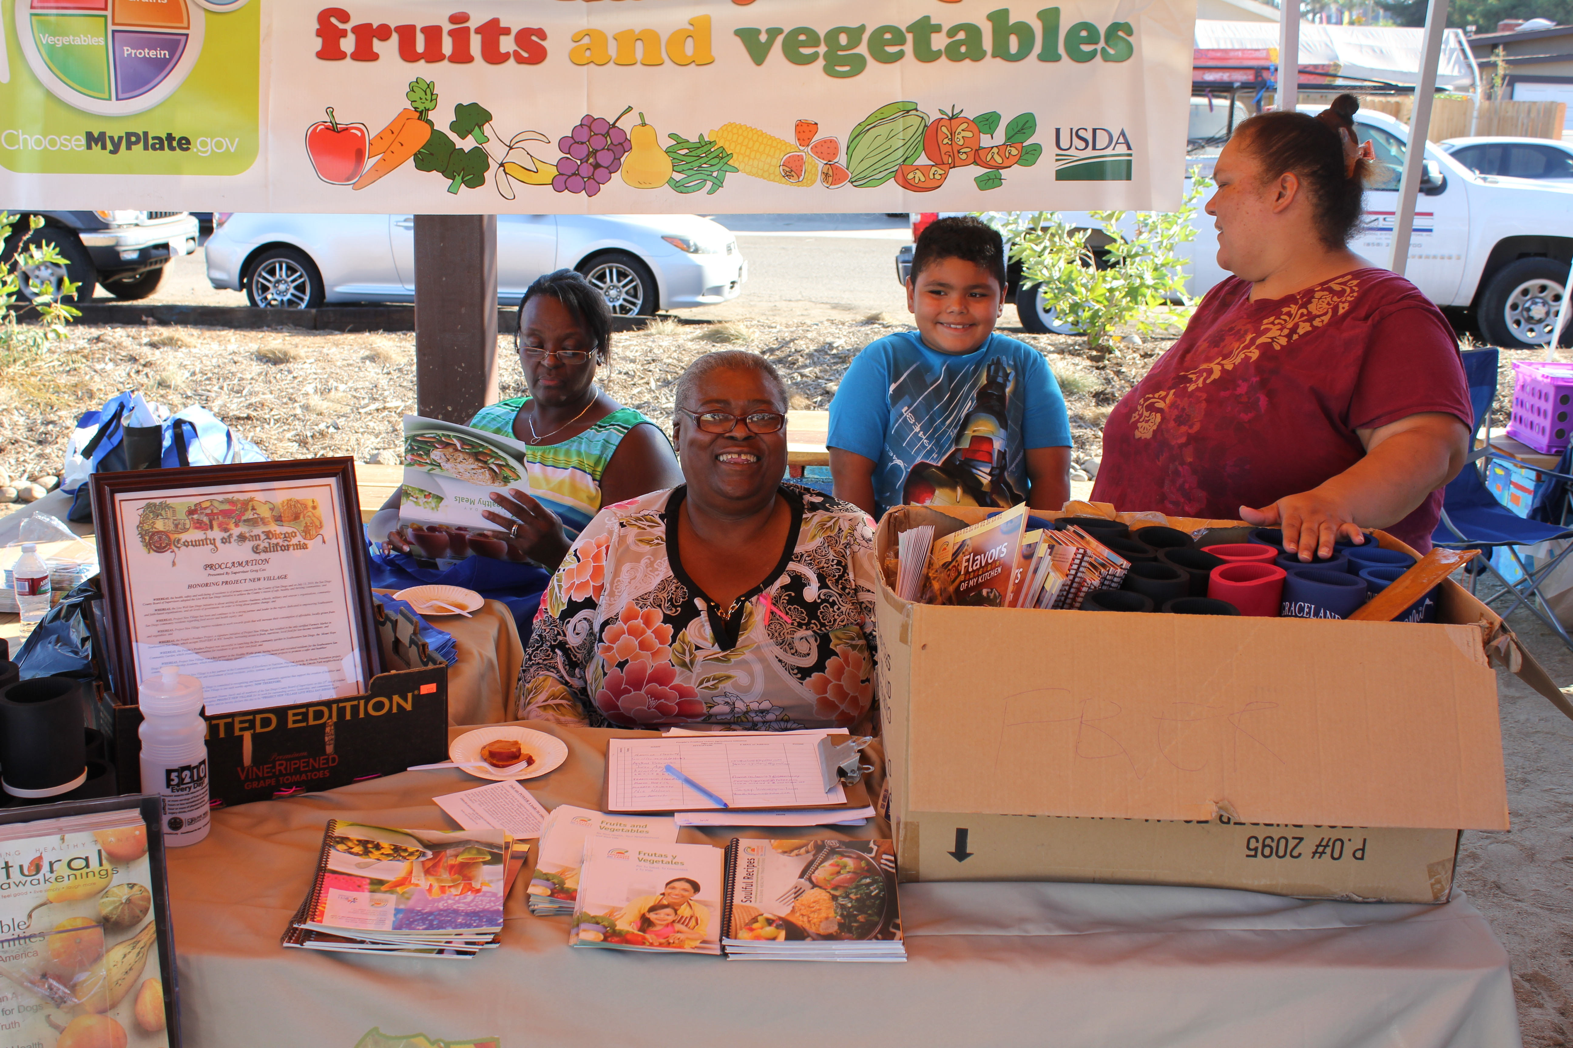
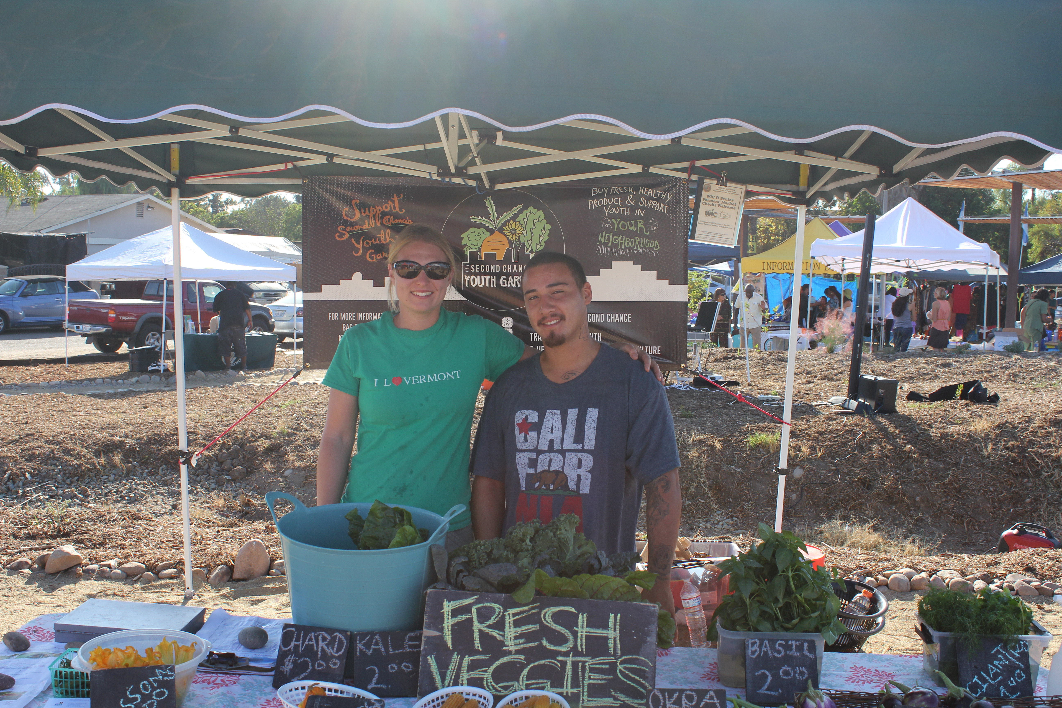
Major Influences on the Food System
Local food Production Policies
City & County Ordinances
Farmer’s Market
Notes:
Overview: Relate the concepts here to what is happening in the participants’ neighborhood around food systems.
Facilitator Tip: Do some research on local food policies and ordinances. Bring these to the group and facilitate a discussion about how they affect community health.

Slide 16
Video Clip
Food, Inc.
Notes:
Overview: Food, Inc gives one perspective on our current food system and how it affects the health of people, community, business, and the environment.
Facilitator Tip: Food Inc. is available for check out from the Resource Library. Please choose a clip that suits your group that is no more than 20 minutes.
https://www.youtube.com/watch?v=5eKYyD14d_0

Slide 17
Break Time
Notes:
Facilitator Tip: Use this time for a break. Give participants a five to ten minute break depending on the needs of the group and the length of the meeting. Use the resources in the Digital Library to choose one stretch for your group.

Slide 18
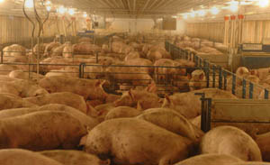
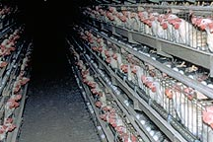
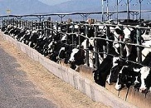
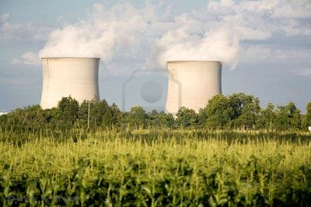
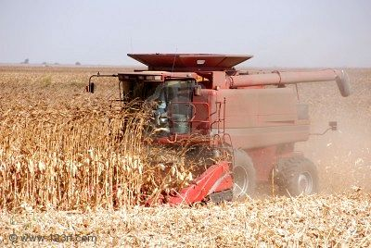
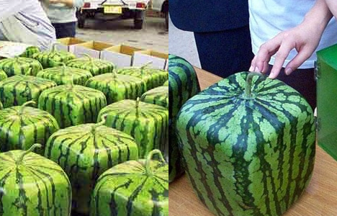
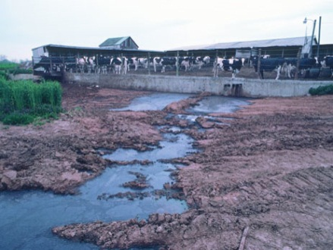
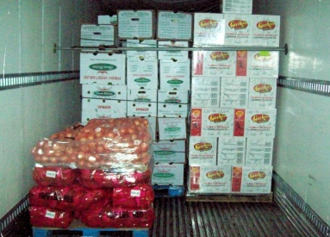
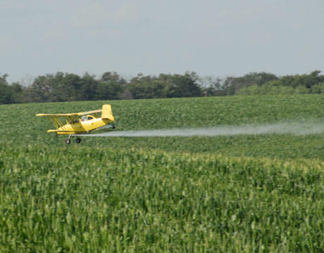
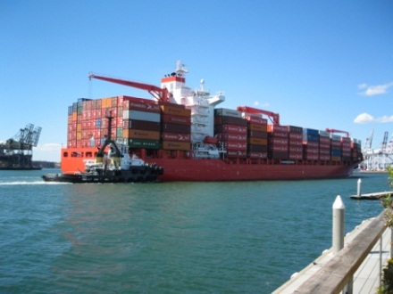
Business Practices
Notes:
Overview: Business practices of the agriculture and food industry affect our health.
Group Discussion: Anything you can add? How does this affect your neighborhood and family?

Slide 19
Impacts on the Food Systems
ANIMALS
ENVIRONMENT
WORKERS
ECONOMY
Notes:
Overview: Our food system affects more than the health of the individual consumer.
Group Discussion: Quickly brainstorm some ideas with the group, impacts on animals, environment, etc.

Slide 20
Food Waste
Biggest contribution to landfills in the U.S.
San Diego landfills receive 450,00 tons of food scraps a year
Contributes to climate change
Notes:
Overview: Food waste is a big contributor to pollution and climate change. Talk about composting as a strategy to reducing food waste.
Facilitator Tip: An option for a guest speaker may include a representative from the San Diego Food Systems Alliance, a local farmer, or a master composter. You could even invite a composter to teach the group how to make their own home composting system.

Slide 21
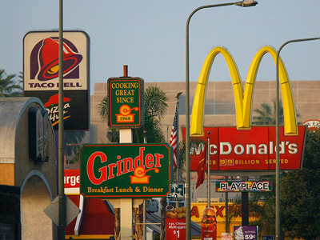
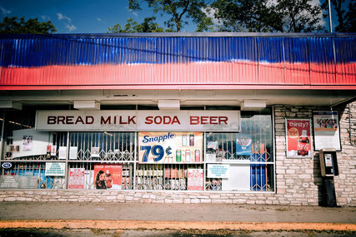
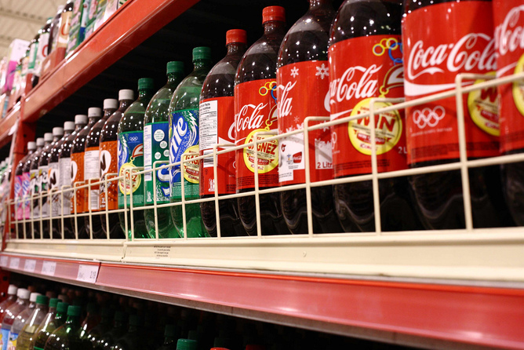
Food Environments
Notes:
Overview: Define food environments:
Food desert: a neighborhood characterized by insufficient access to grocery stores
Food swamp: a lot of high-energy, low nutrient foods compared with healthy options (such as an area with a lot of fast food restaurants).
Group Discussion: Do either of these apply to your neighborhood? If so, why?
Facilitator Tip: If you are not familiar with the neighborhood, do some research about the availability of fresh food in the neighborhood.

Slide 22
Break Time
Notes:
Facilitator Tip: Use this time for a break. Give participants a five to ten minute break depending on the needs of the group and the length of the meeting. Use the resources in the Digital Library to choose one stretch for your group.

Slide 23
Creating a Healthy Food System
Notes:
Overview: These are the characteristics of a healthy food system, which is our goal.

Slide 24
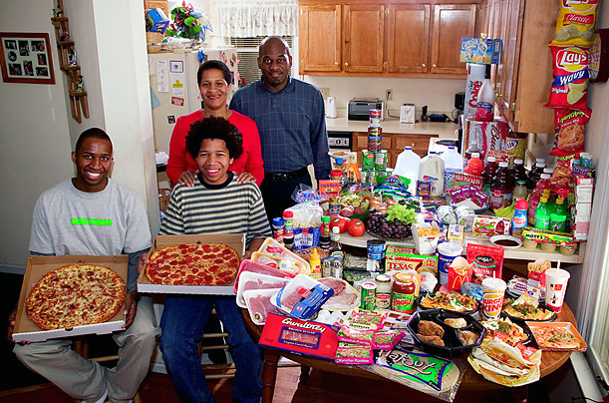
Culture & Cooking
United States
Notes:
Overview: The following are samples of cultural differences in food environments. Note that these are generalizations and not representative of every individual from a certain culture.

Slide 25
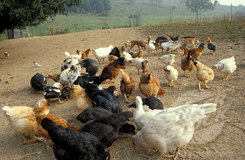
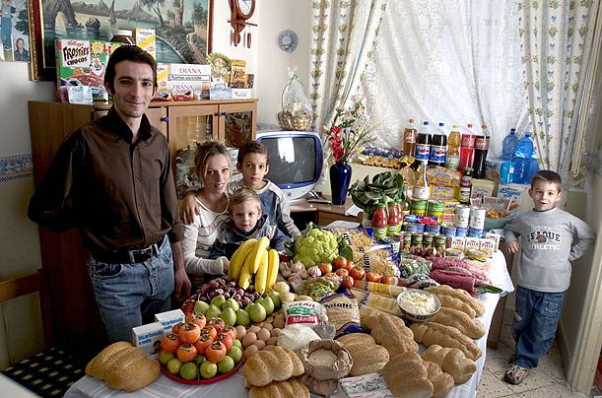
Culture & Cooking
Italy
Free Range Farming
Pantry
Notes:
Overview: An example of food systems and consumption in Italy.

Slide 26
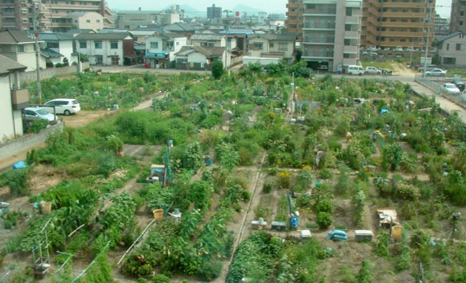
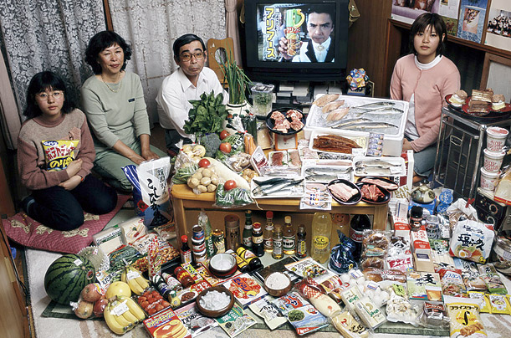
Culture & Cooking
Japan
City Farming
Pantry
Notes:
Overview: An example of food systems and consumption in Japan.

Slide 27
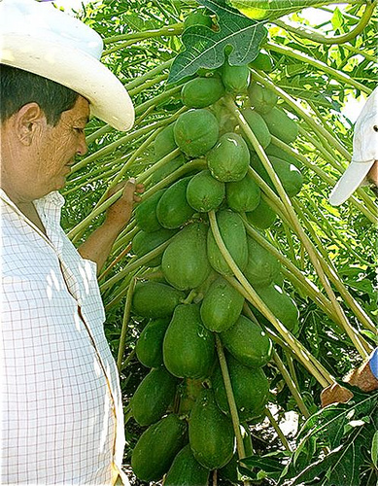
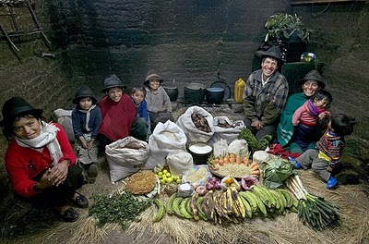
Culture & Cooking
Ecuador
Seasonal Farming
Pantry
Notes:
Overview: An example of food systems and consumption in Ecuador.

Slide 28
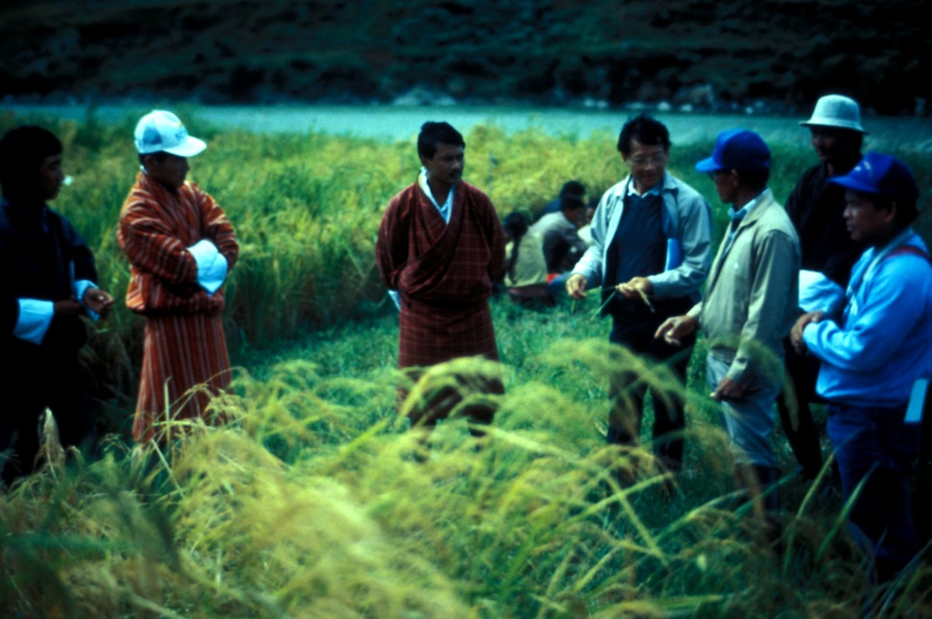
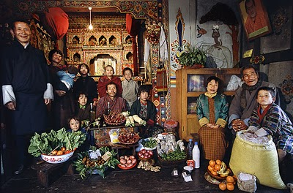
Culture & Cooking
Bhutan
Rice Farm
Pantry
Notes:
Overview: An example of food systems and consumption in Bhutan.

Slide 29
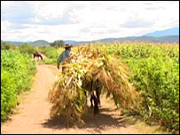
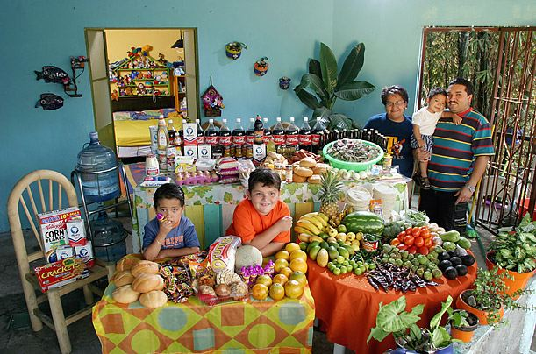
Culture & Cooking
Mexico
Farm
Pantry
Notes:
Overview: An example of food systems and consumption in Mexico.

Slide 30
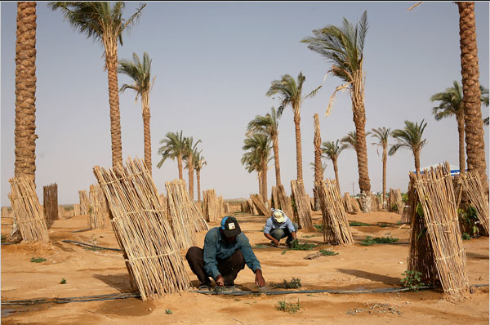
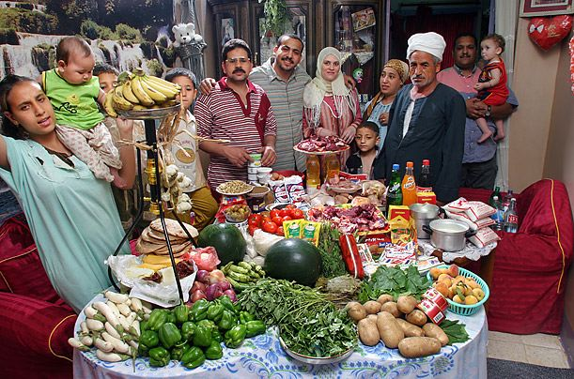
Culture & Cooking
Egypt
Farming Melons
Pantry
Notes:
Overview: An example of food systems and consumption in Egypt.
Group Discussion: What did the American table look like compared to other cultures? Do you see yourself and your family? As you look at these examples, could Americans adopt any of these strategies?

Slide 31
Video Clip
The Perennial Plate Episode 90: Refugee Garden
Notes:
Overview: A day spent with a Bhutanese family and their Garden in Atlanta, GA.
https://vimeo.com/36220762

Slide 32
Activity
Instructions:
To gain insight into your own food history:
Talk to your parents and grandparents. Ask them what they ate when they were children, how they prepared their food, what they fed their own children, and why.
Talk to elders and other long-term residents in your community. Ask them how the community was different, where they got their food, and how that has changed over the decades.
Notes:
Overview: Our food system has changed over time. Take time to talk about the differences the group found when talking to elders and others about their own food history.
Group Discussion: Ask the participants who did this activity what they learned.
Facilitator Tip: Make sure to do the activity yourself to model participation and to contribute to the discussion.

Slide 33
Video Clip
Soul Food Junkies
Notes:
Overview: Food histories and current consumption is influenced by history and culture.
http://www.pbs.org/black-culture/ shows/list/soul-food-junkies/
Facilitator Tip: Soul Food Junkies is available for check out from the Resource Library. Please choose a clip that suits your group that is no more than 20 minutes. Or as an alternative choose a podcast that suits your group from the Kitchen Sisters Hidden Kitchens series available at http://www.kitchensisters.org/hidden-kitchens/

Slide 34
Policy, Systems, and Community Change
Strategies for a healthy food system
Notes:
Overview: There is broad interest and movement among communities nationwide to create policy, systems, and environmental changes, which support a healthy food system. With a nation deeply engaged in making change, we are starting to see positive change. Working together to bring healthy options to communities, working with government officials to change policies that support healthier neighborhoods, and working with employers to establish incentives that encourage healthier behaviors are making our communities healthier.
Activity: Break the group into small groups and give each group a piece of flip chart paper. Ask the group to brainstorm community level changes they could work on that would create a healthier food system in their neighborhood. Ask participants to pick a spokesperson to share their ideas. Place a star on any of the strategies that are repeated across groups. Have a large group discussion about their upcoming CIP and encourage thoughtful discussion about specific ideas the group and/or individuals in the group might have for their CIP.

Slide 35
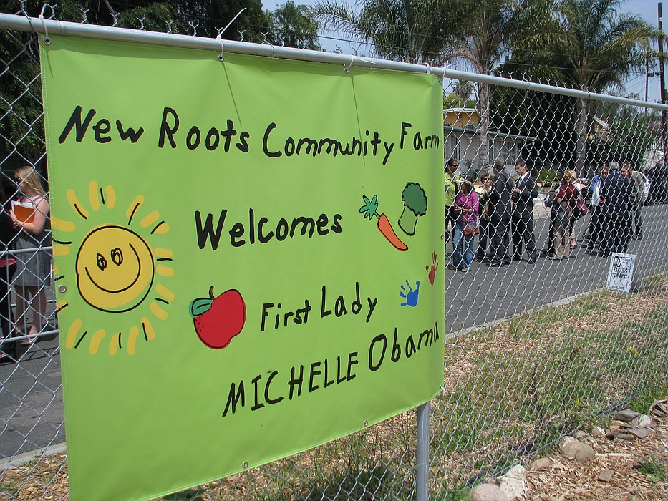
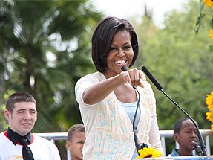
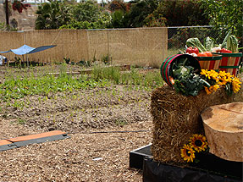
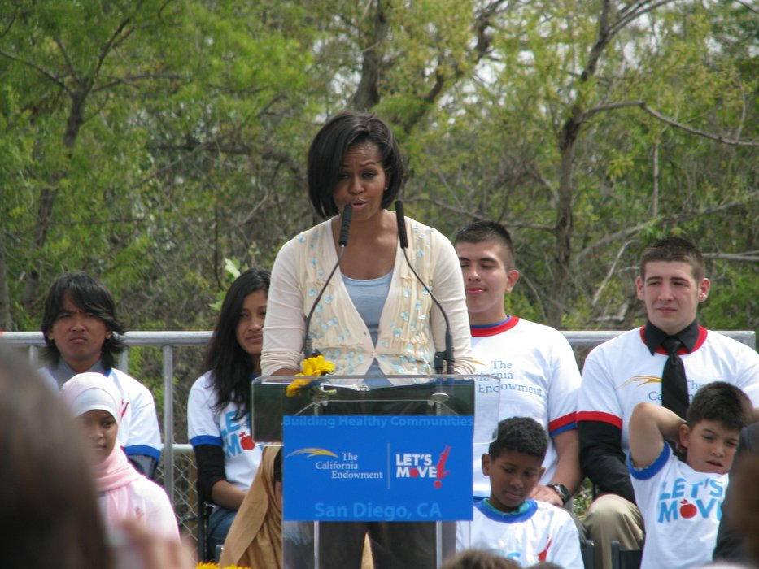
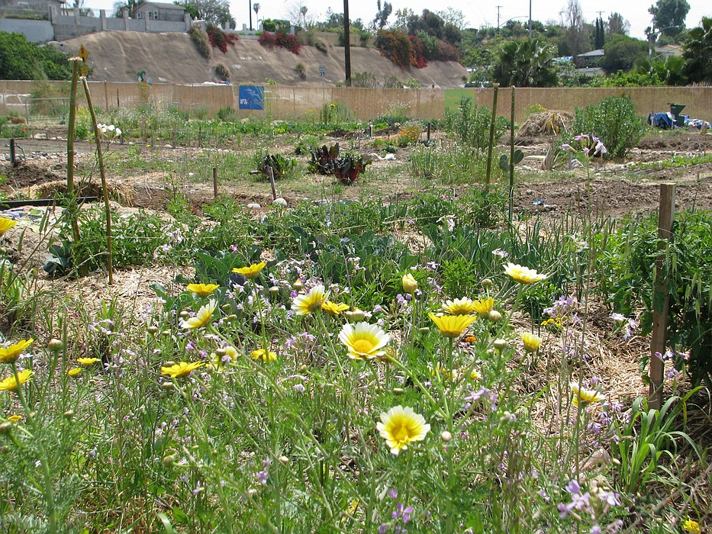
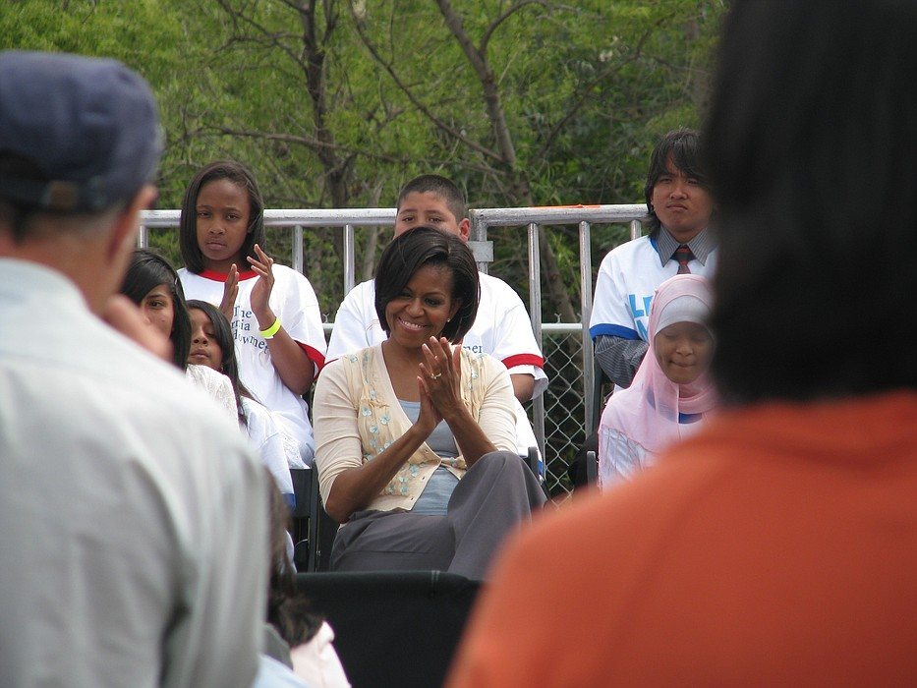
Success Story
City Heights Garden visited by Mrs. Obama
Notes:
Overview: First Lady Michelle Obama leveraged her popularity to change policies and tapped into the Nation’s political will. The Let’s Move! Campaign changed policies in business practices (Walmart selling more fruits and veggies) and school systems (policies created for better school lunches)
Images from: http://www.kpbs.org/news/2010/apr/
16/first-lady-addresses-obesity-city-
heights-speech/
http://www.sandiego.gov/citycouncil/cd9/
news/events2010/newroots.shtml

Slide 36
Video Clip
City Heights Garden visited by Mrs. Obama
Notes:
Overview: First Lady, Michelle Obama, visits City Heights Garden and addresses obesity.
http://www.kpbs.org/news/2010/apr/16/first-lady-addresses-obesity-city-heights-speech/

Slide 37
Conclusion
Homework
Read Section 3.1 Civic Engagement
Complete the Food Histories Interview (if you did not do it last week).
Questions?
Comments?
Concerns?
Notes:
Overview: Answer questions and review homework.
Facilitator Tip: This section has a lot of content and lots to discuss. You may choose to spread it over two sessions.

Slide 38
"This curriculum was supported by the Cooperative Agreement Number DP005528-01, funded by the Centers for Disease Control and Prevention through the County of San Diego, Health and Human Services Agency. Its contents are solely the responsibility of the authors and do not necessarily represent the official views of the Centers for Disease Control and Prevention or the Department of Health and Human Services."

