Slide 1
SECTION 3: Taking Action
Civic Engagement
Notes:
Overview: Welcome to the next session!

Slide 2
Agenda
Section 3.1: Civic Engagement
Icebreaker/Review
What is Civic Engagement
Levels of Government
Local Government
Interacting with Decision Leaders
Consensus Organizing
Conclusion
Notes:
Overview: Brief review of agenda.
Image from: http://www.wcpss.net/carrollms

Slide 3
Section 3: Taking Action
Learning Objectives:
Understand what civic engagement is and how to influence the decision-making process.
Create an implementation plan for a Community Improvement Project (CIP).
Notes:
Overview: Review the learning objectives.

Slide 4
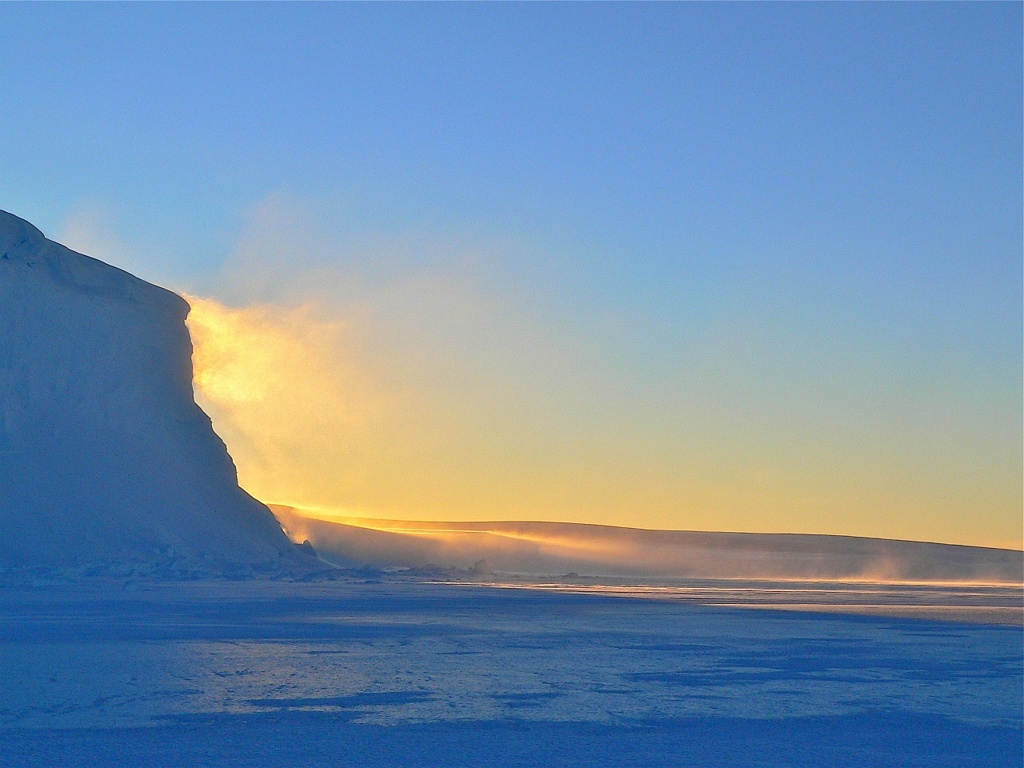
Ice Breaker
Notes:
Overview: Use the resources in the Digital Library to choose an icebreaker activity for your group.

Slide 5
Food Systems Review
What did we learn About Food Systems?
Food Policies
Big Businesses
Food Environments
Health Costs
Building a Healthy Food System
Notes:
Overview: Revisit the strategies that we have learned about:
Food Systems – Starting a community garden
Connect those to what we learned about:
Land Use – Creating a bike lane
Active Transportation – Getting a sidewalk repaired to improve walkability
Supporting Health – Promoting smoke-free public spaces
Group Discussion: In what ways do the strategies in Section Two intersect?
Ask people if they have any early thoughts about a possible Community Improvement Project (CIP). What made them decide to go in that direction? Tell us about some of the ideas you have on the Social-Ecological Model (SEM) Activities you have been doing in your workbook.

Slide 6
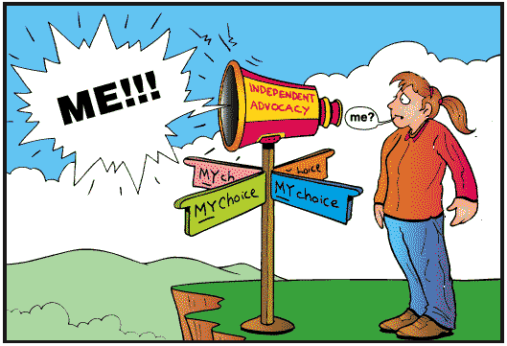
Civic Engagement
Notes:
Overview: Civic engagement is defined as working to make a difference in the civic life of our communities by promoting the quality of life in communities through both political and non-political processes.
Group Discussion: What does civic engagement mean to you? Possible answers are voting, attending public hearings, and signing a petition for or against something that affects your neighborhood or state.
Source: Civic Responsibility and Higher Education, edited by Thomas Ehrlich, published by Oryx Press, 2000.

Slide 7
Video Clip
The U.S. Government Explained in 5 Minutes
Notes:
Overview: The “Three Branches of Government” explained as the “Three Brothers of Government.”
https://www.youtube.com/watch?v=buQQuyWFtZU

Slide 8
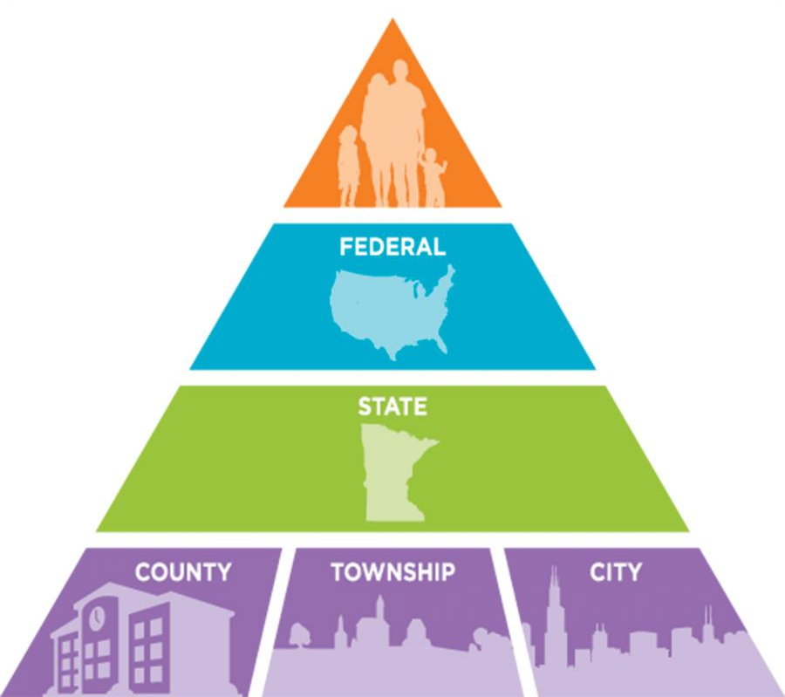
Levels of Government
Notes:
Overview: Discuss the broad roles of policy makers in larger society.
Group Discussion: Quiz the group on the titles at each level:
Federal – President, Congresswoman, or Secretary of Agriculture
State – Governor, Assemblyman, or State Attorney General
County – Supervisor, Chief Administrative Officer or Sheriff
City – Mayor, Councilmember, or Police Chief
Image from: http://education.mnhs.org/northern-lights/learning-resources/chapter-7-minnesotas-newcomers/levels-government

Slide 9
San Diego County
Municipalities and Tribal Nations
There are 18 municipalities, or incorporated cities and 18 Native American Reservation in San Diego County.
Notes:
Overview: These are all governed by their own elected officials within the larger county, state, and federal governments.
Source: www.sandag.org

Slide 10
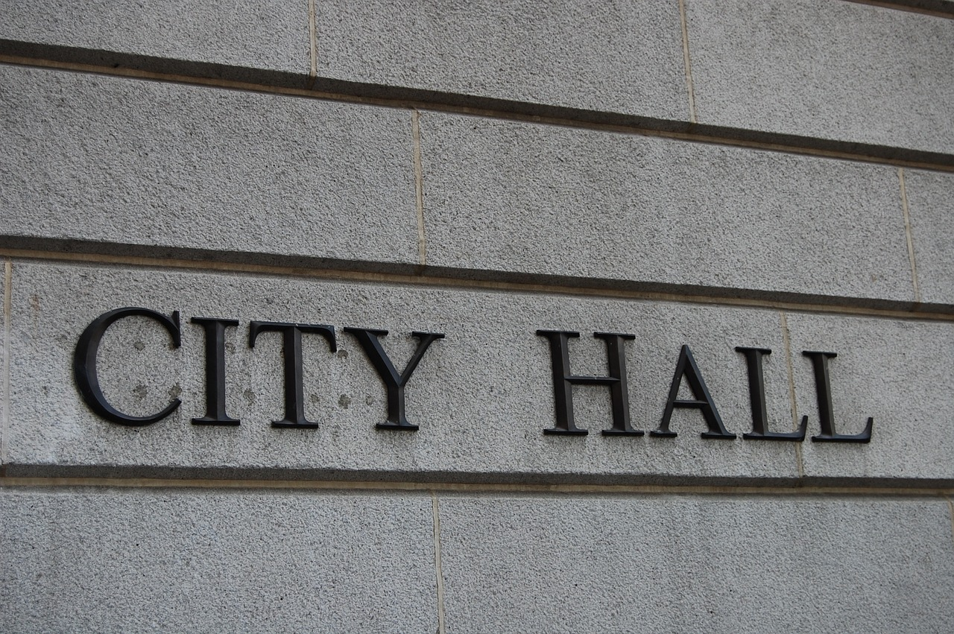
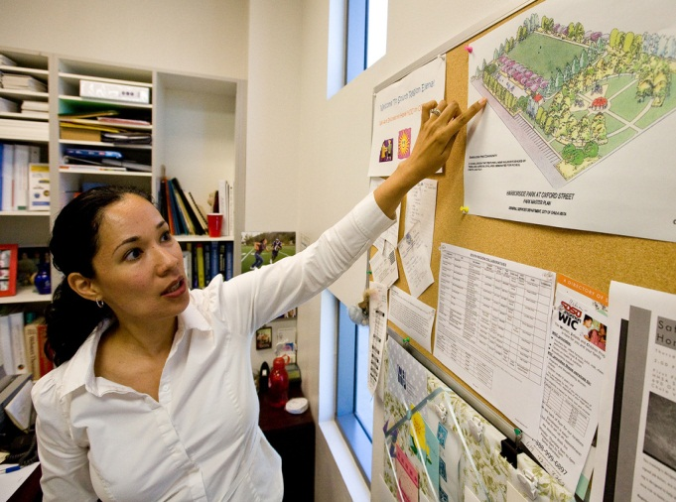
MOST CIPs Start With Local Government
County Board of Supervisors
The Mayor
County Staff
Commission Members
City Council Members
City Staff
City Planners
Notes:
Overview: Most CIPs start at the local level of government. Community groups can make significant health impacts and improvements at the local level.
Group Discussion: Discuss why local level change is effective. A couple of points to cover are access to local decision makers and the time it takes for some projects to come to fruition, even local projects.

Slide 11
How to interact with Decision Leaders
You should be:
Professional
Prepared
Patient
Concise
Persuasive
Passionate
Respectful
Notes:
Overview: Local leaders are important change-makers. Approaching them with your CIP and the issues it addresses is a great start to making change. The following exercise will help you prepare to have a quick and direct conversation with them.
Suggested Activity: Break the group into pairs and have them role-play a meeting with an elected official suggesting a community improvement strategy in their neighborhood. Give each person 10-15 minutes. Imagine you only have 10 minutes with the elected official:
Introduction (2 minutes)
State the issue (3 minutes)
Propose the solution (3 minutes)
Ask for support (2 minutes)
Ask participants to share how it went with the larger group.
Facilitator Tip: As a facilitator this will give you insight on the participants’ attitudes toward working with government and any unspoken fears they may have. Note that this activity takes at least a half an hour. Depending on your group you may want to skip it, however it gives very good practice on how to present a CIP and the issue it addresses. If you do not feel like you have time to do it in class you can assign it as homework.

Slide 12
Break Time
Notes:
Facilitator Tip: Use this time for a break. Give participants a five to ten minute break depending on the needs of the group and the length of the meeting. Use the resources in the Digital Library to choose one stretch for your group.

Slide 13
Video Clip
Lakeview Elementary School
Notes:
Overview: Lakeview parents make a difference
https://www.youtube.com/watch?v=saUjx_WTvMY

Slide 14
Community Organizing
Civic Organizing
Creates a forum for resident leaders to promote social good and community structure.
Resident leaders use official channels and partner with government to promote change and access to services.
Notes:
Overview: This is a snapshot of Civic Organizing. You can familiarize yourself more with different types of organizing including the three presented here by looking at.
Source: http://www.sagepub.com/ sites/default/files/upm-binaries/ 24165_Chapter1.pdf

Slide 15
Community Organizing
Community Building
Develops partnerships between:
Residents
Government
Business
Interested partners
The effort generally has an identified leader or coordinator who leads the group in order to accomplish high level planning and set community priorities.
Notes:
Overview: This is a snapshot of Community Building
Source: http://www.sagepub.com/ sites/default/files/upm-binaries/ 24165_Chapter1.pdf

Slide 16
Community Organizing
Consensus Building
Brings together partners based on mutual self-interest to accomplish goals that benefit everyone involved.
Builds partnerships based on shared leadership and social connectedness, but generally has an identified organizer.
Notes:
Overview: This is a snapshot of Consensus Building. Think about consensus building as we go through the next slides on leadership and creating community change.
Source: http://www.sagepub.com/ sites/default/files/upm-binaries/ 24165_Chapter1.pdf

Slide 17
Leadership
7 steps in consensus organizing
Step 1: Establish your Group of Community Leaders
Step 2: Build Relationships
Step 3: Conduct a Community Analysis
Step 4: Design and Implement Win–Win Projects
Step 5: Share Information
Step 6: Develop Strategies and Implement an Action Plan
Step 7: Build Leadership within the Group
Notes:
Overview: These are the steps in theory to leadership using a consensus building as a community-organizing model.

Slide 18
Leadership
Step 1: Establish your Group of Community Leaders
Notes:
Overview: Have a general discussion on what leadership means, remember the video from our first night about everyday leadership. Leadership is a verb not a title! People have different ways of leading and different strengths, each of them are valuable. A team that draws from and utilizes the full range of different strengths and skills of their membership will generally be stronger than the one that relies on one person to follow.
Group discussion: This is what is happening right now, you are all leaders in your own way. Through this training you have already begun the process! Ask them to share how their perception of themselves as leaders has changed or strengthened throughout the training so far.
Facilitator Tip: This is a great time to acknowledge the different strengths of each group member. Take some time to think about each participant and highlight something great that you have noticed about them and share it in front of the group. Be sure to highlight every group member.

Slide 19
Leadership
Step 2: Build Relationships
Notes:
Overview: The group has read these steps in theory. Guide this section to be practical in order for them to see how they can apply these steps during their CIP process.

Slide 20
Leadership
Step 3: Conduct a Community Analysis
Notes:
Overview: Talk about the community assessment tools available to them (there are some tools already identified in this guide). Also talk about the value of a SWOT analysis, which they will do during the CIP planning process. The SWOT analysis on page 74 identifies strengths and weaknesses within the group and opportunities and threats within the larger environment.

Slide 21
Leadership
Step 4: Design and Implement Win–Win Projects
Notes:
Overview: Define a win-win as a situation where everyone benefits. Describe an example of a CIP that was a win-win and name the stakeholders involved.
Group Discussion: Ask the participants if they have already identified any strategies or have any CIP ideas that could be a win-win.

Slide 22
Leadership
Step 5: Share Information
Notes:
Overview: Share information about the project in ALL manners available. Social media is cheap, but it is only one way. Do not discount the “old school” methods of press releases, flyers, phone calls, and knocking on people’s doors for a neighborly chat! Think about everyone you need to reach and what methods of communication they use.
Group Discussion: Identify those within your RLA that have a strength and interest in social media, writing, and/or designing newsletters and flyers.

Slide 23
Leadership
Step 6: Develop Strategies and Implement an Action Plan
Notes:
Overview: Having a well thought out plan keeps you on track and brings clarity to the goal.

Slide 24
Leadership
Step 7: Build leadership within the group
Notes:
Overview: Build on the strengths and interests of each individual in the group to assign tasks. This is an on-going process. Life happens and people will ebb and flow within the RLA.

Slide 25
Activity
Instructions:
Write your name next to the role and responsibility that best fits you.
Write your peers’ name on the role and responsibility that fits him/her.
Notes:
Overview: Everyone in this group has leadership skills. Everyone has strengths that contribute to a successful CIP. Combining them and using them effectively promotes success.
Activity: Create a list of roles and responsibilities and write each one on a piece of flip chart paper on the wall. Have the group write their name on the different roles they think they can help with and/or would be best at. Then have them go around again and have them write their cohorts names on the roles and responsibilities they think other group members would be good at. Sometimes others see talents in someone else that they do not see in themselves.

Slide 26
Video Clip
A change in The Air
Notes:
Overview: Community advocates in the heavily industrial city of Richmond, California, successfully worked to improve local air quality by documenting the effects of diesel truck traffic in residential neighborhoods and mapping new routes for the polluting vehicles.
https://www.youtube.com/watch?v=AH2Q1vOMsBM

Slide 27
Paulo and Julia’s Story
Win-Win
Notes:
Overview: Refer the group to Paulo’s story in the workbook.
Group Discussion: Did anyone see himself or herself in Paulo’s story? If so, why?

Slide 28
Julia’s Story
The Joy of Asking Questions
Notes:
Overview: There are a few important things to remember about this process:
Play to your individual strengths and the strengths of the rest of your group.
Learn by getting involved and asking questions. You do not have to understand the entire process and know all of the players before you start.
Have patience. This is a learning process and like any other skill you have to practice.
Image from: http://kevinlhagan.com/where-are-you-looking/

Slide 29
Conclusion
Homework
Fill out the Root Causes worksheet to be collected next session.
Review all your SEM activities and reflection questions and bring at least one idea for a CIP to the next session.
Read Section 3.2 CIP Planning and Implementation and Section 4 Evaluation
*Please do NOT do the activities!*
Questions?
Comments?
Concerns?
Notes:
Overview: Next week we will begin planning our CIP! We want to get ideas from everyone and we know everyone already has a lot of great ideas in their SEM Activities and reflection questions. Please bring your favorite ideas to the next session and get ready to practice your consensus building skills.

Slide 30
"This curriculum was supported by the Cooperative Agreement Number DP005528-01, funded by the Centers for Disease Control and Prevention through the County of San Diego, Health and Human Services Agency. Its contents are solely the responsibility of the authors and do not necessarily represent the official views of the Centers for Disease Control and Prevention or the Department of Health and Human Services."

