Slide 1
Section 4
Evaluation and Celebrations
Notes:
Overview: Welcome to the next session!

Slide 2
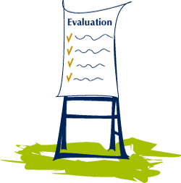
Agenda
Section 4.1: Evaluation
What is Evaluation?
Types of Evaluation
Notes:
Overview: The topic for tonight is evaluation. Evaluation is like cooking…it can be simple or it can be complicated. Think about steaming some fresh vegetables from your garden or cooking an elaborate sauce the takes all day. We all know people that cook like that! We are going to take our time with each slide. Like cooking, knowing the basics can take you far.

Slide 3

Ice Breaker
Notes:
Overview: It is icebreaker time. This subject can be a bit intimidating; you might consider an icebreaker that is fun and a little goofy to loosen people up.

Slide 4

Section 4: Evaluation and Celebration
Learning objectives
Identify the types of evaluation and the key concepts of each.
Apply the five steps of the evaluation process to your Community Improvement Project (CIP).
Create a strategy to share the results of your Community Improvement Project (CIP).
Notes:
Overview: Review the learning objectives.

Slide 5

What is Evaluation?
A process
Understanding what something does
And how well it does it
Notes:
Overview: This is critically important to getting support both in sweat equity and financial resources; people want to be a part of projects that are successful. This includes projects that make mistakes but are able to correct themselves. Just like the ability to self-reflect and change course makes successful leaders, projects that are able to do the same attract support too!

Slide 6



Why is evaluation Important?
Success or failure
Are resources spent well
Any changes need to be made
Notes:
Overview: Evaluation is important for many reasons.
Group Discussion: As a leader, how would this information affect your motivation and the sustainability of your efforts? How will other stakeholders respond to this information?

Slide 7
The Evaluation Process
1. Involve key stakeholders
2. Determine evaluation goals
3. Identify pieces of the project elements you can track that will help meet the goals
4. Decide on a data collection, analysis, and reporting plan
5. Share the results and celebrate
Notes:
Overview: These are the five basic steps to the evaluation process.
Group Discussion: Ask group to provide examples of each step.

Slide 8

The Evaluation Process
Step 1: Key Stakeholders
What role do stakeholders play?
Community residents (i.e. children and adults of all ages)
Elected Officials (i.e. Board of Supervisors)
Appointed Officials (i.e. planning commission)
Agency Staff (i.e. health dept.,
schools, parks & rec)
Community Planning, sponsor groups, and other stakeholders
Notes:
Overview: Remember, stakeholders are people and groups that have an interest in the success of the project. Make a list, be willing to add and take away from it at any point in your progress. Keep good notes!

Slide 9
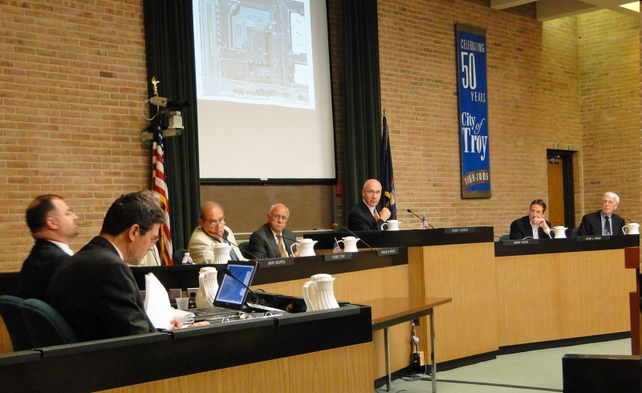
The Evaluation Process
Step 1: Key Stakeholders
Commissions:
Advise policymaking & development process
Review proposed developments
Set conditions for development
Direct agency staff
Notes:
Overview: The next five slides go over some examples of key stakeholders.

Slide 10
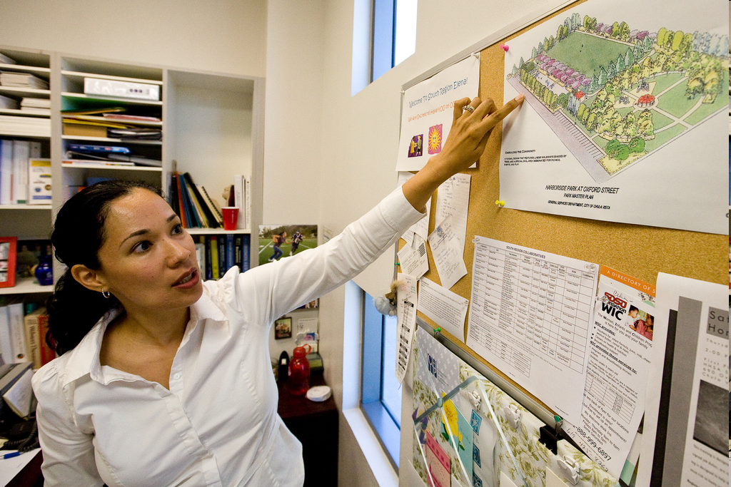
The Evaluation Process
Step 1: Key Stakeholders
City/County Planners:
Prepare, review, & revise plans/ordinances
Implement & interpret plans/ordinances
Oversee development
Seek funding for implementation
Notes:
Overview: Examples of key stakeholders.

Slide 11
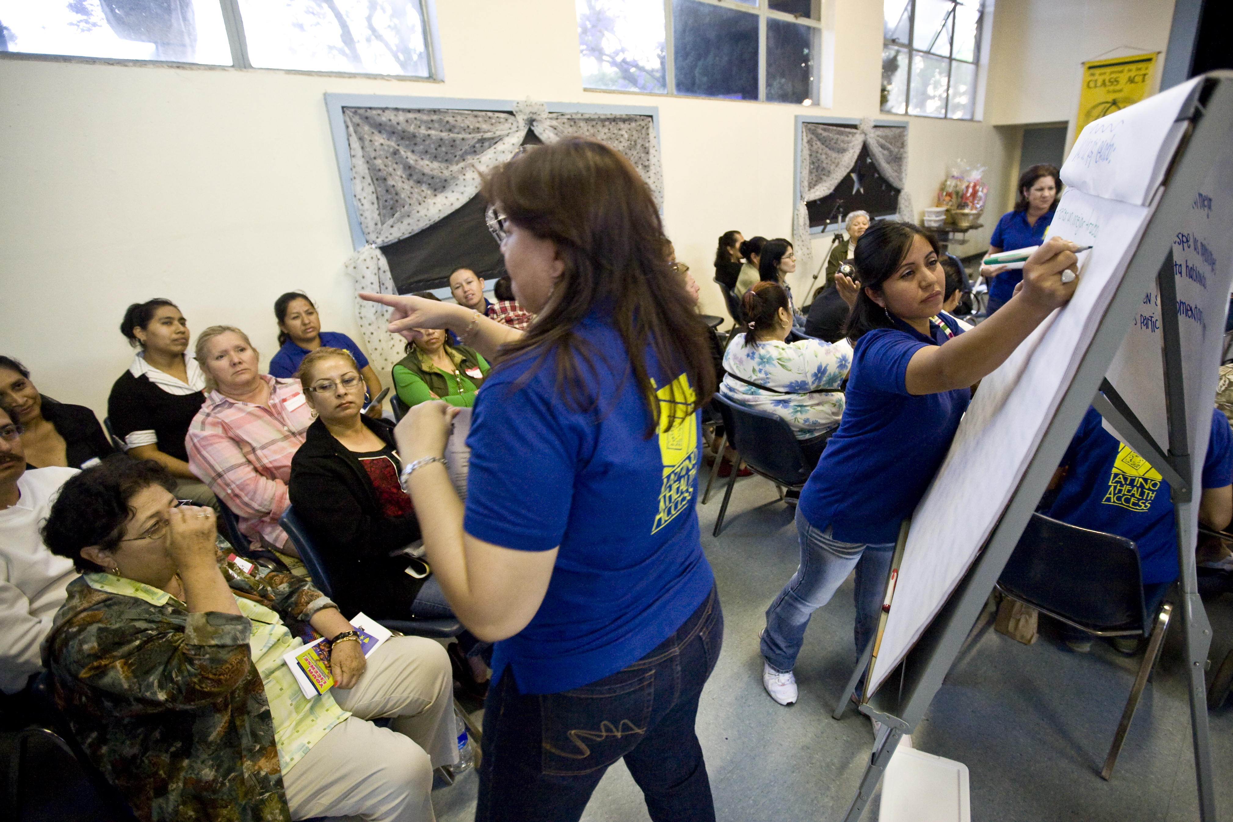
The Evaluation Process
Step 1: Key Stakeholders
Public Health:
Share health data
Organize community participation
Partner on implementation
Participate in development review
Notes:
Overview: Examples of key stakeholders.

Slide 12
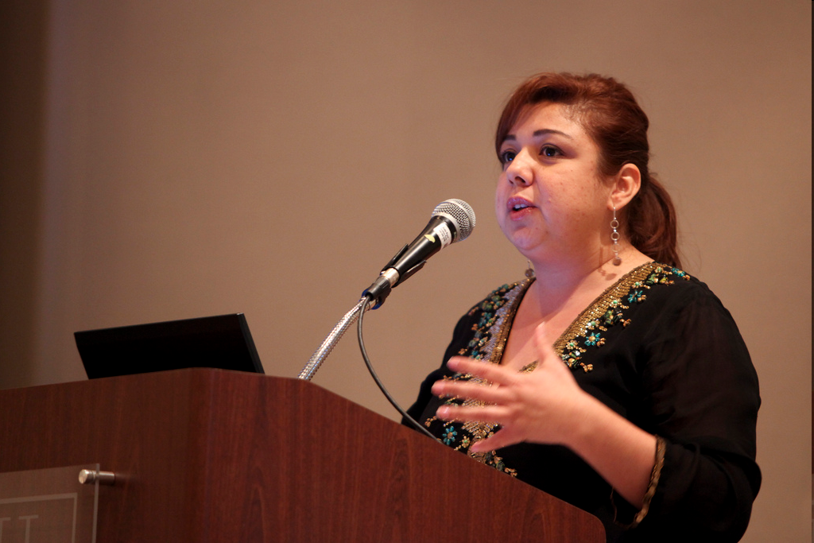
The Evaluation Process
Step 1: Key Stakeholders
Other Agencies:
Schools (joint use)
Parks & Rec (maintenance, programming)
Public Works (complete streets, sidewalks, traffic calming)
Notes:
Overview: Examples of key stakeholders.

Slide 13

The Evaluation Process
Step 1: Key Stakeholders
Community Residents:
Cultivating elected champions
Sharing community priorities
Public-private partnerships
Notes:
Overview: Examples of key stakeholders.

Slide 14
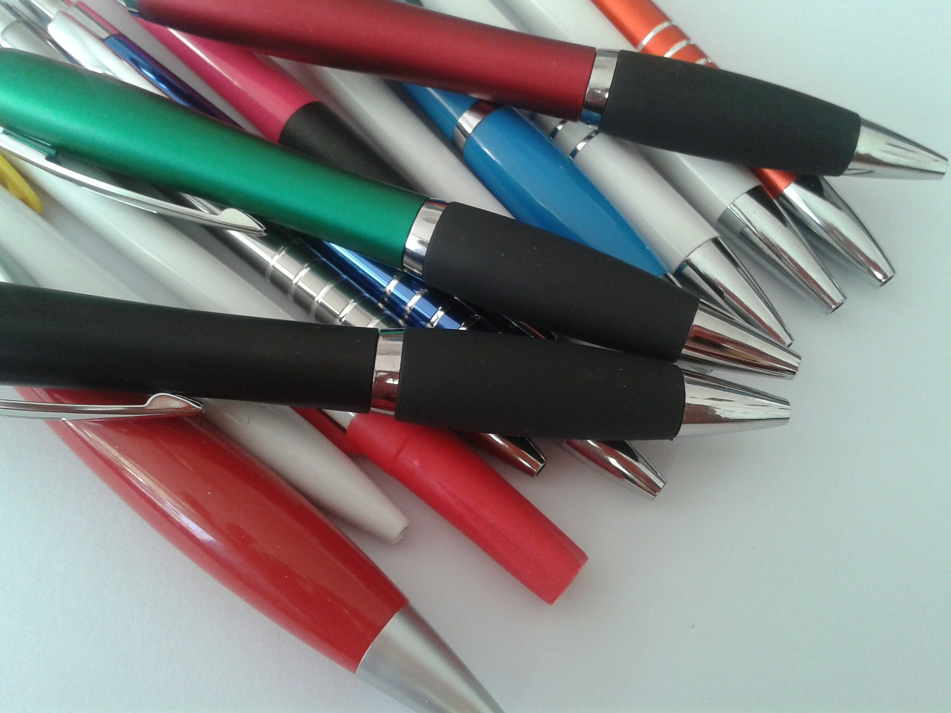
Activity
Instructions:
Answer the following questions in your workbook
  Who are potential stakeholders in your community?
  How can we get them involved?
Notes:
Overview: Identify the stakeholders related to your CIP.
Activity: Break into small groups to fill out the activity in their workbooks. Though they will be able to work as a team to talk about questions and share ideas, they should all fill out the activities fully in their individual workbooks.

Slide 15

Break Time
Notes:
Facilitator Tip: Use this time for a break. Give participants a five to ten minute break depending on the needs of the group and the length of the meeting. Use the resources in the Digital Library to choose one stretch for your group.

Slide 16

The Evaluation Process
Step 2: Evaluation Goal(s)
Notes:
Overview: Define your goals.
Image from: http://daveschoenbeck.com/build-quarterly-business-plan-8-steps/

Slide 17
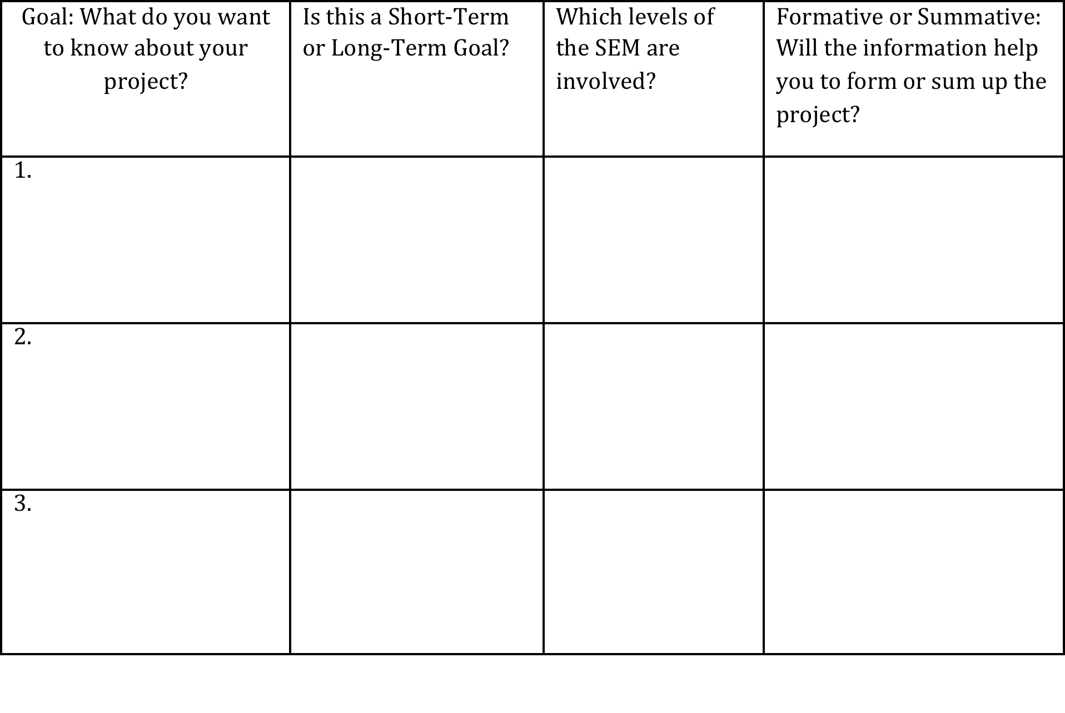
Activity
Instructions:
Define your CIP goals
Fill out the table
Notes:
Overview: Define your goals.
Activity: Keep your small groups together throughout this session. Again, everyone should do the activity in their own workbook also.
Remember the Deep Dive has additional resources!

Slide 18

The Evaluation Process
Step 3: Key Indicators
Notes:
Overview: The pieces of information that you gather to meet your outcome(s) are called indicators and are an important part of your evaluation plan.

Slide 19
Activity
Instructions:
Identify your indicators by
  Plug your goals into the boxes
  List information you need to meet your goals
  Circle the piece of information you think will be most helpful
Goal 1:
Notes:
Overview: Remember that the “goal” of your evaluation is what you want to learn from the evaluation for your CIP (before, during, and/or after the project), so indicators are just the pieces of information you need to meet that goal. Your evaluation plan answers how successful your outcome is.
Facilitator Tip: Facilitator could draw this as a diagram on the board to make it clearer.

Slide 20
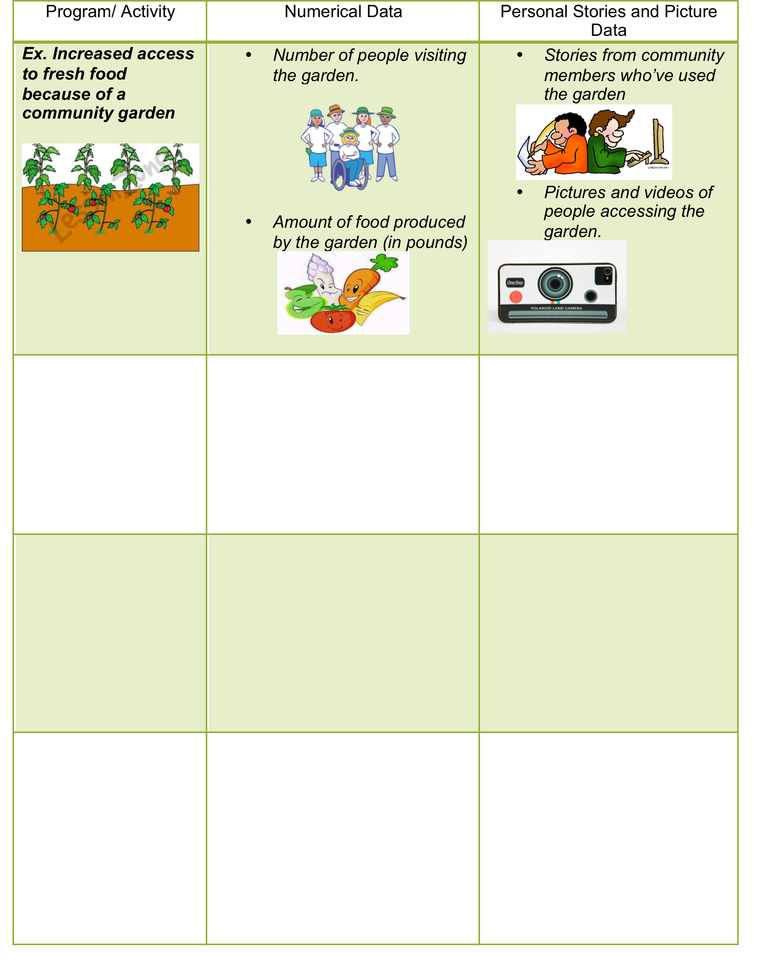
Activity
Instructions:
Plug in your indicators from the previous activity
Think of tools to measure each indicator
Notes:
Overview: Evaluation is stronger when it includes BOTH numbers and stories, so make sure to think of both types of data for each indicator.

Slide 21
The evaluation process
Step 4: Data Collection
Data Collection System
Data Collection
Personal:
Interviews
Pictures/Videos
Stories
Data Analysis
Data Storage
Personal and Numerical:
Excel/Word/Pictures/Files
Paper copies
CDs/Thumb Drives
Numerical:
Pre/Post Surveys
Review of existing data (attendance, incident reports weight changes, etc.)
Review of new data/experiments
Personal:
Visual Comparisons
Summary of existing documentation for basic trends and highlights
Numerical:
Basic Math Comparisons
Notes:
Overview: Planning how you will collect and store your data will save you lots of time (and potentially headaches!) later.

Slide 22
Activity
Instructions:
Brainstorm Your Data Collection System
Which data collection tools do you like?
Where should your data be kept?
How will your data be analyzed?
Who should collect, store, and analyze your data?
Notes:
Overview: Ask the group to think of appropriate and accessible options. What tools/processes best fit your project? What tools are easiest for your team to access? What role would each person play in each step of the process? These are not set in stone, but it is good to start somewhere with a plan.

Slide 23

The Evaluation Process
Step 5: Sharing and celebrating
Notes:
Overview: Yes, celebration is A PART OF evaluation! Sharing your results does not just have to be handing out a boring report (just kidding, reports are important too); it can also be throwing a block party to share with your community and key stakeholders.

Slide 24

Conclusion
Questions?
Comments?
Concerns?
Notes:
Overview: You used a lot of brain power tonight!

Slide 25

"This curriculum was supported by the Cooperative Agreement Number DP005528-01, funded by the Centers for Disease Control and Prevention through the County of San Diego, Health and Human Services Agency. Its contents are solely the responsibility of the authors and do not necessarily represent the official views of the Centers for Disease Control and Prevention or the Department of Health and Human Services."

