Slide 1
Section 4
Evaluation and Celebrations
Notes:
Overview: Welcome to the last session!

Slide 2
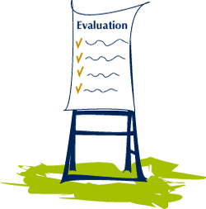
Agenda
Section 4.2: Celebration
What is a Strategic Celebration?
Planning our Celebration
Notes:
Overview: Brief review of agenda.

Slide 3

Ice Breaker
Notes:
Overview: Use the resources in the Digital Library to choose an icebreaker activity for your group or ask each person to share their favorite part of their Resident Leadership Academy (RLA) experience.

Slide 4

Section 4: Evaluation
Learning objectives
Identify the types of evaluation and the key concepts of each.
Apply the five steps of the evaluation process to your Community Improvement Project (CIP).
Create a strategy to share the results of your Community Improvement Project (CIP).
Notes:
Overview: Review the learning objectives. Today’s focus is on learning objective 3.

Slide 5
The Evaluation Process
1. Involve key stakeholders
2. Determine evaluation goals
3. Identify pieces of the project elements you can track that will help meet the goals
4. Decide on a data collection, analysis, and reporting plan
5. Share the results and celebrate
Notes:
Overview: Briefly review steps 1-4. Today is all about celebration.

Slide 6

Sharing and celebrating
Stakeholder Participation
Clear Message
Recognition
Timeliness
Appropriateness
Notes:
Overview: It is party time. Remember to keep your activities consistent with your goals to increase health. Think about healthy snacks, transportation, and maybe even some fun physical activities depending on your CIP. Celebrating strategically is the key to making this a useful step in the CIP process.

Slide 7
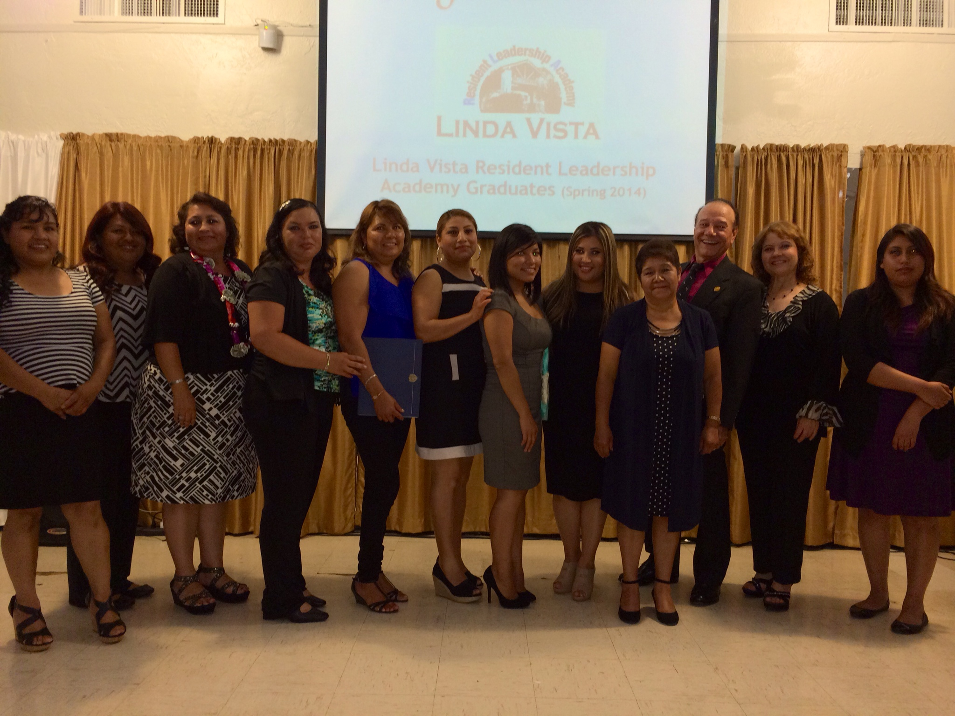
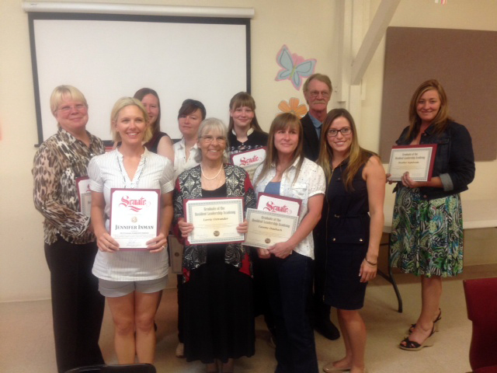
Sharing and celebrating
Stakeholder Participation
Involve a wide variety
Contribute meaning to project
Notes:
Overview: Plan the invitation list , have you invited all of your current and potential stakeholders?
Group Discussion: Who will be on the guest list? How will you make their participation more meaningful than just showing up? Can they be involved in the planning or have a special activity in the day? People are more motivated to attend and promote the event if they have a role in it.

Slide 8

Sharing and celebrating
Clear Message
Clear, concise, and consistent
Educate key stakeholders
What is your
message?
Notes:
Overview: Think about the 8-80 metaphor, it applies here also, can someone 8 years old and 80 years old understand your message? Do all key people involved in planning and putting on the event know what the message is? You do not want someone getting caught off guard with a question they either do not know the answer to or do not know where to direct people for the answer.

Slide 9

Break Time
Notes:
Facilitator Tip: Use this time for a break. Give participants a five to ten minute break depending on the needs of the group and the length of the meeting. Use the resources in the Digital Library to choose one stretch for your group.

Slide 10

Sharing and celebrating
Recognition
Acknowledge key stakeholders
Thank people for support and effort
Notes:
Overview: Recognition should be a part of the celebration. There is nothing more special than being thanked for your efforts! Even those who have not been very involved yet, but who you want to motivate to be more involved, can be thanked in some small and appropriate way.
Group Discussion: Who should receive public recognition at the event and what should be said about their contribution? Write this down.

Slide 11

Sharing and celebrating
Timeliness
Don’t delay
Timing is key
Notes:
Overview: Timing your celebration to be soon after project completion is best for keeping momentum and excitement up.

Slide 12

Sharing and celebrating
Appropriateness
Location
Refreshments
Activities
Etc.
Notes:
Overview: Remember to support the Live Well goals! Is your event healthy, safe, and accessible?

Slide 13

Activity
Instructions
Begin to think about what celebrations you should have and when you should have them.
Answer the questions in your workbook.
Notes:
Overview: Work as a team to decide how best to celebrate the RLA’s accomplishments.
Activity: Group members can work together to plan their celebration but everyone should fill out their individual workbook answers as a guide and as a reminder for future CIPs and celebrations.
Facilitator Tip: This should be a practical exercise that results in a plan for the actual celebration and recognition of the group’s CIP.

Slide 14
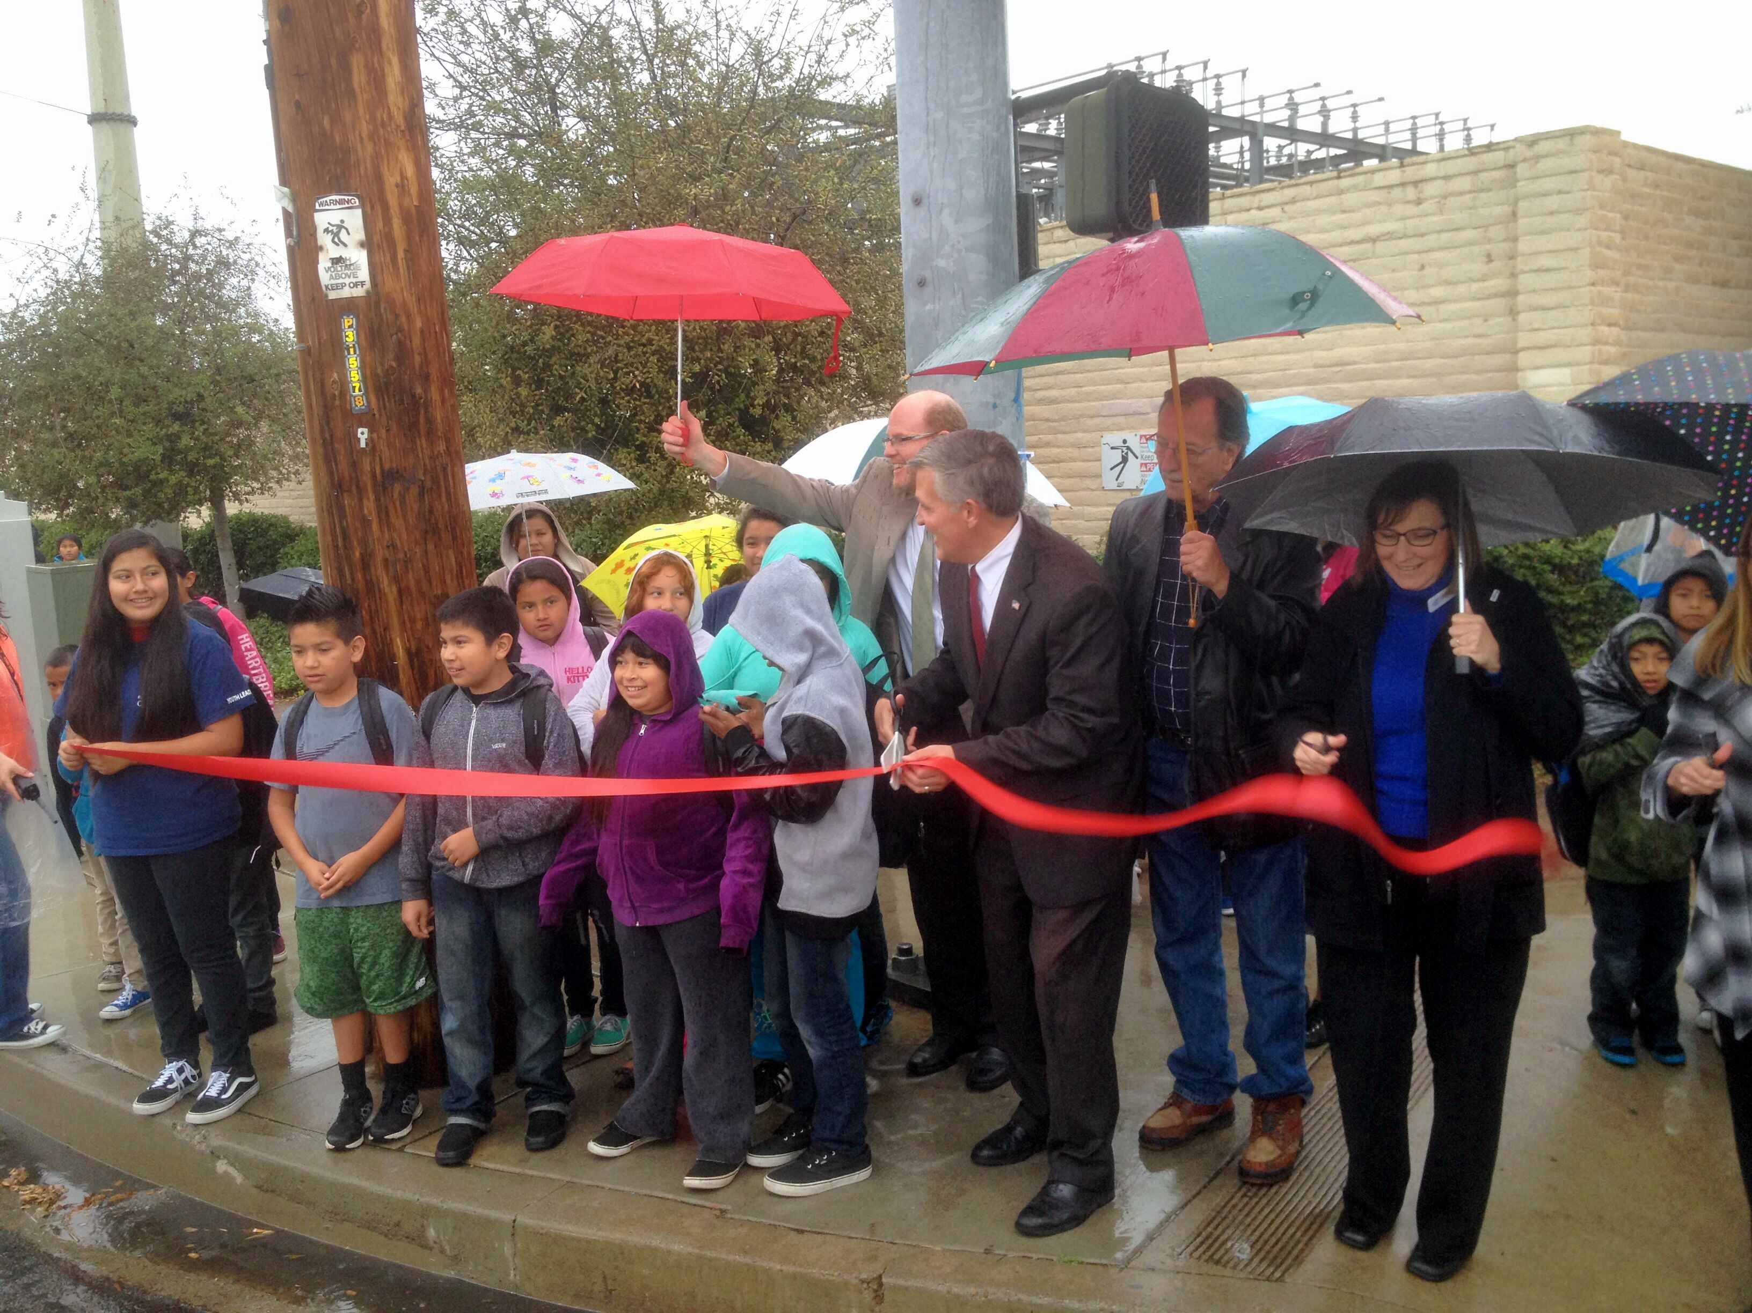
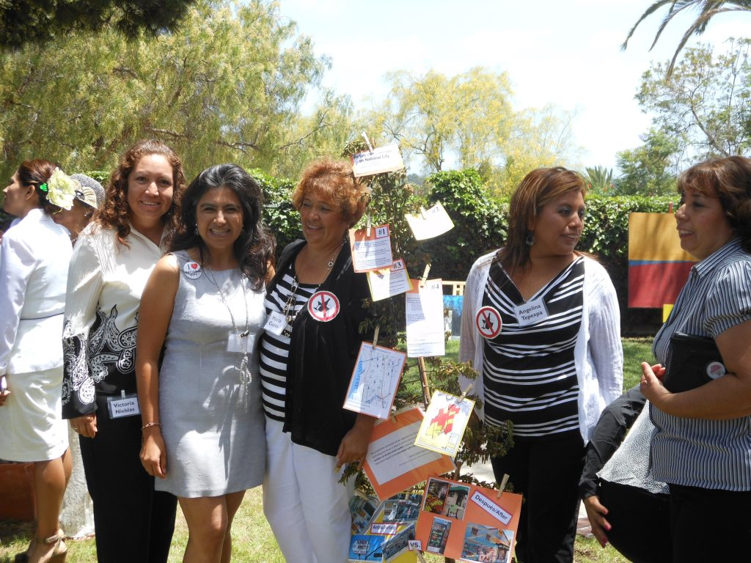
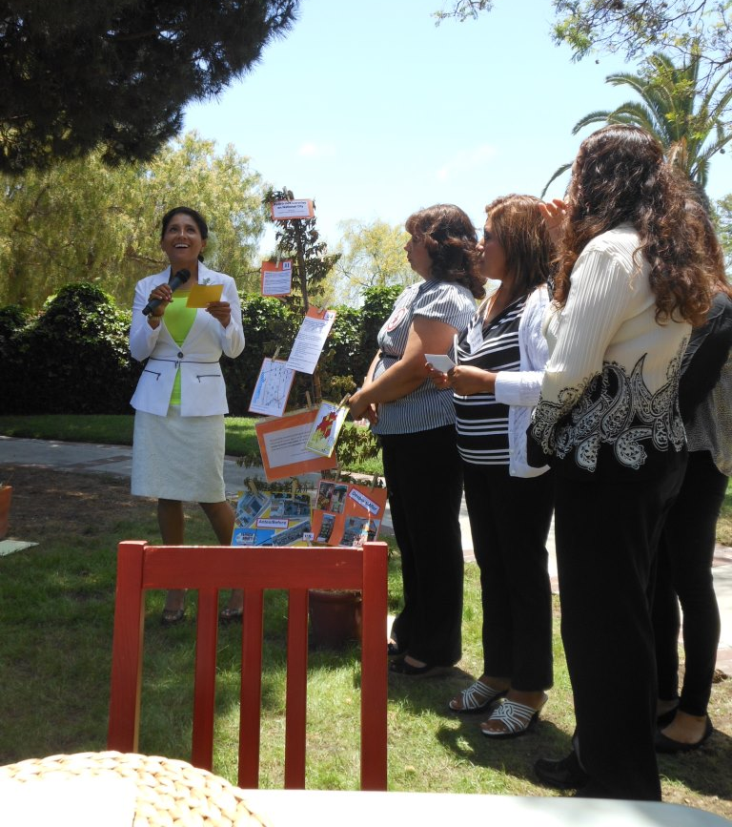
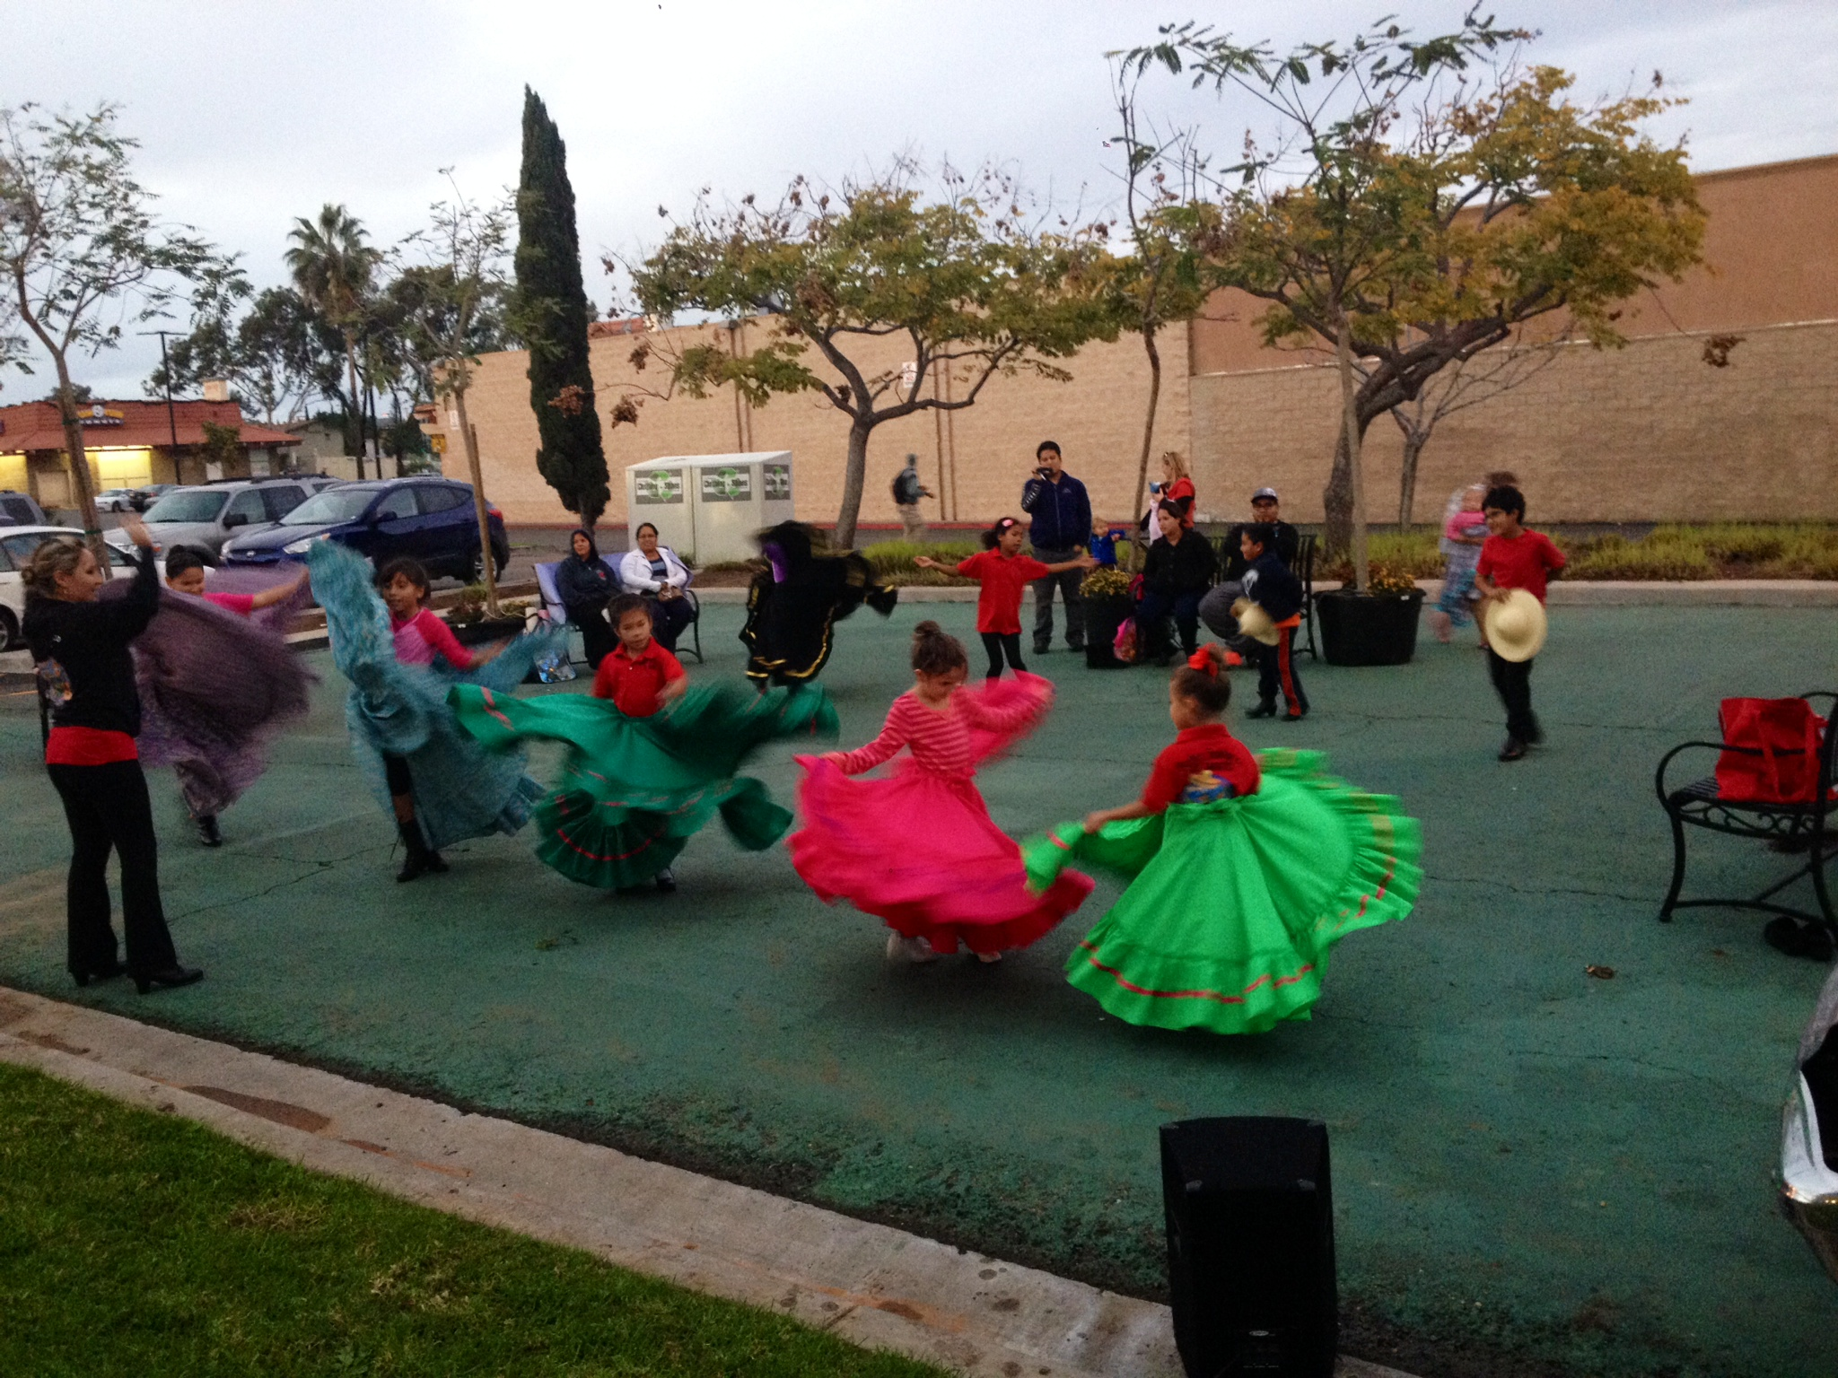
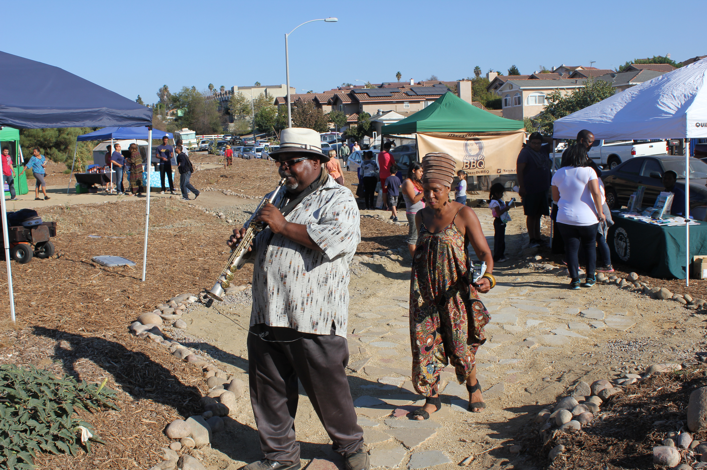
Sharing and celebrating
Notes:
Overview: Past RLAs have celebrated in a variety of ways from ribbon-cuttings to block parties to cultural celebrations.

Slide 15

Conclusion
Questions?
Comments?
Concerns?
Notes:
Overview: Thank you! You worked hard and accomplished so much. This does not have to be the end. You have learned so much about promoting and improving health that you can continue to repeat the CIP process as many times as you want with the RLA group you have already established or with others.

Slide 16

"This curriculum was supported by the Cooperative Agreement Number DP005528-01, funded by the Centers for Disease Control and Prevention through the County of San Diego, Health and Human Services Agency. Its contents are solely the responsibility of the authors and do not necessarily represent the official views of the Centers for Disease Control and Prevention or the Department of Health and Human Services."

Slide 17

Conclusion
Notes:
Overview: You are already doing this! Keep it up!

