Slide 1
القسم الأول: نظرة عامة
Notes:
Overview: This is your introduction to the group and your chance to make an impression and begin to set the tone and camaraderie for the group.
Welcome everyone to the group.
Introduce yourself, your professional, and/or personal background that relates to the Resident Leadership Academy (RLA) training, and something you are looking forward to about the RLA.
Acknowledge the hosting organization if applicable for providing space, refreshments, or other resources.

Slide 2
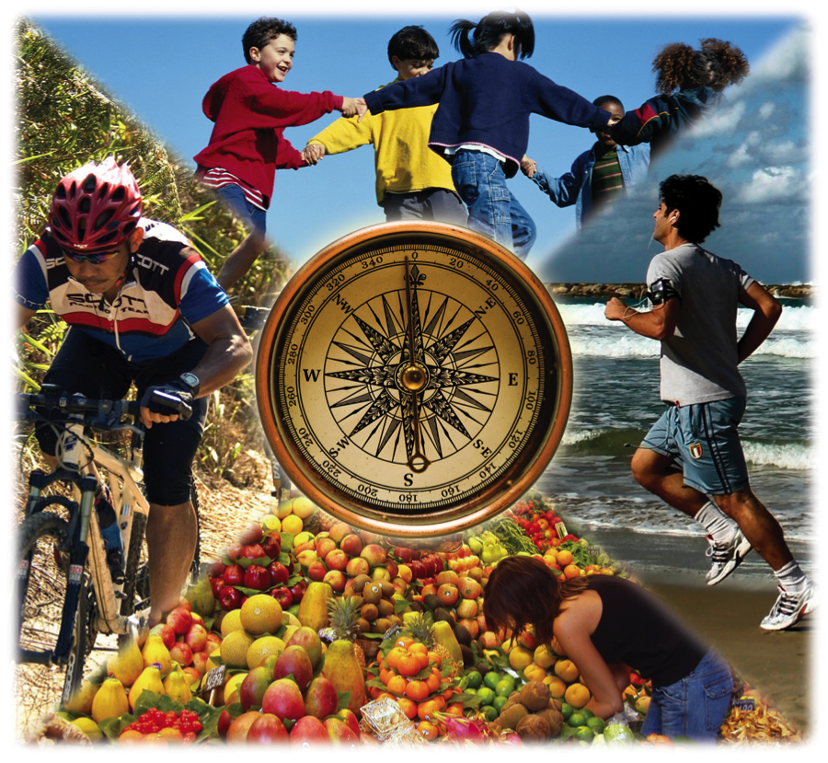
جدول المحتويات
القسم الأول: نظرة عامة
المقدمات/الترحيب
التهيئة
المحددات الاجتماعية
نظرة عامة على برنامج المبادرة المجتمعية
الخاتمة
Notes:
Overview: Continue your introduction to the group.
This is a weekly training comprised of a minimum of nine sessions, but can be up to ten separate meetings. Each session lasts 2-2.5 hours. In addition to the training, there will be time spent outside of the training sessions to implement a Community Improvement Project(s) (CIP).
Discuss your expectations for the training, such as starting on time, reading assigned sections, doing homework, and active participation. This is a group learning process and since they are the experts on their community they are the most important voices in the room.

Slide 3

القسم الأول: نظرة عامة
الأهداف التعليمية:
تحديد المشاكل الصحية داخل مجتمعاتنا.
عرض النموذج الاجتماعي البيئي وكيفية تطبيقه للنهوض بصحة المجتمع.
فهم المحددات الاجتماعية للصحة.
Notes:
Overview: Introduce the objectives for this section of the training. This section will provide you with foundational knowledge about chronic health issues in the County of San Diego and what our community members, organizations, and government are doing to address health and wellness in the county. The training will prepare them to take up leadership roles in the community.

Slide 4

المقدمات
شاركنا باسمك
كم طول المدة التي:
  سكنت فيها بهذا المجتمع
  أو عملت فيها بهذا المجتمع
  أو كنت مرتبطًا فيها بهذا المجتمع؟
اذكر أحد الأشياء التي تحبها في منطقتك وأحد الأشياء التي ترغب في تحسينها.
Notes:
Overview: We will have short activities at the beginning of each session to help you connect with one another, and explore your leadership skills.
Group Discussion: Go around the room and have each participant answer these questions. If you have late arrivals please ask them to introduce themselves with this information if you are at a natural break during instruction or before the first break.

Slide 5
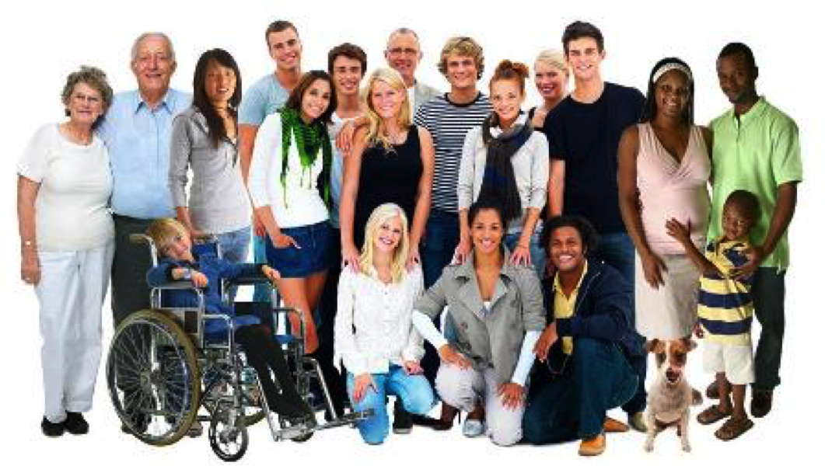
مرحبًا
ما هي أكاديمية قادة المجتمع ؟
تُشرك السكان في أنشطة ومعلومات ينتج عنها بيئة أكثر صحة داخل الأحياء السكنية
كانت انطلاقتها في مقاطعة سان دييغو
تدعم أفراد المجتمع لخلق مناطق وأحياء سكنية أفضل وأكثر صحة
يتعلم فيها المشاركون طرق تشجيع القاعدة المحلية على المشاركة في مشاريع تحسين المجتمع
Notes:
Overview: The RLA is an effort initiated in San Diego County that is designed to engage and support community members like you in creating healthier neighborhoods. Congratulations on being part of the solution! The basic concept behind the RLA is to engage residents in activities that can lead to healthier neighborhood environments. RLA participants will learn ways to involve local grassroots networks in Community Improvement Projects (CIPs) to make positive change in your community.
As you participate in the RLA, you will work with the whole group to create and implement one or more Community Improvement Plans (CIPs). The project(s) will enable you to gain experience in carrying out projects that result in positive changes in your neighborhood. The intent of the curriculum is to help support the group’s efforts, and build leadership skills, for future CIPs.

Slide 6




أقسام تدريب الأكاديمية
التقييم
الفعالية
الإستراتيجيات
نظرة عامة
التقييم
الاحتفالات
إشراك المجتمعات المدنية
خطة برنامج المبادرة الاجتماعية والتطبيق
تعزيز الصحة
استعمالات الأراضي
النقل النشط
الأنظمة الغذائية
التهيئة
المحددات الاجتماعية للصحة
نظرة عامة لبرنامج المبادة الاجتماعية
Notes:
Overview: The training portion of the RLA follows this model:
Section 1 gives you an overview of the RLA, chronic health issues, and the underlying causes of those health issues.
Section 2 provides specific strategies you can use to create change in your community that support health.
Section 3 provides information on how to take action by working with your neighbors, government agencies, decision-makers, and community-based organizations to create positive and effective change.
Section 4 helps you to evaluate the impact your project is having on your community, and how to celebrate success strategically.
Your workbook is a tool. It contains an overview of the topics that we will expand upon in the trainings so please read the assigned sections ahead of time. There are activities for you to do throughout the workbook that will help you to think about how the topics are connected to one another and how they apply to your community.
Group Discussion: In looking at the contents of the training, which parts sound the most interesting?

Slide 7

Notes:
Overview: In 2010, the Board of Supervisors adopted a vision called Live Well San Diego. This vision to advance the health, safety and overall wellbeing of the region is being built with community involvement in three parts.
The first component – Building Better Health – was adopted in July 2010. Building Better Health calls for improving the health of all residents and supporting healthy choices.
The second component – Living Safely – was adopted in October 2012. Living Safely calls for ensuring residents are protected from crime and abuse, neighborhoods are safe, and communities are resilient to disasters and emergencies.
The third phase – Thriving –was adopted in October 2014, calls for promoting a region in which residents can enjoy the highest quality of life.

Slide 8
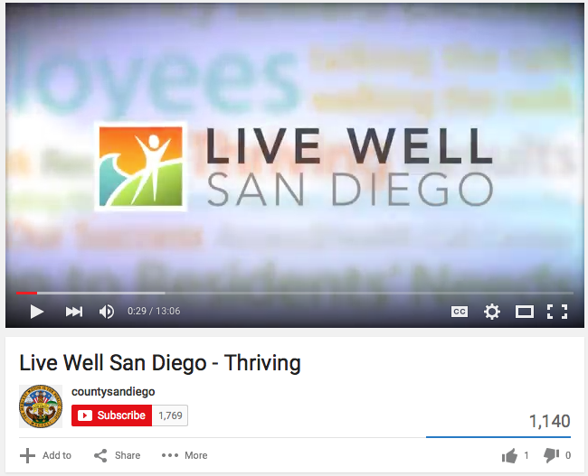

مقطع فيديو
انبضي بالحياة يا سان دييغو
Notes:
Overview: This video was produced by Live Well San Diego to give an overview of the entire vision. The work you do in your RLA is connected to a network of activities happening around the entire county.
https://www.youtube.com/watch?v=QyK9Yeqzt5k

Slide 9
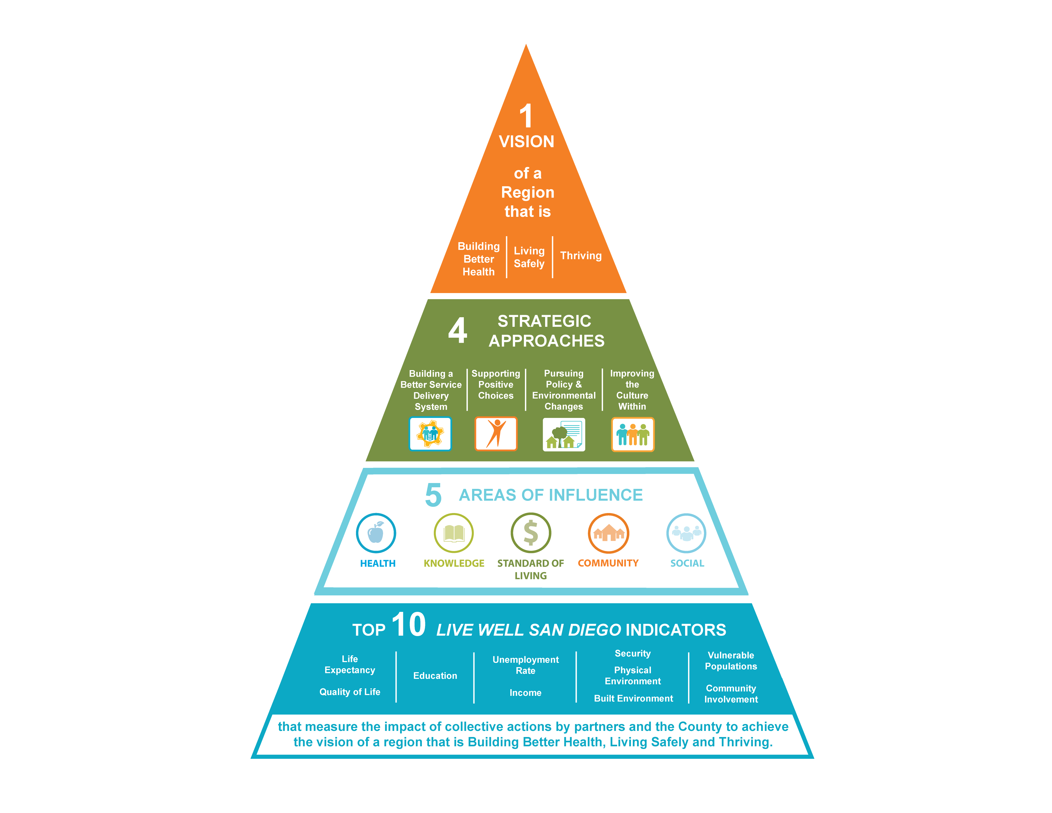
Notes:
Overview: Live Well San Diego is San Diego County’s vision to achieve healthy, safe and thriving communities. Live Well San Diego involves everyone. Only through a collective effort—in which all of us work together toward a shared purpose—can meaningful change be achieved in a region as large and diverse as San Diego County.
The County has adopted four approaches for realizing the Live Well San Diego vision:
Building a Better Service Delivery System – Improve the quality and efficiency of County government and its partners in the delivery of services to residents, contributing to better outcomes for clients and results for communities.
Supporting Healthy Choices – Provide information and resources to inspire county residents to take action and responsibility for their health, safety, and well-being.
Pursuing Policy and Environmental Changes – Create environments and adopt policies that make it easier for everyone to live well, and encourage all individuals to get involved in improving their communities.
Changing Culture from Within – Increase understanding among County employees and providers about what it means to Live Well and the role that all employees play in helping county residents Live Well.

Slide 10
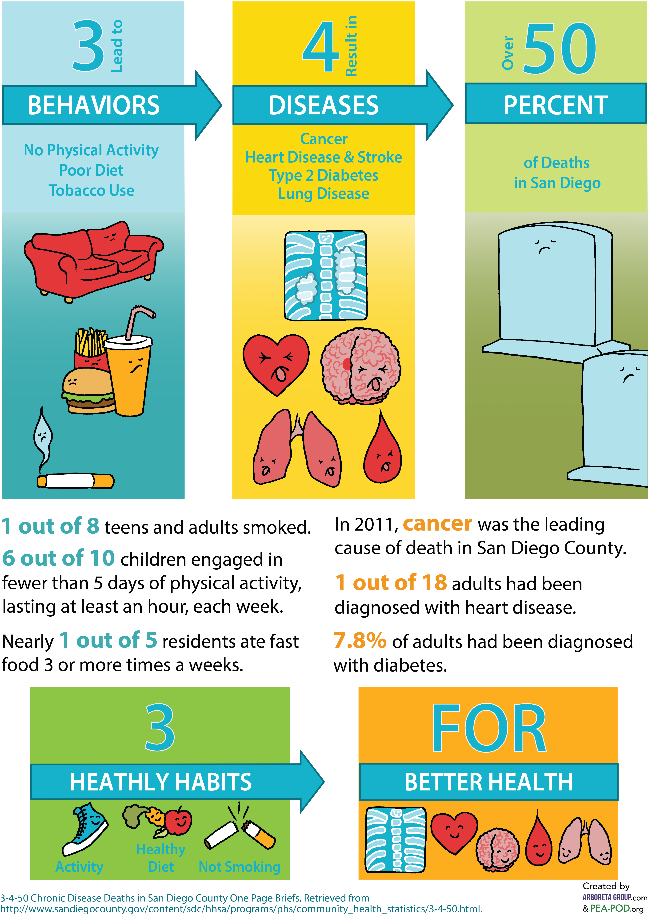
بناء صحة أفضل
هل كنت تعلم؟
Notes:
Overview: The main goal of Live Well is to address the 3-4-50 concept.
Group discussion:
Discuss the three behaviors that contribute to disease. Ask about individual behaviors and how many of us, or people we know, eat fast food, watch too much TV, or smoke currently or have in the past?
Discuss the four chronic diseases. How many participants have close friends and family members that have been touched by the diseases listed?
Discuss the 50% of deaths. Does this surprise them? Why or why not?
Facilitator Tip: Remember, and remind the group, that participants should share based on their own comfort level. Do not call on individual people; allow them to participate in the manner they choose.

Slide 11
المشاكل الصحية المزمنة
Notes:
Overview: Ask the group to look at the statistics in their workbook. This is a good time for a very quick statistics lesson.
Group Discussion: Think about the math when you hear statistics, for example 10% is one in ten people or ten in 100 people. That means if there were 20 people in a group, 10% would mean that two of them would have a chronic disease.
Suggested Activity: Do the math comparing some common statistics or those in the graph to how many people are in the room. Go through each statistic and have the corresponding number of people stand.

Slide 12
مقطع فيديو
تلك هي الصحة العامة
Notes:
Overview: One important way we address and prevent disease is through the use of public health strategies.
https://www.youtube.com/watch?v=oQkGx6gRGIY
This is an alternative or additional video that provides a broad definition of public health from a global perspective.
https://www.youtube.com/watch?v=oy1CAMObRzc

Slide 13

النشاط
إرشادات:
  تحيط بنا عناصر الصحة العامة، فهل يمكنك تحديد استراتيجياتها ومهاراتها في مجتمعك؟
Notes:
Overview: Help the group to make connections between the broad definition of public health explained in the video and what Live Well San Diego is implementing via the RLAs.
Group Discussion: What is public health? What role can the RLA take within public health? What is the role of the larger society or systems like government, public utilities, or nonprofit organizations?
Activity: There are a variety of public health strategies and services all around us everyday. Have the group call out all of them that they can think of and write them on flip chart paper. Some less common ones: sewage, garbage trucks/waste management, busses/mass transit, lead paint and mold control, etc.

Slide 14

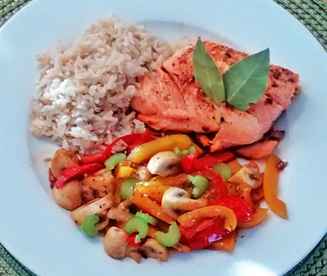
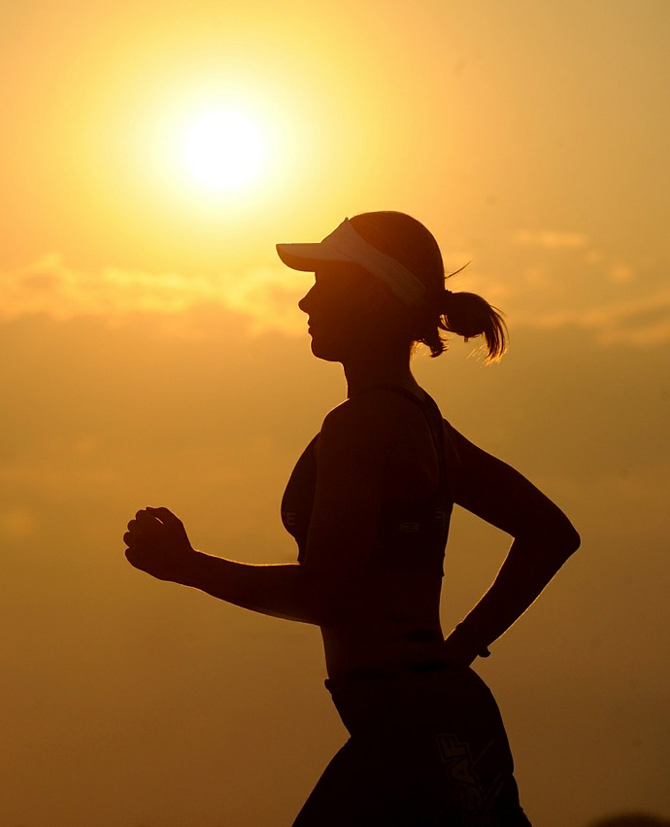


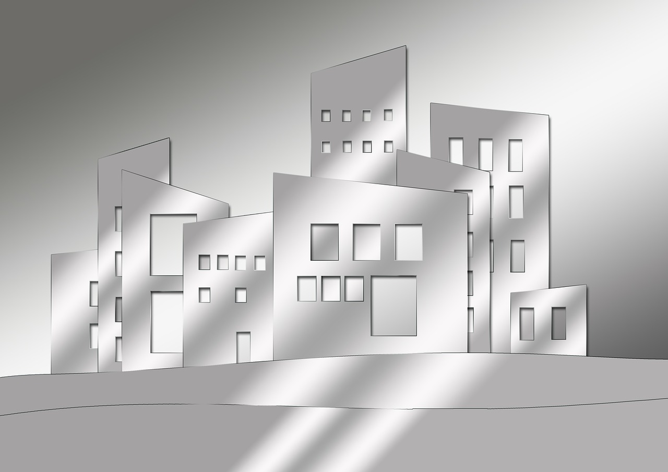
الصحة العامة مقابل الرعاية الصحية
الصحة العامة | الرعاية الصحية
الهدف هو الوقاية من الأمراض والإصابات | الهدف هو علاج الأمراض والإصابات
Public Health
HealthCare
التثقيف الصحي
تعزيز الصحة
التخطيط العمراني
Notes:
Overview: Summarize the basic difference between public health’s focus on preventing disease and injury in comparison to healthcare that focuses on individualized treatment of disease and injury.

Slide 15
نموذج الصحة العامة للوقاية
1. تعريف المشكلة بوضوح
2. تحديد الخطر وعوامل سرعة الاستجابة
3.عمل تدخلات أو إجراءات تقلل من حدة الخطر وترفع سرعة الاستجابة
4. تقييم ما إذا كانت التدخلات قد أثرت إيجابًا على البرنامج
Notes:
Overview: This is the public health model for preventing disease and injury and promoting health and safety. It provides a simple framework for addressing public health issues. Refer participants to page 5 of their workbook and remind them that the workbook will become their trusted companion throughout the RLA process.
Summarize each of the four steps and highlight that it is a process that may begin over and over through adjustments to the interventions in response to community trends, effectiveness of the program, and changes in society such as laws, technology, and economics.
Group discussion: Can you think of how this would be different than looking at a problem from the traditional healthcare model?
Using lung disease as an example:
How would a doctor look at the issue, when would they discover it, and what interventions would they provide?
How would a public health practitioner look at the issue, when would they discover it, and what interventions would they provide?

Slide 16
نموذج الصحة العامة للوقاية
مثال
التقييم
زيادة استهلاك الأغذية الصحية
التدخل
العمل مع المتاجر الصغيرة على تخزين وبيع المنتجات الصحية وتقبل الدفع بنظام EBT فود ستامب
العائق
عدم القدرة على الحصول على أغذية صحية وبتكلفة مناسبة
المشكلة
معدلات سمنة مرتفعة في منطقة سكنية منخفضة الدخل
Notes:
Overview: Review this example.

Slide 17
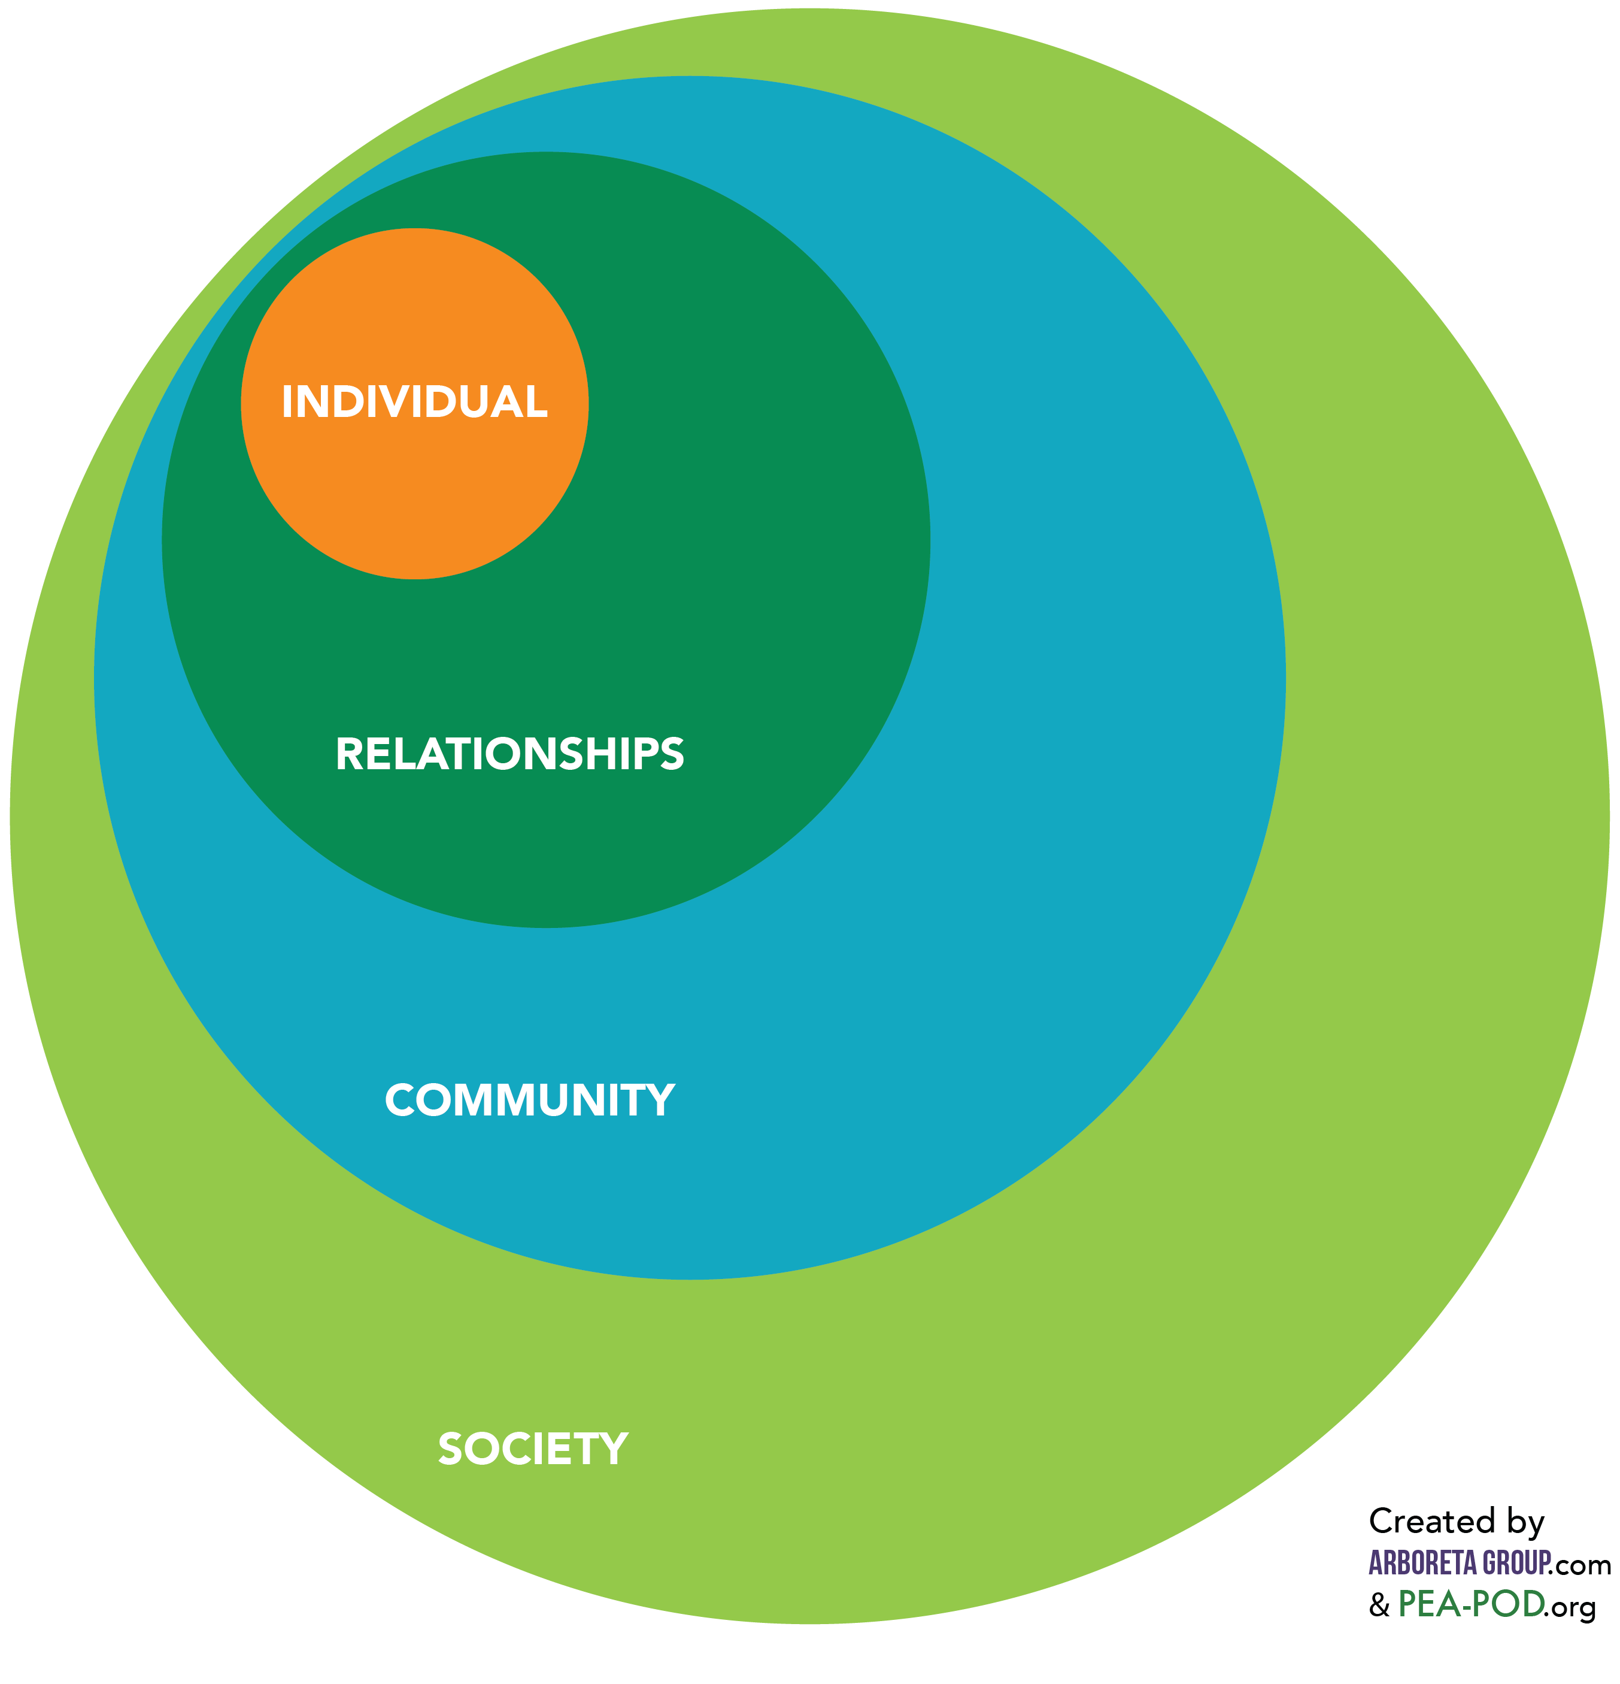
النموذج الاجتماعي البيئي
Notes:
Overview: The Social-Ecological Model (SEM) was adapted as a framework for public health in the 1970’s from Urie Bronfenbrenner’s Ecological Systems Theory and is a foundational model for creating change because it addresses the different spheres of influence that affect individual health and decision-making. It is also one of the foundational building blocks of this training and the CIP. Ask them to review the SEM in their workbook, found on page 6.
Individual – Biological and personal history factors, personal beliefs, and behaviors that protect health.
Relationships – A person's closest relationships including partners, family members, and friends.
Community – Settings including schools, workplaces, and neighborhoods.
Society – Broad societal factors including social norms and the health, economic, educational, and social policies that help to maintain economic or social inequalities between groups in society.
Source: Dahlberg LL, Krug EG. Violence-a global public health problem. In: Krug E, Dahlberg LL, Mercy JA, Zwi AB, Lozano R, eds. World Report on Violence and Health. Geneva, Switzerland: World Health Organization; 2002:1–56.

Slide 18
النشاط
الإرشادات
نموذج الصحة العامة
استخدم نموذج الصحة العامة في مجموعات صغيرة لابتكار تدخلات على مستوى المجتمع للمشكلة الصحية المكلفين بها.
المشكلة
العائق
التدخل
التقييم
Notes:
Overview: This activity gives the group an opportunity to apply the public health model to chronic disease in their community.
Activity: Break into groups and give each group one of the four chronic health issues. Try to get the groups to be odd numbers with no more than seven per group. Ask them to use the model on page 5 of their workbook to come up with their own example that addresses the community level of the SEM.
Facilitator Tip: Pay attention to the dynamics of the groups. The size of groups can often influence the group’s dynamics. For example, in too large of a group a single person may begin to “lecture” and in even numbers people may begin to set-up teams.

Slide 19

فترة استراحة
Notes:
Facilitator Tip: Use this time for a break. Give participants a five to ten minute break depending on the needs of the group and the length of the meeting. Use the resources in the Digital Library to choose one stretch for your group. Participating in the stretching activity is optional and modify if needed.

Slide 20
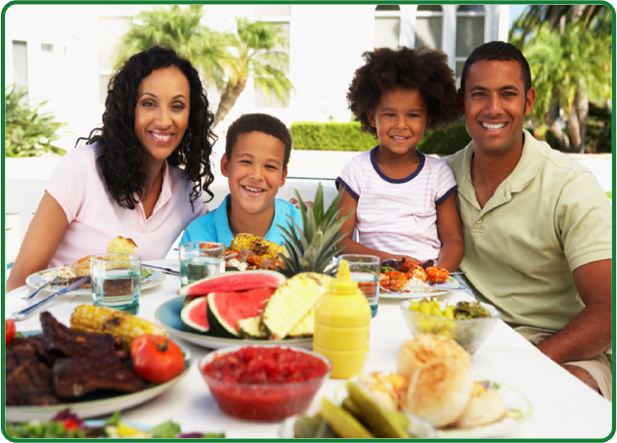
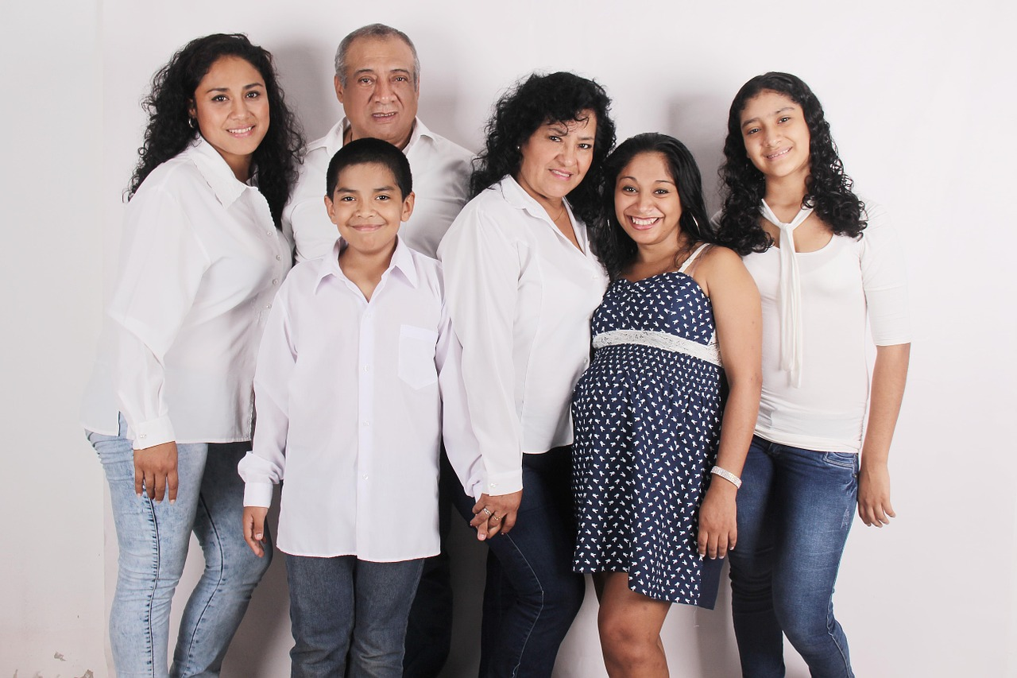

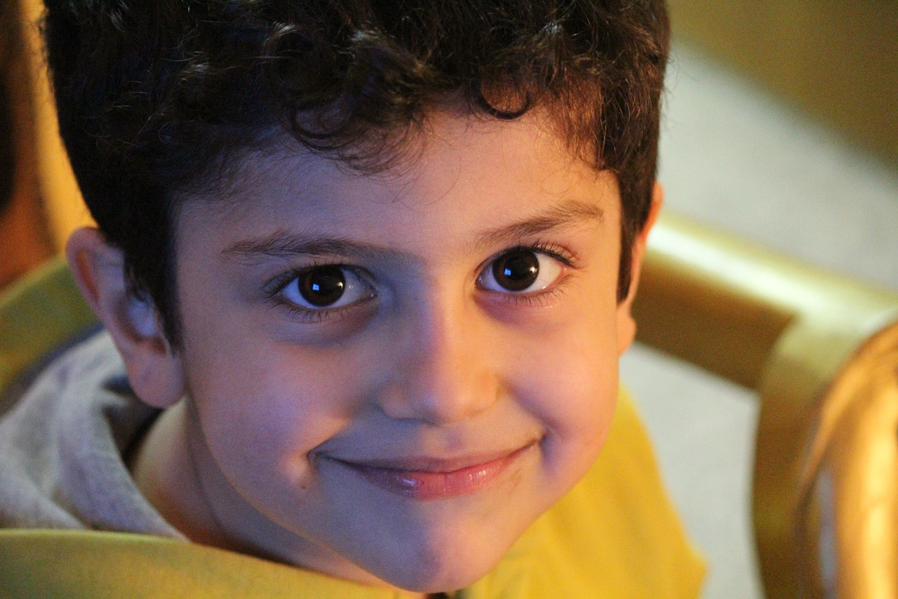
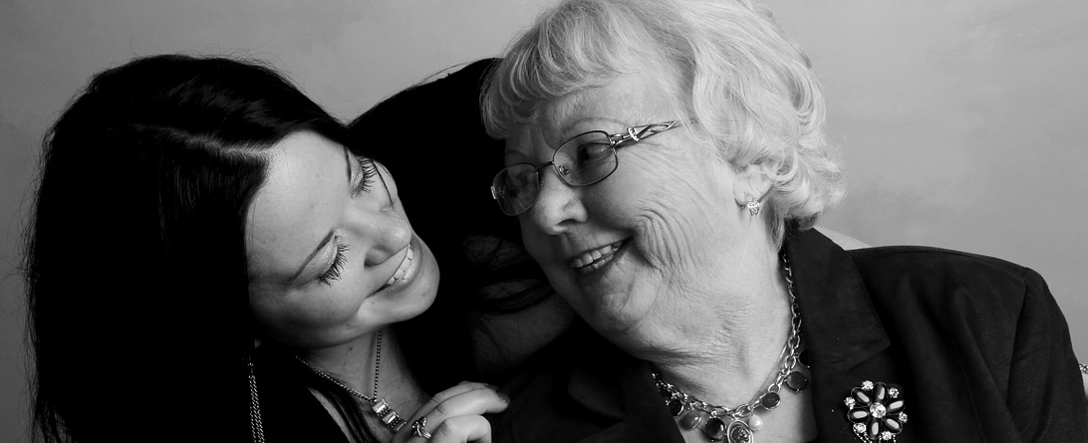
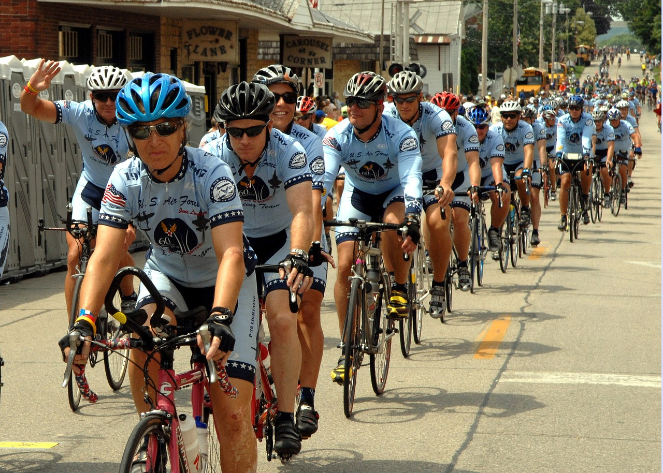

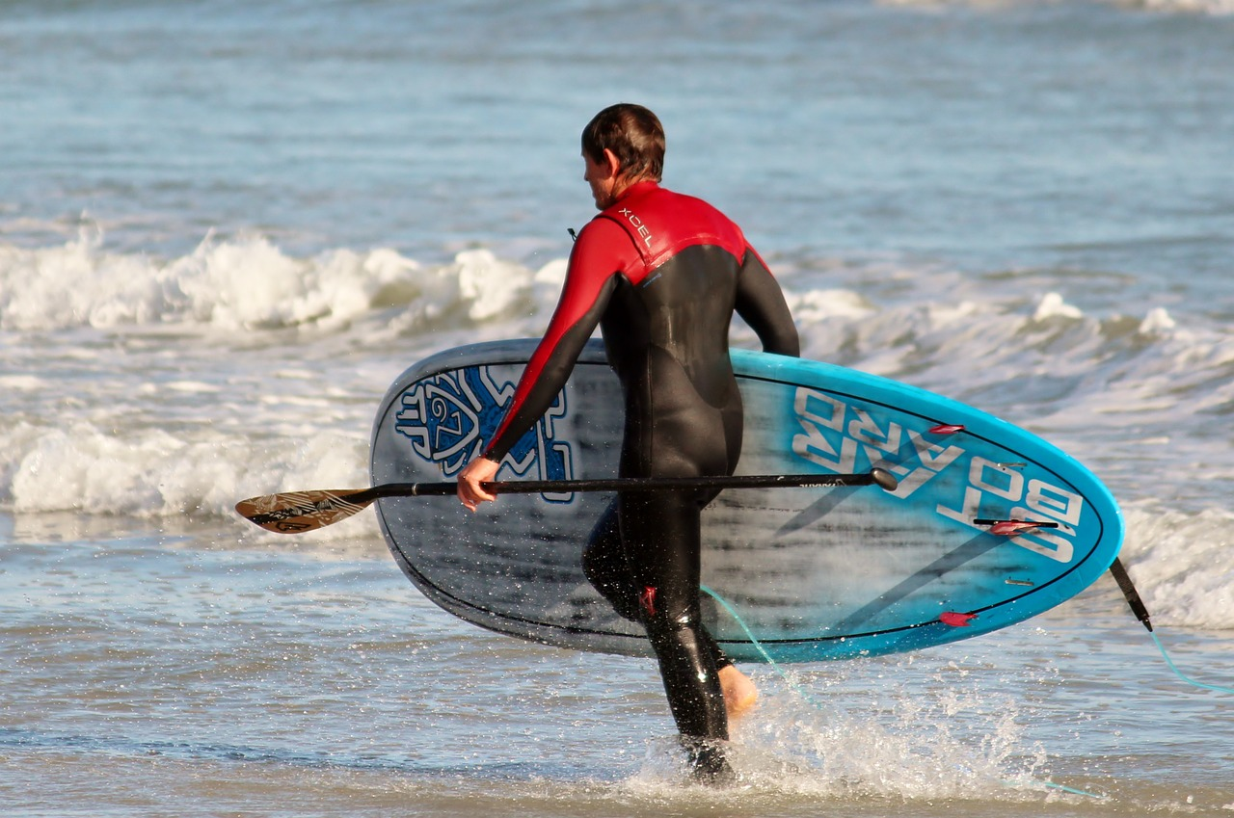
الأمريكيون الأصحاء مكسب للجميع
Notes:
Group discussion: Name some reasons why healthy Americans benefit everyone, for example:
Productive at work (less sick days).
High cost to society, prevention is cheaper than treatment (think the costs of health screening versus being in the hospital).
Impact of the environment from pollution to safety (asthma, second-hand smoke, trucking in food from across the country).

Slide 21

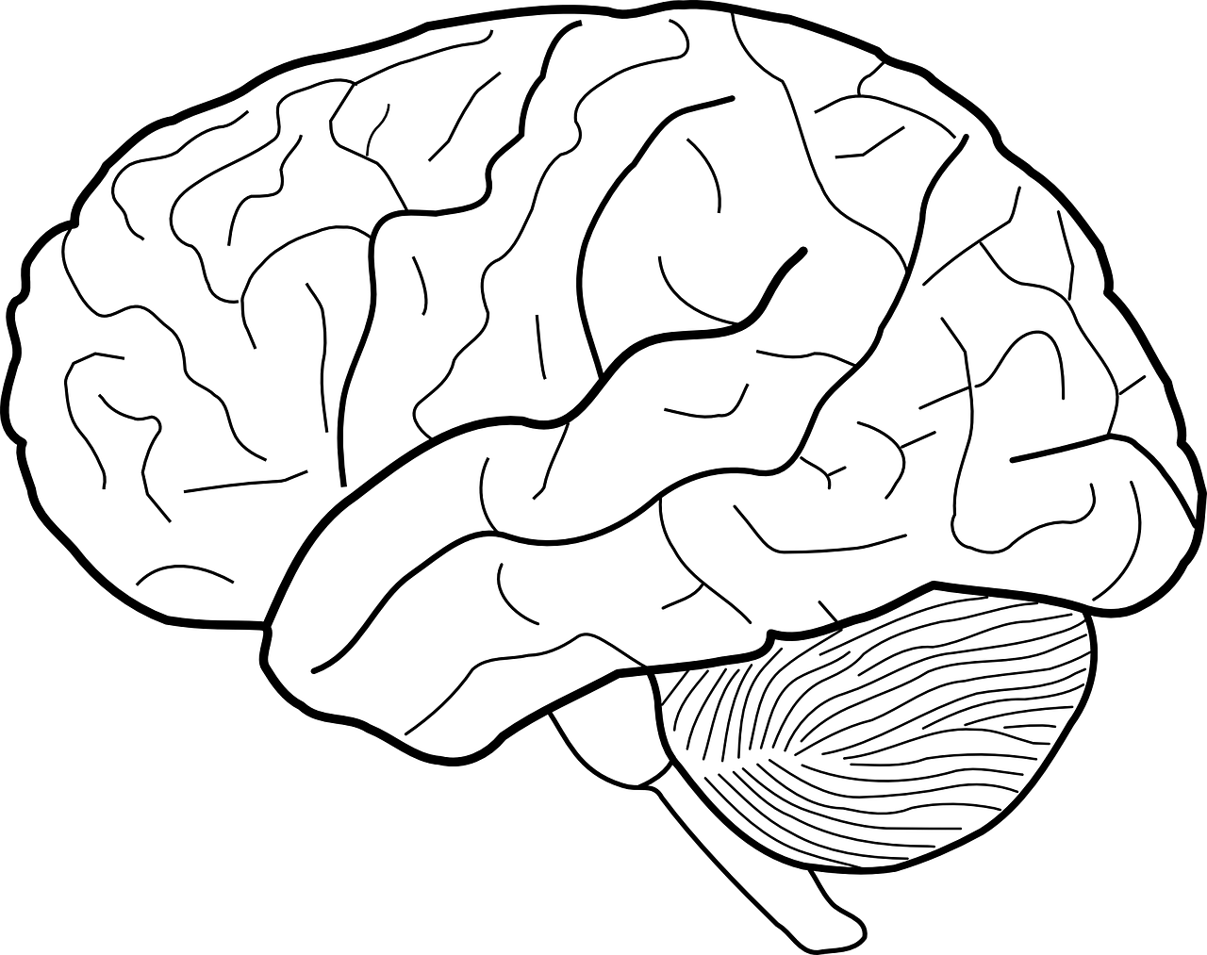
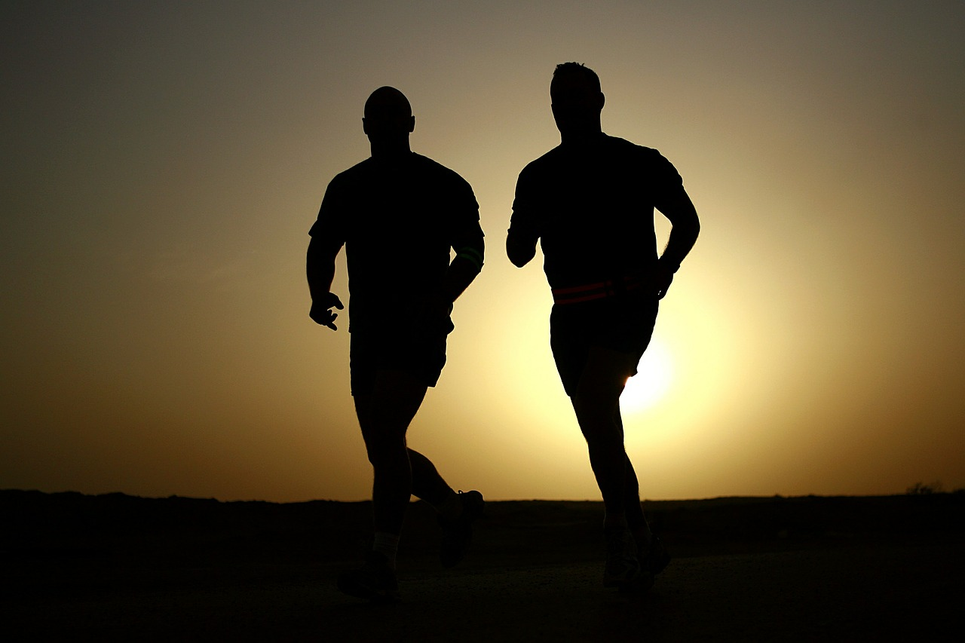

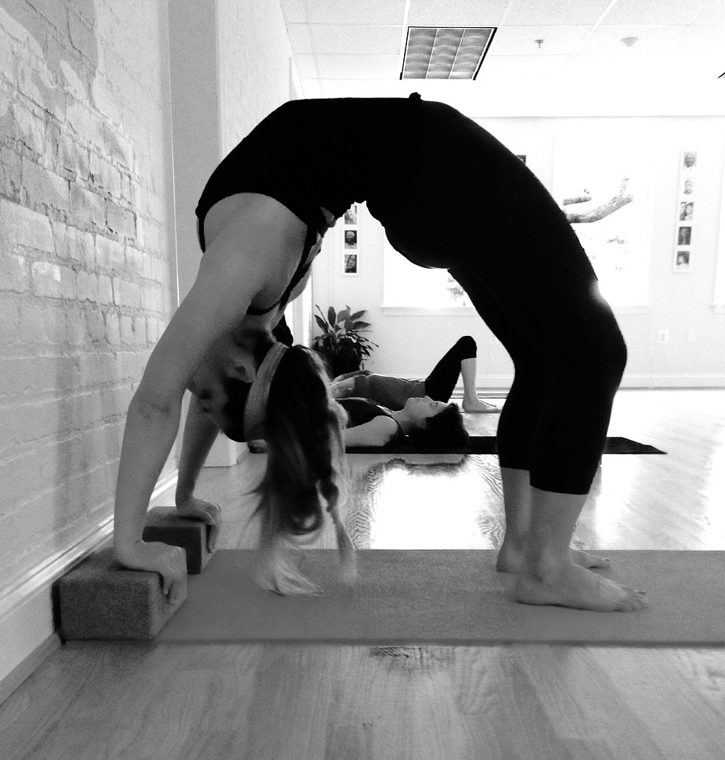
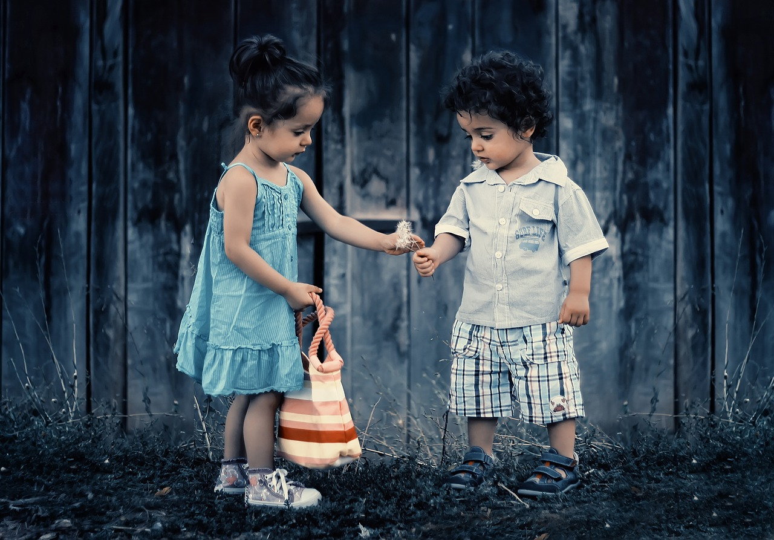
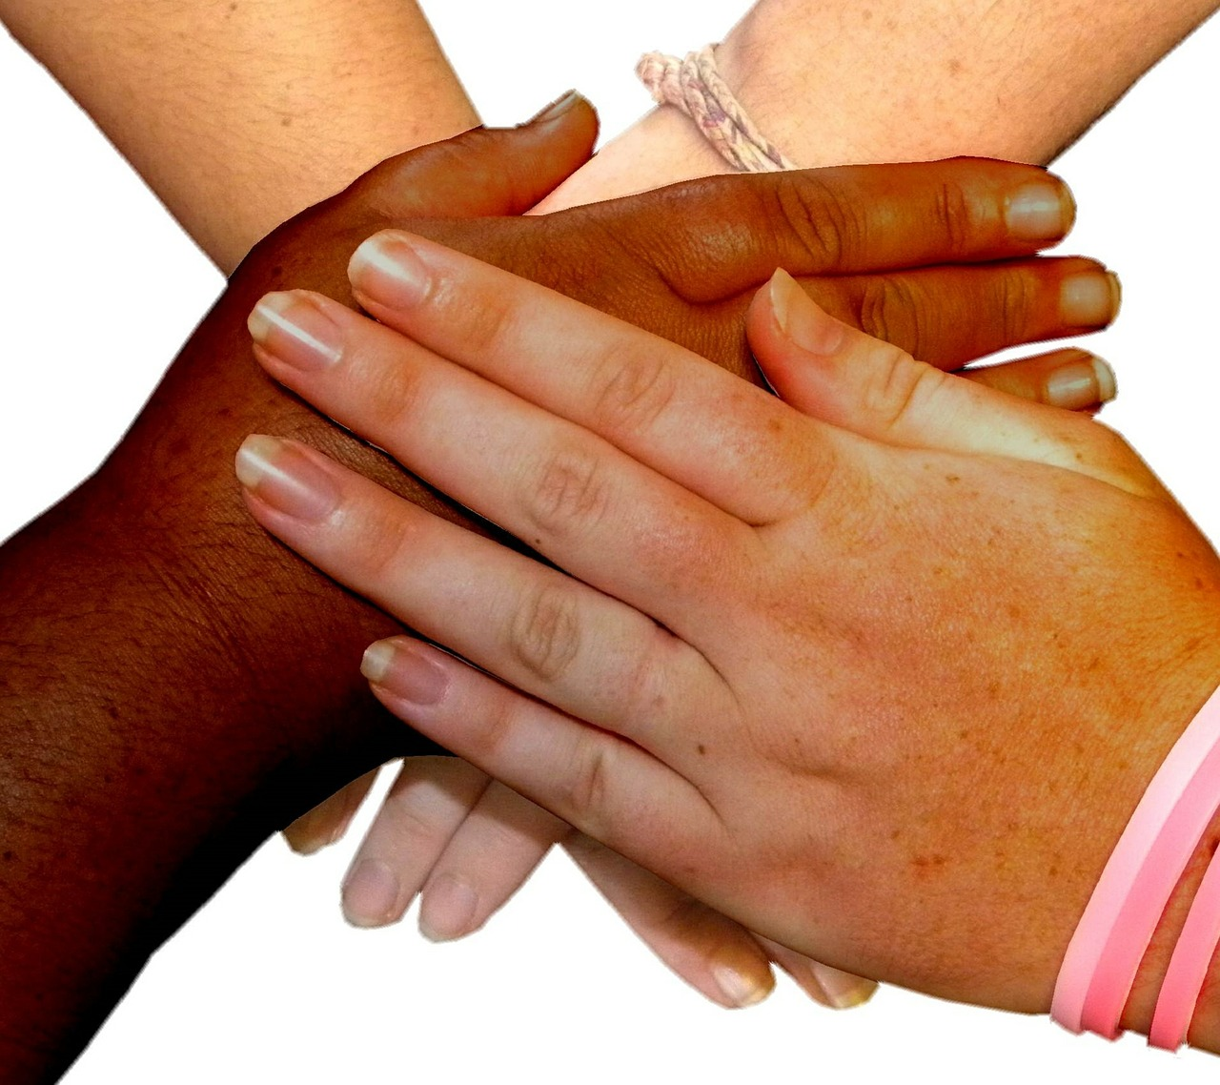
ما الصحة؟
بدنية
ذهنية
نفسية
اجتماعية
Notes:
Overview: Your workbook contains the World Health Organization’s broader definition of health on page 10 (According to the World Health Organization, “health is a dynamic state of complete physical, mental, spiritual, and social well-being and not merely the absence of disease or infirmity.”). Ask someone to read it and do a quick yes or no poll of whether they agree.
Facilitator Tip: Restate that their manual is truly a WORKBOOK, and you will assume that they will have done their homework before class, and that the materials reviewed in class will not repeat information but will build upon it. This is the only class that you will be presenting the information that is directly in the workbook. Reinforcing this ideal will make the facilitating role easier and a lot more fun. You will be able to creatively enhance the training materials via the Deep Dive, Digital Library, Resource Library, and with guest speakers.
Source: United States Public Health 101, slideshow presentation, November 2013

Slide 22
ما الذي يحدد الحالة الصحية؟
Notes:
Overview: There is a common misconception that the real reasons we are unhealthy are due to genetics and individuals making poor decisions about their health, including things like what they eat, how much they exercise, and whether or not they smoke.

Slide 23
مقطع فيديو
ماذا لو أبقانا نظامنا للرعاية الصحية أصحاء؟
Notes:
Overview: This video connects healthcare systems to the SEM and the social determinants in a way that is easy to understand.
https://www.ted.com/talks/rebecca_onie_what_if_our_healthcare_system_kept_us_healthy

Slide 24
التفاوت الصحي مقابل العدالة الصحية
التفاوت الصحي
اختلافات في النتائج الصحية بين أفراد المجموعة
عادةً ما تكون بسبب الاختلاف الوراثي
العدالة الصحية
كافة الفئات السكانية تتمتع بنفس المستوى من الرعية الصحية
ليس للأوضاع الاجتماعية أو المالية للسكان تأثير إيجابي أو سلبي على صحتهم
Notes:
Overview: Explain the difference between health equity and health disparity, which is “…a particular type of health difference that is closely linked with economic, social, or environmental disadvantage.”
Source: Healthy People 2020, Office of Disease Prevention and Health Promotion, Department of Health and Human Services.

Slide 25
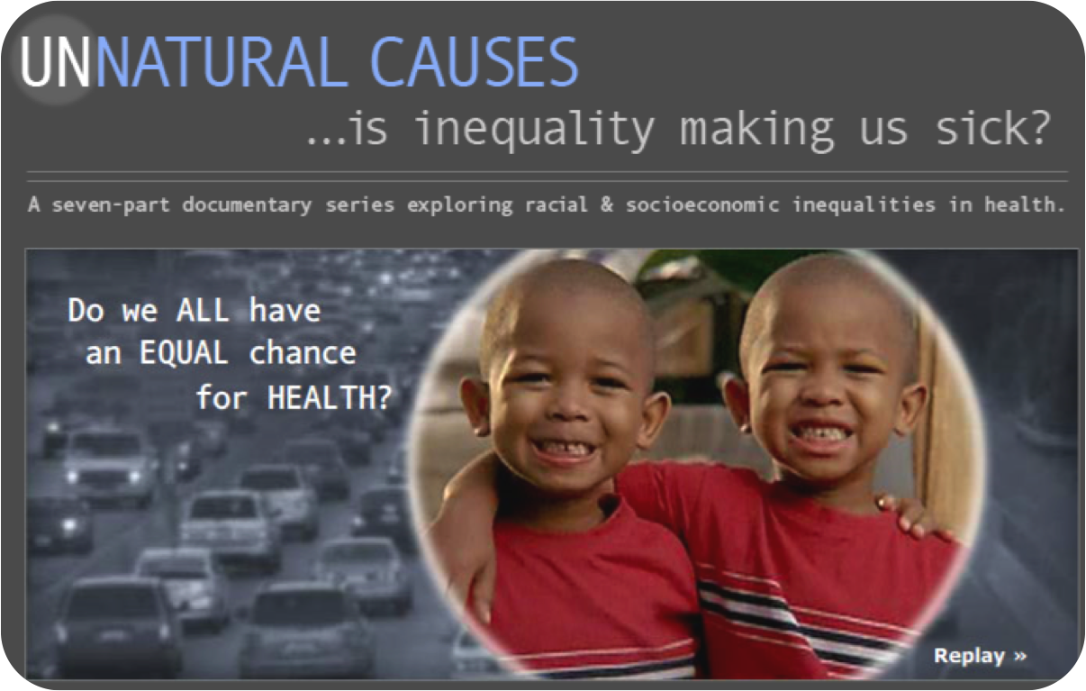
فيديو كليب
أسباب غير طبيعية: التوائم
Notes:
Overview: This video series provides a great example of health determinants and health disparities. We will watch a clip now.
http://www.unnaturalcauses.org/?replay=true

Slide 26
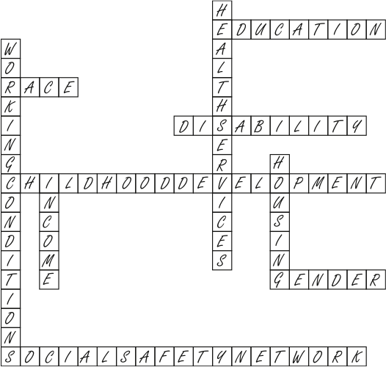
المحددات الاجتماعية
Notes:
Overview: Direct the group to the definition of social determinants on page 7 of their workbook. Here is the very long and technical version from the Centers for Disease Control and Prevention (CDC), the federal agency that is tasked to protect and promote the nation’s health:
“The complex, integrated, and overlapping social structures and economic systems that are responsible for most health inequities. These social structures and economic systems include the social environment, physical environment, health services, and structural and societal factors. Social determinants of health are shaped by the distribution of money, power, and resources throughout local communities, nations, and the world.”
Group Discussion: Work with the group to break this down into laymen’s terms that make sense to them.
Facilitator Tip: Reinforce that this is new information and throughout the training they will learn to break down complex topics in order to apply practical solutions.

Slide 27
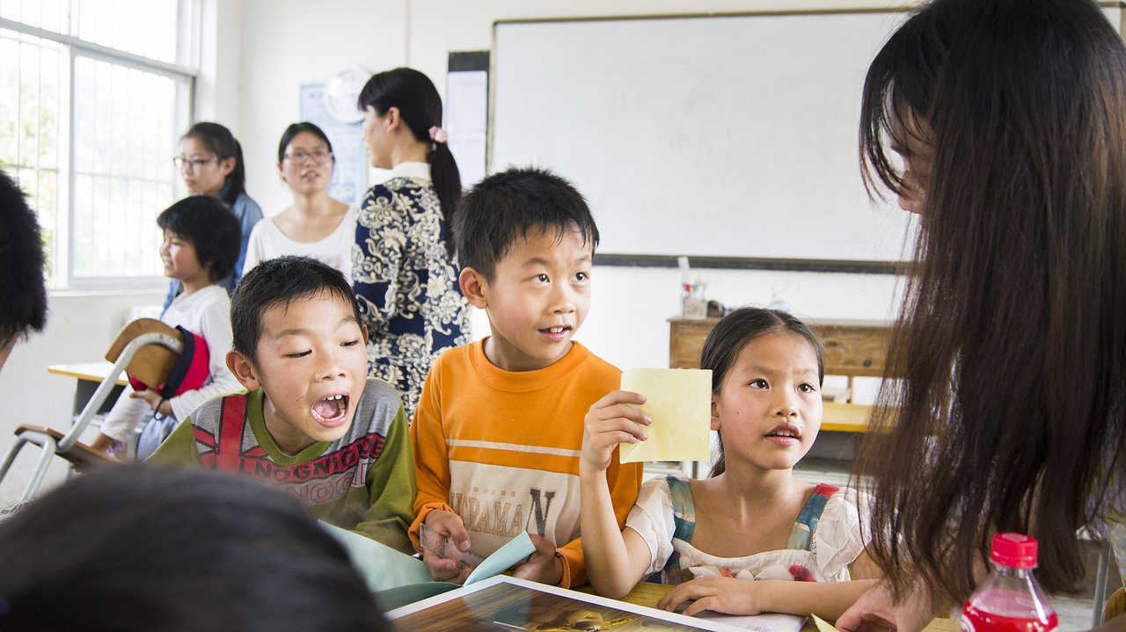


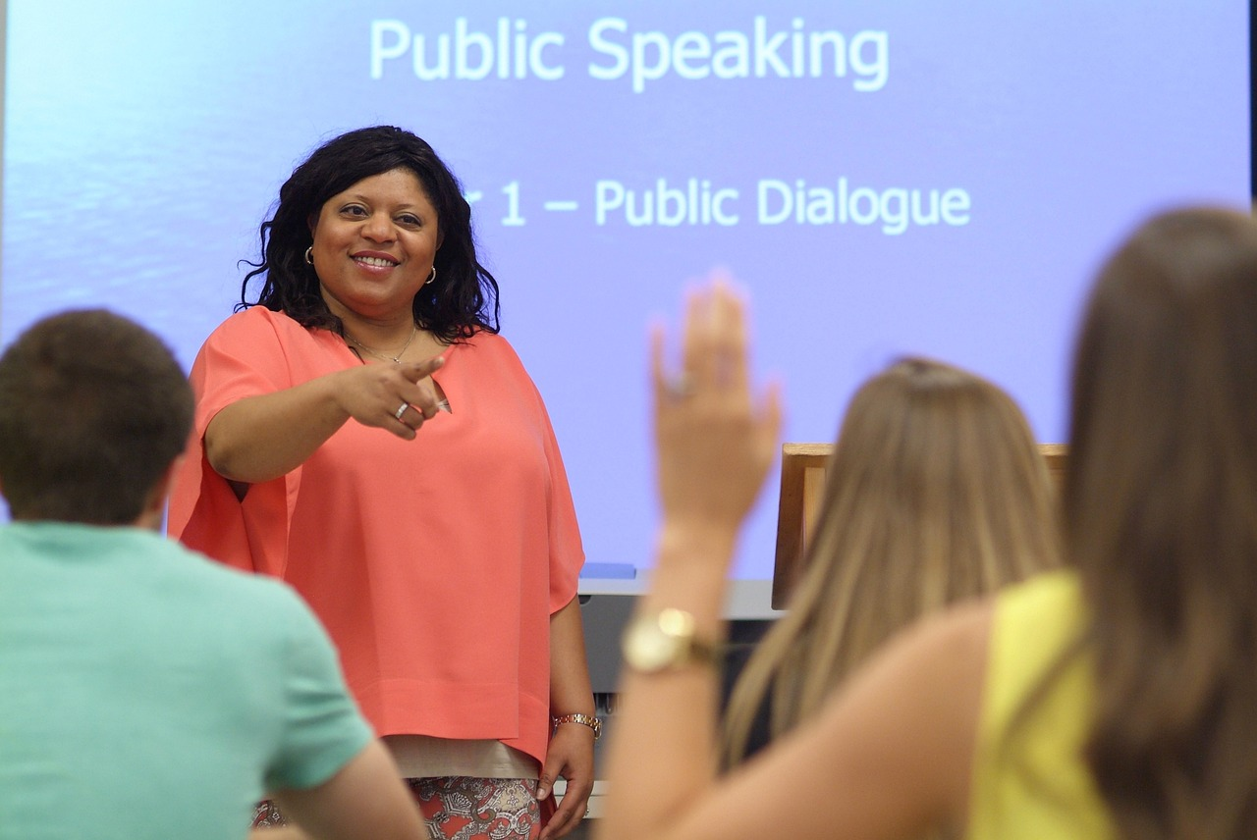



التعليم
المحدد الاجتماعي | الأثر
Notes:
Group Discussion: Why is education a social determinant?
There are many answers but a few include: impacts earning potential, broadens employment options, and increases health literacy (ability to understand your health issues and treatment options).
Facilitator Tip: There are a wide variety of possible answers for social determinants. Pay attention to your time on these slides. There are so many possibilities. When you get a good variety of answers move on.

Slide 28
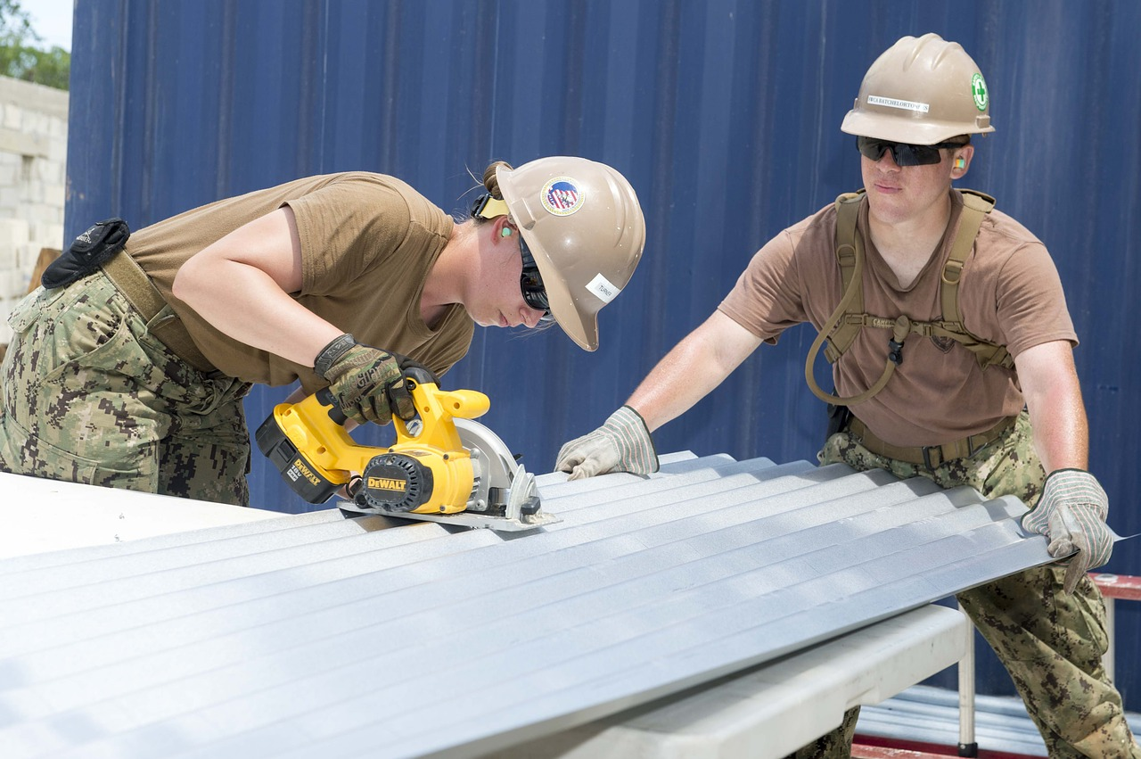
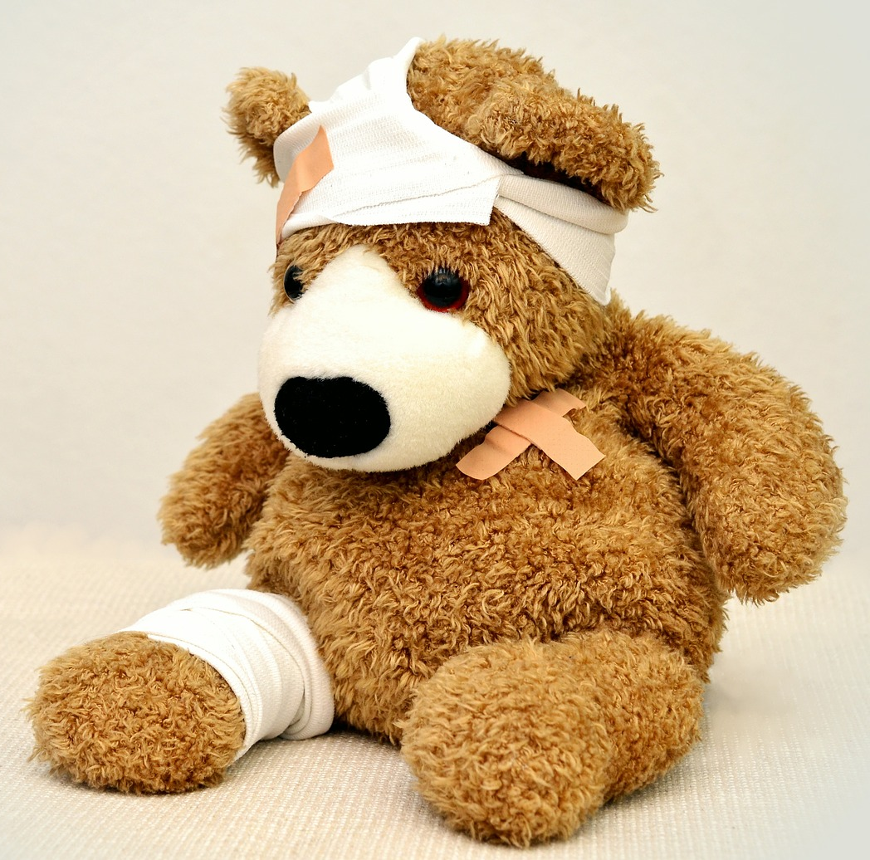
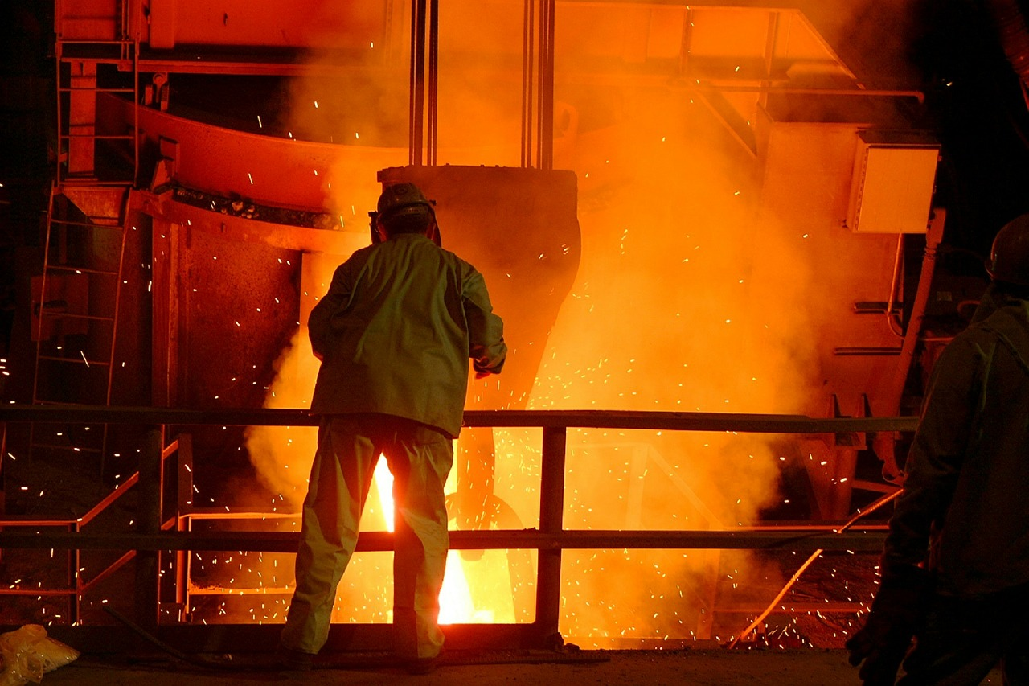
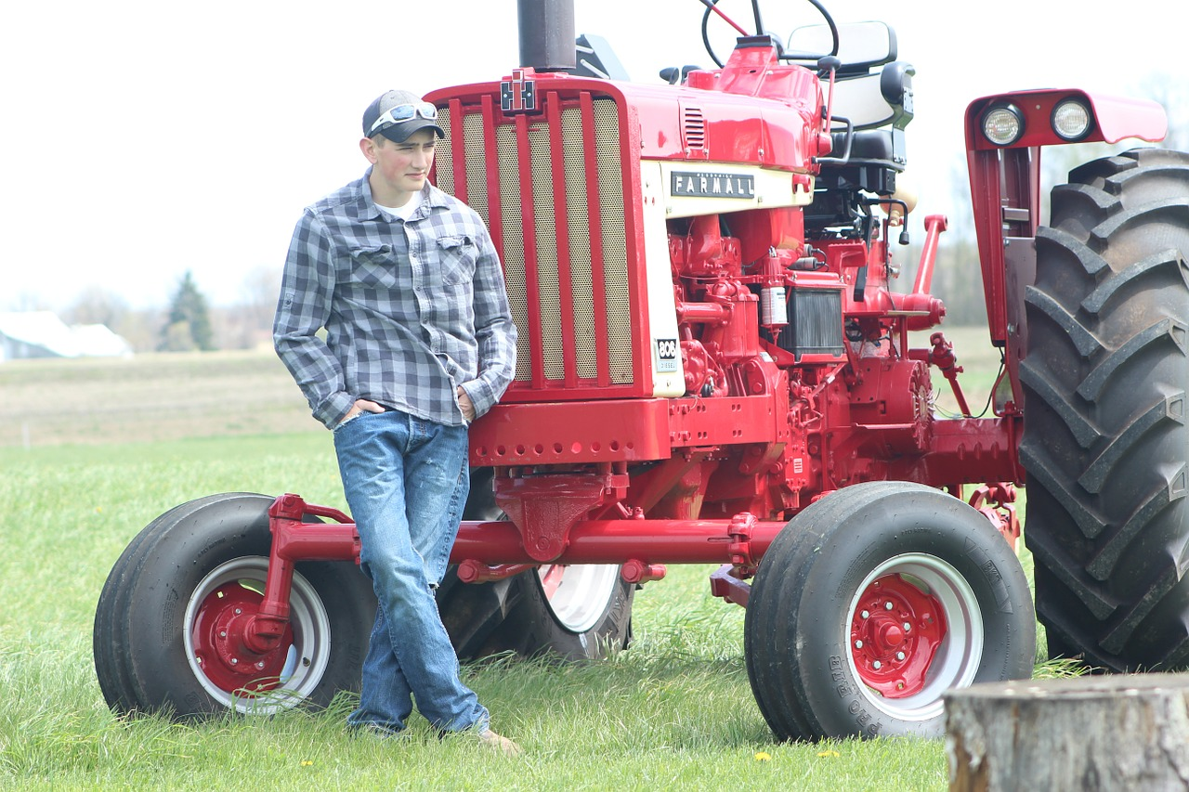
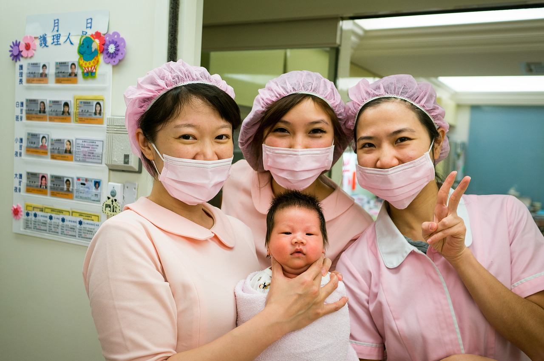

الوظيفة
المحدد الاجتماعي | الأثر
Notes:
Group Discussion: Why is employment a social determinant?
Possible answers include: hazardous work environments, provision of healthcare, and employee wellness programs.

Slide 29


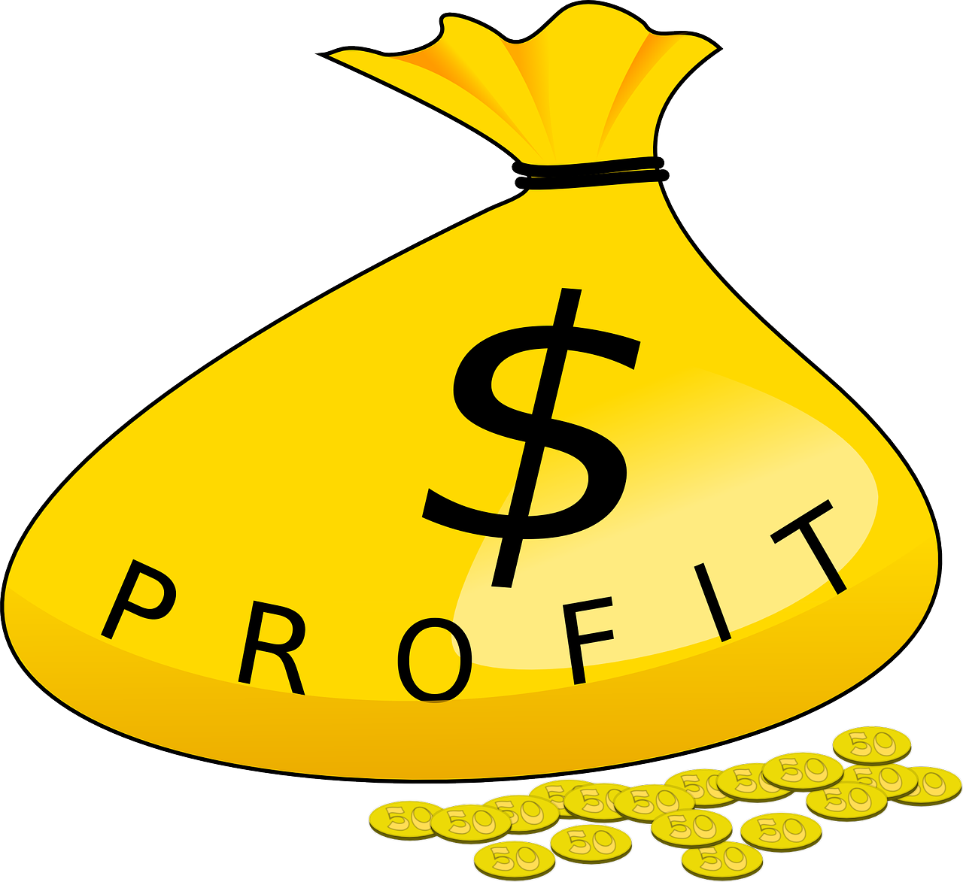
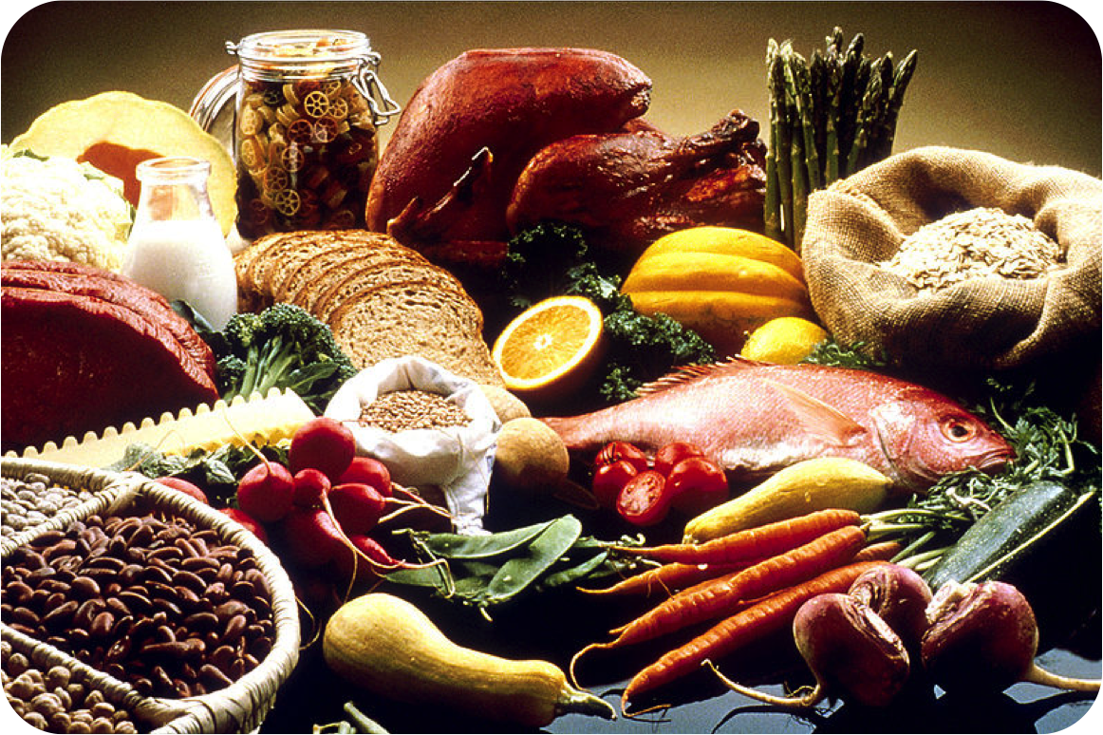

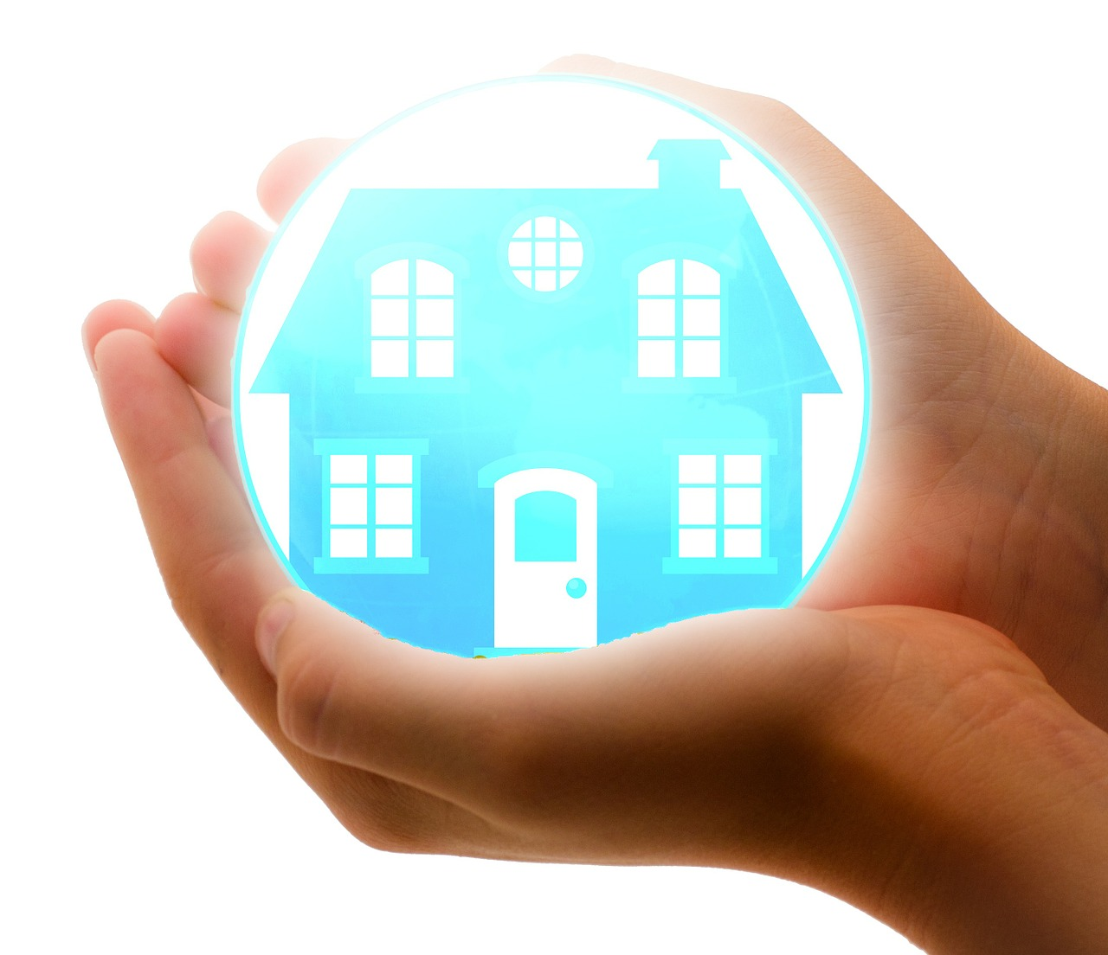
الدخل
المحدد الاجتماعي | الأثر
Notes:
Group Discussion: How is income a social determinant?
Possible answers include: healthy food, living in a clean and safe neighborhood, the ability to walk and play outside, and that poor neighborhoods may have more industry that causes pollution.

Slide 30





الرعاية الصحية
المحدد الاجتماعي | الأثر
Notes:
Group Discussion: Why is having healthcare a social determinant?
Possible answers include: access to preventive care, health screening to provide early detection of disease, and health insurance protects your incomes and assets in the case of a major illness or injury.

Slide 31



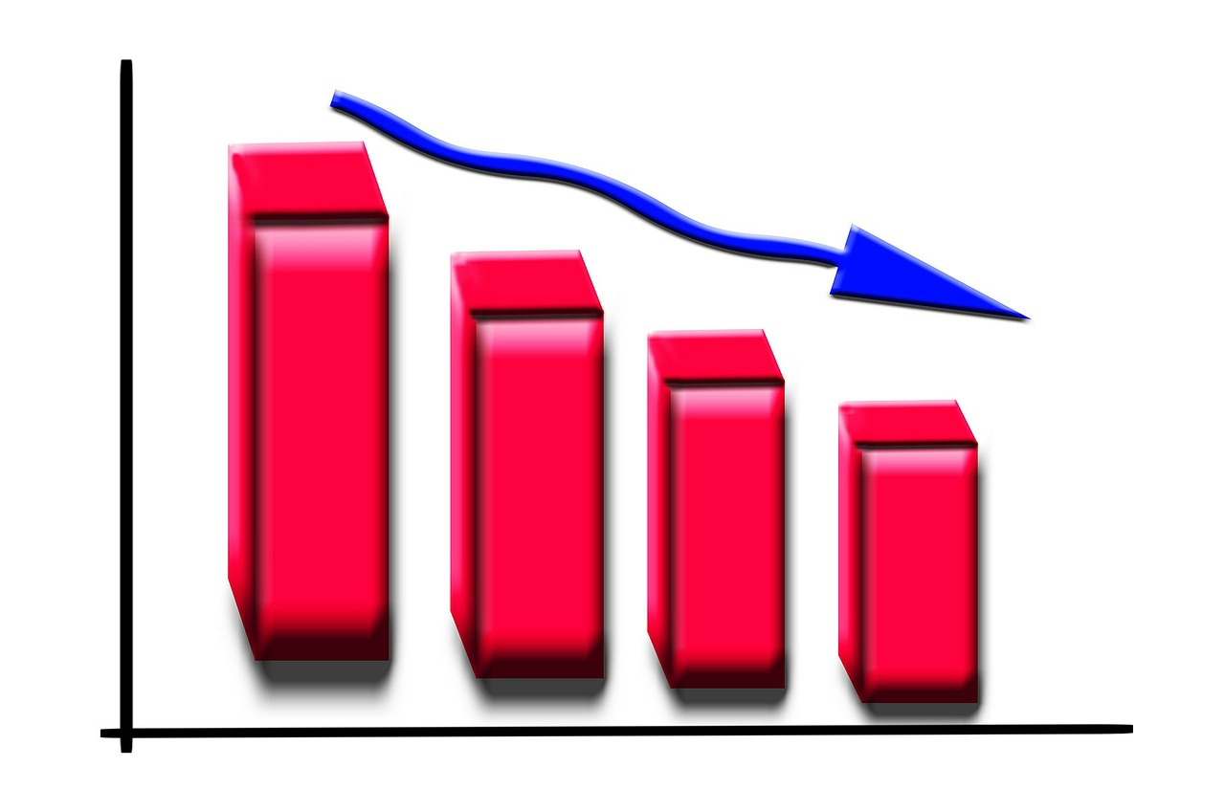
الاضطهاد والتمييز
المحدد الاجتماعي | الأثر
Notes:
Group discussion: How is oppression and discrimination a social determinant?
Possible answers include: hiring discrimination, lower salaries, and bias by medical professionals.
Photo Sources:
Top right image http://glutendude.com/celiac/celiac-discrimination/
Bottom right image: http://www.sipherdburkelaw.com

Slide 32
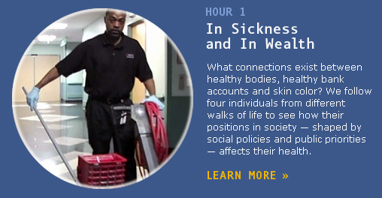
مقطع فيديو
أسباب غير طبيعية: في المرض وفي الصحة
Notes:
Overview: In this video clip, the lives of a CEO, a lab supervisor, a janitor, and an unemployed mother illustrate how class shapes opportunities for good health. Those on the top have the greatest access to power, resources, and opportunity – and thus the best health. Those on the bottom are faced with more stressors – unpaid bills, jobs that do not pay enough, unsafe living conditions, exposure to environmental hazards, lack of control over work and schedule, and worries over children – and the fewest resources available to help them cope.
DVD: Unnatural Causes: In Sickness and in Health

Slide 33
استراحة
Notes:
Facilitator Tip: Use this time for a break. Give participants a five to ten minute break depending on the needs of the group and the length of the meeting. Use the resources in the Digital Library to choose one stretch for your group. Modify the stretches if necessary and participation is optional.

Slide 34

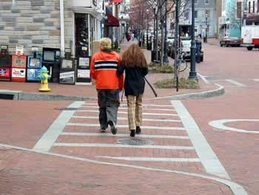
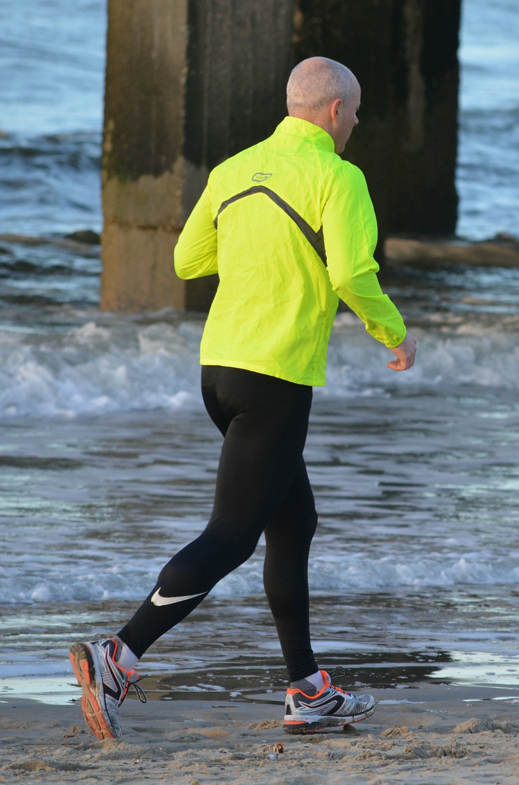

أهداف أكاديمية قادة المجتمع:
تغيير أحد الأشياء أو الظروف في الحي أو المجتمع و/أو البيئة والتي تتسبب في سوء الحالة الصحية وانتشار الأمراض
النهوض بمجتمعنا
تسهيل الأمر على الأفراد لتحقيق النجاح بتطبيق سلوكيات وتصرفات يترتب عليها صحة أفضل
  المشي
  ركوب الدرجات الهوائية
  تناول الأطعمة الصحية
Notes:
Overview: State the goals of the Resident Leadership Academy (RLA).

Slide 35
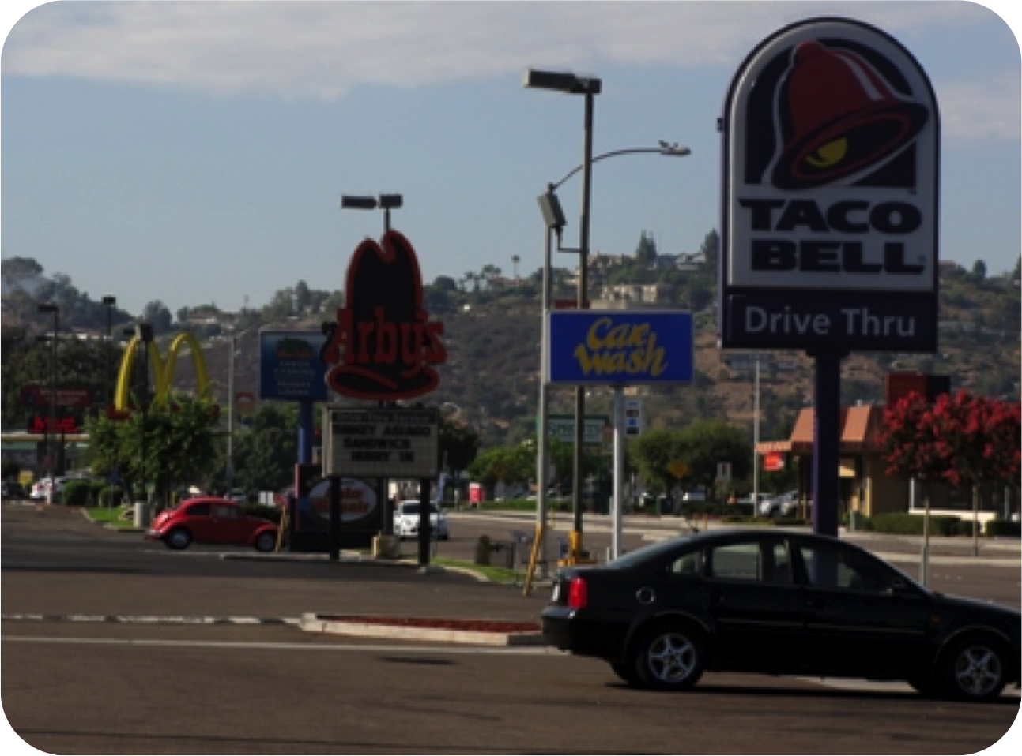


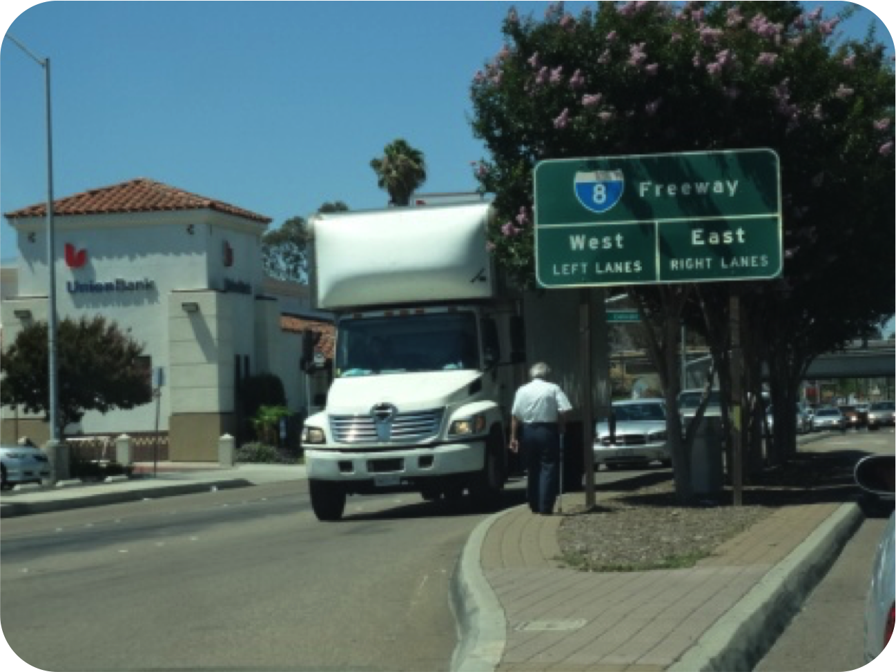
نموذج )أ (مقابل نموذج )ب(
نموذج )أ(
Notes:
Overview: Direct the participants to Model A and Model B on page 12 of their workbook looking at Model A first. The goal is for them to begin to incorporate what they are learning.
Quick poll: Do you think the residents in Neighborhood/Model A are generally healthy or unhealthy?

Slide 36
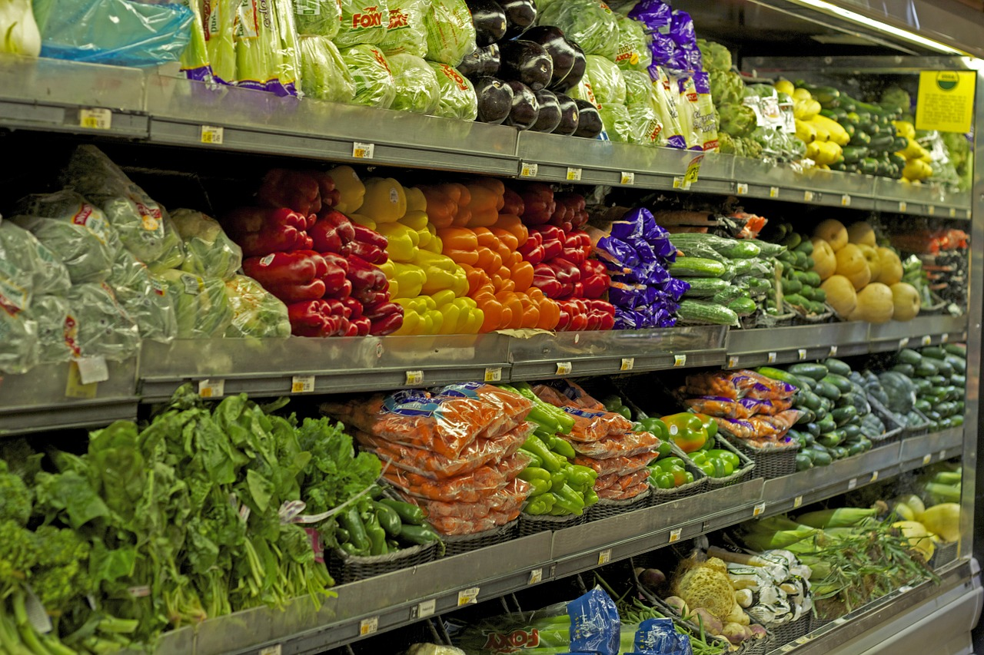
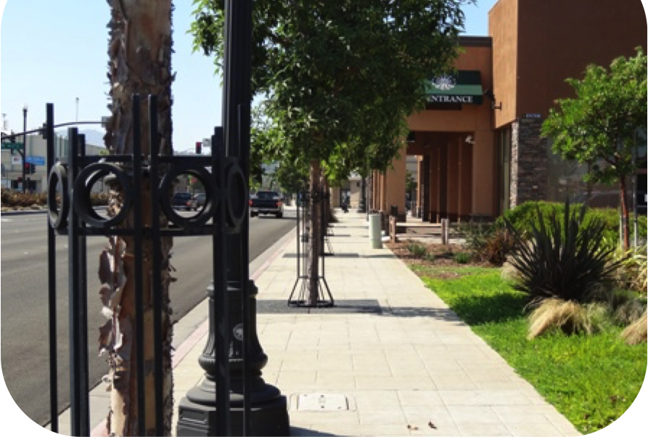
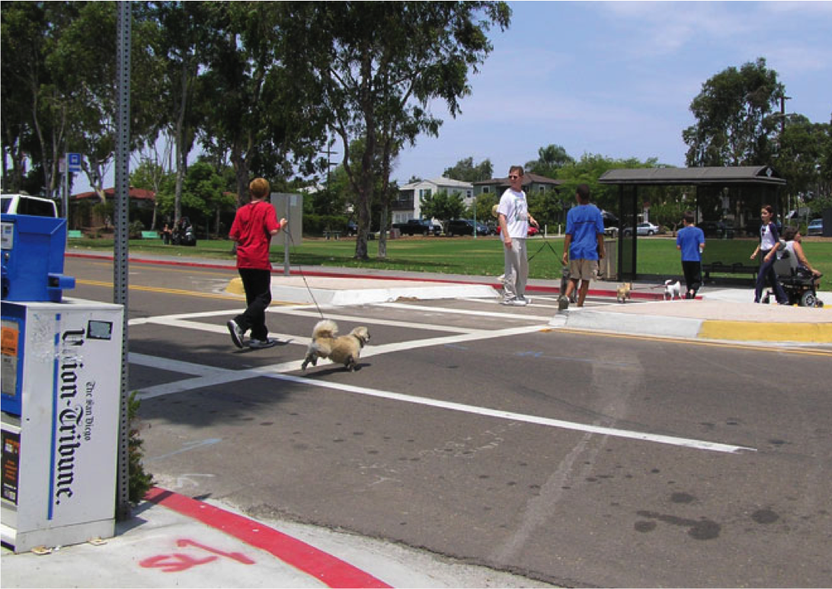

نموذج )أ( مقابل نموذج )ب(
نموذج )ب(
Notes:
Overview: Direct the participants to Model B on page 12.
Quick poll: Do you think the residents in Neighborhood/Model B are generally healthy or unhealthy?
We do not know the answer for sure but we can make some fair assumptions based on what we have learned.

Slide 37

نشاط
الإرشادات:
انضم إلى مجموعات صغيرة
أجب عن ثلاثة أسئلة
  أيّ من عناصر النموذج )أ( تتلاءم مع منطقتك السكنية؟
  أيّ من عناصر النموذج )ب( تتلاءم مع منطقتك السكنية؟
  أيّ من العناصر تتناسب مع النموذج )ب( و ترغب في الحصول عليها في منطقتك السكنية؟
Notes:
Overview: Direct the participants to answer the questions on the slide in small groups.
Facilitator Tip: Ask the group to think in terms of the social determinants of health; the conditions in which people are born, grow, live, work and age.
Source: World Health Organization

Slide 38
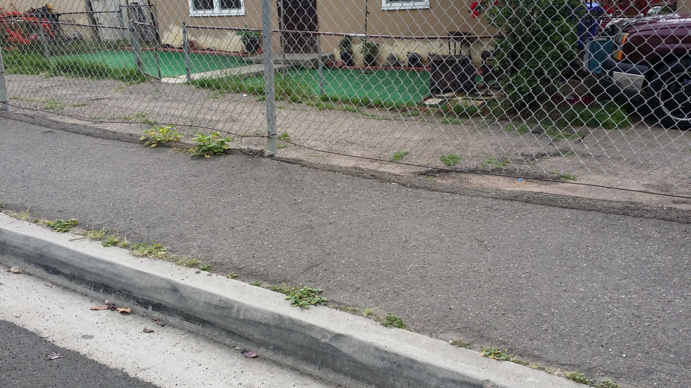
نجاح أكاديمية الريادة السكانية! الشباب يحقق تغييرات إيجابية في جنوب شرق سان دييغو
بعد
قبل
Notes:
Overview: Another successful RLA in National City.
Activity: Ask the participants to answer the questions in their workbook on page 16.

Slide 39
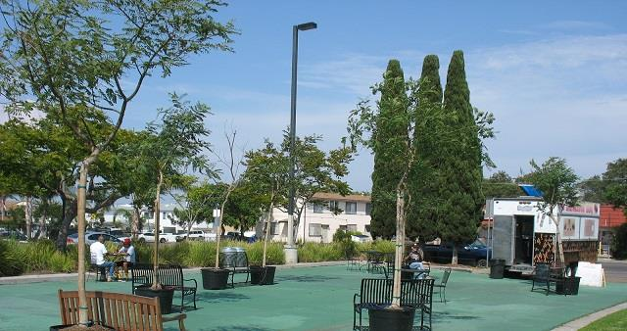
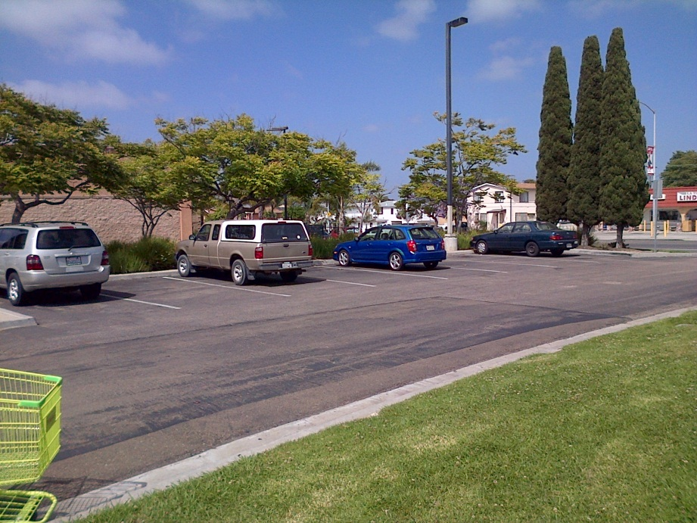
نجاح أكاديمية الريادة السكانية! ليندا بلاسيتا
بعد
قبل
Notes:
Overview: Here is an example of a successful RLA with a youth led group who implemented a photo voice project to create a more walking friendly, or walkable, neighborhood.
Activity: Ask the participants to answer the questions in their workbook on page 14.

Slide 40
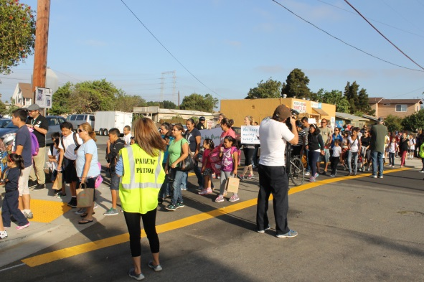
نجاح أكاديمية قادة المجتمع ! طريق آمن مؤدي إلى أماكن صحية
Notes:
Overview: Linda Placita is the result of a successful CIP completed by RLA participants in Linda Vista with Bayside Community Center.
Activity: Ask the participants to answer the questions in their workbook on page 15.

Slide 41
الريادة
درو دادلي– قيادة يومية
Notes:
Overview: Watch this video on leadership for some end of the night motivation! Drew Dudley calls on all of us to celebrate leadership as the everyday act of improving each other’s lives.
https://www.ted.com/talks/drew_dudley_everyday_leadership

Slide 42
الخاتمة
الواجب المنزلي
مراجعة القسم الأول
قراءة القسم 2.1 دعم الصحة: يوميًا بكل الطرق
إتمام جميع أنشطة كراس التمارين
الأسئلة؟
التعليقات؟
المخاوف؟
Notes:
Overview: Revisit the idea that the workbook will be their best friend throughout this process. The more they use it the better their experience will be! Let them know that if they want more information on social determinants, you have got a load of resources to share!

Slide 43


"هذا المنهج حاصل على دعم الاتفاقية التعاونية رقم DP005528-01، وتم تمويله من قِبل مراكز مكافحة الأمراض والوقاية منها، من خلال هيئة الخدمات الصحية والإنسانية في مقاطعة سان دييغو. ويتحمل المؤلفون المسؤولية كاملة عن محتوياته، والتي لا تعبر بالضرورة عن الآراء الرسمية لمراكز مكافحة الأمراض والوقاية منها أو إدارة الخدمات الصحية والإنسانية".

