Slide 1
القسم الثاني: الستراتيجيات
تعزيز الصحة: يوميًا بكل الطرق
Notes:
Overview: Welcome to our next session.

Slide 2
الأجندة
القسم الثاني: تعزيز الصحة: يوميًا بكل الطرق
تهيئة/مراجعة
الأنظمة الصحية
المنزل والأحياء السكنية
مكان العمل
السوق التجاري
الخاتمة
الاستفادة من الخدمة الصحية
الاستفادة من الخدمة الصحية
Notes:
Overview: Brief review of agenda.

Slide 3


تهيئة
مشاركة أساليبنا القيادية
ماذا كانت نتيجتك وهل تناسبك؟
كيف يبدو أسلوبك في الحفلات؟
كيف يبدو أسلوبك في الأزمات أو الخلافات؟
Notes:
Overview: This is a fun, non-scientific activity to get participants thinking about their own leadership and communication styles, to get to know one another, and to begin to learn how they will work together as a team using the variety of natural strengths in the group.
Activity:
Before class print out the shape descriptions in the Ice Breaker section of the Digital Library.
Ask the participants to pick the first shape they are attracted to then get into groups with other participants who picked the same shape.
Read the description of each shape out loud to the entire group. You can find the descriptions in the Ice Breaker section of your Digital Library.
Then have the groups discuss the questions on the slide.
After about ten minutes mix up the groups so that they are in “mixed-shape” groups and have them discuss the same questions.
After about ten minutes bring the entire group back together and ask for a volunteers to talk about their observations.

Slide 4

مراجعة القسم الأول
ماذا تعلمنا في القسم الأول؟
المحددات الاجتماعية
العدالة الصحية
التفاوتات الصحية
مشروع تحسين المجتمع
Notes:
Overview: Time for a basic review. Also ask if there were any “aha” moments since the last time you met. If appropriate, have a very brief group discussion.

Slide 5

القسم الثاني: الستراتيجيات
الأهداف التعليمية:
معرفة محددات الصحة وكيف تؤثر على الصحة
معرفة التغيرات التي يمكن إحداثها في المجتمعات للارتقاء بالمستوى الصحي
Notes:
Overview: Review the learning objectives.

Slide 6
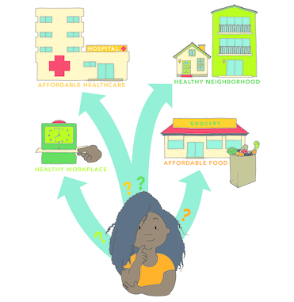
محددات الصحة
Notes:
Overview: The participants “met” Ciara in their workbook homework. Direct participants to their workbook to quickly review her story on page 23.
Group Discussion: Could you relate with Ciara? What were some of the barriers she faces in making healthy decisions? What were some of the things that supported her making healthy decisions? Ask if any participants are willing to share some of the things that challenge or support their ability to make healthy decisions.

Slide 7
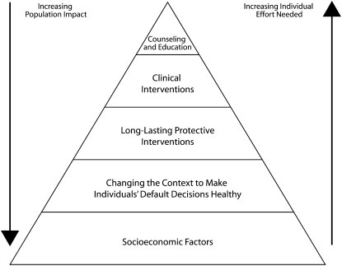
النظام الصحي
هرم الأثر الصحي
Notes:
Overview: The healthcare system is big and complex. There are many factors that impact how individuals, communities, and societies use the healthcare system. This is an opportunity to break down the health pyramid in laymen’s terms. The overall goal is to show that focusing efforts on upstream approaches such as community and policy changes are better models because they decrease the need for treatment by decreasing the incidence of chronic diseases.

Slide 8

مقطع فيديو
هل قانون إصلاح الرعاية الصحية (أوباما كير) فعال؟ قانون الرعاية الصحية يسير التكلفة بعد خمس سنوات
Notes:
Overview: The Affordable Care Act (ACA) is a government policy that attempts to make our complex and expensive healthcare system more accessible and easier to manage for all Americans.
https://www.youtube.com/watch?v=wMuXcuudvCc

Slide 9

استراحة
Notes:
Facilitator Tip: Use this time for a break. Give participants a five to ten minute break depending on the needs of the group and the length of the meeting. Use the resources in the Digital Library to choose one stretch for your group.

Slide 10

قصة سيارا
Notes:
Overview: Revisit Ciara and talk about the group’s answers about her health determinants in the workbook.

Slide 11
النشاط
الإرشادات:
Fill in the boxes below with your answers.
الاستفادة من الرعاية الصحية
الحصول على الفرص الاقتصادية
الحصول على أطعمة صحية
Notes:
Group Discussion: Ask for a few participants to share their answers.
Facilitator Tip: This was an activity in the reading assignment from last week. If they did not complete it let them know that you will revisit these workbook activities in class.

Slide 12

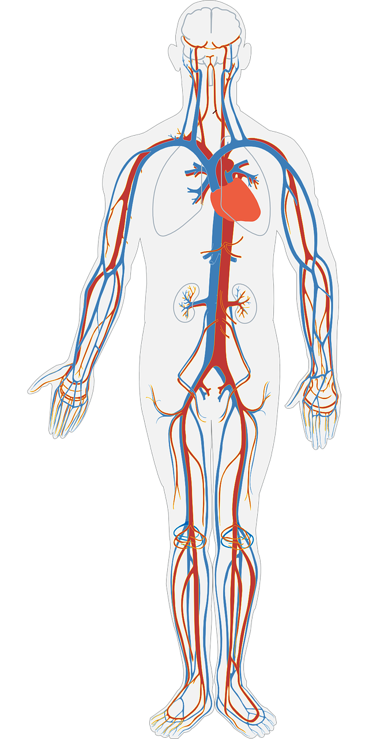

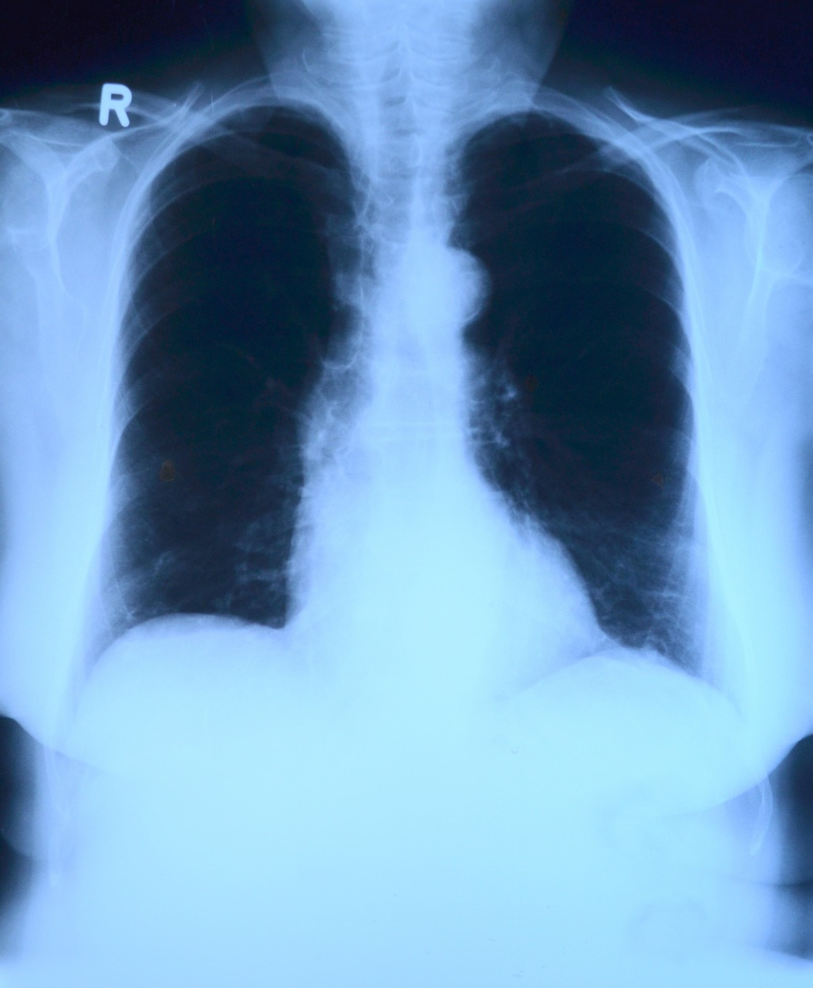

محدد الصحة
النظام الصحي
Notes:
Overview: At this point the trainings will shift to strategies rather than a review of the reading. Help guide the group in thinking about their own neighborhood and keeping them at the community rather than individual level.
Group Discussion: Thinking about the SEM, what are some community level strategies for increasing community access to healthcare?
Some answers may include bringing screenings into the community, putting together a list of preventive classes and services that are already in the neighborhood, and pairing people together (in particular seniors and those with disabilities, a chronic health issue(s), or an emerging health issue) to attend doctor appointments.
Facilitator Tip: This may be an opportunity to have a quest speaker from a local health clinic to talk about how to enroll people in their neighborhoods in ACA and offer links to free services. Also a good opportunity to briefly mention the concept of patient advocacy (individuals taking control of how they receive healthcare services) and remind people about further information in the Deep Dive.

Slide 13
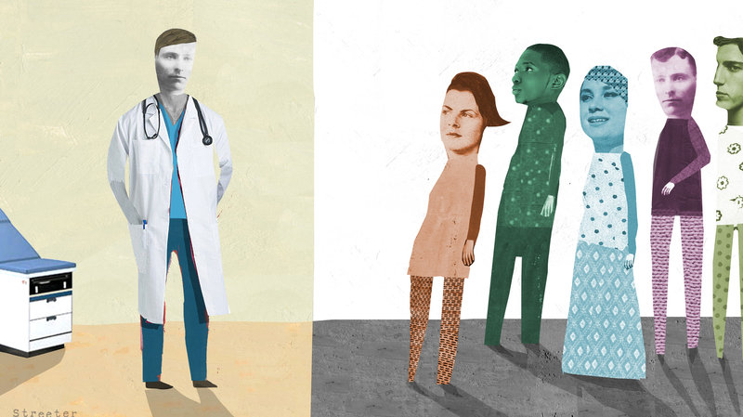
نشرة صوتية
هل يمكن علاج الصحة من التحيز العنصري؟
Notes:
Overview: This connects access to healthcare with oppression and discrimination as a social determinant.
http://www.npr.org/sections/health-shots/2015/08/20/ 432872330/can-health-care-be-cured-of-racial-bias?sc=tw

Slide 14
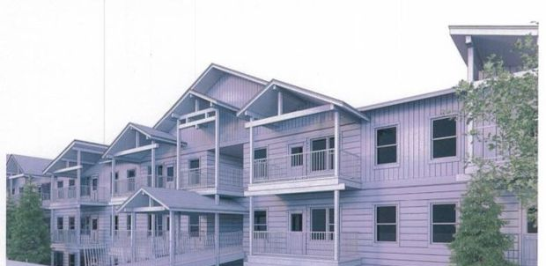


محددات الصحة
المنزل ومنطقة السكن
Notes:
Group Discussion: Thinking about the SEM, what are some community level strategies for increasing health in homes and neighborhoods?
Some possible answers include limiting exposure to mold and lead, smoke free Multiunit Housing (MUH), parks and faith organizations, and exposure to pollution through industry in neighborhood.
Facilitator Tip: The next slides include group discussion. Assess how much time you have, and adjust the discussion for each slide accordingly.
Apartment picture from: http://missoulian.com/news/local/new--unit-apartment-planned-for-former-missoula-trailer-park/article_dc291641-d6e5-5454-9e7a-1909f2cbe61c.html

Slide 15

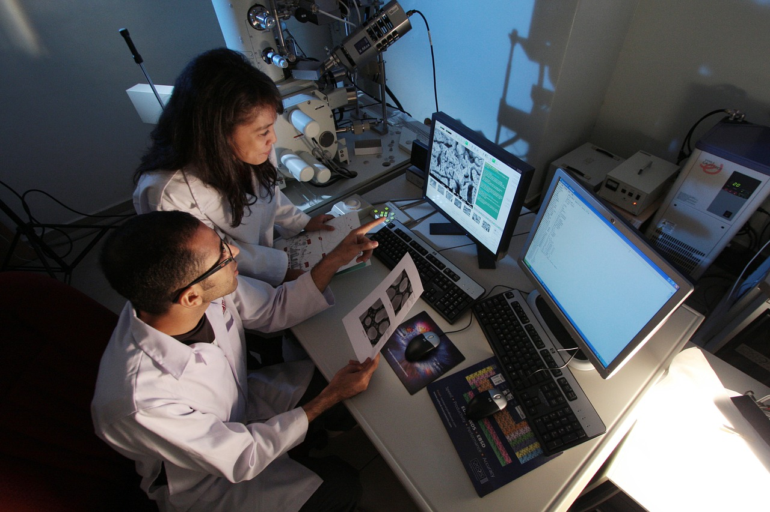
محددات الصحة
مكان العمل
Notes:
Group Discussion: Thinking about the SEM, what are some community level strategies for increasing health through workplaces?
Some possible answers include enforcement of safety standards and provision of proper protective equipment, walking meetings, providing healthy snacks and a water dispenser, and employee wellness programs.

Slide 16
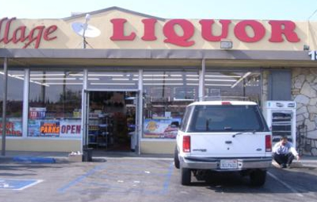
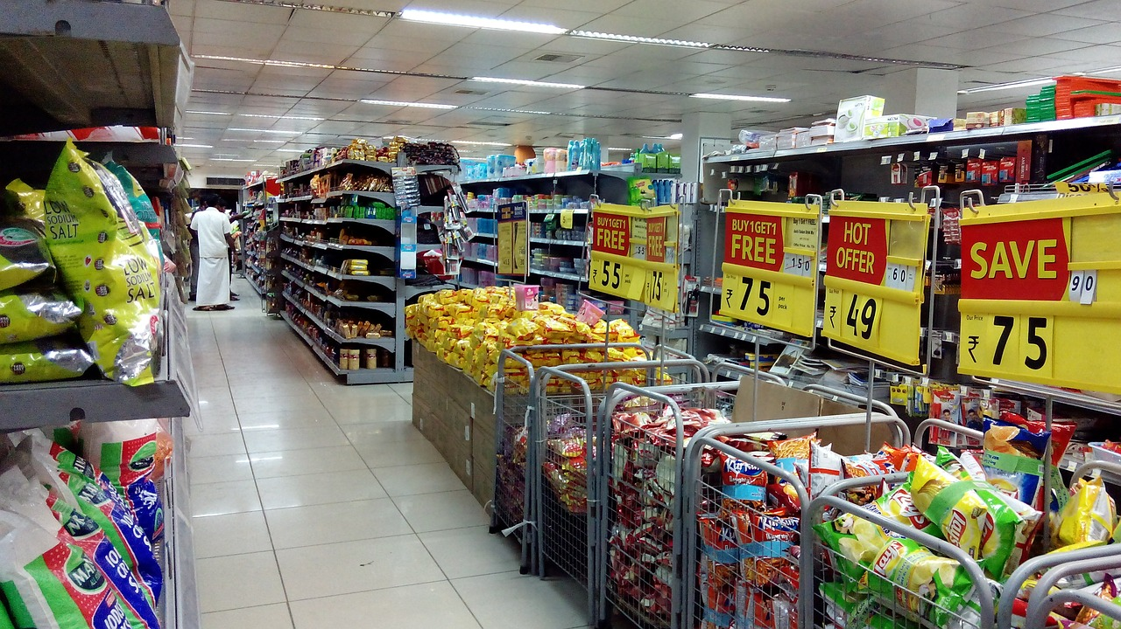


محددات الصحة
مكان العمل
Notes:
Group Discussion: Thinking about the SEM, what are some community level strategies for increasing health through the marketplace?
Some possible answers include bringing fresh food to small markets in food deserts, curbing advertisements of unhealthy food, alcohol, and cigarettes, enforcement of not selling tobacco and alcohol to minors, and tobacco retail licensing.

Slide 17
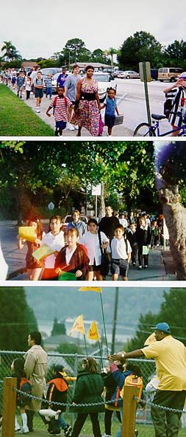
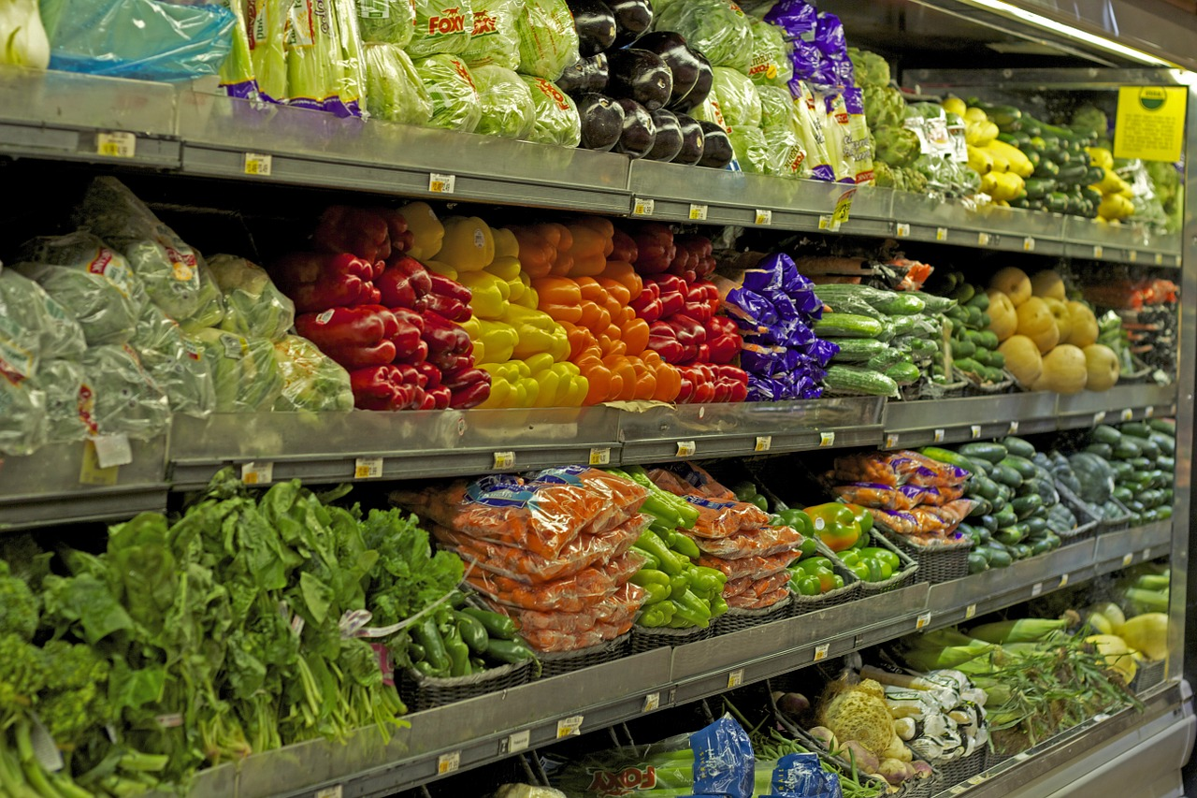
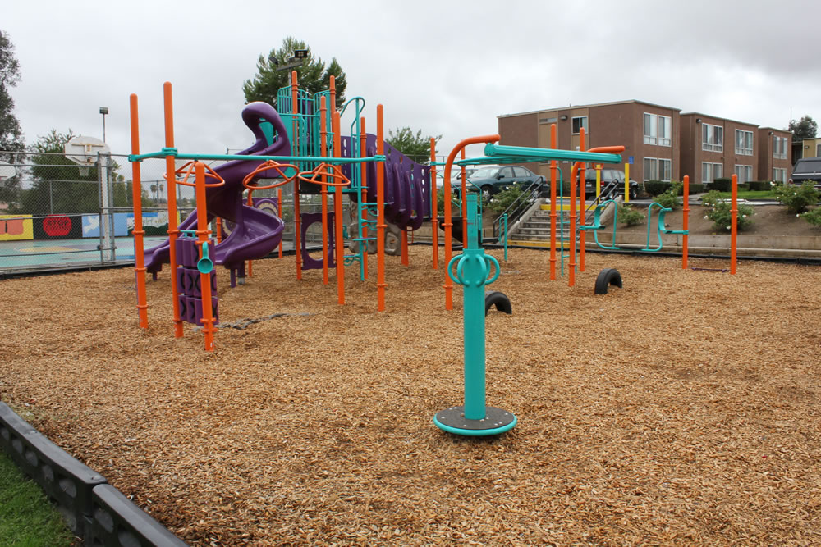
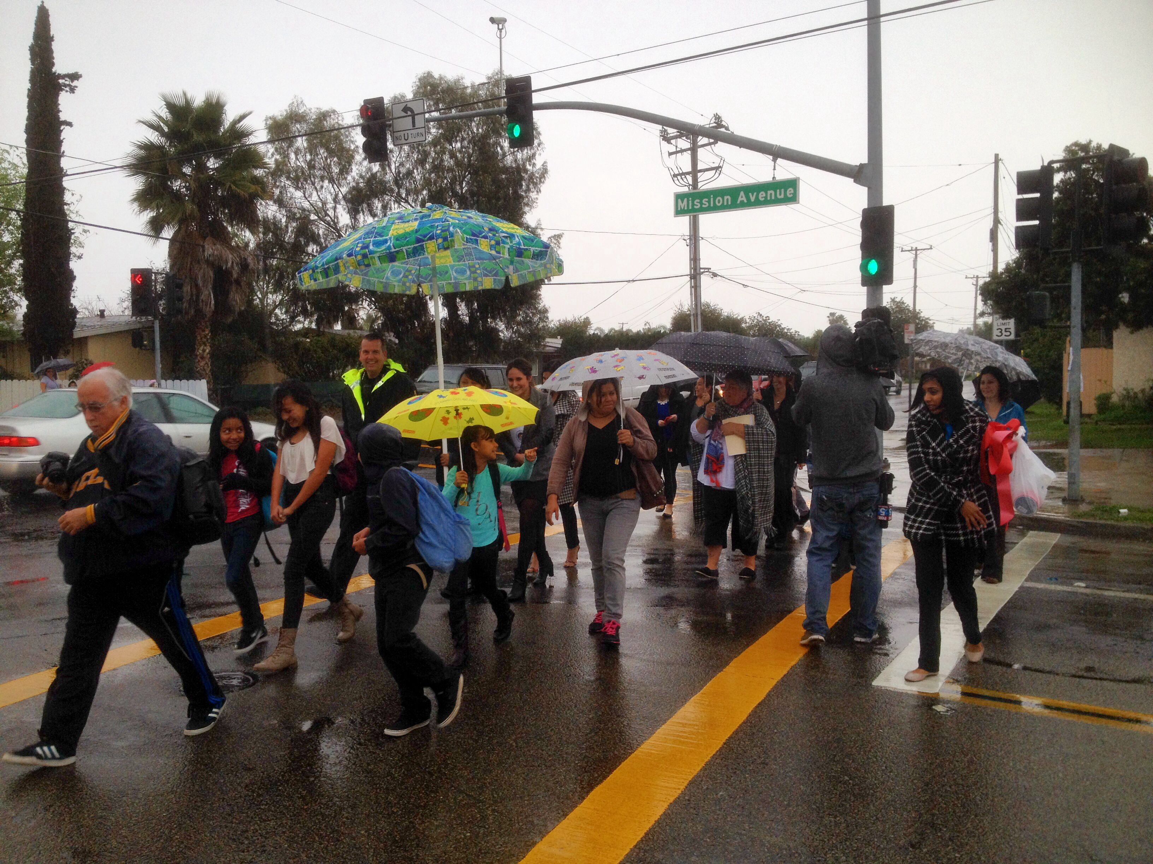
الفوائد الصحية
أماكن خلقت بيئة ملائمة للأنشطة
مع الحصول على أطعمة طازجة وصحية سيكون هناك أناس متمتعون بالصحة
Notes:
Overview: Communities that support and encourage healthy behaviors including exercise, eating right, and not smoking help residents get healthy and stay healthy.

Slide 18
سياسة حظر التدخين في PJAM
Notes:
Overview: This is a resident led success story that got tobacco out of this multiunit housing complex.
Group Discussion: What health determinants did this RLA address? What was the solution? How do you imagine the group participants made decisions about what strategy to use? What challenges did you think they faced?

Slide 19
استراتجيات حظر استخدام التبغ
تنفس براحة في المنزل
Notes:
Overview: Tobacco prevention efforts aimed at community and policy change have decreased the rate of smoking by about 50%. Even so, smoking is still the number one cause of preventable death. This video series shows lots of examples of community level changes that RLAs can think about for their own communities.
https://www.youtube.com/watch?list=PLxdDQiAI50j9 dvC6FgzlIi7dHbevdQz86&v=Cfcv6QRss_c

Slide 20
الخاتمة
الواجب المنزلي
قم بقراءة قسم 2.2 عن استعمالات الأراضي
ألق نظرة على جزءDeep Dive لتأخذ فكرة عن المعلومات الإضافية المتاحة لك
الأسئلة؟
التعليقات؟
المخاوف؟
Notes:
Overview: Answer any lingering questions and/or take the time to address issues that you think may remain unclear. Remind participants that the sections are an overview and there is more information about each topic in the Deep Dive.

Slide 21


"هذا المنهج حاصل على دعم الاتفاقية التعاونية رقم DP005528-01، وتم تمويله من قِبل مراكز مكافحة الأمراض والوقاية منها، من خلال هيئة الخدمات الصحية والإنسانية في مقاطعة سان دييغو. ويتحمل المؤلفون المسؤولية كاملة عن محتوياته، والتي لا تعبر بالضرورة عن الآراء الرسمية لمراكز مكافحة الأمراض والوقاية منها أو إدارة الخدمات الصحية والإنسانية".

