Slide 1
القسم الثاني: استعمالات الأراضي
استعمالات الأراضي
Notes:
Overview: Welcome to our next session!
Facilitator Note: An alternative for this session is to have a guest speaker come in from the planning commission or local official’s office to talk about Land Use in their community.

Slide 2
أجندة
القسم 2.2: استعمالات الأراضي
تهيئة/مراجعة
تخطيط القادم من المجتمع
منع الجريمة من خلال التصميم البيئي (CPTED)
البيئات المبنية
مجتمعات أكثر أمانًا
الخاتمة
Notes:
Overview: Brief review of agenda.

Slide 3
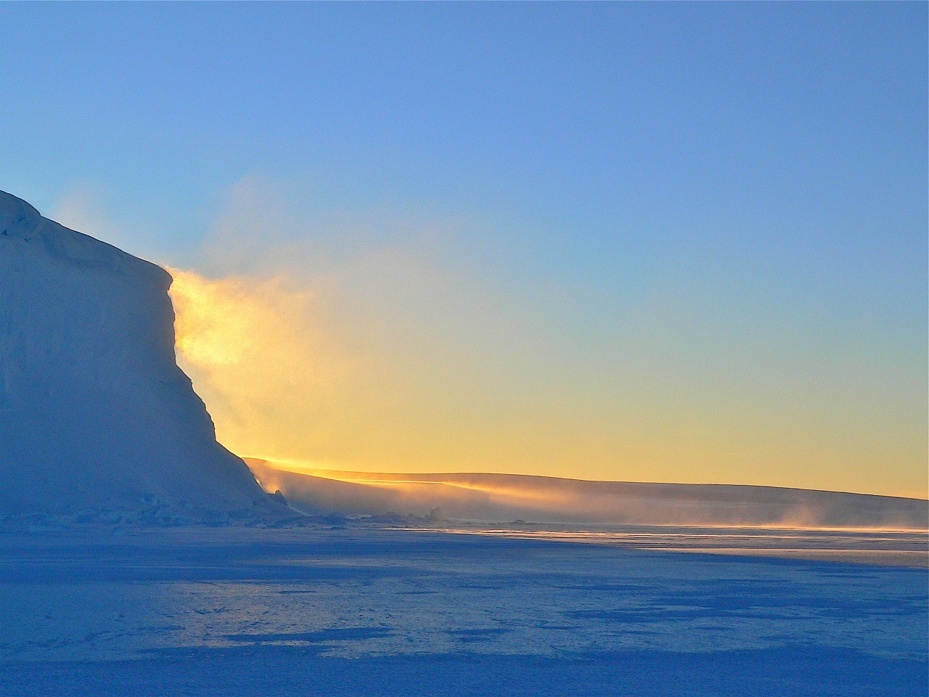
تهيئة
Notes:
Overview: Use the resources in the Digital Library to choose an icebreaker activity for your group.
Group Discussion: Did anyone have any “aha” moments this week, if the facilitator had an “aha” moment share it here.
Facilitator Tip: Choose ice breaker and other activities based on your observations of the group and community. There may be emerging ideas or areas that you can support or help develop a skill with the right icebreaker activity (found in the Ice Breaker section of your Digital Library or borrow the book, Great Group Games from the Resource Library). If you have not already done so, connect with other facilitators to share ideas, challenges, and successes.

Slide 4
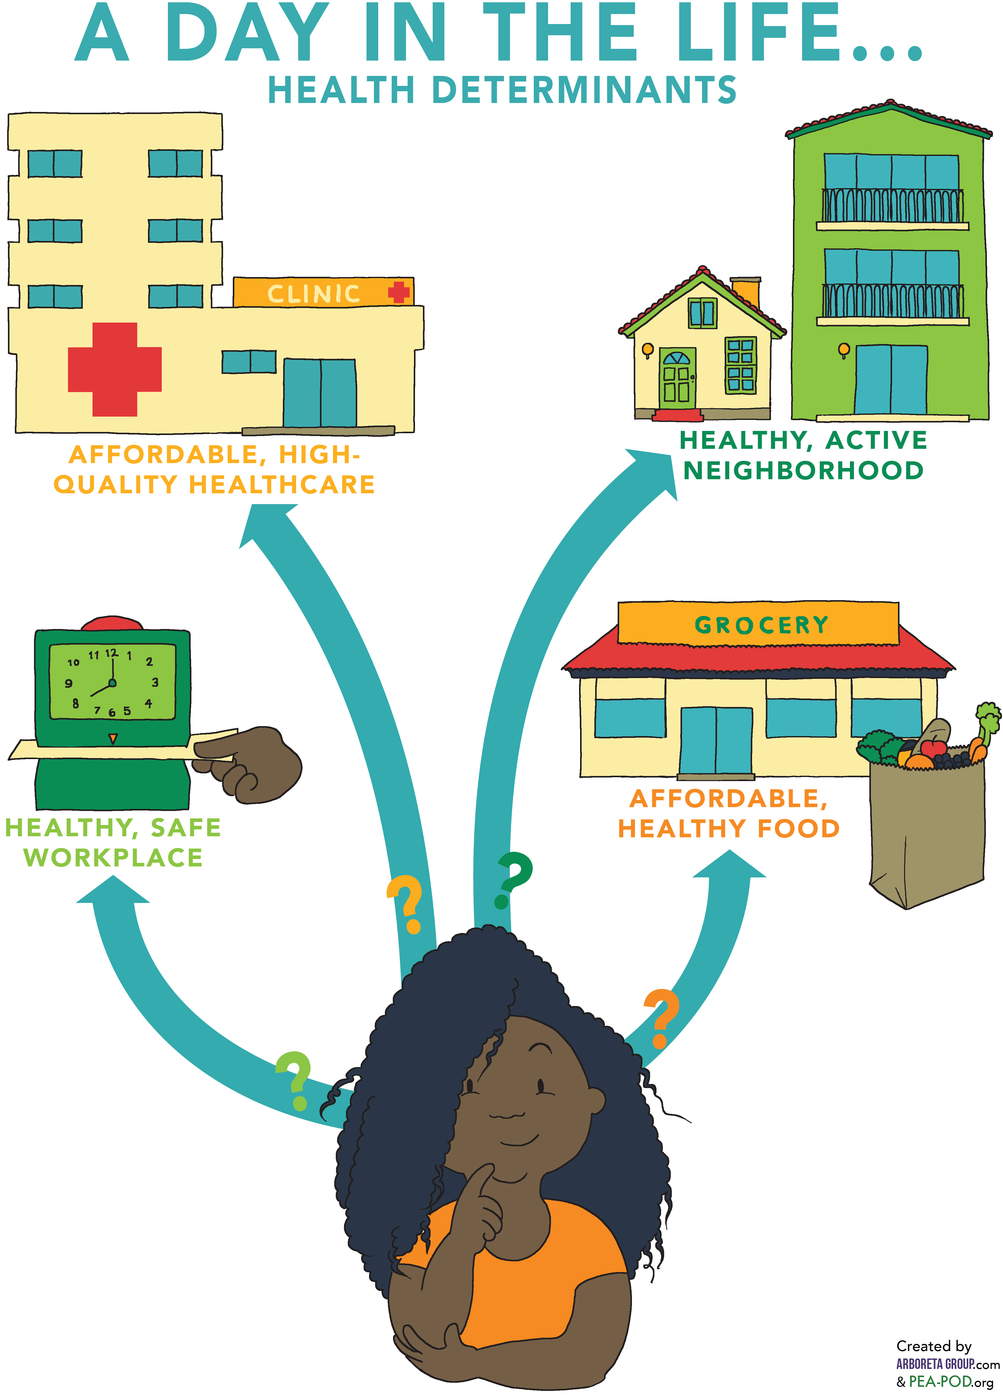
مراجعة على الاستفادة من الرعاية الصحية
ماذا تعلمنا عن الاستفادة بالرعاية الصحية؟
النظم الصحية
المنزل ومنطقة السكن
مكان العمل
السوق التجاري
Notes:
Overview: Basic review of the previous section.
Group Discussion: Check in with the group to see if they have any questions from the last session. Ask about any of the connections they may have noticed or ideas they might have had from their readings of Section 2.1 Supporting Health and Section 2.2 Land Use about how both effect their neighborhood.

Slide 5
القسم الثاني: الستراتيجيات
الأهداف التعليمية:
معرفة محددات الصحة وكيف تؤثر على الصحة.
معرفة التغييرات التي من شأنها النهوض بالصحة عند تطبيقها في المجتمعات
Notes:
Overview: We are working our way through strategies that support health on a community and society level. Give the group a reminder that they are doing high level learning about complex issues, so this is a great place to ask questions and think through challenges together.

Slide 6
نشاط
كيف اتيت إلى المحاضرة اليوم؟
لماذا؟
Notes:
Overview: Land Use and community planning are very complicated, but help make it practical for the group by using laymen's terms and by referring to further information in the Deep Dive. This activity in particular is related to Active Transportation and Land Use so it is also a preview for the next reading assignment and training session.
Group Discussion: Discuss the question above and then expand to get to the underlying reasons behind why we make the decisions we make.
For those who drove, why did you drive? Explain that, as the facilitator, you want to understand a little more about the community context, e.g., was the location too far away to walk? Is transit unreliable, too expensive, or not available in the community? Are there bike lanes and good sidewalks?
Our meeting here today is just one example of getting from place to place, how often are you able to utilize different modes of transportation? Why or why not?
Discuss the ways the built environment influences transportation decisions and how our communities are designed that either expands or limits our transportation choices.

Slide 7
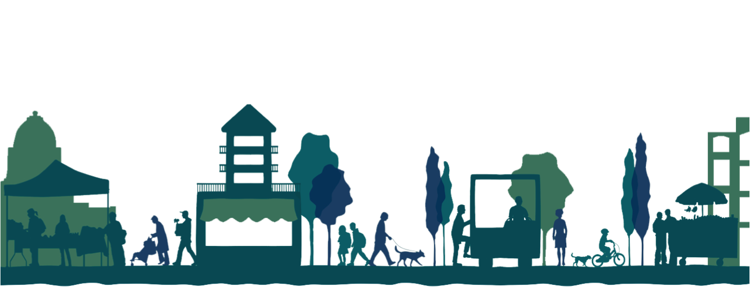
تخطيط المجتمعات
ما هو؟
كيف يعيش الناس ويعملون ويلهون معًا في نفس المكان؟
Notes:
Overview: Review what land use and community planning are and emphasize that the community planning process includes a public hearing. This is the point in the decision-making process that is designed for hearing the voices of the community. If people do not speak up it is less likely that their needs will be met.
Group Discussion: Discuss what they learned about land use in their reading. Did they have any ideas about how land use and built environment decisions were being made in their community and how they are being implemented? Talk about what parts of their neighborhoods they enjoy and what improvements they would like to see.

Slide 8
الخطة العامة
Notes:
Overview: It looks complicated and frankly, it is complicated. Remind your group that they are part of a supportive team of people working together. You do not have to know all of the answers to begin making positive changes in your community.

Slide 9
البيئات المبنية
جميع سمات البيئة المحيطة التي شيدت على أيدي الناس: المساكن، والمباني، والطرق، والمتنزهات الخ.
Notes:
Overview: Review built environments.
Group Discussion: Ask for any observations about this photo and the built environment it represents.

Slide 10
البيئات المبنية
Notes:
Overview: Review built environments.
Group Discussion: Ask for any observations about this photo and the built environment it represents. How are the land use and community planning decisions different here versus the picture from the previous slide?

Slide 11
الحصول على معلومات
كيفية الوصول إلى وثائق التخطيط المحلي
ابدأ بالبحث على الإنترنت عن مخطط "]اسم المدينة[ العام."
أنواع أخرى من المخططات تشمل:
مخططات محددة أو مخططات وسط المدينة
المخططات الرئيسية للمشاة
المخططات الرئيسية لسير الدرجات الهوائية
المخططات الرئيسية للمتنزهات
مخططات الزراعة في المدينة
Notes:
Overview: In order to influence the community planning process you have to first learn about the plans for your neighborhood. These are some of the ways to access your area’s plans and planners.
Facilitator Note: Do some research ahead of time for your group so that you can help them connect with the right local resources. You can also load up some of the information on your computer ahead of time to show the group what they will be looking at, and some of the main websites they may access depending on what they choose for their Community Improvement Project (CIP).

Slide 12
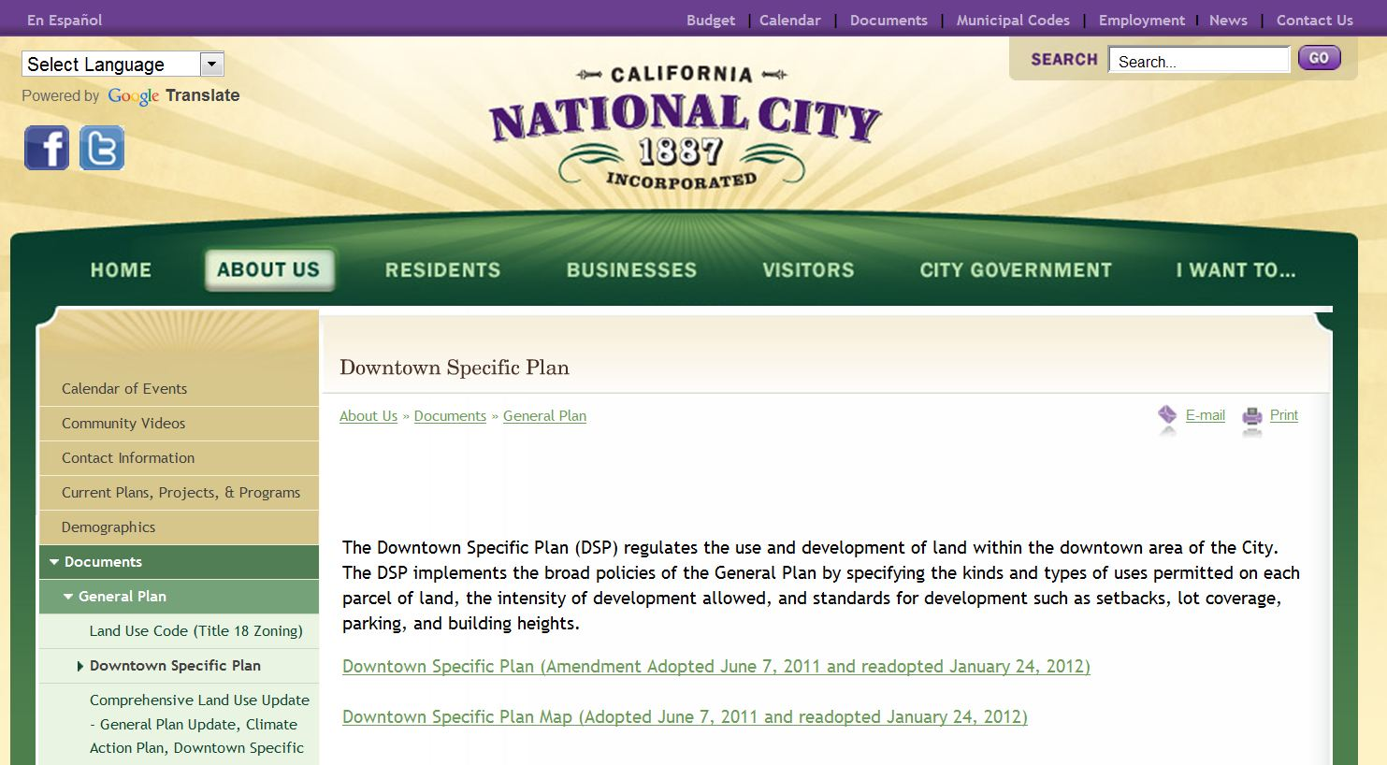
الوصول إلى معلومات عن المجتمع
أدرج صورة ملتقطة للموقع الإلكتروني لمدينتك
مثال::
Notes:
Overview: Most cities have their major planning documents, like the general plan, online. The files are very large, so sometimes the general plan is broken into different sections before it is posted on the website. If your group decides on a CIP that involves land use you may want to begin to think about who among you loves research and details and might be interested in taking the lead on doing this research for the group.
Facilitator Note: Replace this photo with the screen shot of your city’s website.

Slide 13
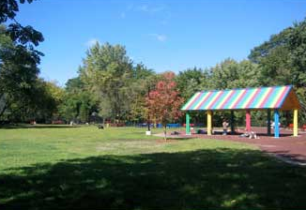
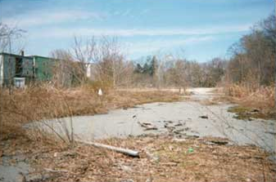
التعمير/إعادة التعمير
أرض مصانع مهجورة
بعد
قبل
Notes:
Overview: This is an example of redevelopment. This example is a brownfield, which is a property that may involve complicated redevelopment efforts due to the presence or potential presence of a hazardous substance, pollutant, or contaminant.
Group Discussion: Discuss recent and/or current developments or redevelopments in their neighborhood.
Source: http://www.epa.gov/brownfields/about.htm

Slide 14
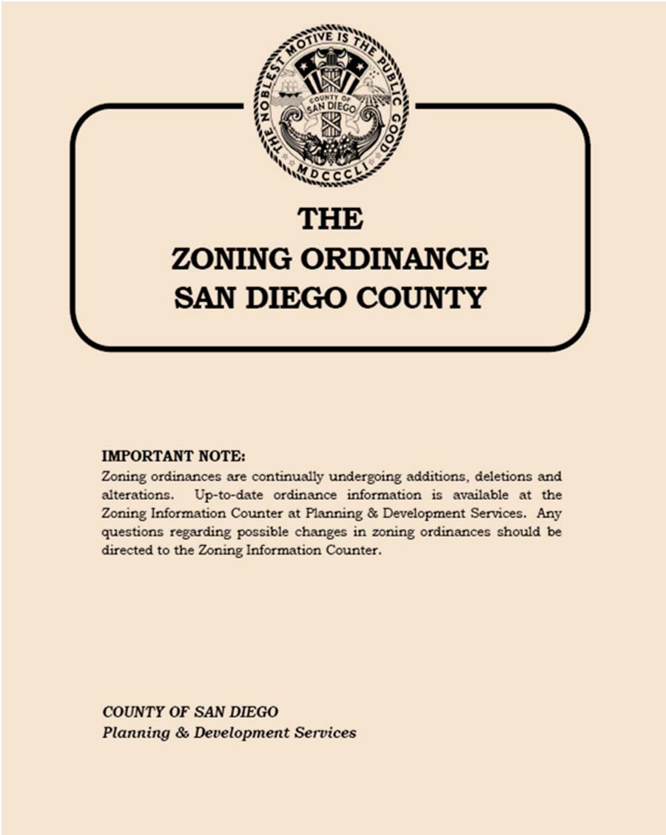
قوانين ترسيم المناطق
قوانين ترسيم المناطق
اللوائح والقوانين المكتوبة التي تحدد كيفية استخدام الممتلكات الواقعة في المناطق الجغرافية المعينة.
تحدد قوانين ترسيم المناطق مدى إمكانية استخدام المناطق لأغراض سكنية أو تجارية، وقد تنظم أيضًا مساحة أرض البناء، وتعيين المكان الملائم، والحجم (أو الكثافة) وارتفاع البنايات.
Notes:
Overview: After discussing this, tell the group there is a great video series on page 106 of the Deep Dive resources for adults and children called “Little Kids, Big City” that explains zoning in more detail.
Group Discussion: What do you think Commercial zoning means? Residential? Mixed use? How do you think these regulations affect your neighborhood now and in the future?
Source: www.investopedia.com/terms/z/zoning-ordinance.asp

Slide 15
استعمالات الأراضي
مرئي
أدرج صور لمنطقتك السكنية
Notes:
Group Discussion: What kind of zoning do you think this building has? Why? What were your clues? Thinking of the health determinants that you learned about last week, do any of these examples support the health of residents?
Facilitator Tip: Take photos of different buildings and places in the local neighborhood like parks, apartments, mixed use developments, etc. and discuss them and how they effect community health.

Slide 16
استراحة
Notes:
Facilitator Tip: Use this time for a break. Give participants a five to ten minute break depending on the needs of the group and the length of the meeting. Use the resources in the Digital Library to choose one stretch for your group.

Slide 17
مخاوف أصحاب المصالح في استعمالات الأراضي
Notes:
Overview: Part of the reason land use and community planning is so complex is because there are a lot of interested parties.
Group Discussion: Discuss what is happening in the group’s neighborhood. What do they wish was happening or not happening?

Slide 18
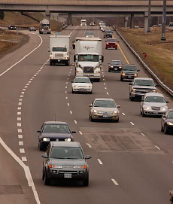
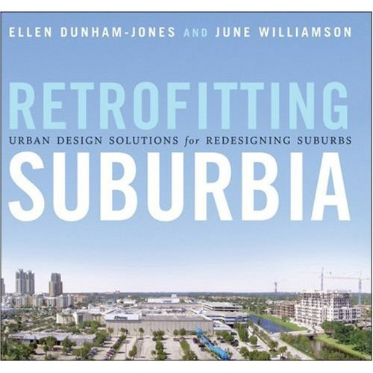
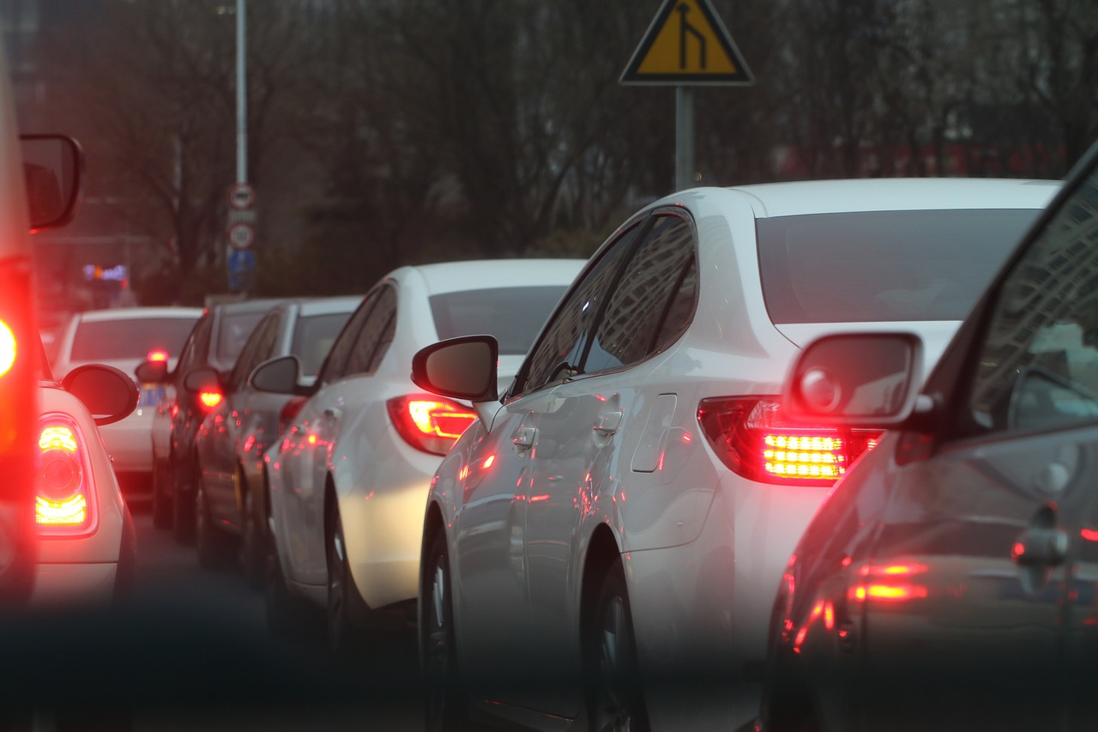
فوضى اجتماعية
Notes:
Group Discussion: Discuss the case study in the workbook about urban sprawl. Discuss how that relates to San Diego and their neighborhood. Some ideas to address include stress and time spent commuting, effects on activity levels, and contribution to greenhouse gasses and climate change.
Picture on top right side from: http://bungalowhouseplans.com/craftsman-house-plans-blog/a-retro-fit-of-suburbia/

Slide 19
سبع خطوات لفهم استعمالات الأراضي والتأثير عليها
قم بدراسة الأمر
Notes:
Overview: Again, remember that your RLA is a team and bet that there are some natural researchers out there.
Facilitator Tip: They have already reviewed these steps in theory. Make this discussion practical. One option is to discuss the steps and then put the participants in small groups to identify how they would apply the steps in their own community using a land use CIP idea (it does not have to be the CIP they ultimately work on). There is a lot of discussion in the following slides. Check on your time and manage the discussion on each slide accordingly. Depending on the group you may spend more than one session on this topic.

Slide 20
سبع خطوات لفهم استعمالات الأراضي والتأثير عليها
تواصل مع السكان الآخرين
Notes:
Overview: Otherwise known as neighborhood organizing: talking to people, listening and sharing your concerns, and analyzing the information you received.

Slide 21
سبع خطوات لفهم استعمالات الأراضي والتأثير عليها
ضع خطة عمل
Notes:
Group Discussion: Discuss the value of having a well-organized plan. How does it help? Who should develop it and who should have a copy of it?
Hint: the answer to the last two questions is EVERYONE!

Slide 22
سبع خطوات لفهم استعمالات الأراضي والتأثير عليها
قدم مشروعك
Notes:
Overview: Discuss different ways to frame a message. Think about who you are trying to influence. In this case it is elected city officials and community planners, how can you deliver your message in a way that makes them pay attention?
Facilitator Tip: Let people know there are actual strategies already created that they can find in the Deep Dive and that you have in the Digital Library.

Slide 23
سبع خطوات لفهم استعمالات الأراضي والتأثير عليها
قم بتكوين مجموعة من الشركاء التقليديين وغير التقليديين
Notes:
Overview: We are learning that everything is interconnected so think outside the box and get creative about who your partners can be.
Group Discussion: Who are the players in your neighborhood and why? Get some examples of non-traditional partners. For example, why would the neighborhood pastor, Imam, or other faith leader be interested in a partnership with the owner of a local fast-food franchise?

Slide 24
سبع خطوات لفهم استعمالات الأراضي والتأثير عليها
الاجتماع مع المخططين، والمسئولين المنتخبين وموظفيهم
Notes:
Overview: Focus on relationships. At the end of the day, it comes down to a human being (or a small group of them) making a decision.

Slide 25
سبع خطوات لفهم استعمالات الأراضي والتأثير عليها
تحلى بالإصرار والصبر
Notes:
Overview: Persistence is one of the most potent weapons at your disposal and it is low-cost! Land use changes can take years to complete so patience is necessary for this type of change strategy.

Slide 26
الترابط الاجتماعي
العلاقات مهمة
يبني رأس مال اجتماعي
مقترن بالنهوض بالصحة
يساهم في الوقاية من الأمراض المزمنة
Notes:
Group Discussion: How does social capital help you? What social capital do you contribute to friends, neighbors, and families?

Slide 27
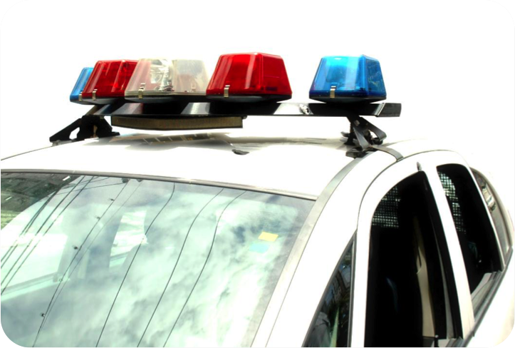
منع الجريمة من خلال التصميم البيئي
ما هو؟
إن منهج منع الجريمة من خلال التصميم البيئي (CPTED) هو فلسفة لمنع الجريمة وهو يشجع التصميم المناسب والاستخدام الفعال للبيئة المبنية، وذلك بهدف:
تقليل الأنشطة الإجرامية
خفض المخاوف من حدوث الجرائم
تحسين نوعية الحياة
Notes:
Overview: Review Live Well San Diego’s goals, safety is a primary issue, this is a tool that can help people address it
Facilitator Tip: You may choose to use the law enforcement perspective on Crime Prevention Through Environmental Design (CPTED) video located in the Deep Dive or have a guest speaker (law enforcement, neighborhood watch captain, or architect/urban planner).

Slide 28
الجيل الأول من منهج (CPTED)
المراقبة الطبيعية
تعزيز الحدود الداخلية
تقييد الدخول
الحماية
Notes:
Group Discussion: Discuss examples in their neighborhood and potential ideas to improve CPTED.
Facilitator Tip: If you are not familiar with the neighborhood, take time to explore the community so you have some examples to share and can be more familiar with the examples presented by the group.

Slide 29
الجيل الأول من منهج (CPTED)
الطاقة الاستيعابية
التماسك الاجتماعي
إمكانية التواصل
ثقافة المجتمع
Notes:
Group Discussion: Discuss examples in their neighborhood and potential ideas to improve CPTED.

Slide 30
مقطع فيديو
الفوائد الصحية وتصميم المجتمع الصحي
Notes:
Overview: Shows that how a community is built affects people’s health.
http://www.cdc.gov/healthyplaces/healthy_comm_design.htm

Slide 31
مشروع الرسم في المناطق العامة لمدينة الكاهون
Notes:
Overview: RLA Success! These boxes in El Cajon, painted by local artists, add beauty and a sense of pride to the neighborhoods and prevents graffiti.

Slide 32
الخاتمة
الواجب المنزلي
قم بقراءة قسم 2.1
الأسئلة؟
التعليقات؟
المخاوف؟
Notes:
Group Discussion: Any outstanding questions? Let the group know that if they want more information you can email them more resources, or use your thumb drive to put materials from the Digital Library onto their computer. And ask them to share if they come across good information to add to the library.

Slide 33
"هذا المنهج حاصل على دعم الاتفاقية التعاونية رقم DP005528-01، وتم تمويله من قِبل مراكز مكافحة الأمراض والوقاية منها، من خلال هيئة الخدمات الصحية والإنسانية في مقاطعة سان دييغو. ويتحمل المؤلفون المسؤولية كاملة عن محتوياته، والتي لا تعبر بالضرورة عن الآراء الرسمية لمراكز مكافحة الأمراض والوقاية منها أو إدارة الخدمات الصحية والإنسانية".

