Slide 1
القسم الثاني: الأنظمة الغذائية
الأنظمة الغذائية
Notes:
Overview: Welcome to the next session!

Slide 2
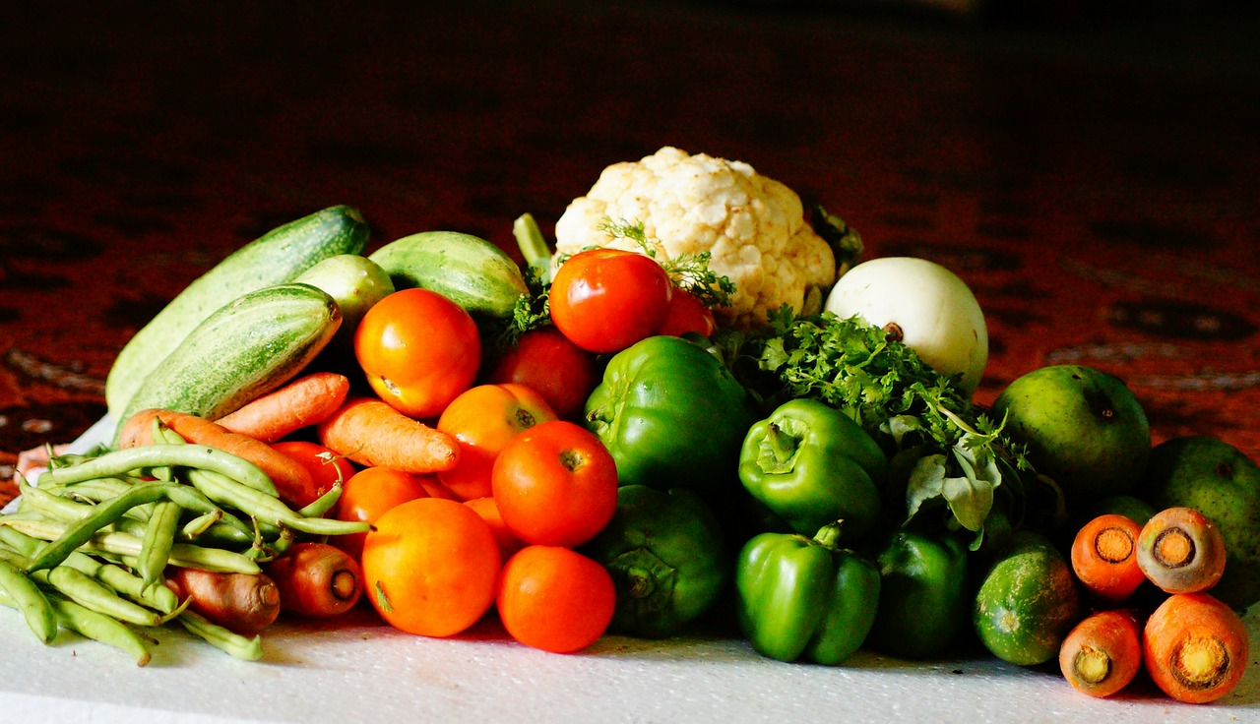
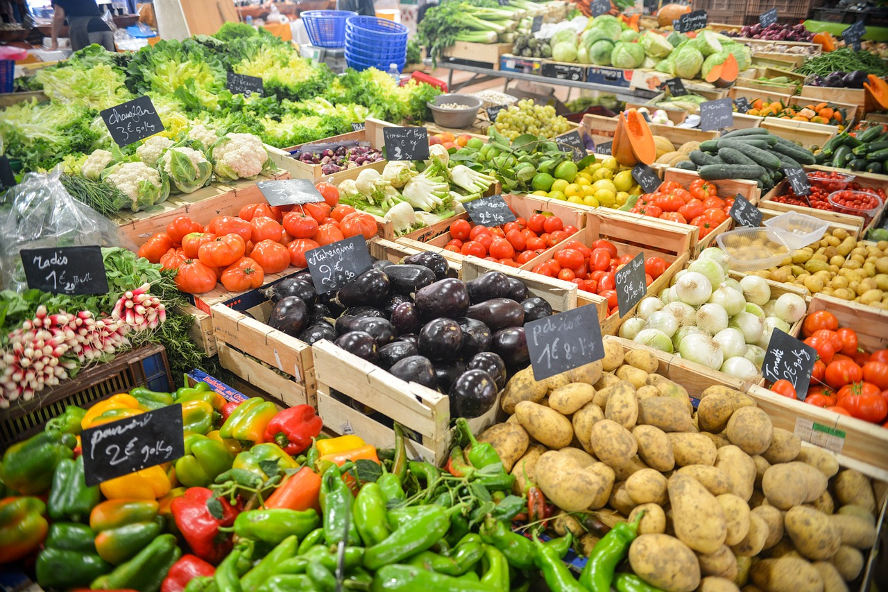
جدول الأعمال
قسم 2.4: الأنظمة الغذائية
تهيئة/مراجعة
النظام الغذائي
السياسات الغذائية
الشركات التجارية الضخمة
البيئة الغذائية
التكاليف الصحية
بناء نظام غذائي صحي
الخاتمة
Notes:
Overview: Brief review of agenda.

Slide 3
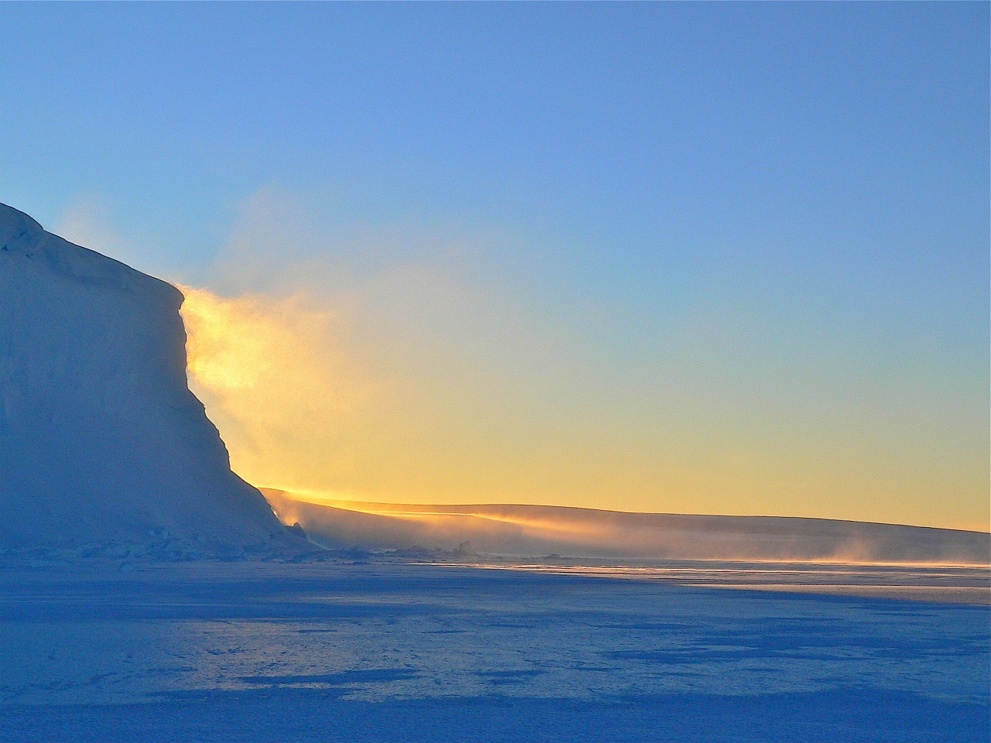
تهيئة
Notes:
Overview: Icebreakers help the group get to know one another and gets them warmed up to participate in group discussion.
Facilitator Tip: choose an icebreaker activity from the Digital Library or get an idea from another RLA facilitator for suggestions on icebreakers that were successful in their groups.

Slide 4
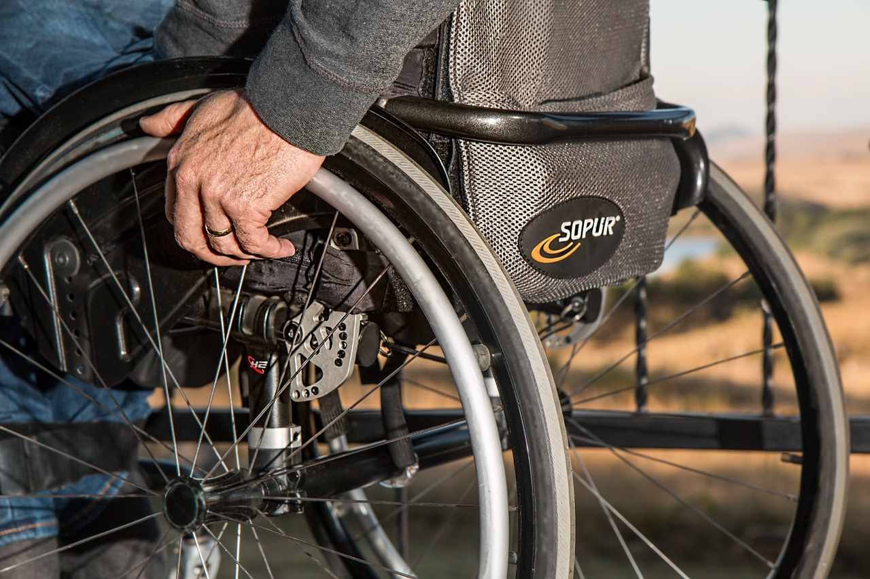
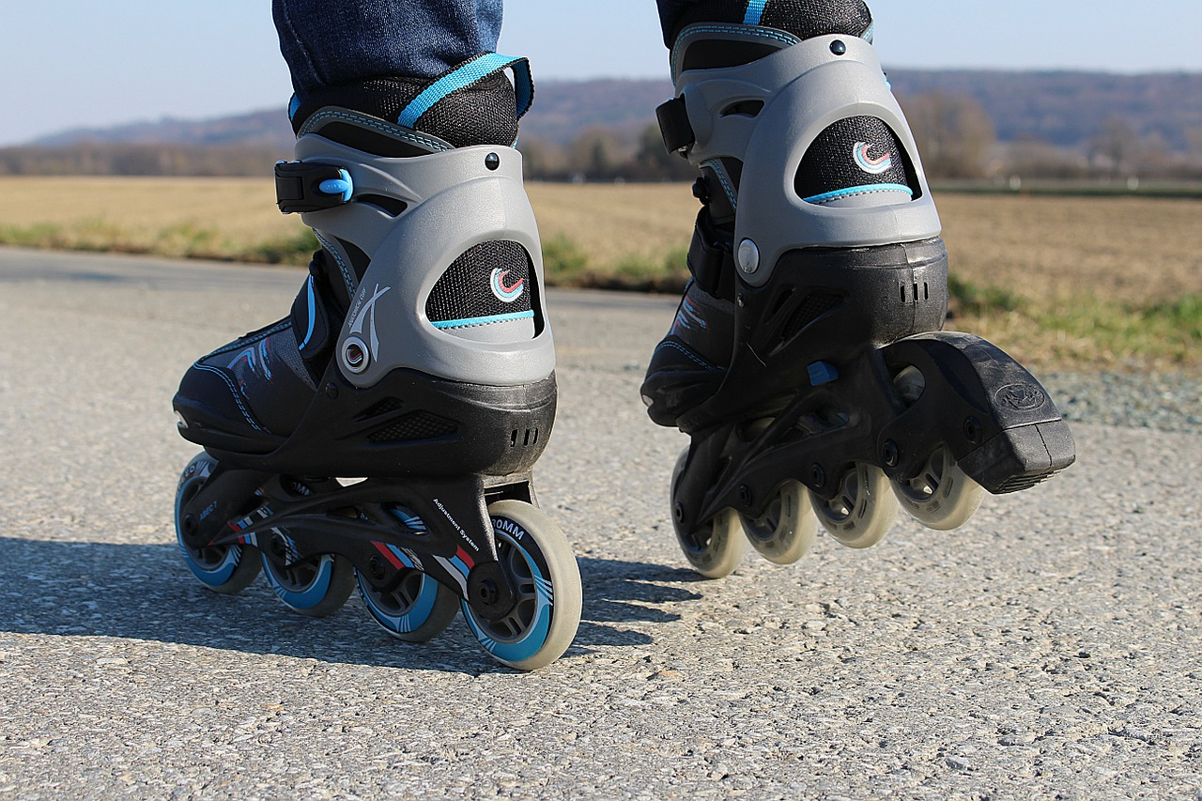
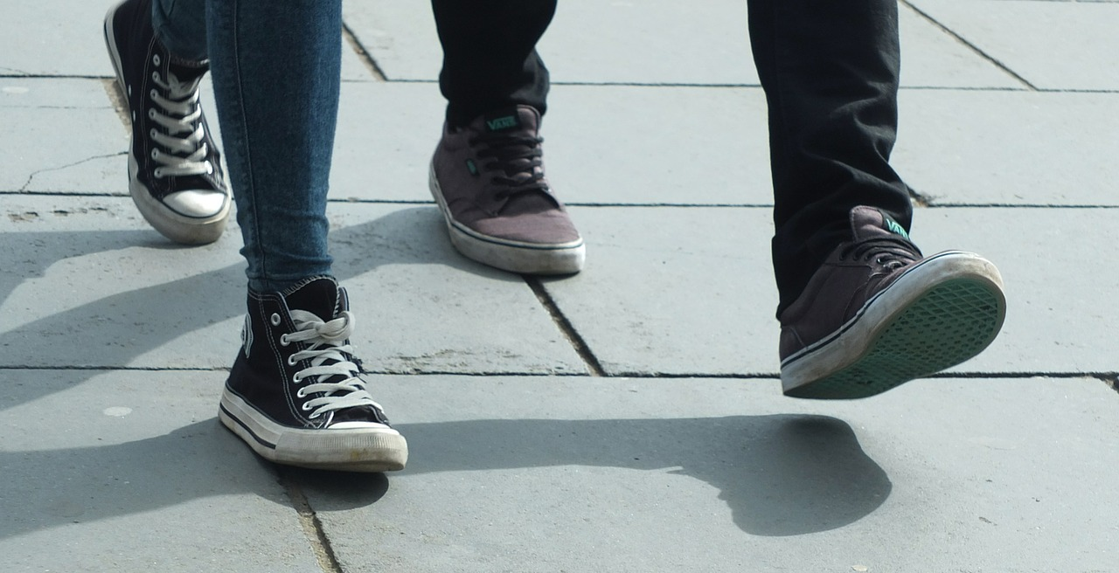
مراجعة على النقل النشط
ماذا تعلمنا عن النقل النشط؟
نقابة الحكومة المحلية في سان دييغو (سان داك)
سهولة السير
سهولة ركوب الدرجات الهوائية
Notes:
Overview: Quick review of last week.
Group Discussion: Did you have any new observations about your neighborhood and ways that it could support better health through the strategies you are learning?
How are the four strategies you have learned and read about so far connected?

Slide 5
القسم الثاني: الستراتيجيات
الأهداف التعليمية:
معرفة محددات الصحة وكيف تؤثر على الصحة.
معرفة التغييرات التي من شأنها النهوض بالصحة عند تطبيقها في المجتمعات.
Notes:
Overview: We know we need to move around (under our own power) to get healthy and stay healthy, and to move around we need fuel. That is food! What we eat, how that food is created, and how it gets to our table is very important.

Slide 6
مقطع فيديو
ضع عنوان ”مقطع الفيديو“ هنا
Notes:
Facilitator Tip: There are a lot of documentaries and films in the Resource Library on food systems. Review a selection of them and use a combination in this session based on the interests of your group. Keep the clips to 5 – 20 minutes in length. There are some suggestions throughout this PowerPoint but please customize the content to your RLA participants. Do not forget to add video clip title to PowerPoint slide.

Slide 7
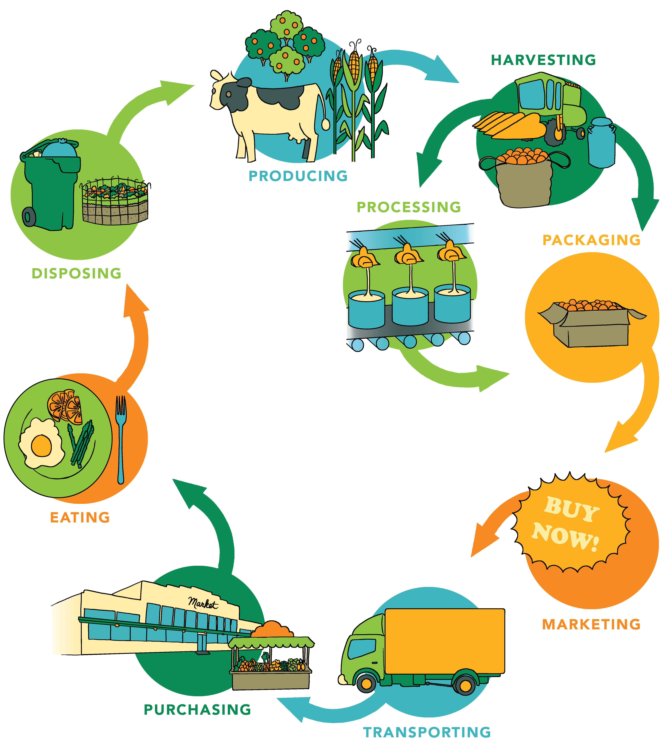
الأنظمة الغذائية
Notes:
Overview: A food system includes all of the processes and infrastructure involved in feeding a population: growing, harvesting, processing, packaging, transporting, marketing, consumption, and disposal of food and food-related items.
Group Discussion: Discuss how reading this section may have expanded how they think about food. What information surprised them?

Slide 8
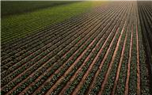
الأنظمة الغذائية
الأنظمة الغذائية
تتأثر بـ
اجتماعي
بيئي
سياسي
اقتصادي
تتطلب موارد بشرية لتوفير العمالة وإجراء الدراسات البحثية والتثقيف. والأنظمة الغذائية إما تقليدية أو مستدامة حسب نموذج مدة صلاحيتها منذ منشأها وحتى تؤكل.
Notes:
Overview: Highlight the differences between a conventional and sustainable food system.
Group Discussion: Can anyone make any connections to social determinants here? Any connections with the SEM and the levels that are represented here? Where does change have to happen to affect the influencers identified?

Slide 9
الأنظمة الغذائية
متفق مع القواعد المقررة عالميًا
إن عولمة نظامنا الغذائي تؤثر على الصحة سلبًا على نطاق شامل
إقليمية
معظم الأغذية التي نبتاعها من أسواقنا المحلية قد سافرت لمسافات طويلة للغاية كي تصل هذه الأسواق
محلية
هي الخيار الأفضل لصحتنا، واقتصادنا المحلي، وبيئتنا، ومجتمعاتنا
Notes:
Overview: Review the definitions of local and regional in the workbook.

Slide 10
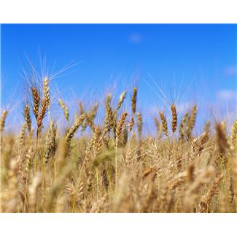
أنواع الأنظمة الغذائية
تقليدية | مستدامة
تتضمن التوزيع الواسع وفقا للتكلفة مدفوعة بالتوسع المالي وزيادة الأرباح تستند إلى نموذج إنتاجية أنظمة غذائية صناعية شركات متعددة الجنسيات | تركز على الإنتاج المحلي لتحقيق المنفعة المباشرة للمجتمعات متوفرة جغرافيًا واقتصاديًا موسمية، وبلدية، ومستدامة نظام غذائي محلي نظام غذائي مجتمعي نظام غذائي عضوي
Notes:
Overview: Although much of America’s food systems are conventional there is a movement toward more sustainable systems. For example, many neighborhoods have started community gardens.

Slide 11
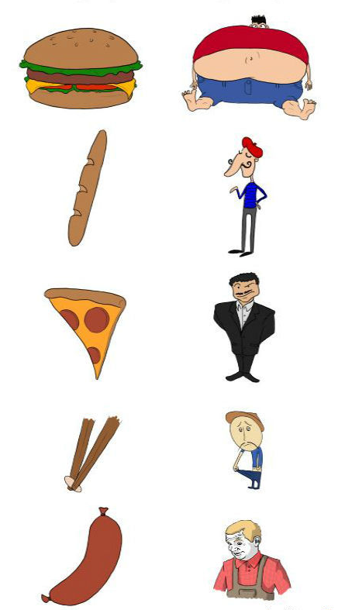
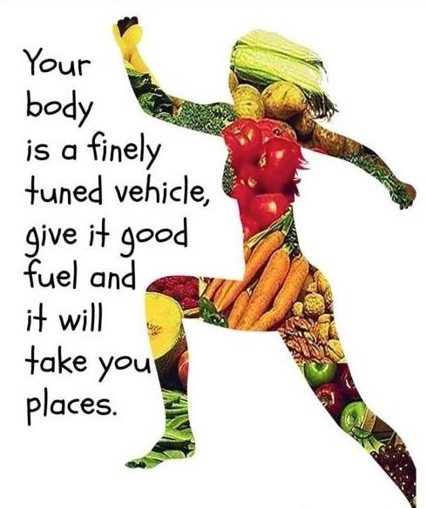
صحتك في غذائك
Notes:
Overview: Healthy food makes us feel healthier. You are what you eat.
Group Discussion: How do you feel after you eat a fast food meal? After a home-cooked meal featuring fresh vegetables?
Image on left from: memecenter.com http://www.memecenter.com/fun/678250/
you-are-what-you-eat
Image on right from: totalwellnesstnetworsk.com http://totalwellnessnetworks.com/you-are
-what-you-eat/

Slide 12
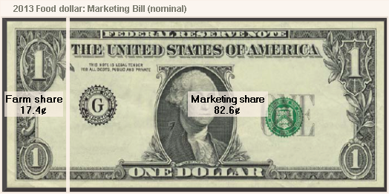
نظامنا الغذائي الحالي
Notes:
Overview: More marketing often equals more sales. This is from the United States Department of Agriculture website.
Group Discussion: Discuss the impact of marketing? What if a bigger share went to the farmers? What would the system look like? What if farmers had a million-dollar marketing budget?
Activity: Break the group into smaller groups and have them make a commercial for fruits and vegetables and present it to the group. This is meant to provide levity and have them think critically about advertising.

Slide 13
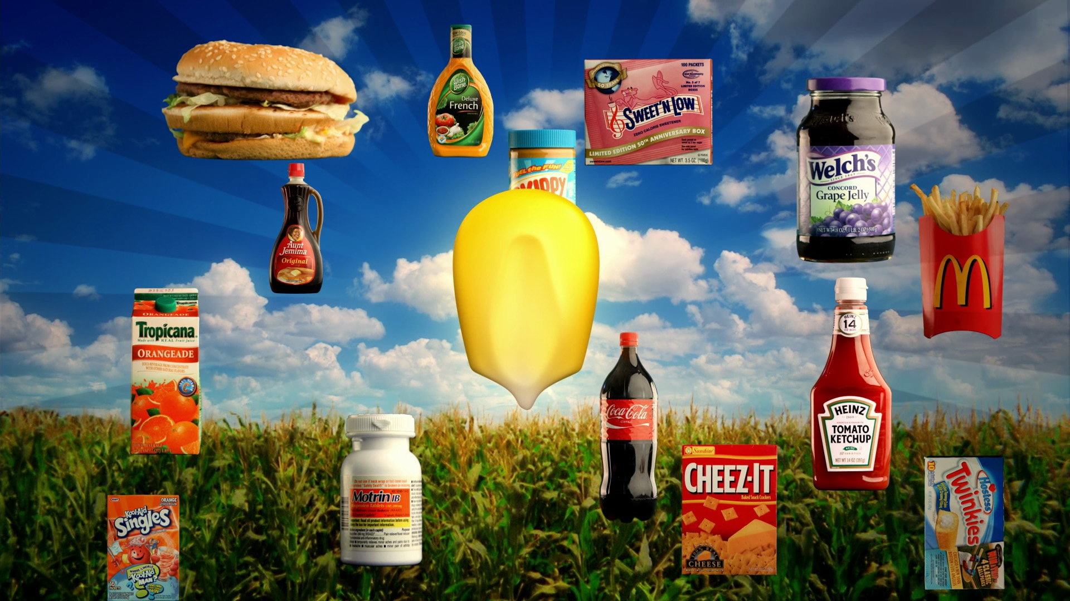
المؤثرات الكبرى على النظام الغذائي
السياسات الحكومية
منذ أكثر من 100عام
دعم حكومي
كثيرًا ما يتم تصنيع المنتجات غير الصحية بمحاصيل رخيصة كالسكر والذرة
Notes:
Overview: Government policies influence people’s accessibility to healthy foods.
Group Discussion: What level of the Social-Ecological Model (SEM) is this? What are some specific, community level strategies to improve your local food system?

Slide 14
السِّمنة
Notes:
Overview: Take a moment to revisit the main reason we are here, which is to combat the chronic diseases that are impacting our communities. Obesity increases the chances that a person will get type 2 diabetes, lung disease, cancer, and heart disease
Group Discussion: Did the connection between advertising, government policy, processed foods, and obesity rates surprise anyone? What are their thoughts on how it affects their neighborhood and family?

Slide 15
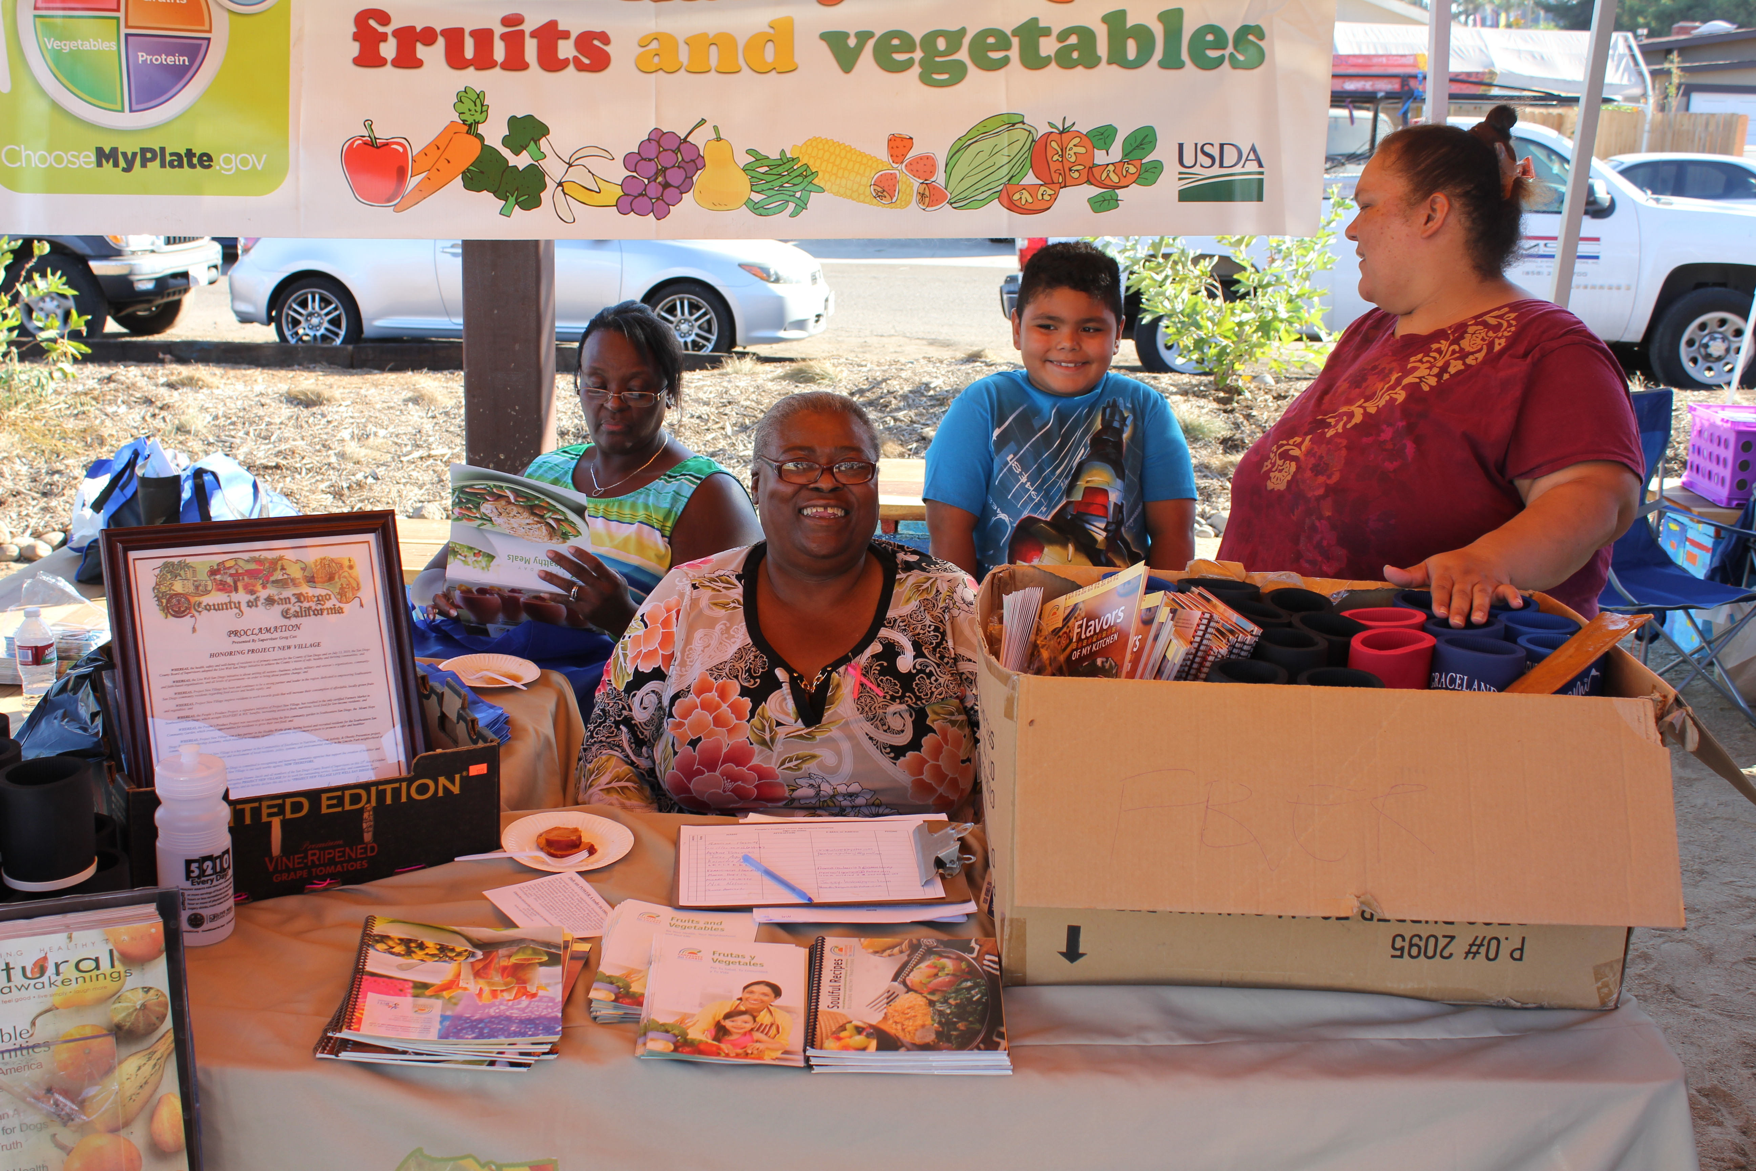
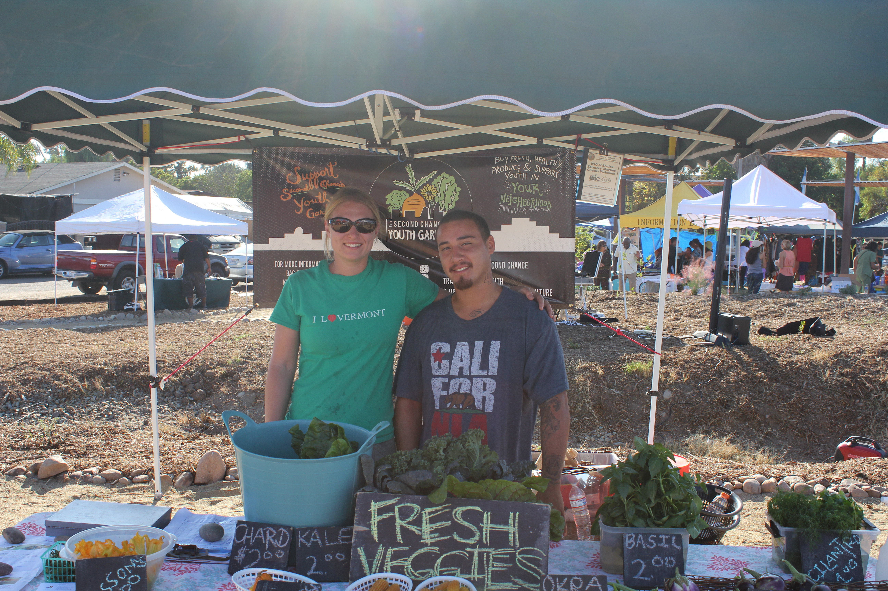
المؤشرات الكبرى على النظام الغذائي
سياسات الإنتاج المحلي للغذاء
قرارات المدينة والمقاطعة
Farmer’s Market
Notes:
Overview: Relate the concepts here to what is happening in the participants’ neighborhood around food systems.
Facilitator Tip: Do some research on local food policies and ordinances. Bring these to the group and facilitate a discussion about how they affect community health.

Slide 16
مقطع فيديو
Food, Inc.
Notes:
Overview: Food, Inc gives one perspective on our current food system and how it affects the health of people, community, business, and the environment.
Facilitator Tip: Food Inc. is available for check out from the Resource Library. Please choose a clip that suits your group that is no more than 20 minutes.
https://www.youtube.com/watch?v=5eKYyD14d_0

Slide 17
استراحة
Notes:
Facilitator Tip: Use this time for a break. Give participants a five to ten minute break depending on the needs of the group and the length of the meeting. Use the resources in the Digital Library to choose one stretch for your group.

Slide 18
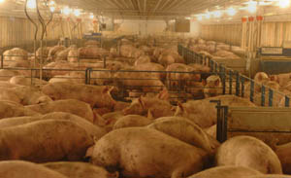
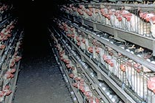
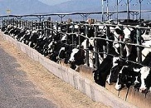
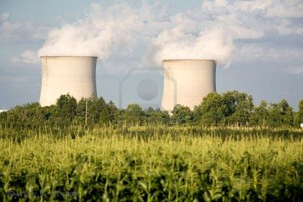
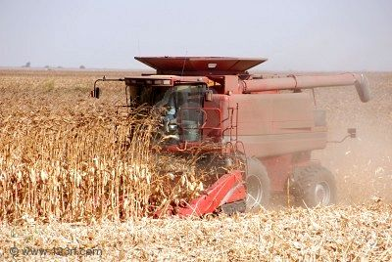
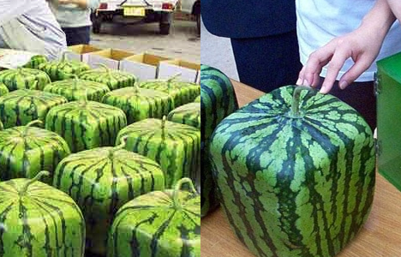
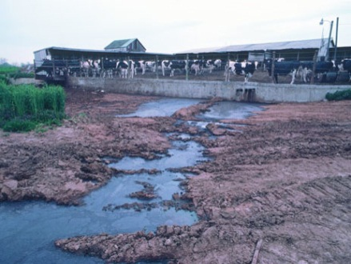
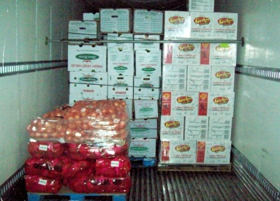
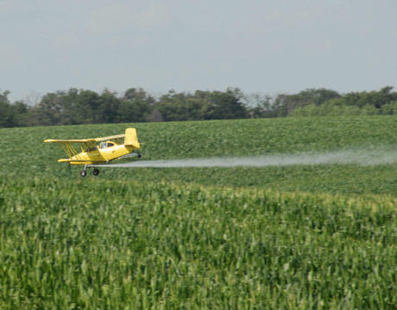
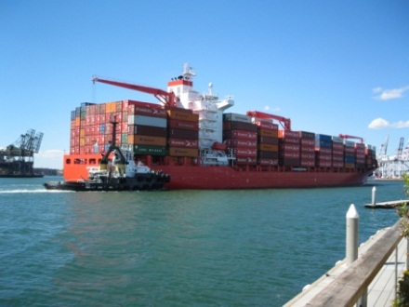
ممارسات تجارية
Notes:
Overview: Business practices of the agriculture and food industry affect our health.
Group Discussion: Anything you can add? How does this affect your neighborhood and family?

Slide 19
الآثار على الأنظمة الغذائية
الحيوانات
البيئة
العمال
الاقتصاد
Notes:
Overview: Our food system affects more than the health of the individual consumer.
Group Discussion: Quickly brainstorm some ideas with the group, impacts on animals, environment, etc.

Slide 20
المخلفات الغذائية
أكبر مساهم في مدافن النفايات في الولايات المتحدة
تستقبل مدافن النفايات في سان دييغو 4500 طن من نفايات الأغذية سنويًا
تُسهم في تغير المناخ
Notes:
Overview: Food waste is a big contributor to pollution and climate change. Talk about composting as a strategy to reducing food waste.
Facilitator Tip: An option for a guest speaker may include a representative from the San Diego Food Systems Alliance, a local farmer, or a master composter. You could even invite a composter to teach the group how to make their own home composting system.

Slide 21
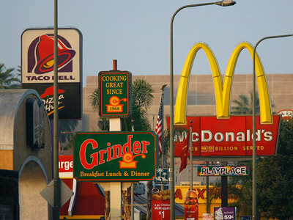
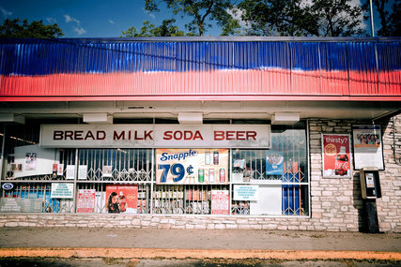
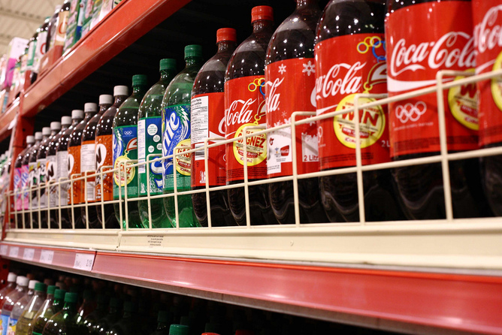
البيئات الغذائية
Notes:
Overview: Define food environments:
Food desert: a neighborhood characterized by insufficient access to grocery stores
Food swamp: a lot of high-energy, low nutrient foods compared with healthy options (such as an area with a lot of fast food restaurants).
Group Discussion: Do either of these apply to your neighborhood? If so, why?
Facilitator Tip: If you are not familiar with the neighborhood, do some research about the availability of fresh food in the neighborhood.

Slide 22
استراحة
Notes:
Facilitator Tip: Use this time for a break. Give participants a five to ten minute break depending on the needs of the group and the length of the meeting. Use the resources in the Digital Library to choose one stretch for your group.

Slide 23
إنشاء نظام غذائي صحي
Notes:
Overview: These are the characteristics of a healthy food system, which is our goal.

Slide 24
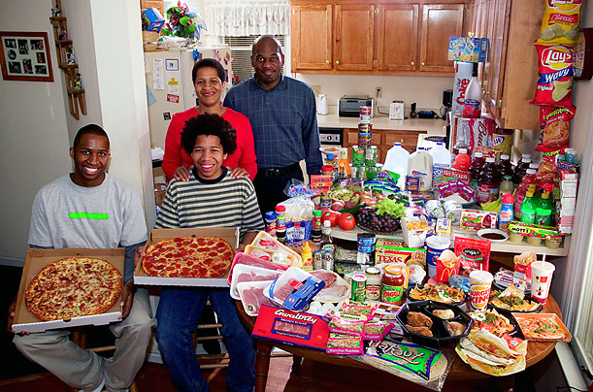
الثقافة والطهي
الولايات المتحدة
Notes:
Overview: The following are samples of cultural differences in food environments. Note that these are generalizations and not representative of every individual from a certain culture.

Slide 25
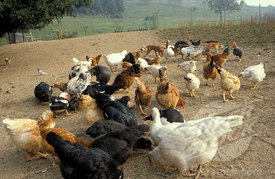
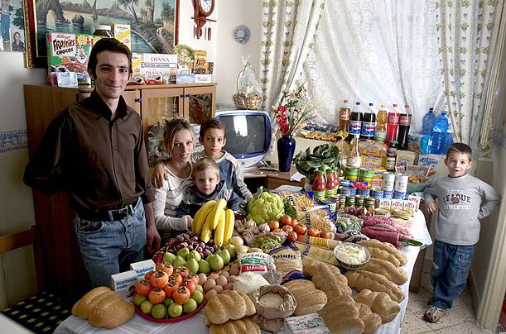
الثقافة والطهي
إيطاليا
التربية في المراعي الحرة
غرفة المؤن
Notes:
Overview: An example of food systems and consumption in Italy.

Slide 26
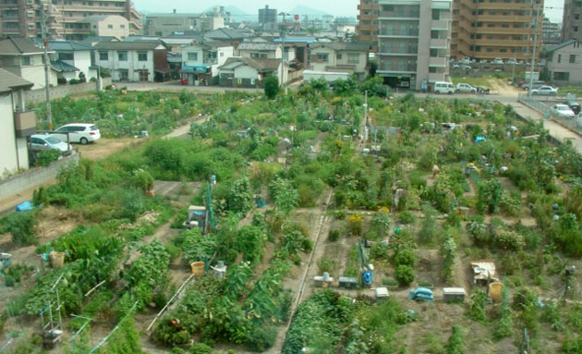
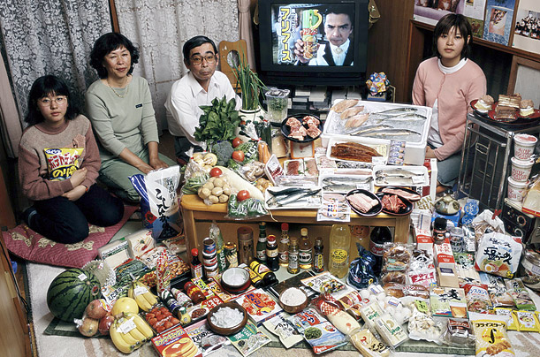
الثقافة والطهي
اليابان
الزراعة في المدن
غرفة المؤن
Notes:
Overview: An example of food systems and consumption in Japan.

Slide 27
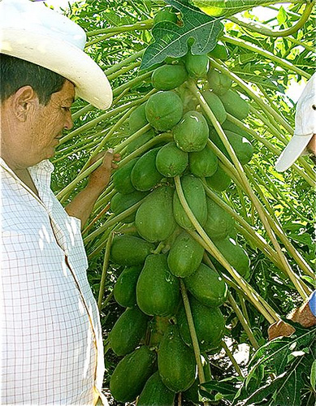
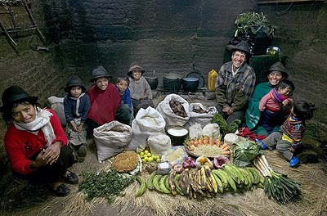
الثقافة والطهي
الإكوادور
الزراعة الموسمية
غرفة المؤن
Notes:
Overview: An example of food systems and consumption in Ecuador.

Slide 28
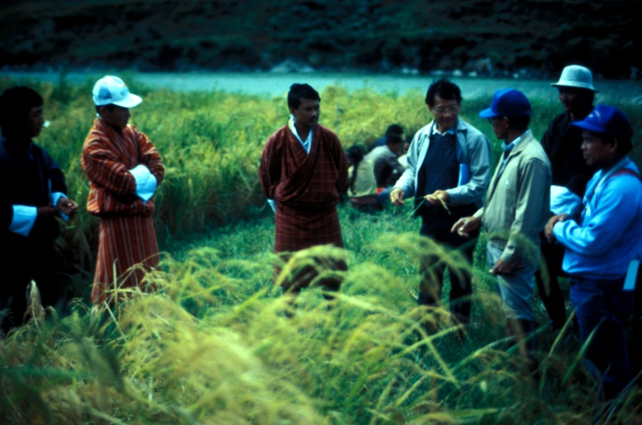
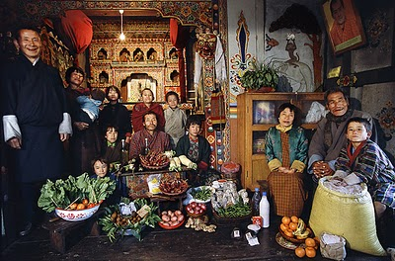
الثقافة والطهي
بوتان
زراعة الرز
غرفة المؤن
Notes:
Overview: An example of food systems and consumption in Bhutan.

Slide 29
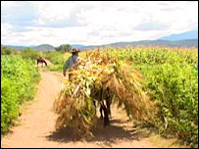
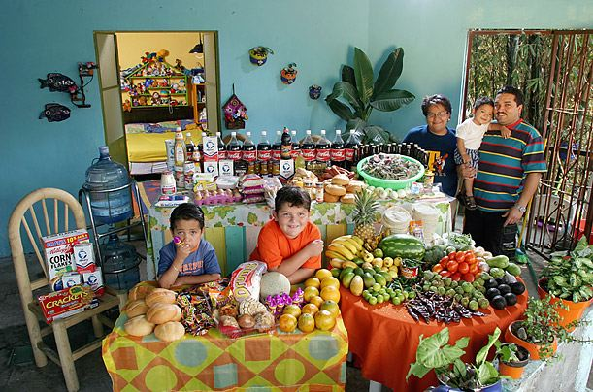
الثقافة والطهي
المكسيك
مزرعة
غرفة المؤن
Notes:
Overview: An example of food systems and consumption in Mexico.

Slide 30
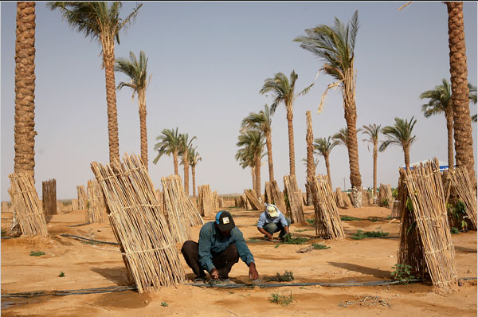
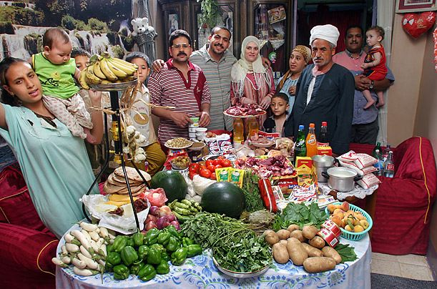
الثقافة والطهي
مصر
زراعة الشمام
غرفة المؤن
Notes:
Overview: An example of food systems and consumption in Egypt.
Group Discussion: What did the American table look like compared to other cultures? Do you see yourself and your family? As you look at these examples, could Americans adopt any of these strategies?

Slide 31
مقطع فيديو
الحلقة 90 من سلسلة «الطبق الدائم»: حدائق اللاجين
Notes:
Overview: A day spent with a Bhutanese family and their Garden in Atlanta, GA.
https://vimeo.com/36220762

Slide 32
نشاط
الإرشادات:
للتعرف إلى تاريخك الغذائي:
تحدث مع والديك وأجدادك. واسألهم عما كانوا يأكلونه عندما كانوا أطفالًا، وكيف أعدوا طعامهم، وماذا أطعموا أطفالهم، ولماذا.
تحدث مع أشخاص راشدين وآخرين من السكان القدامى في مجتمعك. واسألهم كيف كان المجتمع مختلفًا، ومن أين أتوا بطعامهم، وكيف تغير ذلك على مر العقود.
Notes:
Overview: Our food system has changed over time. Take time to talk about the differences the group found when talking to elders and others about their own food history.
Group Discussion: Ask the participants who did this activity what they learned.
Facilitator Tip: Make sure to do the activity yourself to model participation and to contribute to the discussion.

Slide 33
مقطع فيديو
فيلم «سول فود جانكيز» الوثائقي
Notes:
Overview: Food histories and current consumption is influenced by history and culture.
http://www.pbs.org/black-culture/ shows/list/soul-food-junkies/
Facilitator Tip: Soul Food Junkies is available for check out from the Resource Library. Please choose a clip that suits your group that is no more than 20 minutes. Or as an alternative choose a podcast that suits your group from the Kitchen Sisters Hidden Kitchens series available at http://www.kitchensisters.org/hidden-kitchens/

Slide 34
تغير السياسة والأنظمة والمجتمع
استراتيجيات لنظام غذائي صحي
Notes:
Overview: There is broad interest and movement among communities nationwide to create policy, systems, and environmental changes, which support a healthy food system. With a nation deeply engaged in making change, we are starting to see positive change. Working together to bring healthy options to communities, working with government officials to change policies that support healthier neighborhoods, and working with employers to establish incentives that encourage healthier behaviors are making our communities healthier.
Activity: Break the group into small groups and give each group a piece of flip chart paper. Ask the group to brainstorm community level changes they could work on that would create a healthier food system in their neighborhood. Ask participants to pick a spokesperson to share their ideas. Place a star on any of the strategies that are repeated across groups. Have a large group discussion about their upcoming CIP and encourage thoughtful discussion about specific ideas the group and/or individuals in the group might have for their CIP.

Slide 35
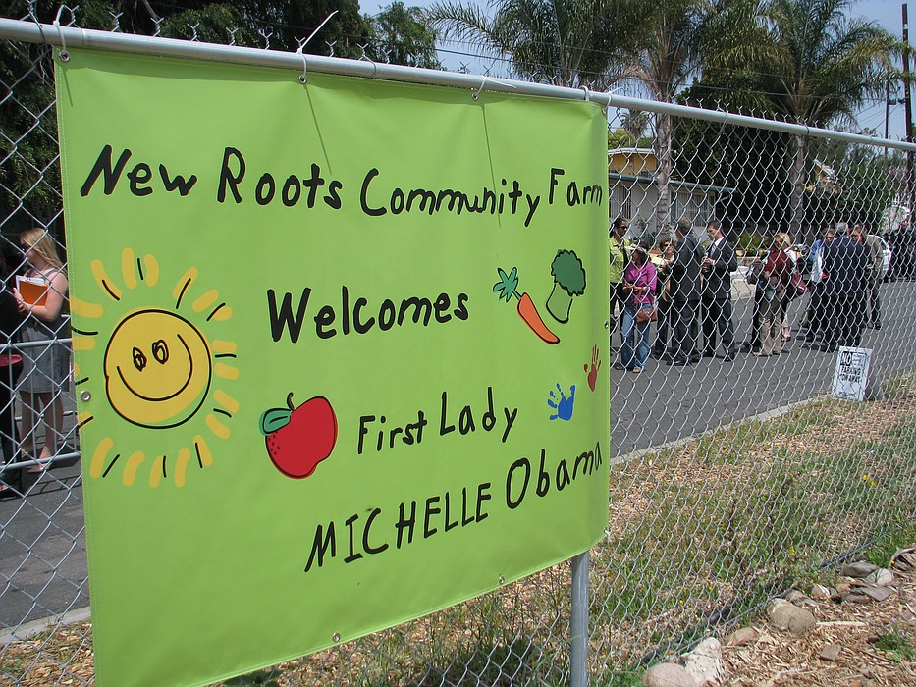
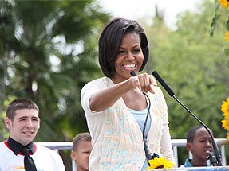
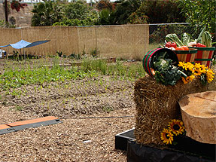
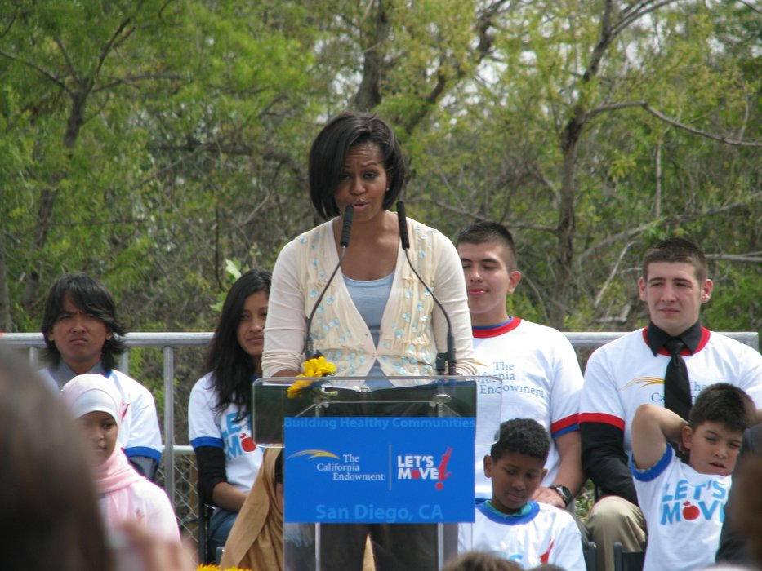
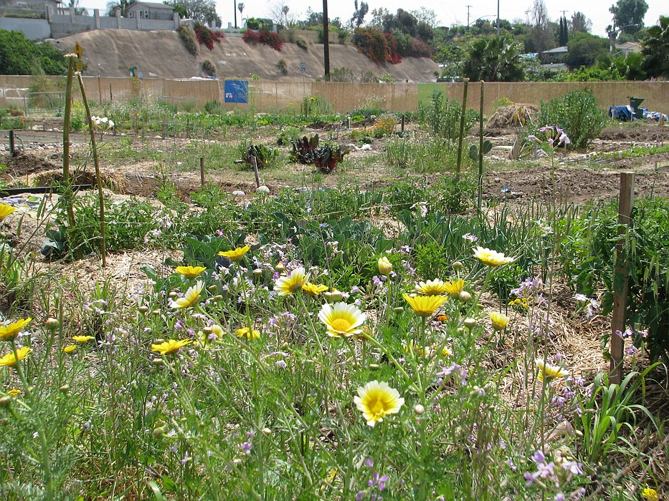
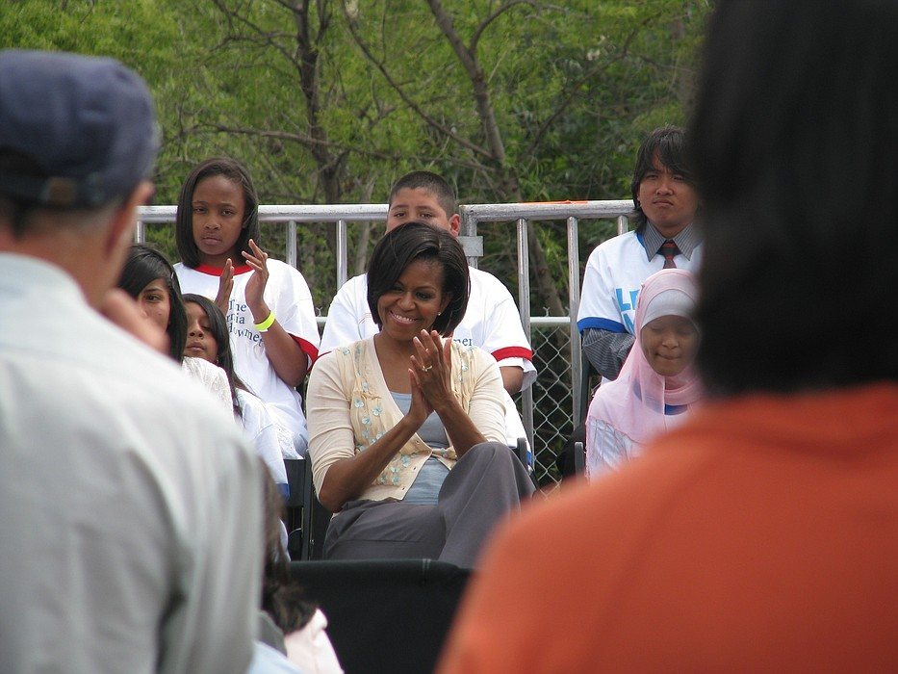
قصة نجاح
السيدة الأولى تزور حديقة سيتي هايتس
Notes:
Overview: First Lady Michelle Obama leveraged her popularity to change policies and tapped into the Nation’s political will. The Let’s Move! Campaign changed policies in business practices (Walmart selling more fruits and veggies) and school systems (policies created for better school lunches)
Images from: http://www.kpbs.org/news/2010/apr/
16/first-lady-addresses-obesity-city-
heights-speech/
http://www.sandiego.gov/citycouncil/cd9/
news/events2010/newroots.shtml

Slide 36
مقطع فيديو
السيدة الأولى تزور حديقة سيتي هايتس
Notes:
Overview: First Lady, Michelle Obama, visits City Heights Garden and addresses obesity.
http://www.kpbs.org/news/2010/apr/16/first-lady-addresses-obesity-city-heights-speech/

Slide 37
الخاتمة
الواجب المنزلي
اقرأ قسم 3.2 عن المشاركة المدنية
أكمل لقاء تاريخ الأغذية (إذا لم تكن فعلت الأسبوع الماضي)
الأسئلة؟
التعليقات؟
المخاوف؟
Notes:
Overview: Answer questions and review homework.
Facilitator Tip: This section has a lot of content and lots to discuss. You may choose to spread it over two sessions.

Slide 38
"هذا المنهج حاصل على دعم الاتفاقية التعاونية رقم DP005528-01، وتم تمويله من قِبل مراكز مكافحة الأمراض والوقاية منها، من خلال هيئة الخدمات الصحية والإنسانية في مقاطعة سان دييغو. ويتحمل المؤلفون المسؤولية كاملة عن محتوياته، والتي لا تعبر بالضرورة عن الآراء الرسمية لمراكز مكافحة الأمراض والوقاية منها أو إدارة الخدمات الصحية والإنسانية".

