Slide 1
Mục 2: chiến lược
Sử dụng đất
Notes:
Overview: Welcome to our next session!
Facilitator Note: An alternative for this session is to have a guest speaker come in from the planning commission or local official’s office to talk about Land Use in their community.

Slide 2
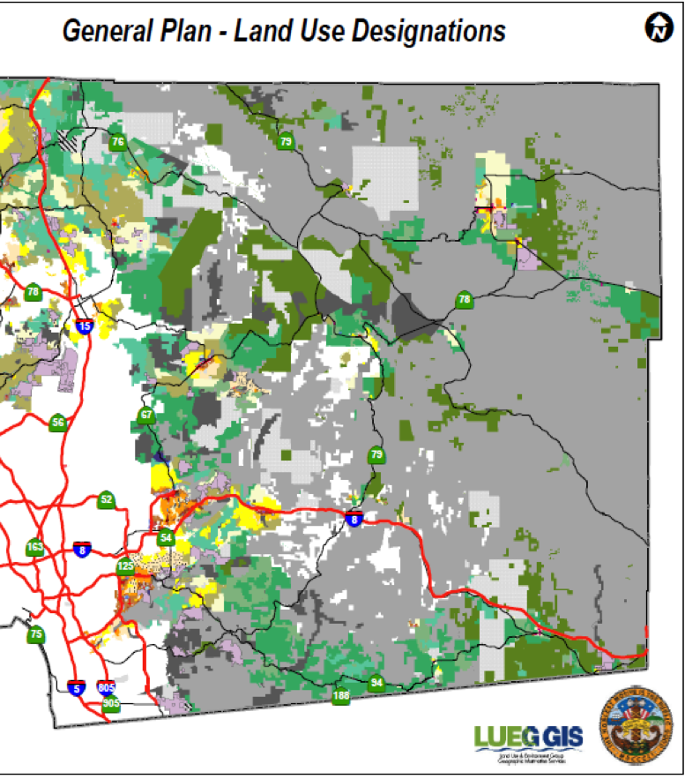
Chương trình
Mục 2.2: Sử dụng đất
Hoạt động mở màn/Ôn tập
Kế hoạch hóa cộng đồng
Ngăn ngừa phạm tội qua thiết kế môi trường (CPTED)
Môi trường đã xây dựng
Cộng đồng an toàn hơn
Kết luận
Notes:
Overview: Brief review of agenda.

Slide 3
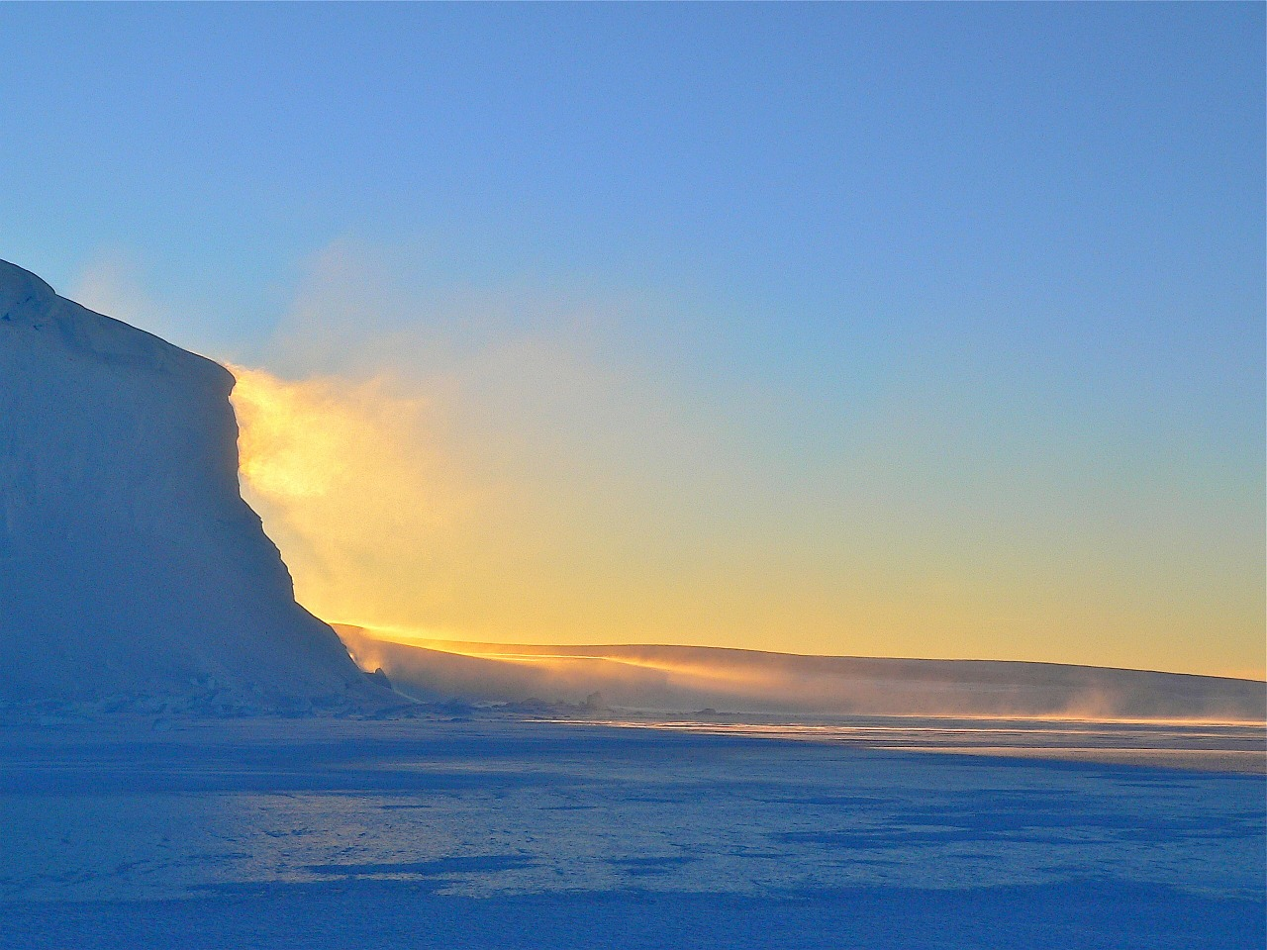
Hoạt động mở đầu
Notes:
Overview: Use the resources in the Digital Library to choose an icebreaker activity for your group.
Group Discussion: Did anyone have any “aha” moments this week, if the facilitator had an “aha” moment share it here.
Facilitator Tip: Choose ice breaker and other activities based on your observations of the group and community. There may be emerging ideas or areas that you can support or help develop a skill with the right icebreaker activity (found in the Ice Breaker section of your Digital Library or borrow the book, Great Group Games from the Resource Library). If you have not already done so, connect with other facilitators to share ideas, challenges, and successes.

Slide 4
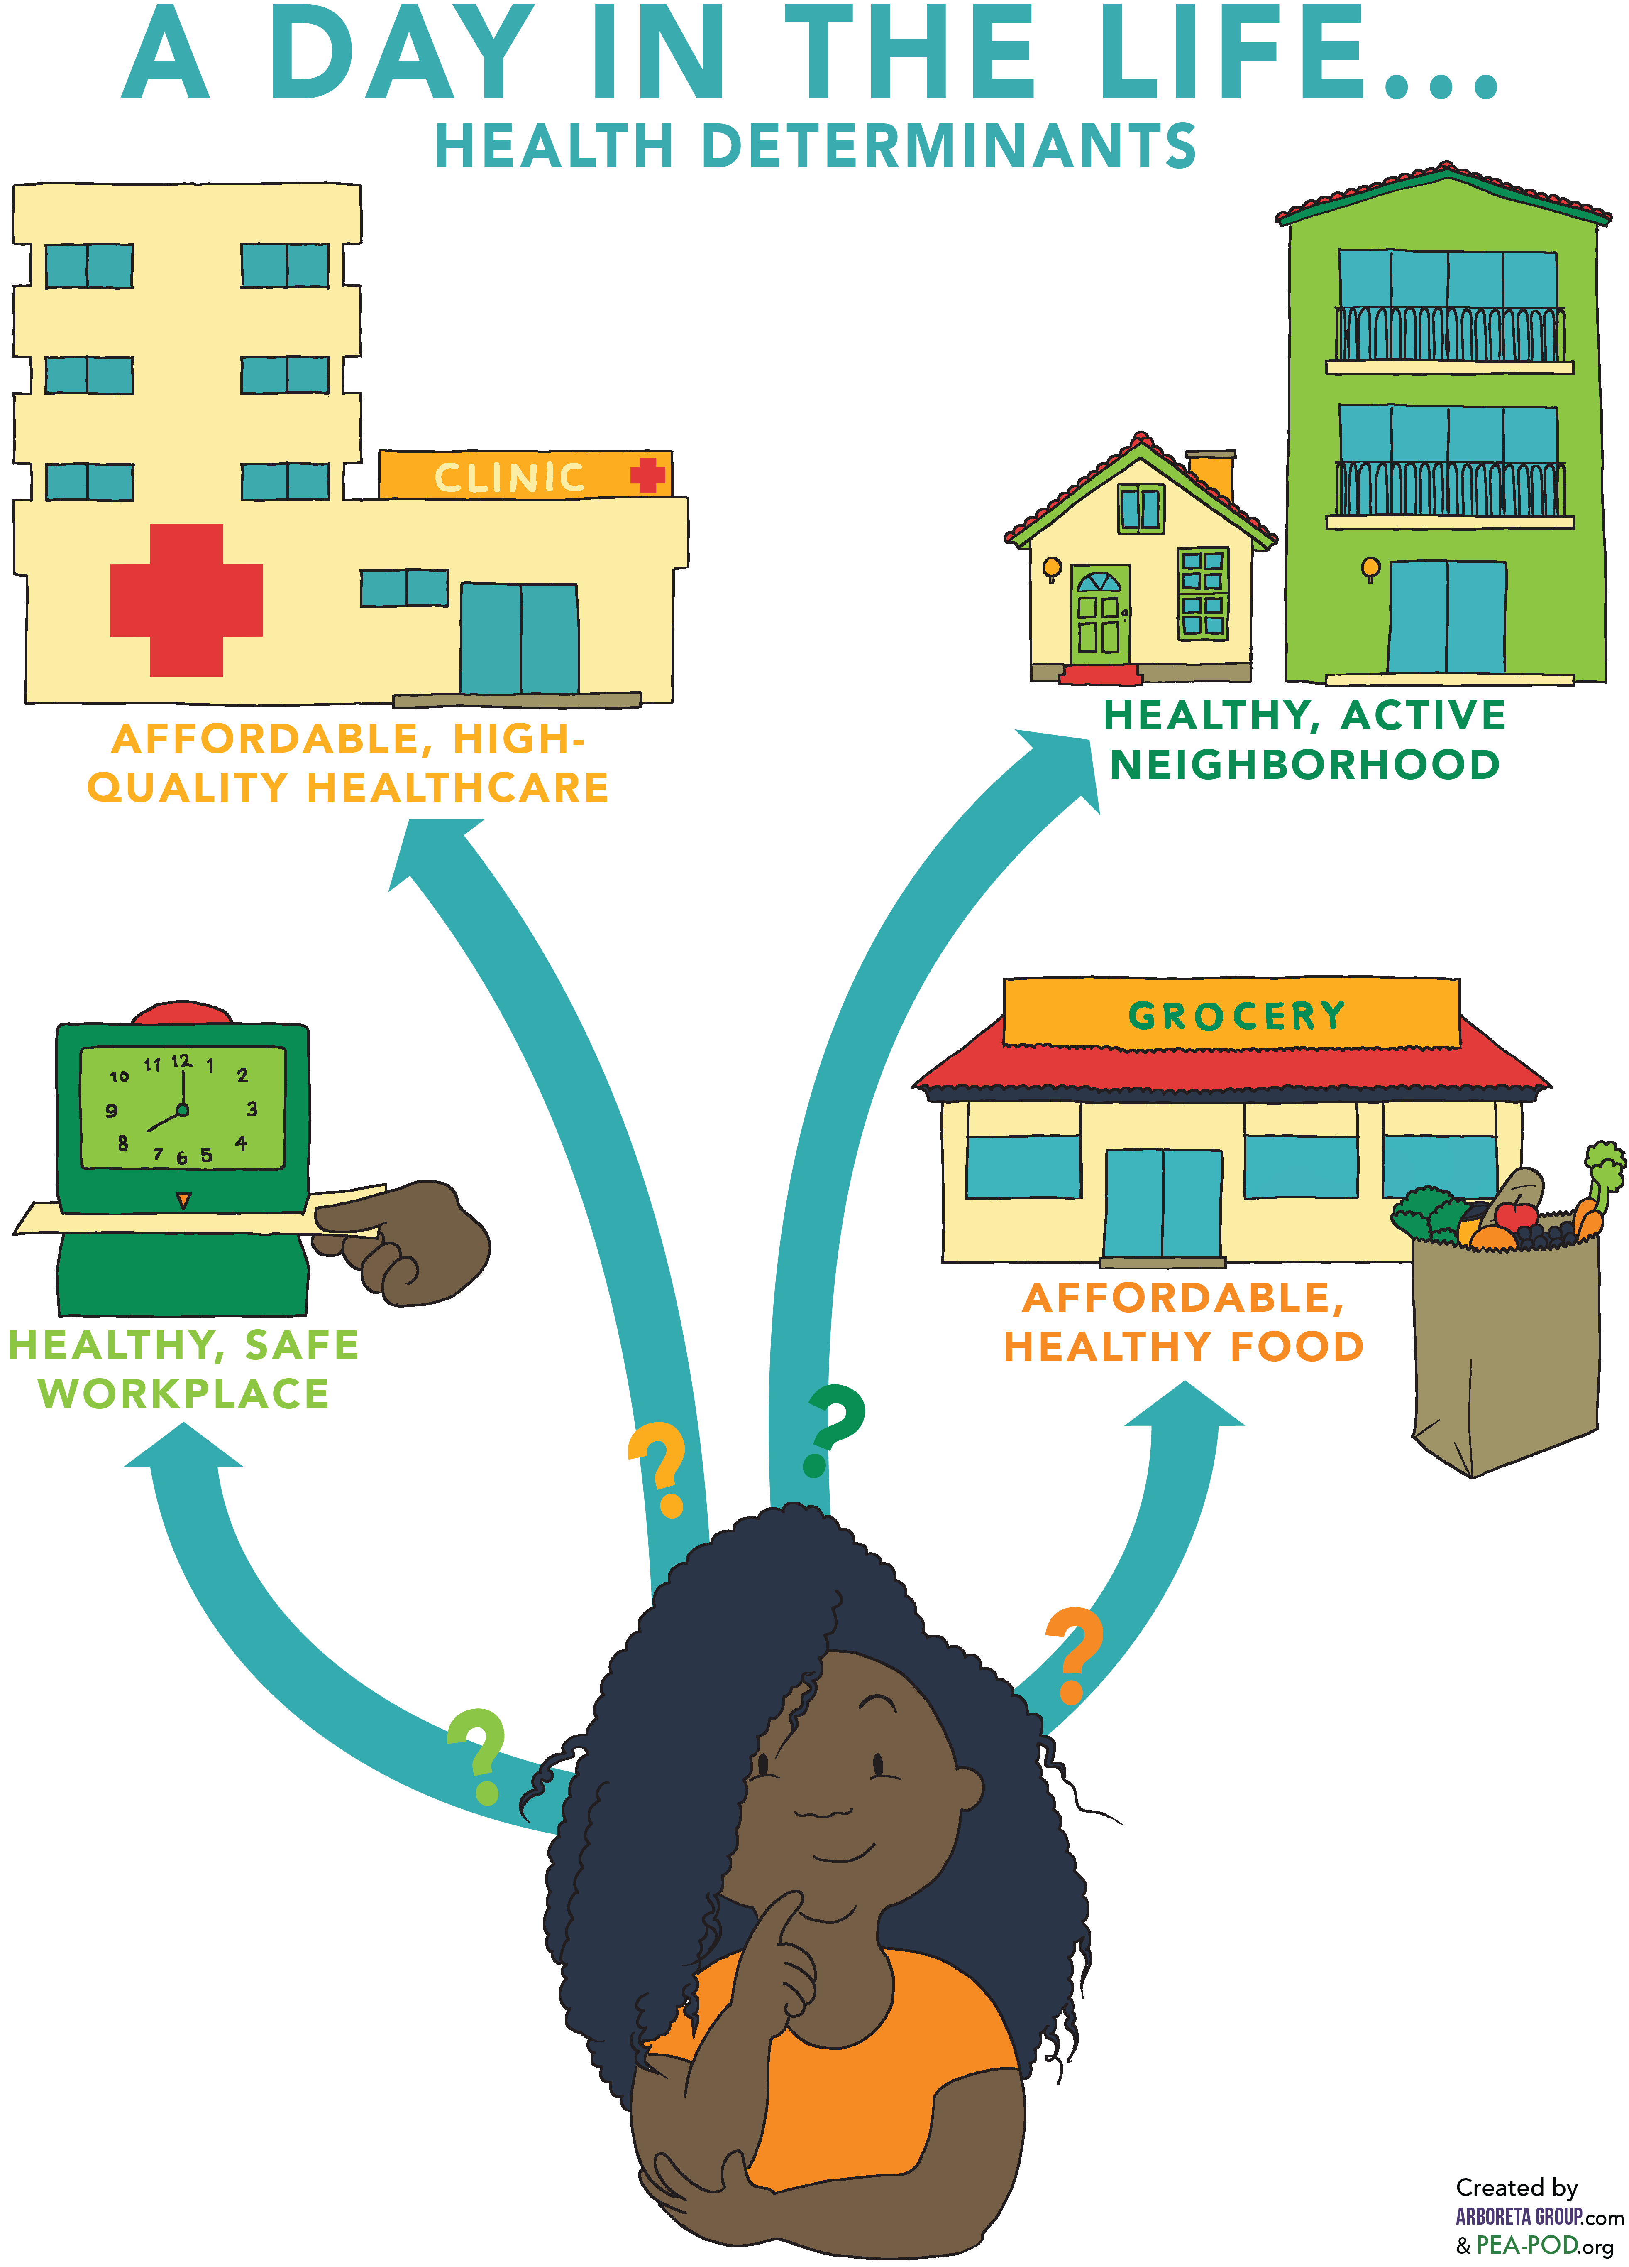
Ôn tập cách tiếp cận sức khỏe
Chúng ta học gì về cách tiếp cận sức khỏe
Hệ thống sức khỏe
Gia đình và khu phố
Công sở
Nơi mua bán
Notes:
Overview: Basic review of the previous section.
Group Discussion: Check in with the group to see if they have any questions from the last session. Ask about any of the connections they may have noticed or ideas they might have had from their readings of Section 2.1 Supporting Health and Section 2.2 Land Use about how both effect their neighborhood.

Slide 5

Mục 2: chiến lược
Mục tiêu học tập:
Xác định các yếu tố sức khỏe mang tính quyết định và cách các yếu tố này tác động tới sức khỏe.
Xác định thay đổi có thể tạo trong
cộng đồng để cải thiện sức khỏe.
Notes:
Overview: We are working our way through strategies that support health on a community and society level. Give the group a reminder that they are doing high level learning about complex issues, so this is a great place to ask questions and think through challenges together.

Slide 6
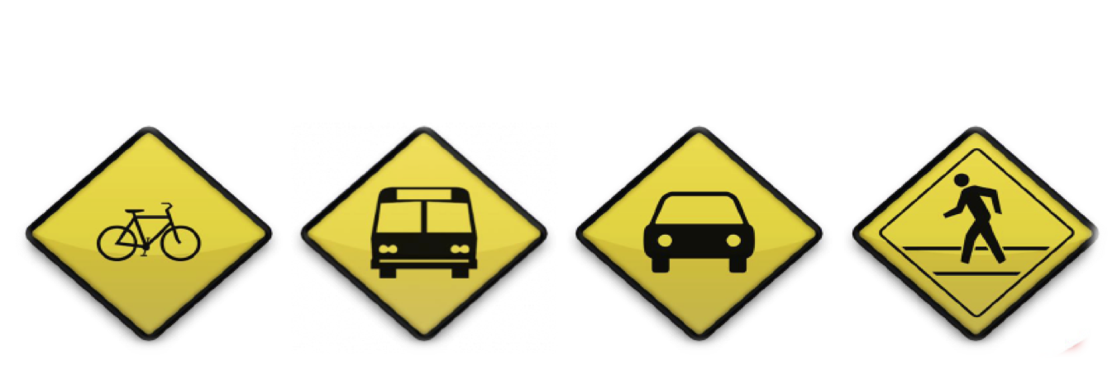
Hoạt động
Hôm nay bạn đến công xưởng bằng cách nào?
Lý do?
Notes:
Overview: Land Use and community planning are very complicated, but help make it practical for the group by using laymen's terms and by referring to further information in the Deep Dive. This activity in particular is related to Active Transportation and Land Use so it is also a preview for the next reading assignment and training session.
Group Discussion: Discuss the question above and then expand to get to the underlying reasons behind why we make the decisions we make.
For those who drove, why did you drive? Explain that, as the facilitator, you want to understand a little more about the community context, e.g., was the location too far away to walk? Is transit unreliable, too expensive, or not available in the community? Are there bike lanes and good sidewalks?
Our meeting here today is just one example of getting from place to place, how often are you able to utilize different modes of transportation? Why or why not?
Discuss the ways the built environment influences transportation decisions and how our communities are designed that either expands or limits our transportation choices.

Slide 7

Kế hoạch hóa cộng đồng
Định nghĩa?
Cách con người cùng sống, vui chơi, làm việc trong cùng một nơi.
Notes:
Overview: Review what land use and community planning are and emphasize that the community planning process includes a public hearing. This is the point in the decision-making process that is designed for hearing the voices of the community. If people do not speak up it is less likely that their needs will be met.
Group Discussion: Discuss what they learned about land use in their reading. Did they have any ideas about how land use and built environment decisions were being made in their community and how they are being implemented? Talk about what parts of their neighborhoods they enjoy and what improvements they would like to see.

Slide 8
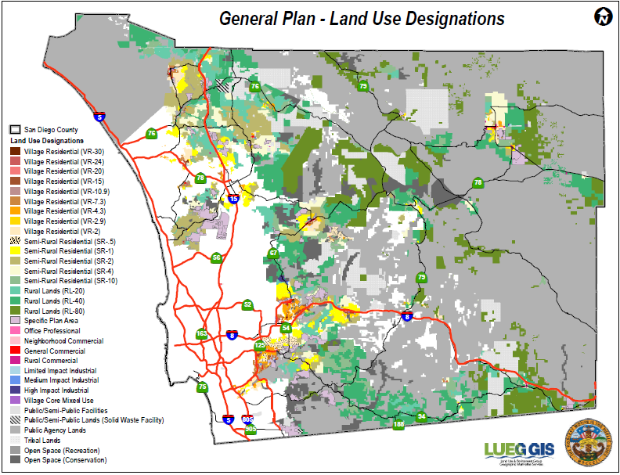
Kế hoạch chung
Notes:
Overview: It looks complicated and frankly, it is complicated. Remind your group that they are part of a supportive team of people working together. You do not have to know all of the answers to begin making positive changes in your community.

Slide 9
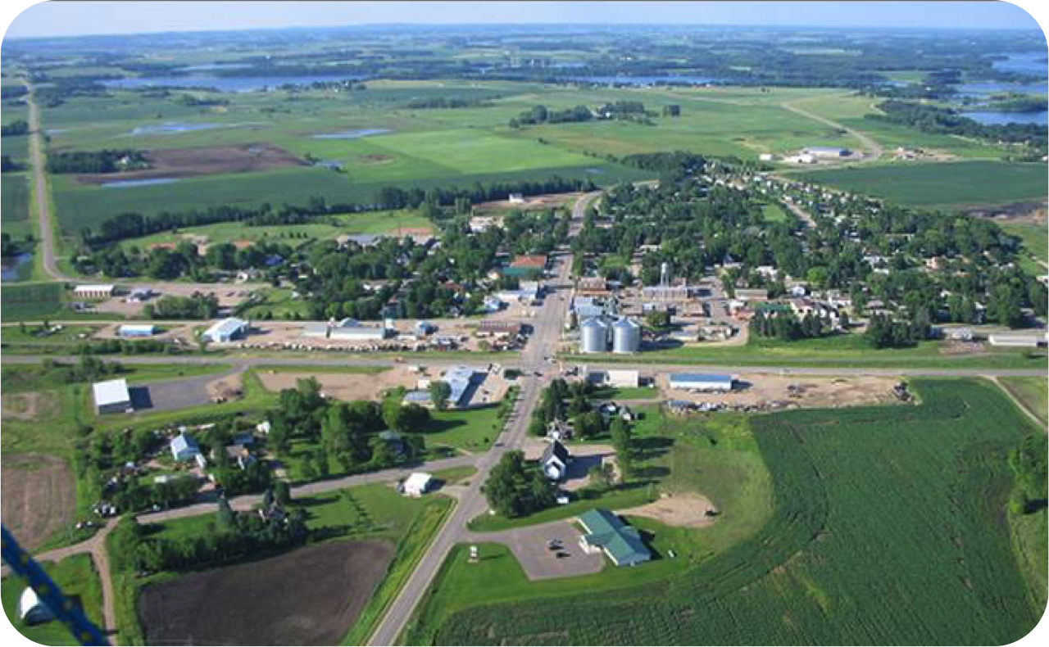
Môi trường đã xây dựng
Tất cả các khía cạnh của môi trường xung quanh do con người xây dựng: gia đình, tòa nhà, đường xá, công viên, vân vân
Notes:
Overview: Review built environments.
Group Discussion: Ask for any observations about this photo and the built environment it represents.

Slide 10
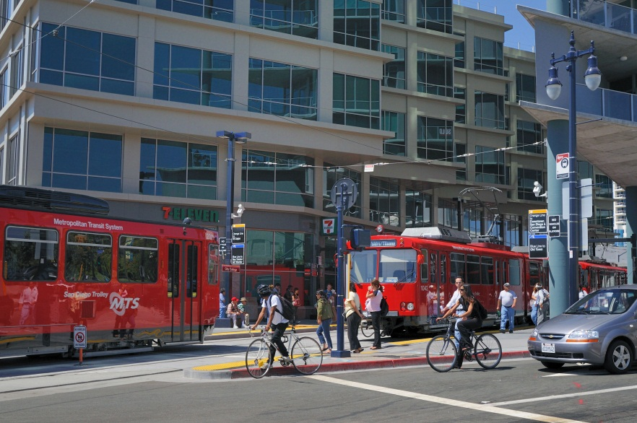
Môi trường đã xây dựng
Notes:
Overview: Review built environments.
Group Discussion: Ask for any observations about this photo and the built environment it represents. How are the land use and community planning decisions different here versus the picture from the previous slide?

Slide 11

Tiếp cận thông tin
Cách tiếp cận tài liệu kế hoạch địa phương
Bắt đầu tìm kiếm trực tuyến cho “[tên thành phố] kế hoạc chung.”
Các loại dự án khác bao gồm:
  Kế hoạch chi tiết hoặc Kế hoạch trung tâm
  Kế hoạch tổng thể cho người đi bộ
  Kế hoạch tổng thể cho cho xe đạp
  Kế hoạch tổng thể cho cho công viên
  Kế hoạch Nông nghiệp đô thị
Notes:
Overview: In order to influence the community planning process you have to first learn about the plans for your neighborhood. These are some of the ways to access your area’s plans and planners.
Facilitator Note: Do some research ahead of time for your group so that you can help them connect with the right local resources. You can also load up some of the information on your computer ahead of time to show the group what they will be looking at, and some of the main websites they may access depending on what they choose for their Community Improvement Project (CIP).

Slide 12
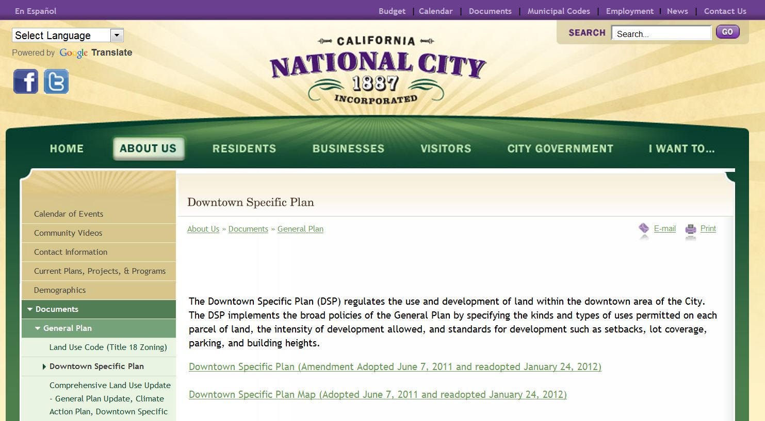
Cách tiếp cận tài liệu kế hoạch địa phương
Chèn ảnh chụp màn hình về trang web thành phố của quý vị
Ví dụ:
Notes:
Overview: Most cities have their major planning documents, like the general plan, online. The files are very large, so sometimes the general plan is broken into different sections before it is posted on the website. If your group decides on a CIP that involves land use you may want to begin to think about who among you loves research and details and might be interested in taking the lead on doing this research for the group.
Facilitator Note: Replace this photo with the screen shot of your city’s website.

Slide 13
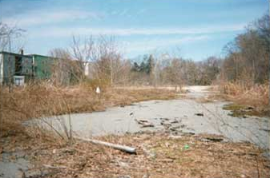
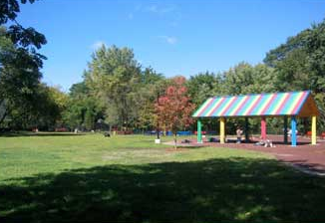
Phát triển/tái phát triển
Khu đất hoang
Trước
Sau
Notes:
Overview: This is an example of redevelopment. This example is a brownfield, which is a property that may involve complicated redevelopment efforts due to the presence or potential presence of a hazardous substance, pollutant, or contaminant.
Group Discussion: Discuss recent and/or current developments or redevelopments in their neighborhood.
Source: http://www.epa.gov/brownfields/about.htm

Slide 14
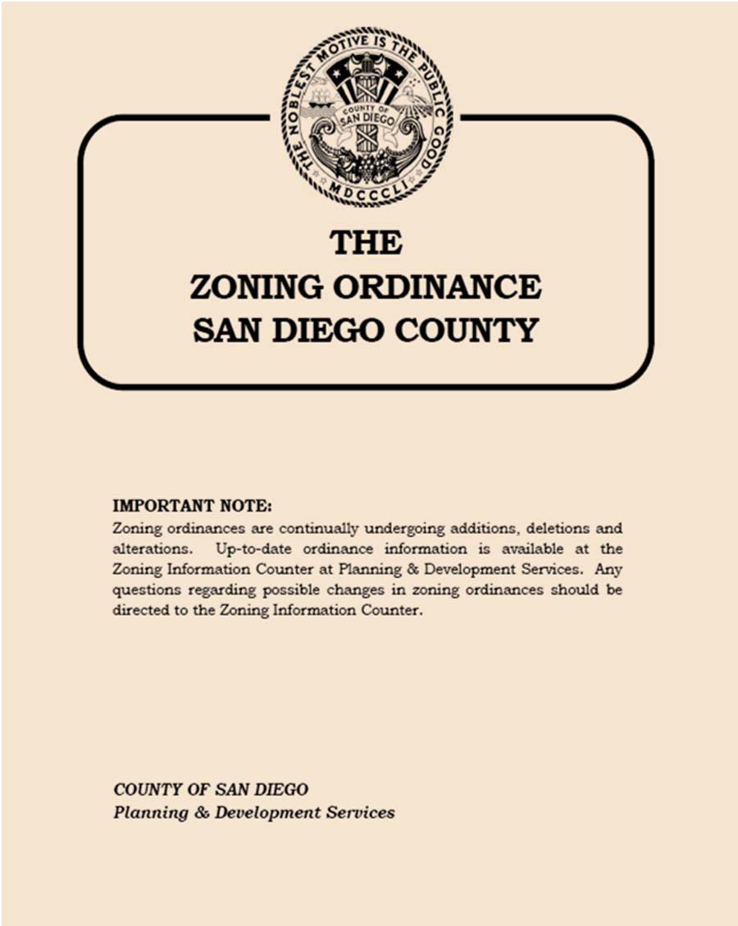
Luật phân vùng
Luật phân vùng
Văn bản quy định và luật xác định cách có thể sử dụng tài sản tại những vùng địa lý cụ thể.
Luật phân vùng chỉ rõ các vùng có thể sinh sống hoặc phục vụ cho thương mại, và cũng có thể điều chỉnh quy mô, sắp xếp, khổ (hoặc tỷ trọng) khu đất và độ cao cấu trúc.
Notes:
Overview: After discussing this, tell the group there is a great video series on page 106 of the Deep Dive resources for adults and children called “Little Kids, Big City” that explains zoning in more detail.
Group Discussion: What do you think Commercial zoning means? Residential? Mixed use? How do you think these regulations affect your neighborhood now and in the future?
Source: www.investopedia.com/terms/z/zoning-ordinance.asp

Slide 15
Sử dụng đất
Trực quan
Chèn một hình ảnh về khu phố của quý vị
Notes:
Group Discussion: What kind of zoning do you think this building has? Why? What were your clues? Thinking of the health determinants that you learned about last week, do any of these examples support the health of residents?
Facilitator Tip: Take photos of different buildings and places in the local neighborhood like parks, apartments, mixed use developments, etc. and discuss them and how they effect community health.

Slide 16

Giải lao
Notes:
Facilitator Tip: Use this time for a break. Give participants a five to ten minute break depending on the needs of the group and the length of the meeting. Use the resources in the Digital Library to choose one stretch for your group.

Slide 17
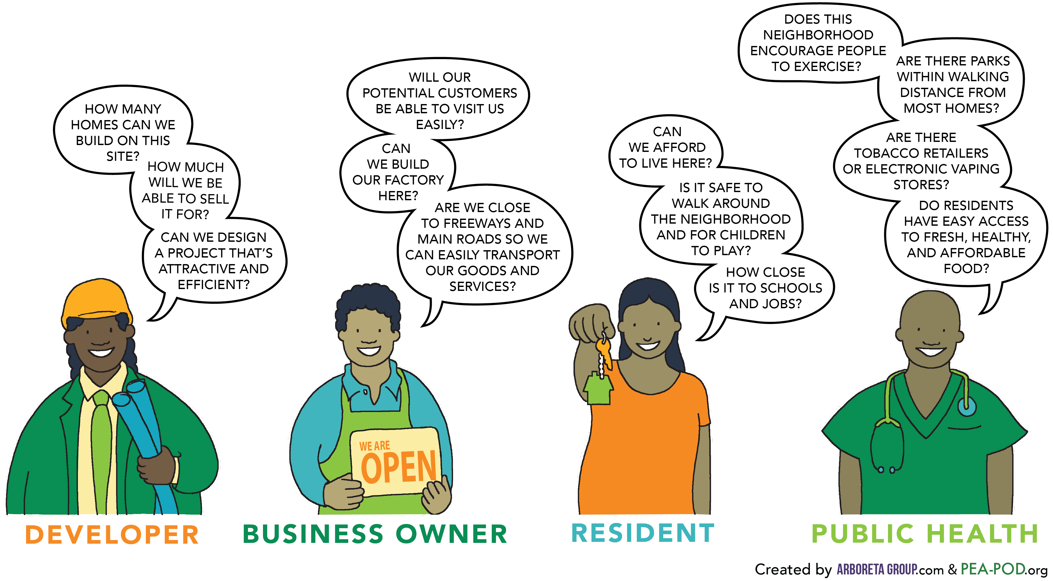
băn khoăn của người giữ tiền đặt cọc sử dụng đất
Notes:
Overview: Part of the reason land use and community planning is so complex is because there are a lot of interested parties.
Group Discussion: Discuss what is happening in the group’s neighborhood. What do they wish was happening or not happening?

Slide 18
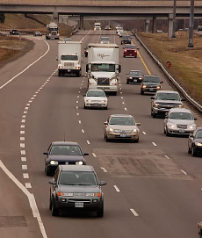

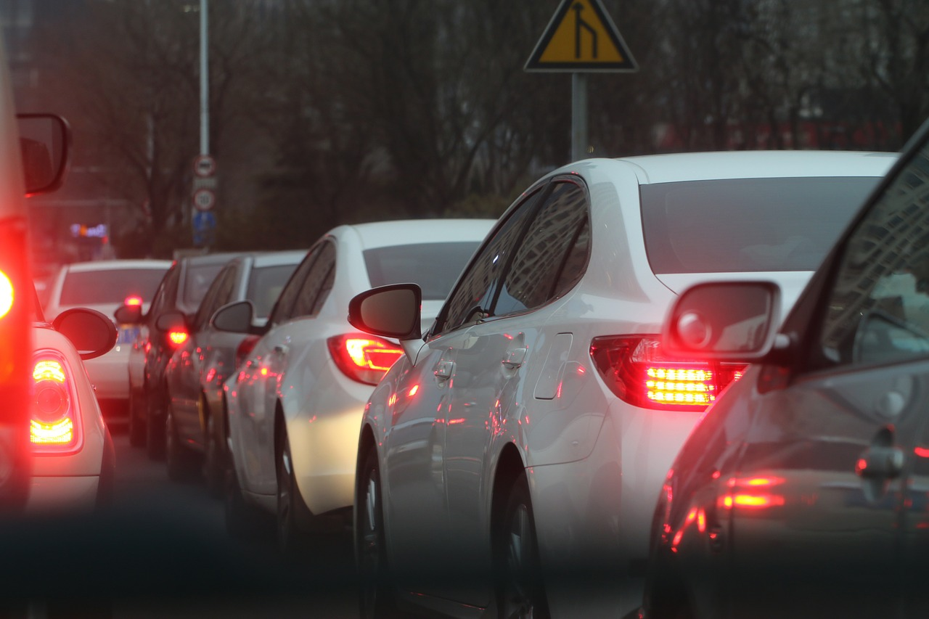
Rối loạn xã hội
Notes:
Group Discussion: Discuss the case study in the workbook about urban sprawl. Discuss how that relates to San Diego and their neighborhood. Some ideas to address include stress and time spent commuting, effects on activity levels, and contribution to greenhouse gasses and climate change.
Picture on top right side from: http://bungalowhouseplans.com/craftsman-house-plans-blog/a-retro-fit-of-suburbia/

Slide 19




7 bước để hiểu và tác động việc sử dụng đất
Tìm kiếm
Notes:
Overview: Again, remember that your RLA is a team and bet that there are some natural researchers out there.
Facilitator Tip: They have already reviewed these steps in theory. Make this discussion practical. One option is to discuss the steps and then put the participants in small groups to identify how they would apply the steps in their own community using a land use CIP idea (it does not have to be the CIP they ultimately work on). There is a lot of discussion in the following slides. Check on your time and manage the discussion on each slide accordingly. Depending on the group you may spend more than one session on this topic.

Slide 20

7 bước để hiểu và tác động việc sử dụng đất
Kết nối với các cư dân khác
Notes:
Overview: Otherwise known as neighborhood organizing: talking to people, listening and sharing your concerns, and analyzing the information you received.

Slide 21
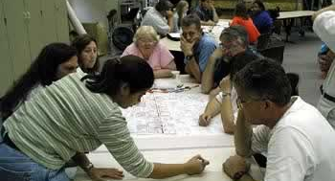
7 bước để hiểu và tác động việc sử dụng đất
Tạo kế hoạch hành động
Notes:
Group Discussion: Discuss the value of having a well-organized plan. How does it help? Who should develop it and who should have a copy of it?
Hint: the answer to the last two questions is EVERYONE!

Slide 22

7 bước để hiểu và tác động việc sử dụng đất
Phát triển thông điệp
Notes:
Overview: Discuss different ways to frame a message. Think about who you are trying to influence. In this case it is elected city officials and community planners, how can you deliver your message in a way that makes them pay attention?
Facilitator Tip: Let people know there are actual strategies already created that they can find in the Deep Dive and that you have in the Digital Library.

Slide 23
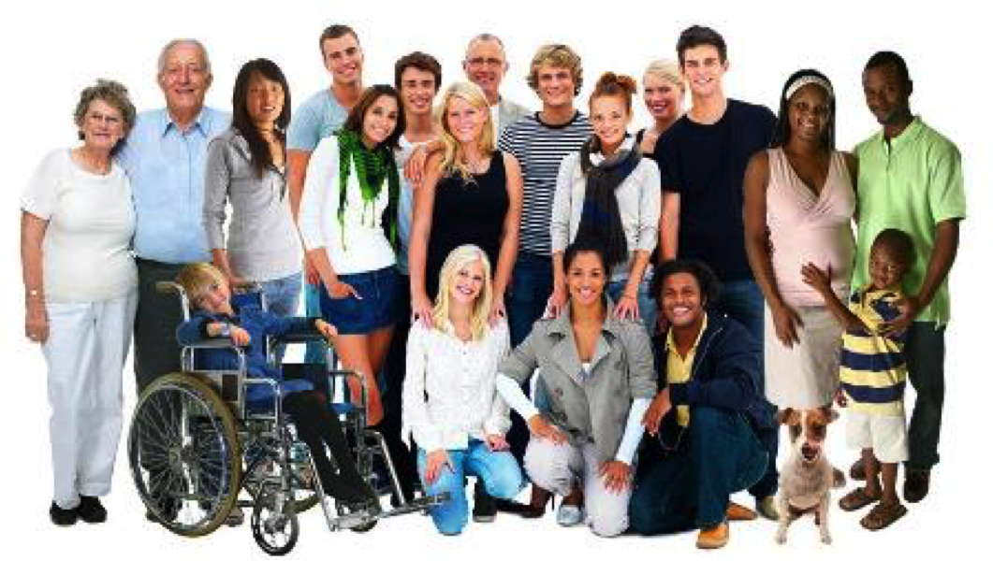
7 bước để hiểu và tác động việc sử dụng đất
Xây dựng hỗ trợ với đối tác truyền thống và phi truyền thống
Notes:
Overview: We are learning that everything is interconnected so think outside the box and get creative about who your partners can be.
Group Discussion: Who are the players in your neighborhood and why? Get some examples of non-traditional partners. For example, why would the neighborhood pastor, Imam, or other faith leader be interested in a partnership with the owner of a local fast-food franchise?

Slide 24
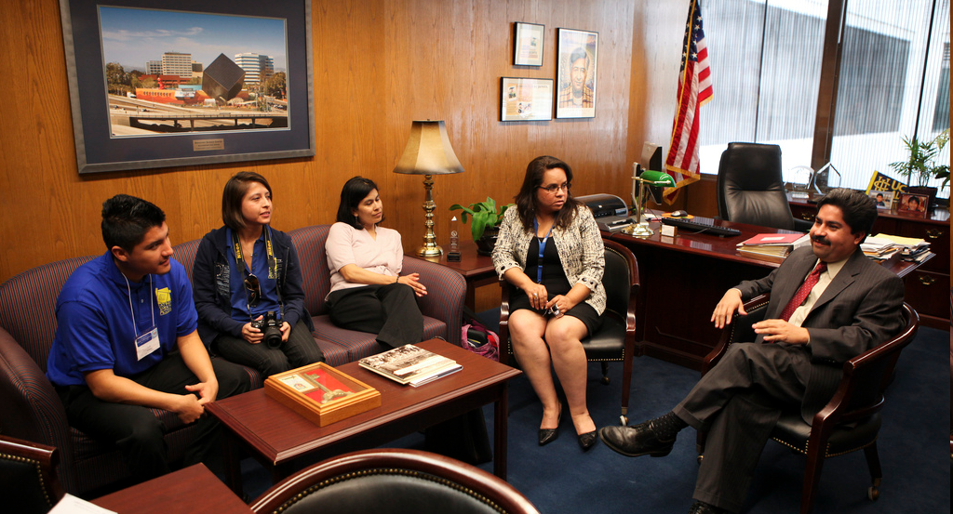
7 bước để hiểu và tác động việc sử dụng đất
Gặp người lập kế hoạch, bầu công chức, và nhân viên thành viên của họ
Notes:
Overview: Focus on relationships. At the end of the day, it comes down to a human being (or a small group of them) making a decision.

Slide 25

7 bước để hiểu và tác động việc sử dụng đất
Hãy Kiên định và kiên nhẫn
Notes:
Overview: Persistence is one of the most potent weapons at your disposal and it is low-cost! Land use changes can take years to complete so patience is necessary for this type of change strategy.

Slide 26

Kết nối xã hội
Mối quan hệ có vai trò quan trọng
Tạo dựng vốn xã hội
Liên kết để tăng sức khỏe
Góp phần ngăn ngừa bệnh mãn tính
Notes:
Group Discussion: How does social capital help you? What social capital do you contribute to friends, neighbors, and families?

Slide 27

NGĂN CHẶN TỘI PHẠM QUA THIẾT KẾ MÔI TRƯỜNG (CPTED)
Định nghĩa?
CPTED là triết lý ngăn chặn tội phạm giúp xúc tiến thiết kế hợp lý và sử dụng hiệu quả môi trường đã xây dựng nhằm:
  Giảm hoạt động phạm tội
  Giảm nỗi sợ phạm tội
  Cải thiện chất lượng cuộc sống.
Notes:
Overview: Review Live Well San Diego’s goals, safety is a primary issue, this is a tool that can help people address it
Facilitator Tip: You may choose to use the law enforcement perspective on Crime Prevention Through Environmental Design (CPTED) video located in the Deep Dive or have a guest speaker (law enforcement, neighborhood watch captain, or architect/urban planner).

Slide 28
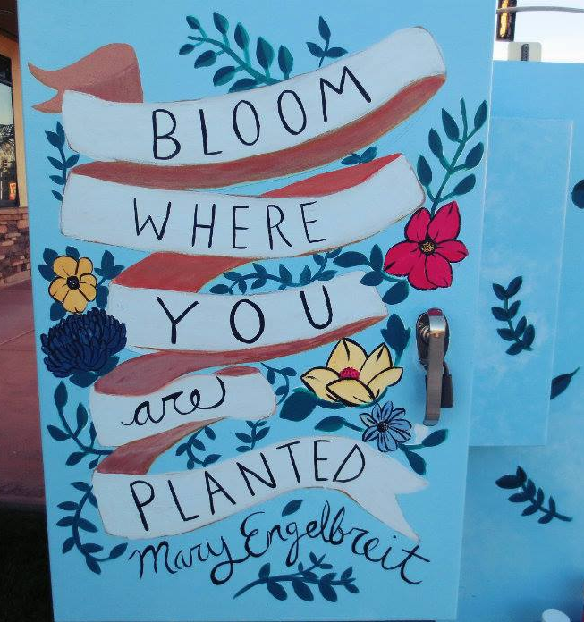
CPTED thế hệ 1
Giám sát tự nhiên
Củng cố lãnh thổ
Kiểm soát tiếp cận
Duy trì
Notes:
Group Discussion: Discuss examples in their neighborhood and potential ideas to improve CPTED.
Facilitator Tip: If you are not familiar with the neighborhood, take time to explore the community so you have some examples to share and can be more familiar with the examples presented by the group.

Slide 29
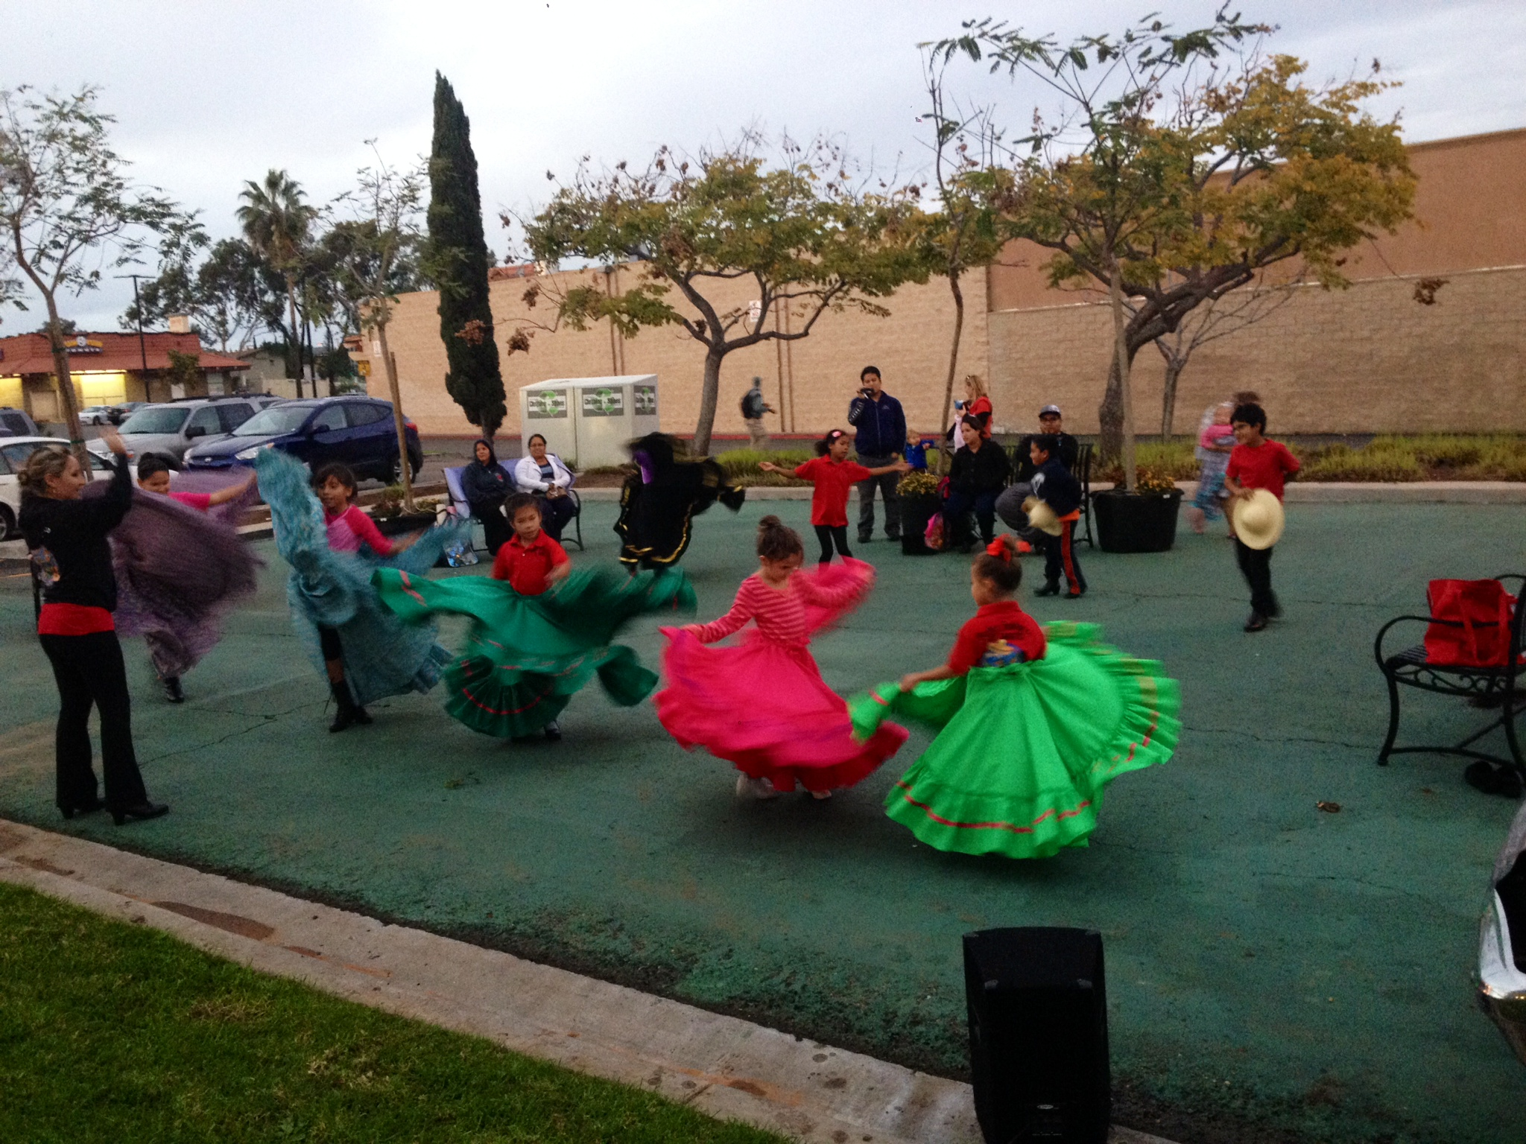
CPTED thế hệ 2
Công suất
Liên kết cộng đồng
Kết nối
Văn hóa cộng đồng
Notes:
Group Discussion: Discuss examples in their neighborhood and potential ideas to improve CPTED.

Slide 30

Đoạn phim ngắn
Lợi ích sức khỏe và thiết kế cộng đồng lành mạnh
Notes:
Overview: Shows that how a community is built affects people’s health.
http://www.cdc.gov/healthyplaces/healthy_comm_design.htm

Slide 31
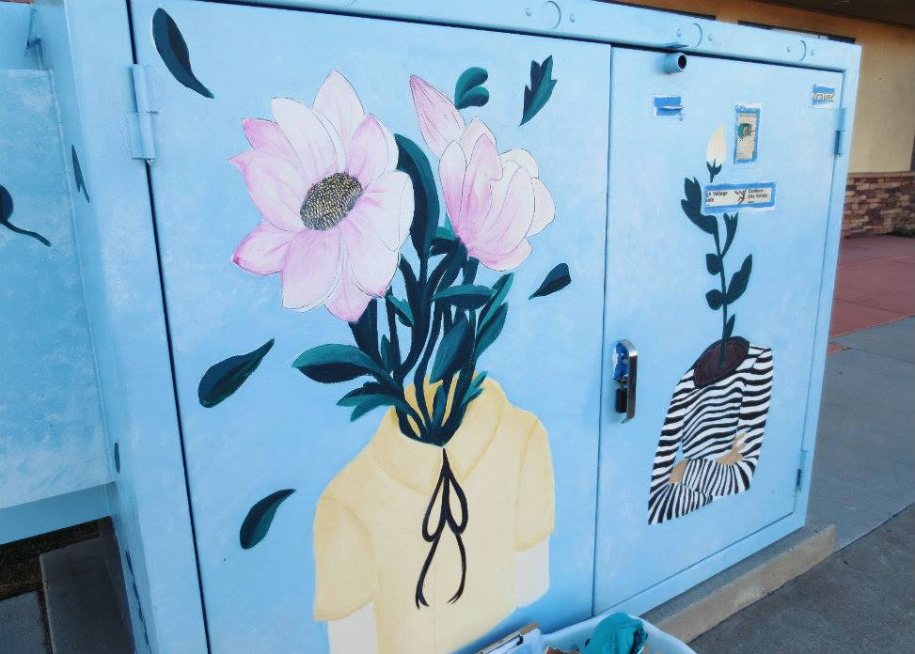
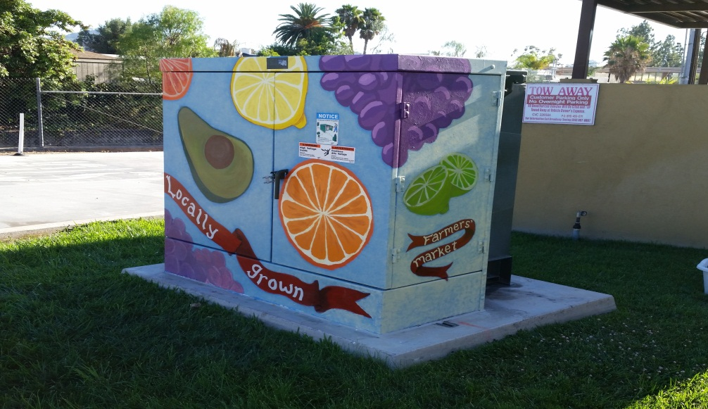
dự án hộp lợi ích nghệ thuật ở El Cajon
Notes:
Overview: RLA Success! These boxes in El Cajon, painted by local artists, add beauty and a sense of pride to the neighborhoods and prevents graffiti.

Slide 32
Conclusion
Homework
Đọc Mục 2.3
Câu hỏi?
Bình luận?
Băn khoăn?
Notes:
Group Discussion: Any outstanding questions? Let the group know that if they want more information you can email them more resources, or use your thumb drive to put materials from the Digital Library onto their computer. And ask them to share if they come across good information to add to the library.

Slide 33


" Giáo trình này được Thỏa thuận hợp tác số DP005528-01 hỗ trợ, Trung tâm kiểm soát và ngăn ngừa dịch bệnh tài trợ thông qua Hạt San Diego, Cơ quan Y tế và dịch vụ nhân sinh. Tác giả hoàn toàn chịu trách nhiệm về nội dung và không cần quan điểm xem xét chính thức từ Trung tâm kiểm soát và phòng ngừa dịch bệnh hoặc Sở y tế và dịch vụ nhân sinh."

