Slide 1
Survey123 training

Slide 2
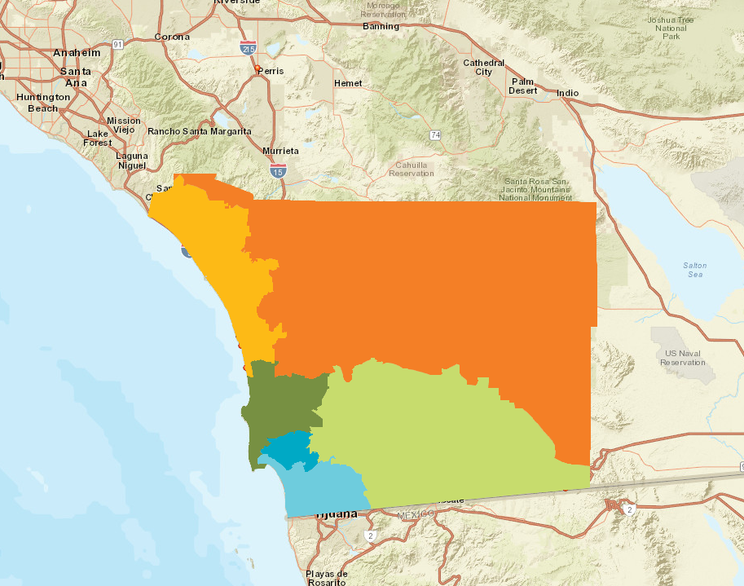
Survey 123 for Love your heart
Data is immediately accessible
Data is displayed geographically
Easy to use!

Slide 3
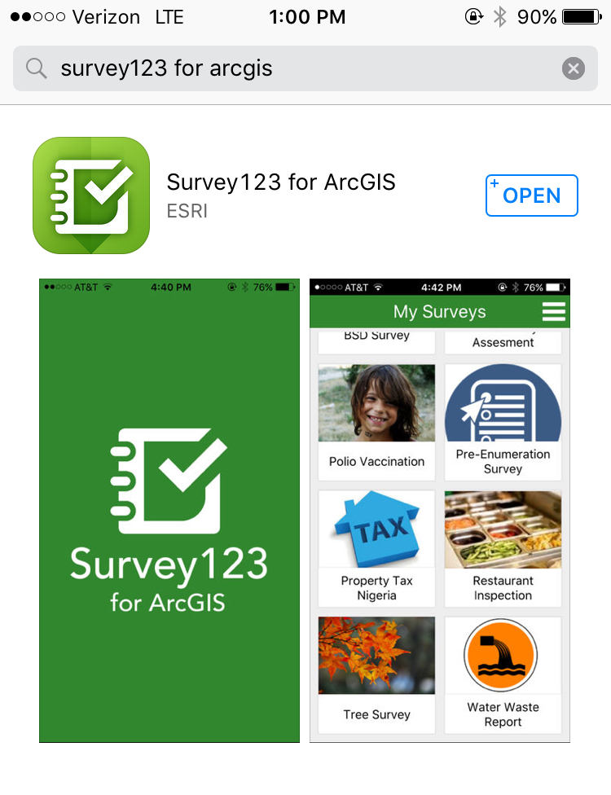
Download application
. Open Application Store
.
. Apple Devices
App Store
.
. Android
Google Play
.

Slide 4
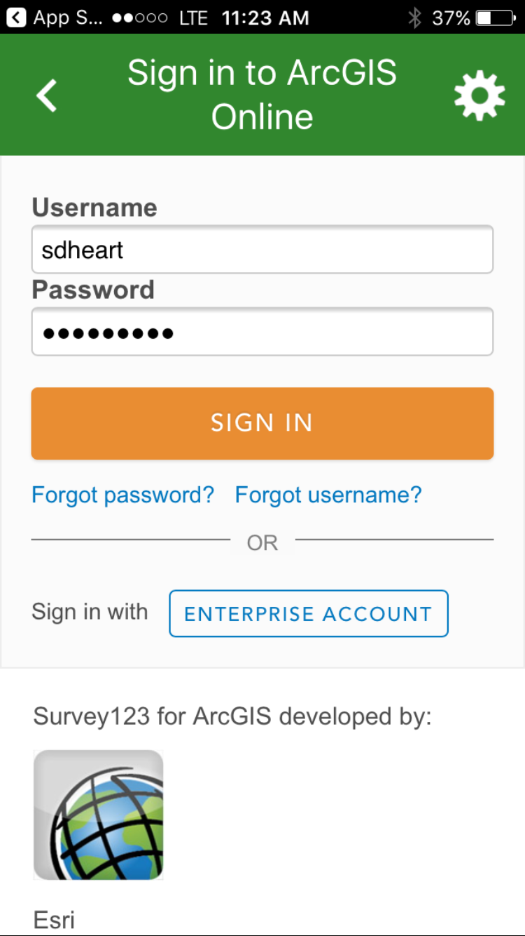
Sign-in
Use your site-specific log-in information

Slide 5
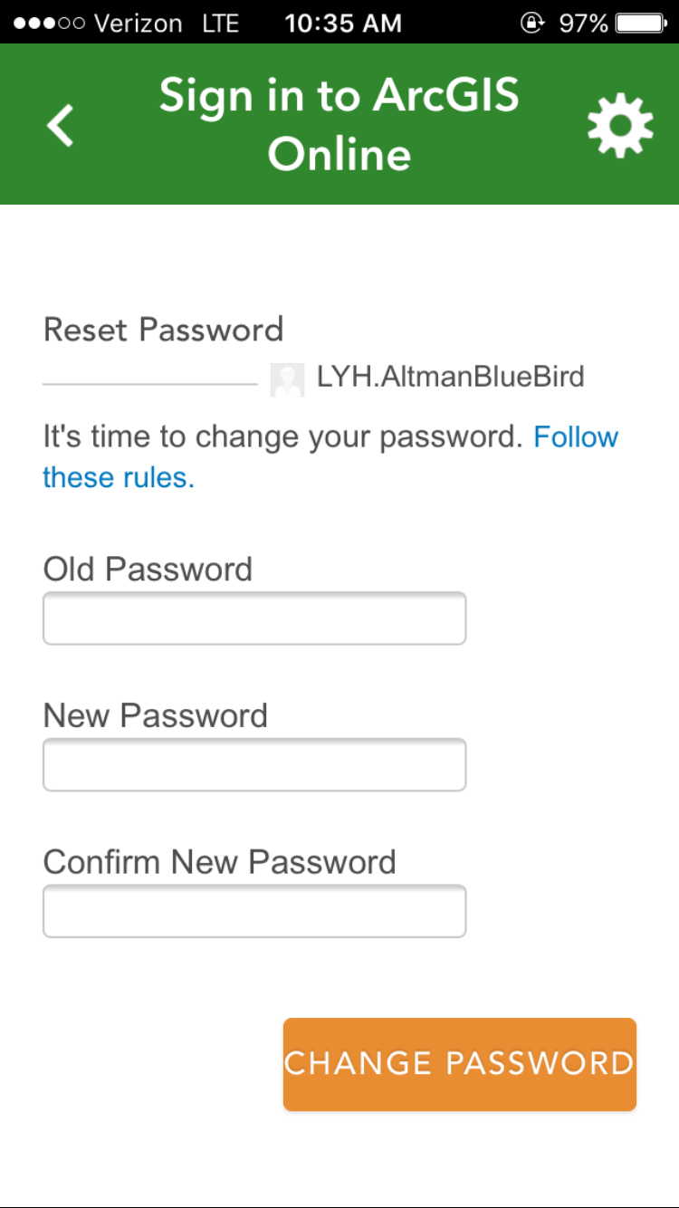
Change password
heart2018
heart214
heart214

Slide 6
CHOOSE SECURITY QUESTION

Slide 7
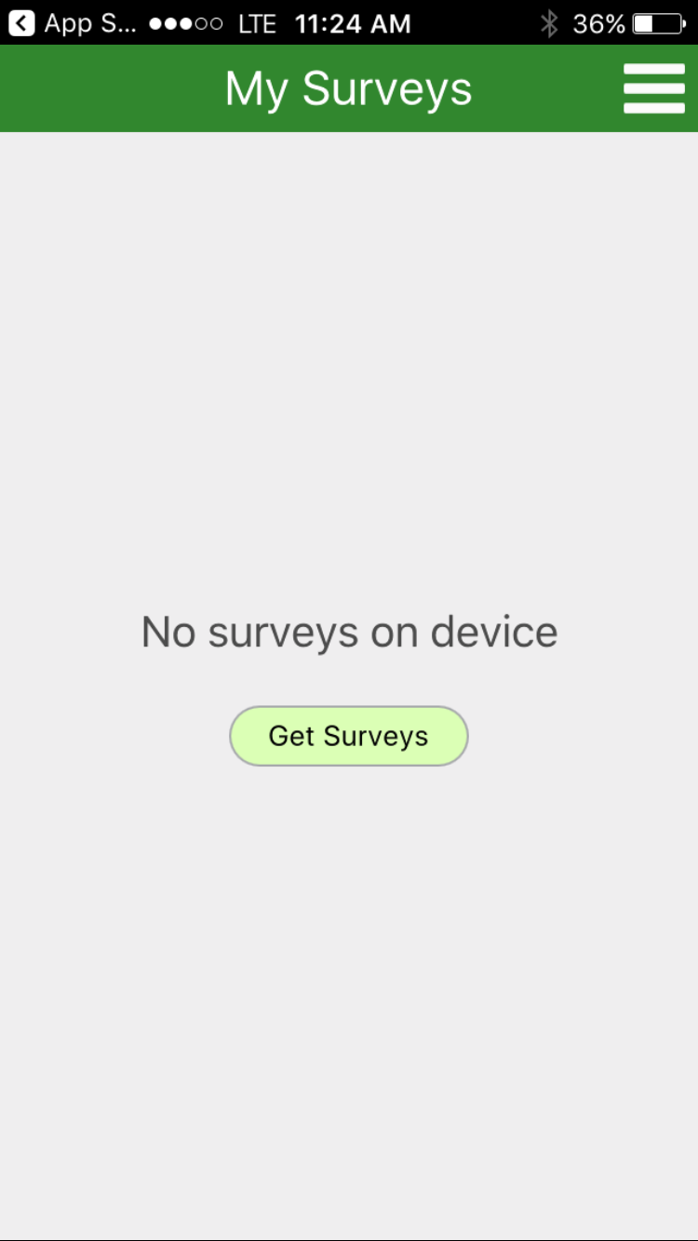
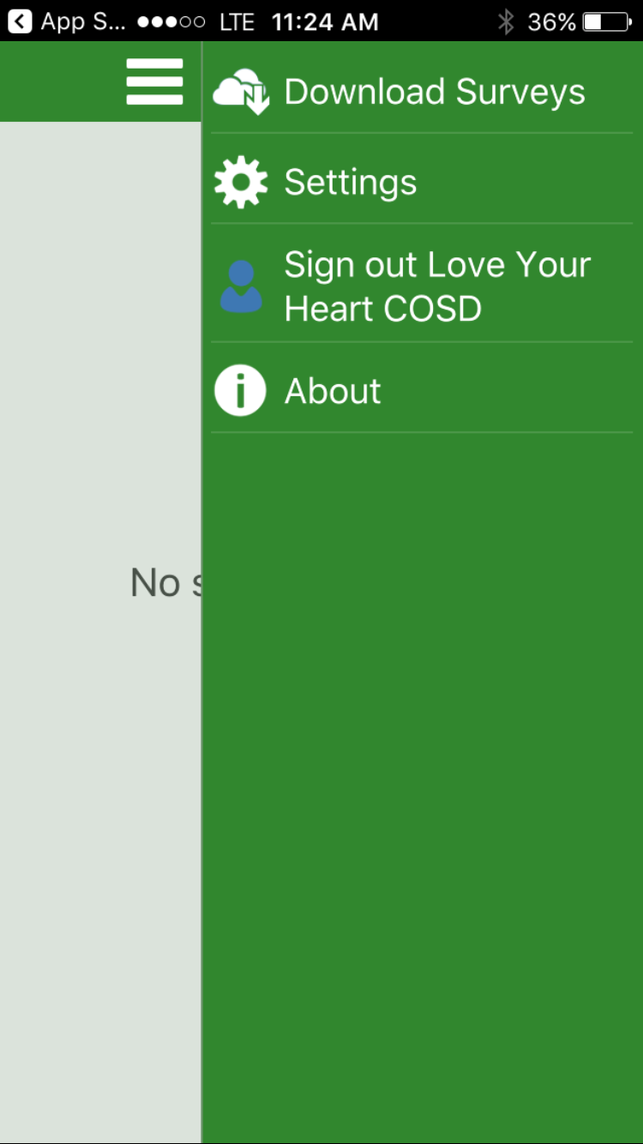
Download Survey
subtitle
Click here
Click here

Slide 8
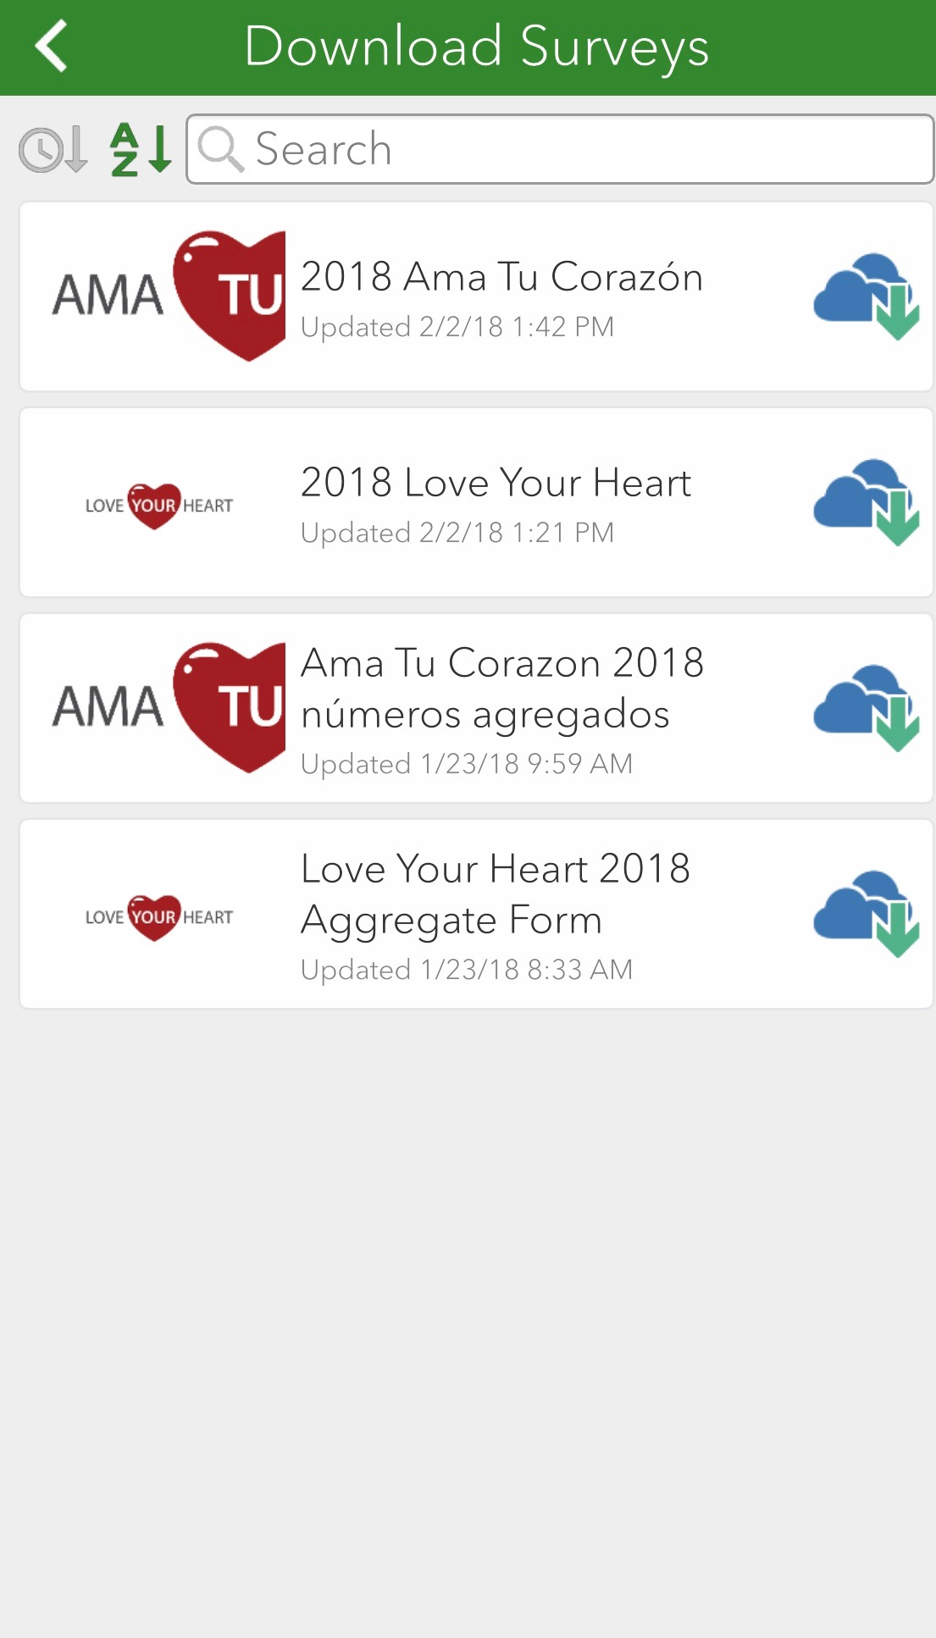
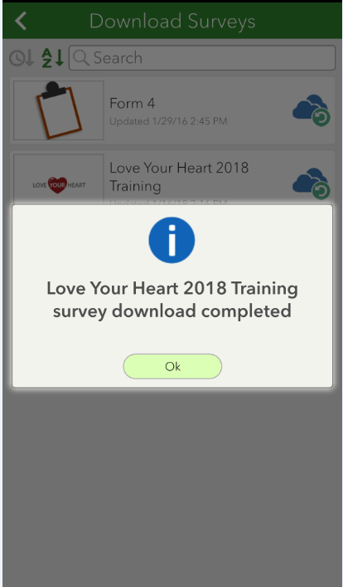
Download survey
Click Here
Click Here

Slide 9
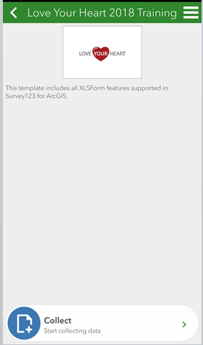
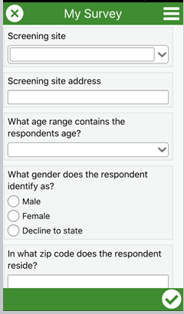
Love Your Heart Survey
Click Here

Slide 10
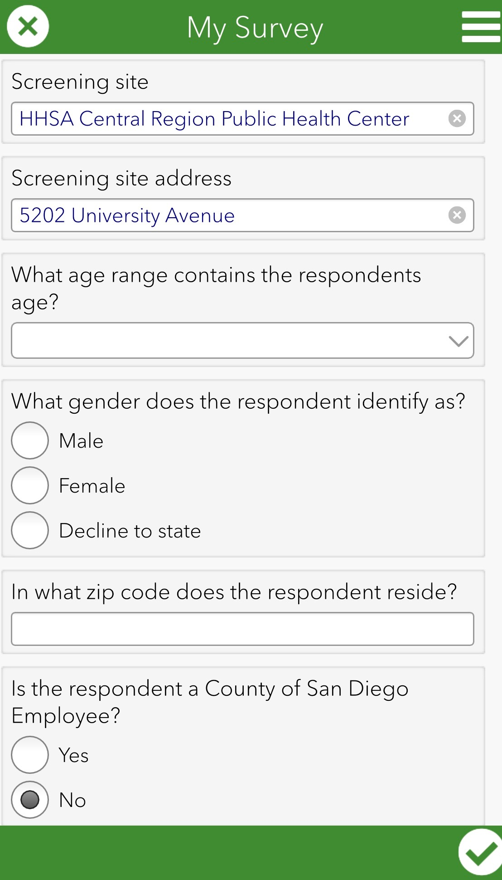
Screening Site

Slide 11
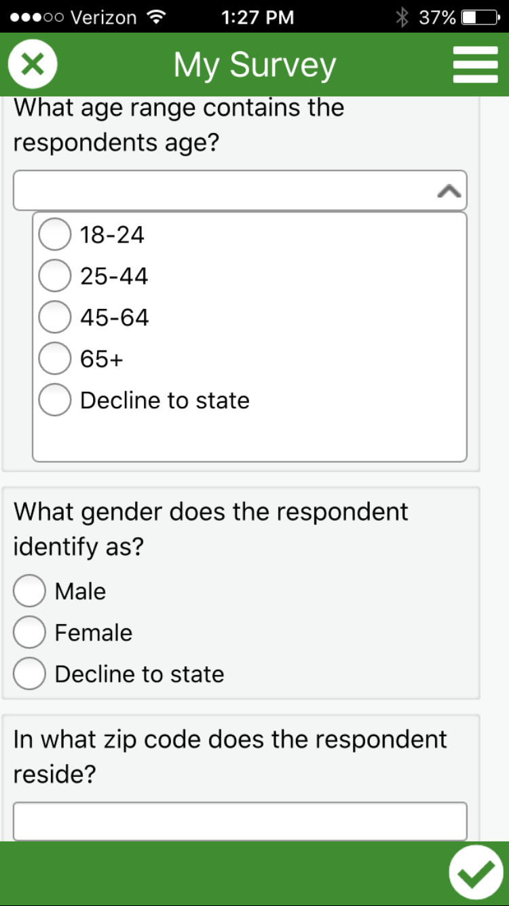
DEMOGRAPHIC INFORMATION

Slide 12
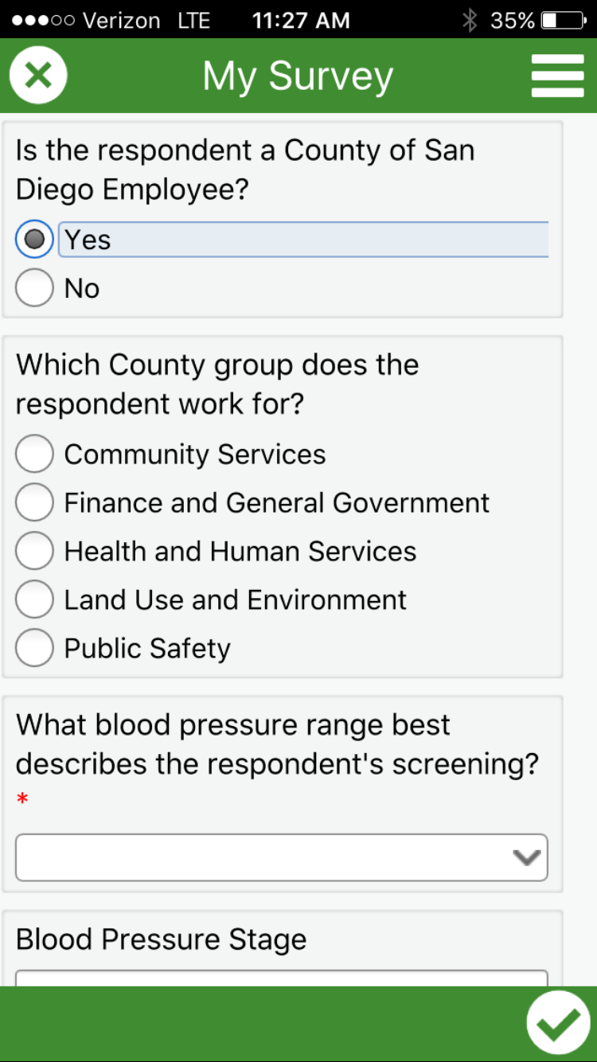
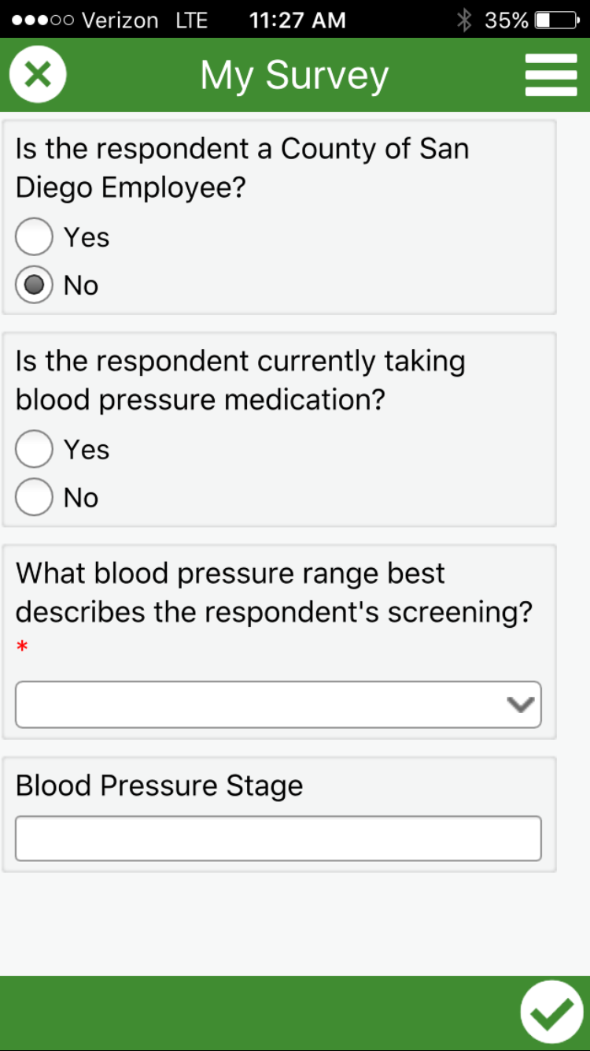
Employee status
County Employees
Non-County Employees

Slide 13
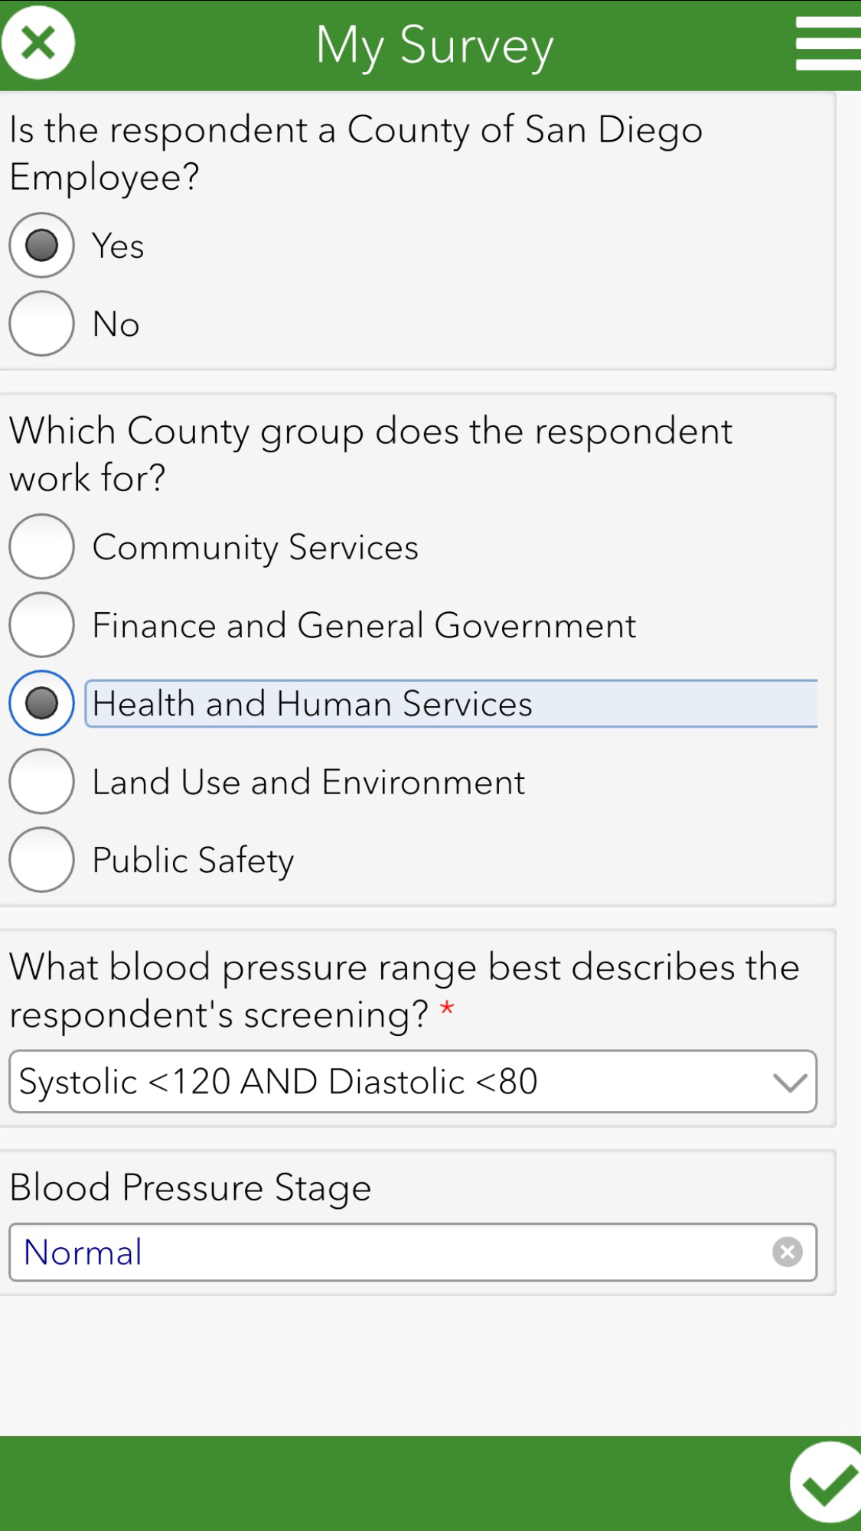
Blood pressure stage
Collect Data!

Slide 14
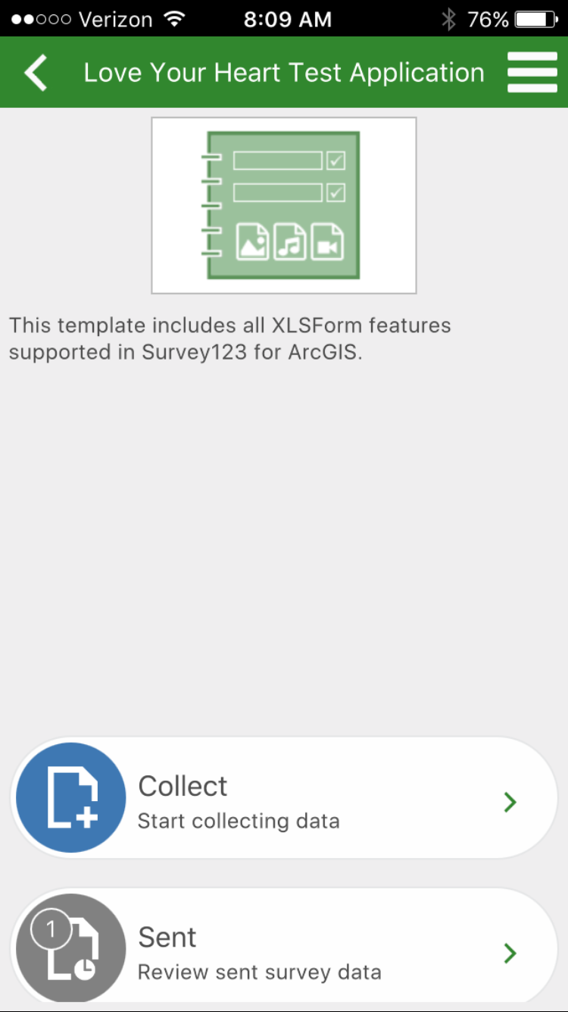
Confirmation Stage

Slide 15
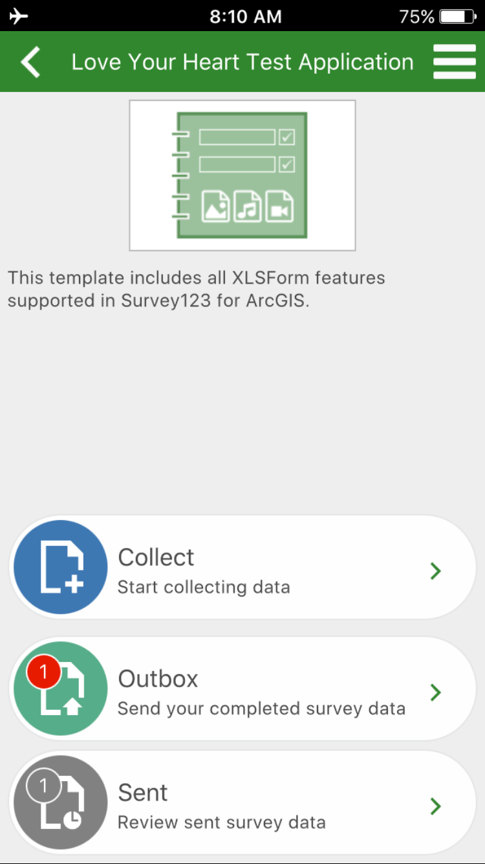
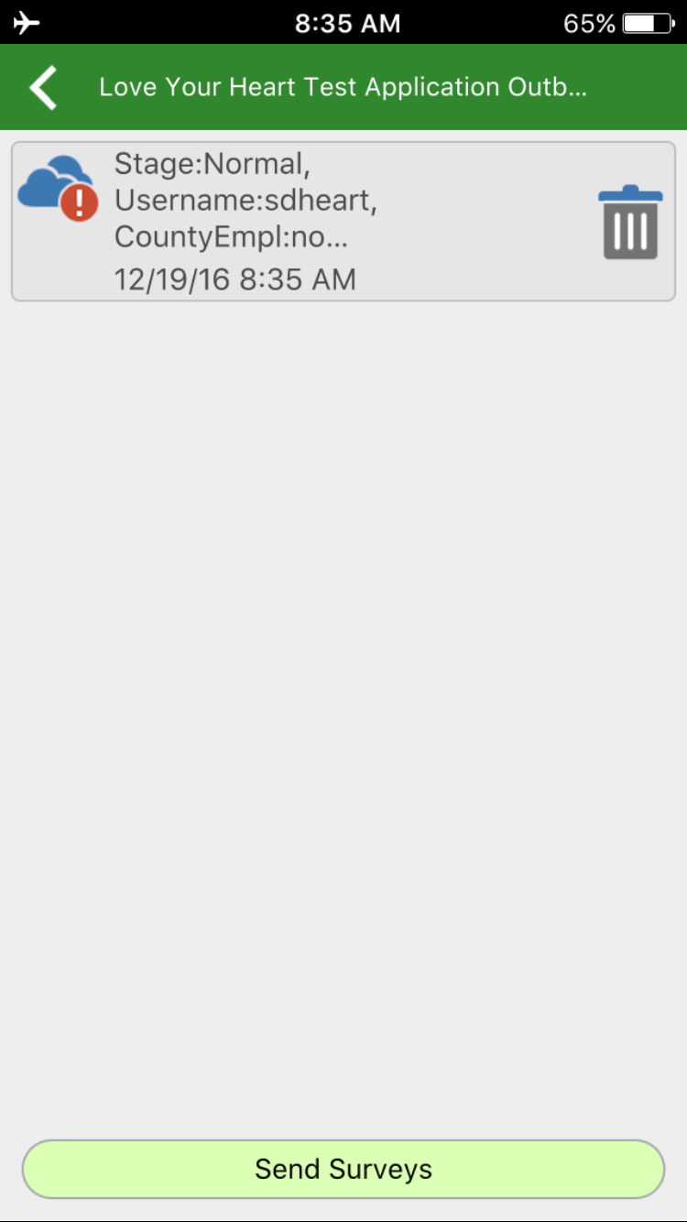
No wifi? No worries!

Slide 16
Preparation
To ensure successful use of electronic data collection be sure that:
- ALL staff and volunteers have the Survey123 app downloaded on their device before LYH Day.
- Your mobile device is fully charged.
- Your site has mobile device chargers and an accessible power supply.

Slide 17
Assuring customers
If customers are unsure about a medical staff/volunteer inputting their information into a mobile device, ensure them that:
Their personal information is NOT being stored on your mobile device. Data is stored in the mobile application, and the application will be deleted from your device at the end of the day.
None of the information they provide can be traced back to them personally. We will not be collecting names, personal addresses, or contact information.
If customers are still unsure about a medical staff/volunteer inputting their information into a mobile device, use the paper-based tracking method.

Slide 18
For more information contact:
Love Your Heart Team at riskcheck@sdcounty.ca.gov

